Slide 1

UE22CS320B – Capstone Project Phase – 2
Project Progress Review #1
Project Title : Efficient AI-driven Edge surveillance using Edge Computing
Project ID : PW25_DS_01
Project Guide : Prof. Dinesh Singh
Project Team : Herman Singh Umrao (PES1UG22AM067)
Govind Subramanian (PES1UG22CS222)
Akshaj B Seerpu (PES1UG22AM018)
Uday V (PES1UG22CS662)

Slide 2
Title of the Project
Outline
Abstract and scope.
Suggestions from phase-1
Design Approach.
Design constraints, Assumptions and Dependencies
Proposed methodology/Approach
Architecture
Design Description
Project Progress Plan for Phase 2
References
Any other Information

Slide 3
Title of the Project
Abstract and Scope
Abstract This project presents an efficient edge-AI based CCTV surveillance system designed for medium-footfall institutional facilities. The system leverages existing CCTV infrastructure combined with edge computing devices to perform real-time video analytics without requiring significant cloud resources.
Processing data at edge helps reduce latency for AI based detection, at the same time helping with security and also lowering required bandwidth. Our proposal will use very lightweight computer vision algorithms optimized for deployment on the edge to perform some of the monitoring tasks such as people detection, occupancy tracking, and anomaly detection.
Our proposed architecture allows facilities to upgrade their conventional CCTV systems with the capability for AI, while minimizing infrastructure cost while maintaining data privacy. Key features in the proposal include real time monitoring, local data processing, customizable alerts, and basic analytics reporting.
This system is designed for facilities that have 50 to 500 people coming daily, making it perfect for smaller and medium-sized institutions that want a less expensive, uncomplicated security system without the complexity of cloud-based or server based solutions.

Slide 4
Title of the Project
Abstract and Scope
Problem Statement
Small companies/businesses cannot afford to have a server/cloud platform to perform analytics.
Tracing actions of a person within the facility premises, requires the user to watch multiple footages from different cameras.
Scope:
This project focuses on developing an AI-driven edge surveillance system that enhances real-time monitoring while minimizing infrastructure costs and privacy risks. Its key principles include:
Real-Time AI Video Analytics – Lightweight models for people detection, occupancy tracking, and anomaly detection with customizable alerts.
Edge Computing – Local processing on low-power AI devices to reduce cloud dependency and latency.
Optimized Resource Utilization – Use of efficient AI models (YOLO, FaceNet) to run on limited hardware.
Scalability & Deployment – Designed for medium-scale institutions (50-500 visitors/day) with easy integration into existing CCTV setups.
Privacy & Security – Local data storage ensures compliance with privacy regulations and prevents unauthorized data access.

Slide 5
Title of the Project
Suggestions from Phase 1
Cold start issue When a new person enters (with no entry in DB) we mark them as Guest, and Notify Administration to add a new ID for them and add the new ID temporarily to the Database.
Entering backwards (face not seen) For this we can add a simple mechanism at the main cameras so that it allows entry only on scanning the face completely.
Having a broader view on the use cases.
Keeping the Optimum fps

Slide 6
Title of the Project
Design Approach
We first implement a very simple cctv system with frame subtraction to detect movement. This we run on pi zero (raspberry / banana/ orange). Whenever we detect motion on the frame we run a yolo algorithm to detect humans.. On detecting humans we find a bounding box and crop the image to the size where only the human is seen. Send this cropped image to our custom algorithm to build a vector to represent that human.
(and to a facenet if its the entry gate to recognise emp_id of that person)

Slide 7
Title of the Project
Design Constraints, Assumptions & Dependencies
We believe in using the following in phases for the System design of our project:
Phase 1:
4 X laptops with webcams
Phase 2:
4 X (Raspberry Pi 3A+ / Raspberry Pi zero)
4 X (Micro SD cards)
4 X (cis cam) (3-5 mp)

Slide 8
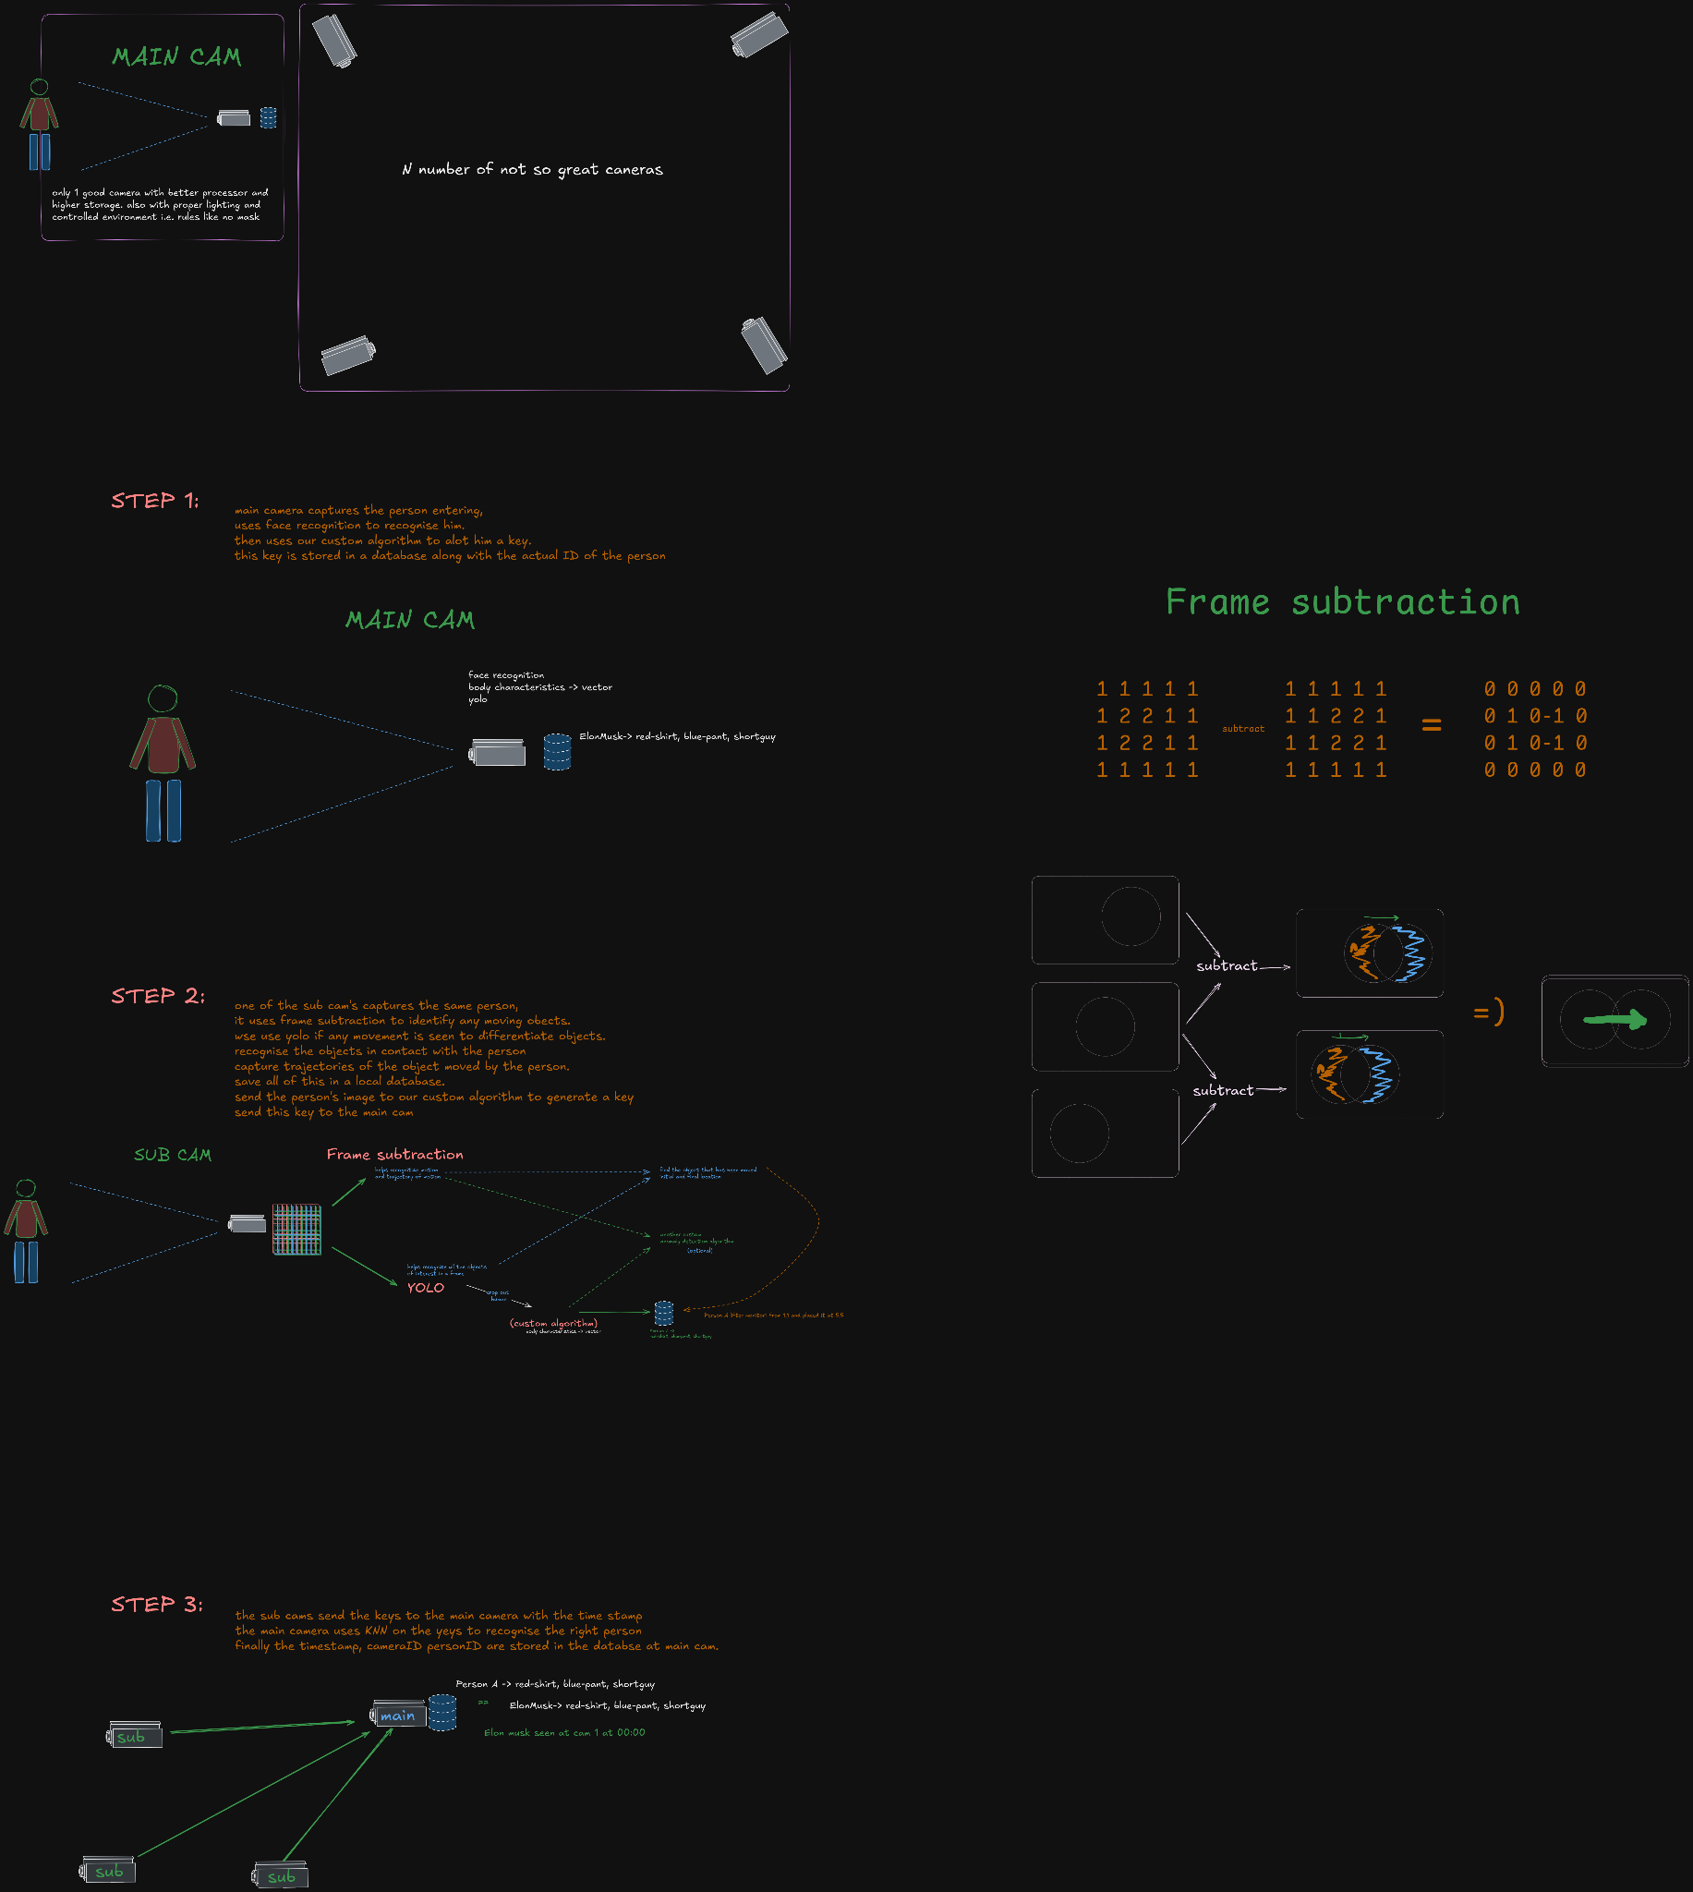
Title of the Project
Architecture

Slide 9
Title of the Project
Architecture

Slide 10
Title of the Project
Architecture

Slide 11
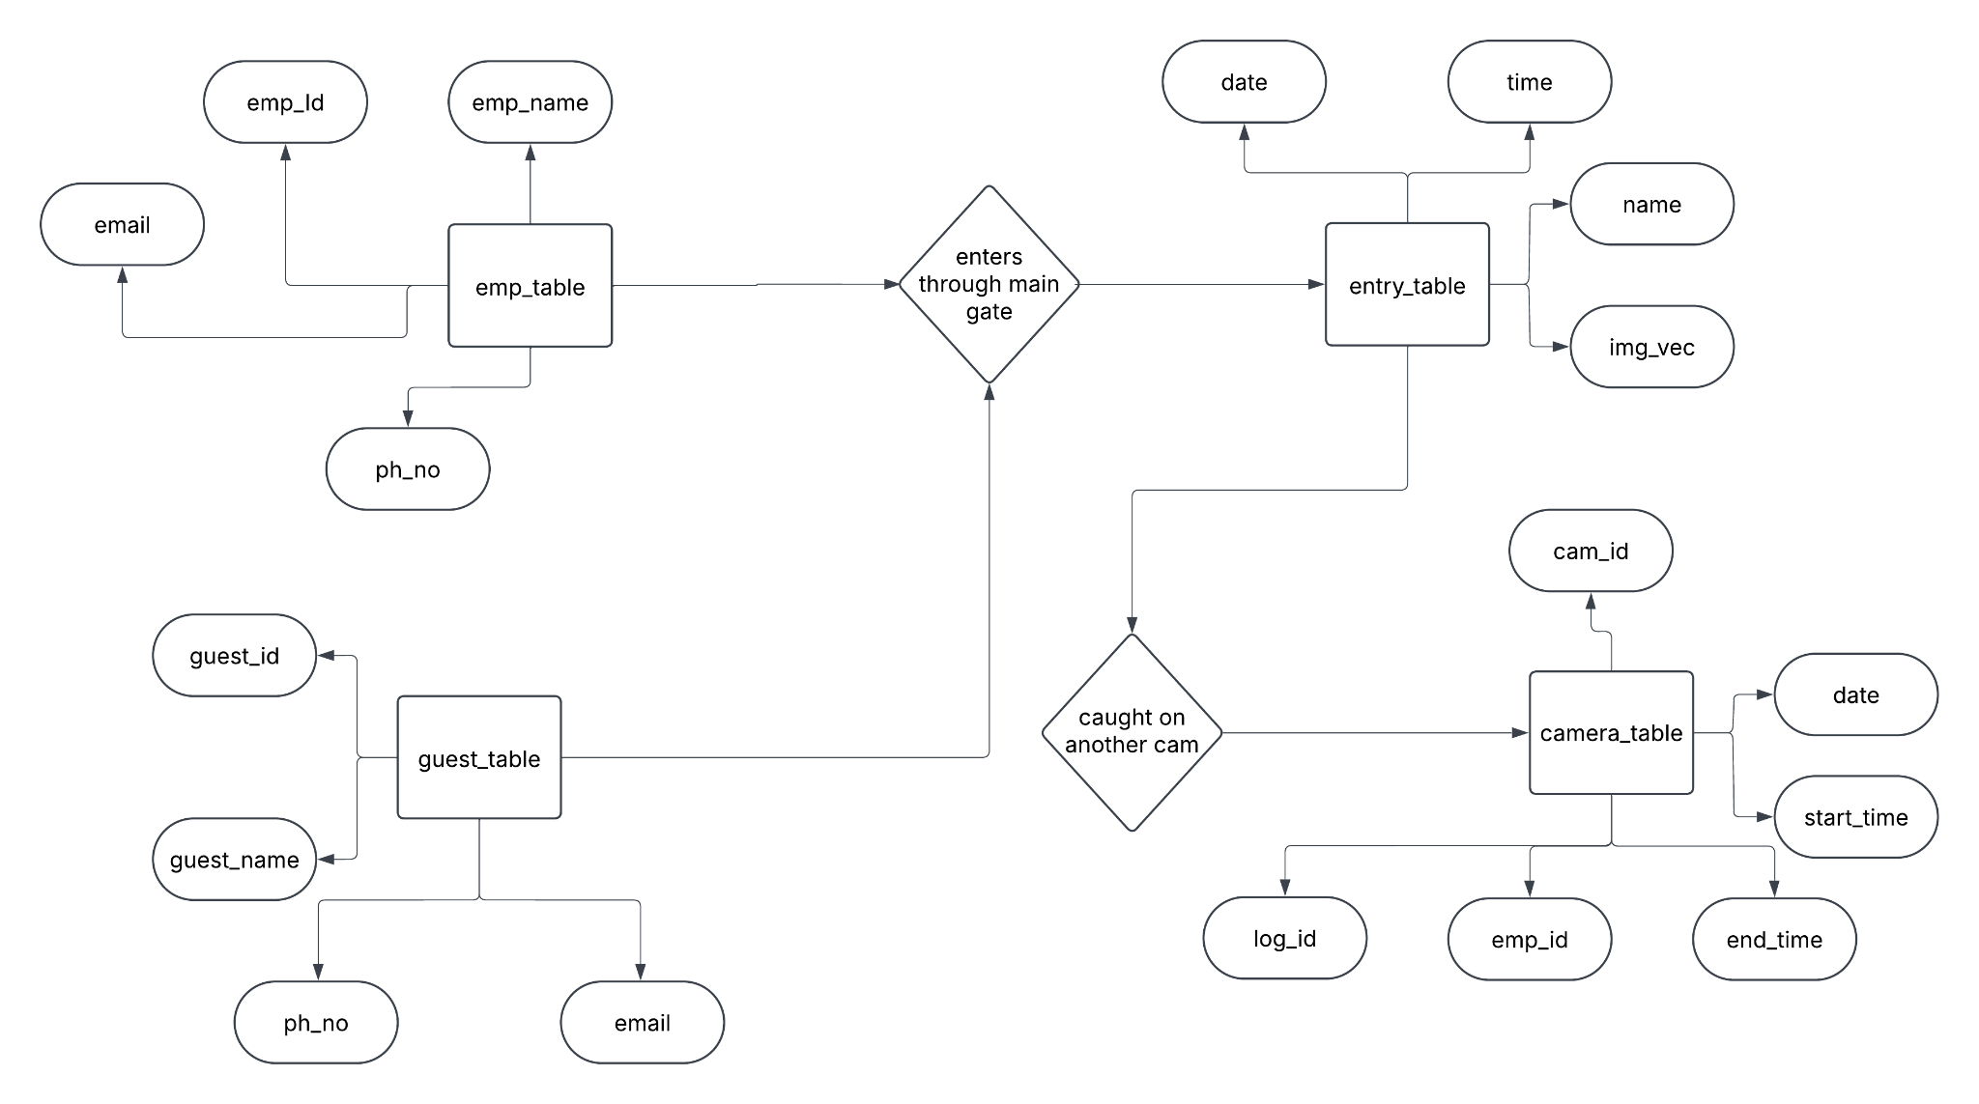
Title of the Project
Control flow Diagram

Slide 12
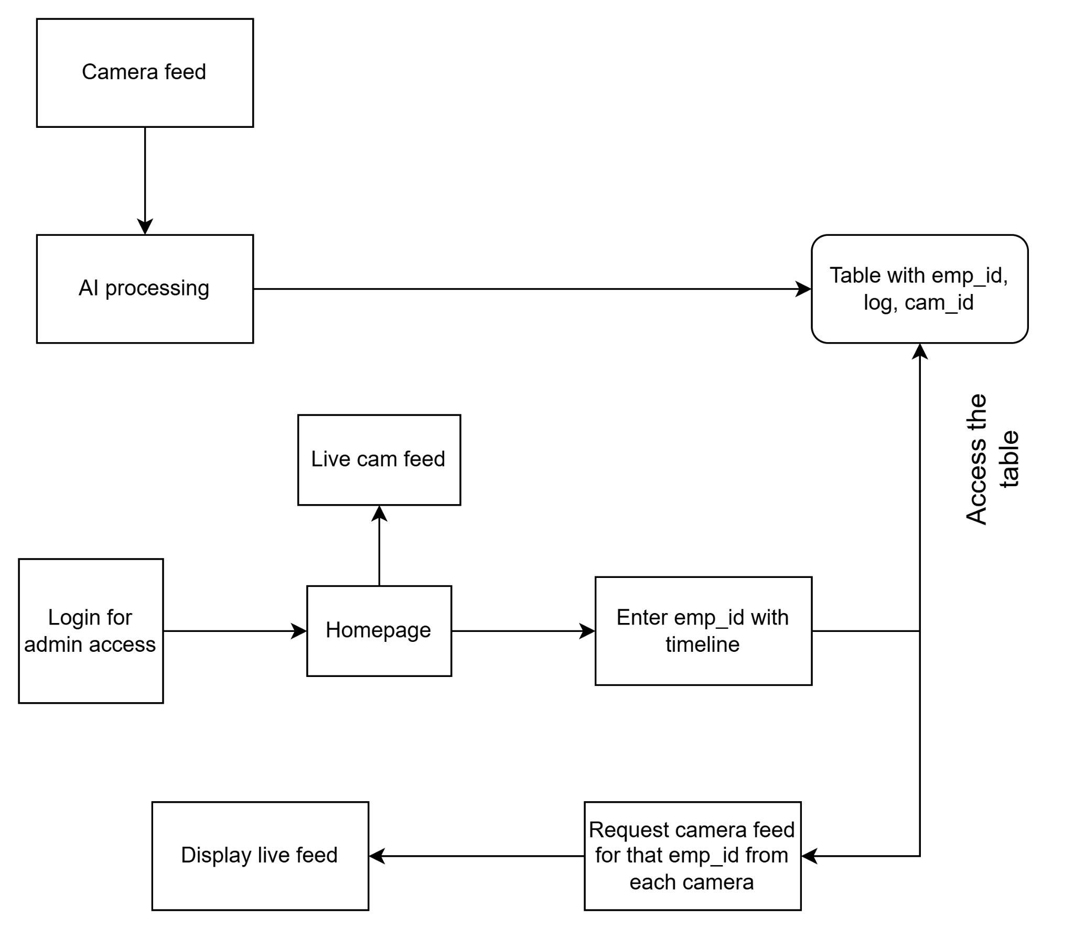
Title of the Project
Control Flow Diagram

Slide 13
Title of the Project
Project Progress Plan for Phase 2
we begin by testing the already available libraries and implementations of cctv and benchmark them on our own chips.
Then we start by making a simple implementation of cctv camera on our pi-zero cam
we benchmark this to other implementations from above and then finally setup the cctv part of it.
then we begin with training models, one human detection with yolo and another a small cnn to produce vector keys
we benchmark the newly trained models to check if raspberry pi-zero is enough or if a banana-pi is required.
else if everything fits into our assumptions we can proceed with integration of all the models
we can begin with the DBMS for storage of required records
finally we can develop a frontend gui to handle all of this .
implement a small daemon to make sure all databases are in sync.

Slide 14
Title of the Project
Current Project Progress
We have already checked lots of implementations of the required libraries for different applications and are now confident that our implementation will work on pi zero.
we have tested motioneyeOS one of the leading open source softwares for cameras/cctv.
we have already started implementing a simple webcam for this project.

Slide 15
Title of the Project
References
1. Á. Carro-Lagoa, V. Barral, M. González-López, C. J. Escudero, and L. Castedo, "CITIC Research Center & Department of Computer Engineering, University of A Coruña, 15071, A Coruña, Spain," received Mar. 8, 2023, revised Jul. 26, 2023, accepted Sept. 8, 2023, available online Sept. 12, 2023, version of record Sept. 18, 2023
2.Y. Martínez-Díaz, H. Méndez-Vázquez, L. S. Luevano, L. Chang and M. Gonzalez Mendoza, "Lightweight Low-Resolution Face Recognition for Surveillance Applications," 2020 25th International Conference on Pattern Recognition (ICPR), Milan, Italy, 2021
3. P. Ramya, R. Rajeshwari, “A Modified frame difference method using correlation coefficient for background subtraction”, 6th International Conference On Advances In Computing & Communications, ICACC 2016, 6-8 September 2016, Cochin, India.
4. Jianguo Wang, Xiaomeng Yi, Rentong Guo, Hai Jin, Peng Xu, Shengjun Li, Xiangyu Wang, Xiangzhou Guo, Chengming Li, Xiaohai Xu, Kun Yu, Yuxing Yuan, Yinghao Zou, Jiquan Long, Yudong Cai, Zhenxiang Li, Zhifeng Zhang, Yihua Mo, Jun Gu, Ruiyi Jiang, Yi Wei, Charles Xie. 2021. Milvus: A Purpose Built Vector Data Management System. In Proceedings of the 2021 International Conference on Management of Data (SIGMOD ’21), June 20–25, 2021, Virtual Event, China. ACM, New York, NY, USA, 14 pages. https: //doi.org/10.1145/3448016.3457550 5.Chen, Sheng & Liu, Yang & Gao, Xiang & Han, Zhen. (2018). MobileFaceNets: Efficient CNNs for Accurate Real-Time Face Verification on Mobile Devices. 10.48550/arXiv.1804.07573.

Slide 16
Thank You

