Slide 1
DELIVERY REVIEW / 01
From specification to implementation
Sprint-by-sprint Jira tickets · 16 October 2026
01
02
03
Foundation
Detailed flows
Planned build
ABANG CEBU AI / JIRA SNAPSHOT 16 OCT 2026 01

Slide 2
SPRINT 1 / CLOSED
Foundation, designed
15 Sep–2 Oct planned · completed 1 Oct
27
27
Done
tickets in sprint
Jira status ≠ independent acceptance or implementation audit.
ABANG CEBU AI / JIRA SNAPSHOT 16 OCT 2026 02

Slide 3
SPRINT 1 / OUTCOME
Requirements before implementation
27 of 27 tickets marked Done; most outputs are plans and design artifacts.
Foundation
Git, AWS, Next.js/MapLibre and Supabase/PostGIS direction.
Access + data
User/profile schema, RLS policy drafts, RBAC and renter/landlord personas.
Experience + QA
Page wireframes, authentication workflow specifications and test plans.
ABANG CEBU AI / JIRA SNAPSHOT 16 OCT 2026 03

Slide 4
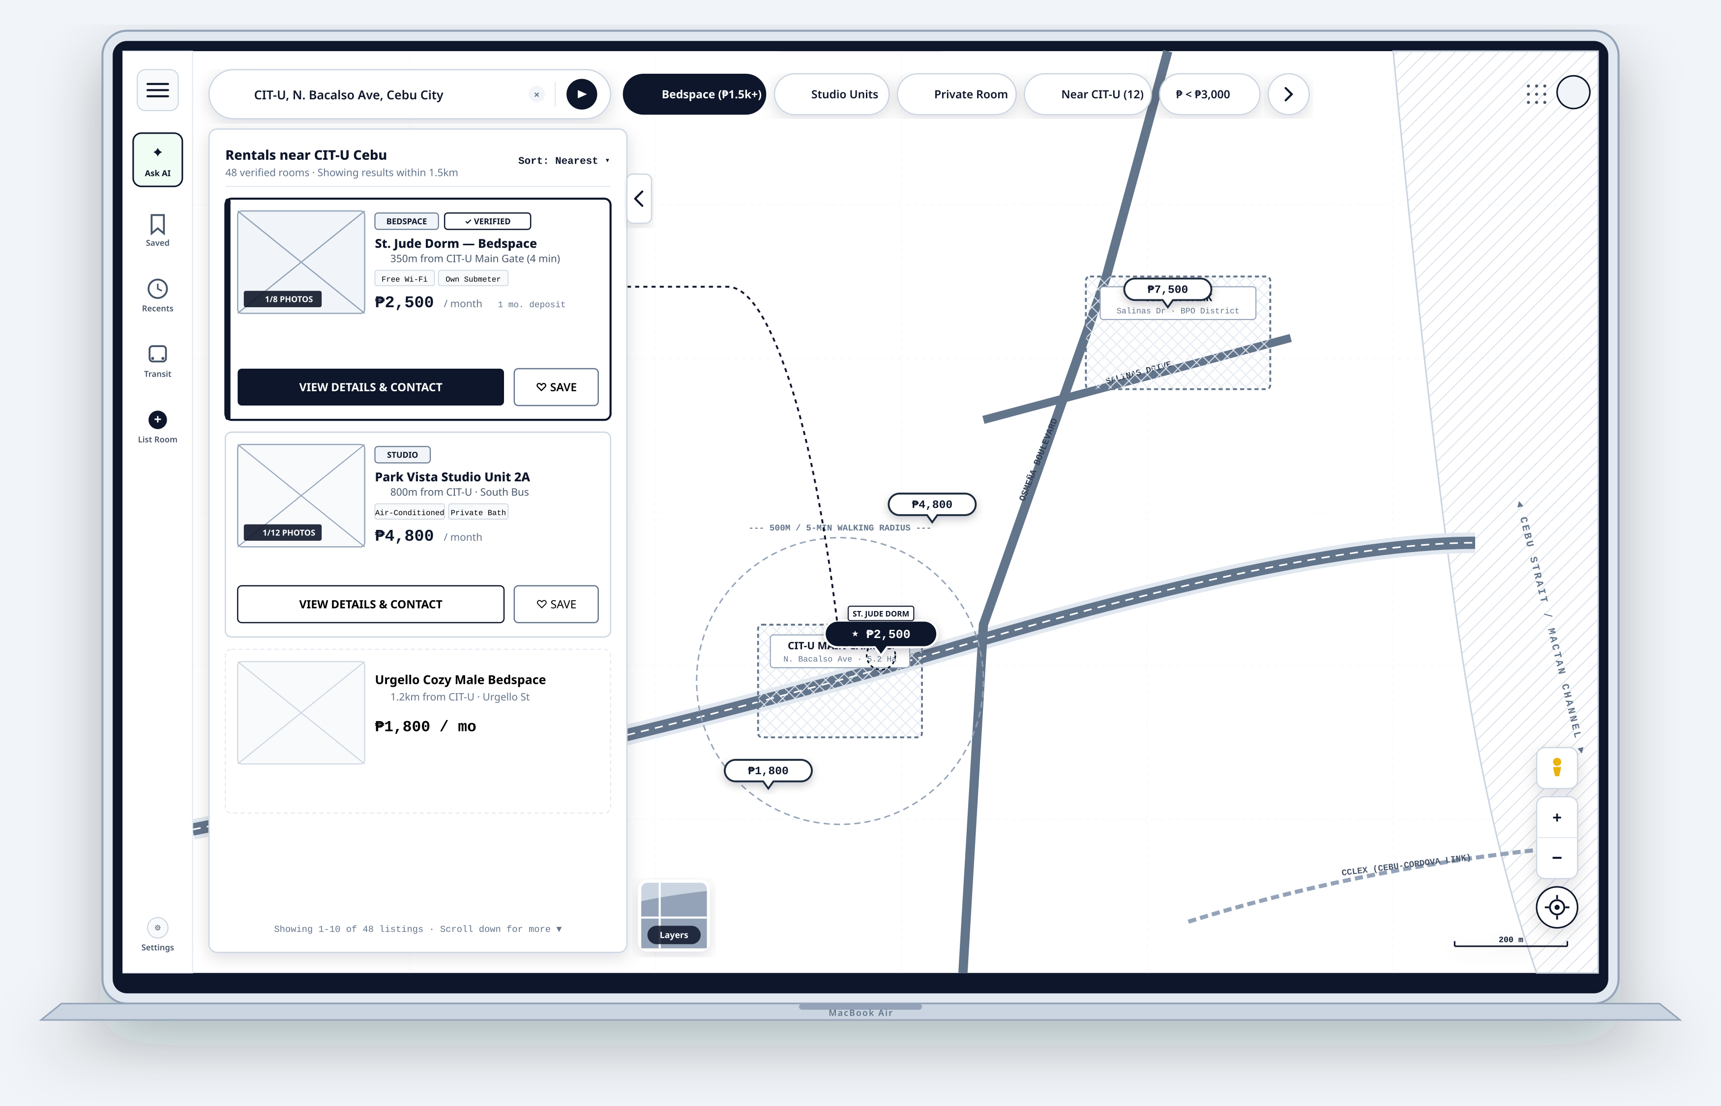
SPRINT 1 / ARTIFACT SPOTLIGHT
SCRUM-64 · Design Landing Page Wireframe / Mockup
Ticket contents and artifact provenance
DONE
• Map-led rental discovery layout
• Search, filters and listing preview are design concepts
Local wireframe; Jira lists same-named attachment
Desktop landing-page blueprint · wireframe, not a live application
OPEN JIRA ISSUE ↗
ABANG CEBU AI / JIRA SNAPSHOT 16 OCT 2026 04

Slide 5
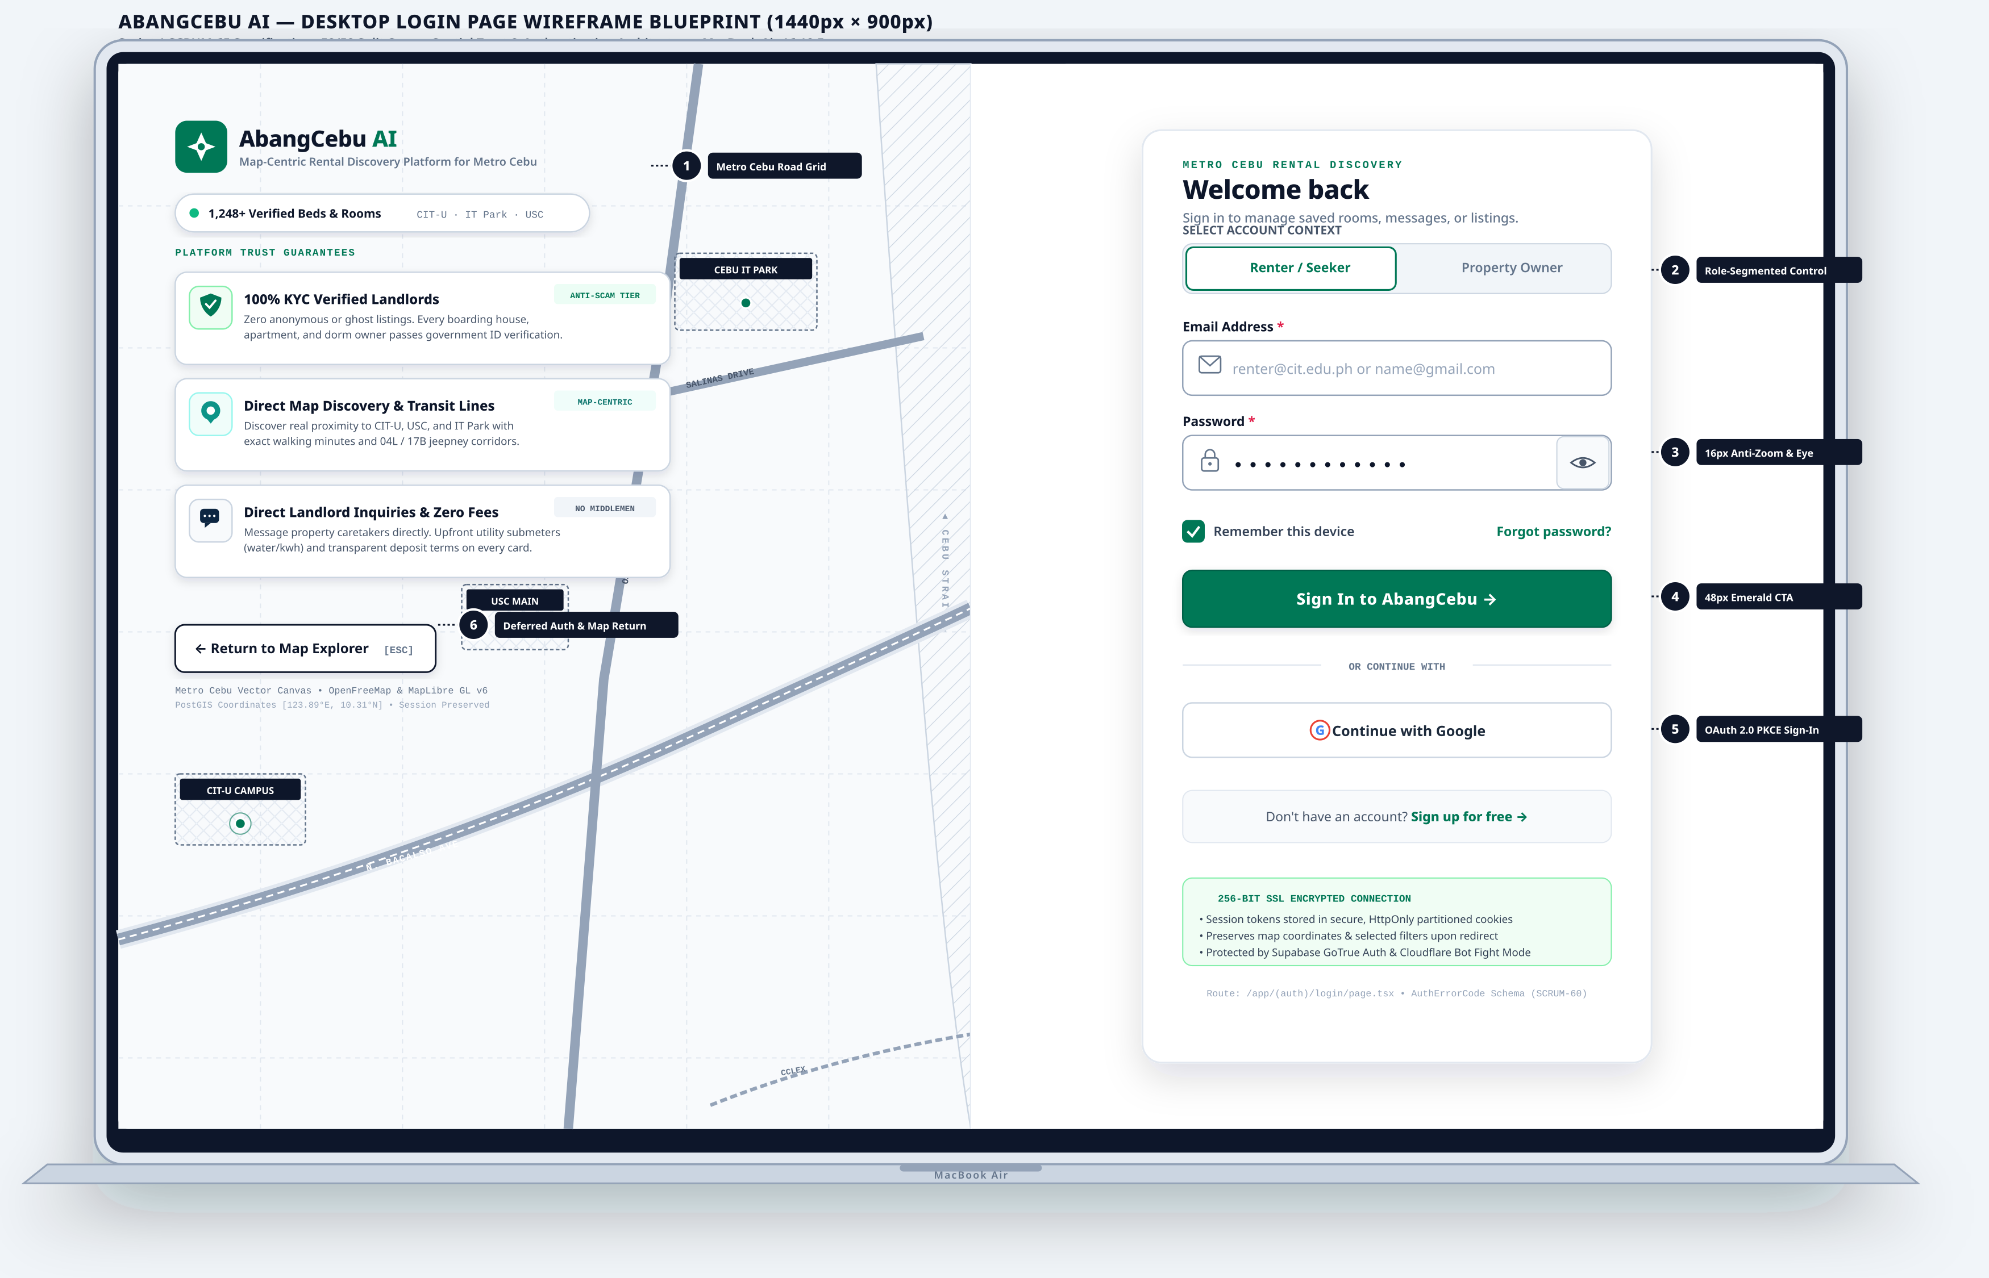
SPRINT 1 / ARTIFACT SPOTLIGHT
SCRUM-65 · Design Login Page Wireframe / Mockup
Ticket contents and artifact provenance
DONE
• Login page visual specification
• Auth implementation remains separate work
Local wireframe; Jira attachment linkage not independently checked
Desktop login-page blueprint · wireframe, not a live application
OPEN JIRA ISSUE ↗
ABANG CEBU AI / JIRA SNAPSHOT 16 OCT 2026 05

Slide 6
INVENTORY / SPRINT 1
Sprint 1 · ticket register
1–6 of 27 / appendix page 1 of 5
SCRUM-10
Create AbangCebu System Flowcharts
DONE
SCRUM-49
Establish Git Branching & PR Collaboration Strategy
DONE
SCRUM-6
create AWS account for the team
DONE
SCRUM-55
Draft Row Level Security (RLS) Policy Specifications
DONE
SCRUM-62
Define Landlord Persona, Permissions & Capabilities
DONE
SCRUM-50
Configure UI Framework & Styling Guidelines
DONE
ABANG CEBU AI / JIRA SNAPSHOT 16 OCT 2026 06

Slide 7
INVENTORY / SPRINT 1
Sprint 1 · ticket register
7–12 of 27 / appendix page 2 of 5
SCRUM-51
Environment Variables & Secrets Governance Plan
DONE
SCRUM-52
Plan Supabase Project Structure & Extensions
DONE
SCRUM-53
Design Initial Database ERD Diagram
DONE
SCRUM-54
Define Users & Profiles Table Schema Specification
DONE
SCRUM-56
Specify User Registration Workflow & Data Contract
DONE
SCRUM-57
Specify User Login & Session Token Lifecycle
DONE
ABANG CEBU AI / JIRA SNAPSHOT 16 OCT 2026 07

Slide 8
INVENTORY / SPRINT 1
Sprint 1 · ticket register
13–18 of 27 / appendix page 3 of 5
SCRUM-58
Specify User Logout & Session Invalidation
DONE
SCRUM-60
Document Authentication Error Handling & Edge Cases
DONE
SCRUM-48
Plan Next.js 15 & MapLibre Project Foundation
DONE
SCRUM-64
Design Landing Page Wireframe / Mockup
DONE
SCRUM-63
Create Role-Based Access Control (RBAC) Matrix
DONE
SCRUM-61
Define Renter Persona, Permissions & Capabilities
DONE
ABANG CEBU AI / JIRA SNAPSHOT 16 OCT 2026 08

Slide 9
INVENTORY / SPRINT 1
Sprint 1 · ticket register
19–24 of 27 / appendix page 4 of 5
SCRUM-59
Specify Password Reset & Recovery Workflow
DONE
SCRUM-65
Design Login Page Wireframe / Mockup
DONE
SCRUM-66
Design Registration Page Wireframe / Mockup
DONE
SCRUM-67
Design User Dashboard Wireframe / Mockup
DONE
SCRUM-68
Design Profile Page Wireframe / Mockup
DONE
SCRUM-69
Draft Authentication Test Plan & Test Scenarios
DONE
ABANG CEBU AI / JIRA SNAPSHOT 16 OCT 2026 09

Slide 10
INVENTORY / SPRINT 1
Sprint 1 · ticket register
25–27 of 27 / appendix page 5 of 5
SCRUM-70
Draft Role & Access Permission Verification Test Cases
DONE
SCRUM-71
Draft Protected Route & Middleware Test Scenarios
DONE
SCRUM-72
Plan Authentication Baseline Latency & Load Strategy
DONE
ABANG CEBU AI / JIRA SNAPSHOT 16 OCT 2026 10

Slide 11
SPRINT 2 / ACTIVE
Flows, specified
1–15 Oct planned · still active on 16 Oct
20
17
3
Done
In Development
tickets in sprint
Jira status ≠ independent acceptance or implementation audit.
ABANG CEBU AI / JIRA SNAPSHOT 16 OCT 2026 11

Slide 12
SPRINT 2 / OUTCOME
Authentication and discovery mapped
17 Done; 3 In Development. The sprint still reads Active in Jira.
Authentication
Registration, login, reset, sign-out and failure flows; test matrices.
Spatial discovery
Map initialization, search, filters and pin/drawer interaction flowcharts.
Carry-over
SCRUM-125, SCRUM-126 and SCRUM-127 remain In Development.
ABANG CEBU AI / JIRA SNAPSHOT 16 OCT 2026 12

Slide 13
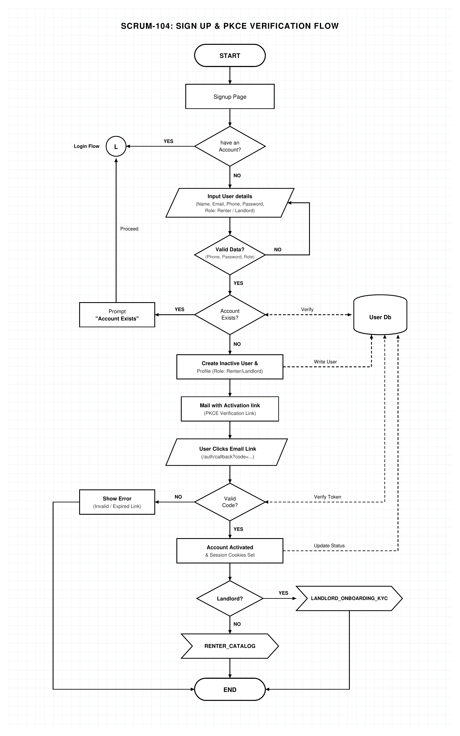
SPRINT 2 / ARTIFACT SPOTLIGHT
SCRUM-104 · Sign Up Module & Flowchart: Registration & PKCE Verification
Ticket contents and artifact provenance
DONE
• Defines registration, validation and duplicate checks
• Models email verification and PKCE callback
Local PNG; Jira lists matching editable .drawio attachment
Registration + PKCE verification flow · diagram excerpt
OPEN JIRA ISSUE ↗
ABANG CEBU AI / JIRA SNAPSHOT 16 OCT 2026 13

Slide 14
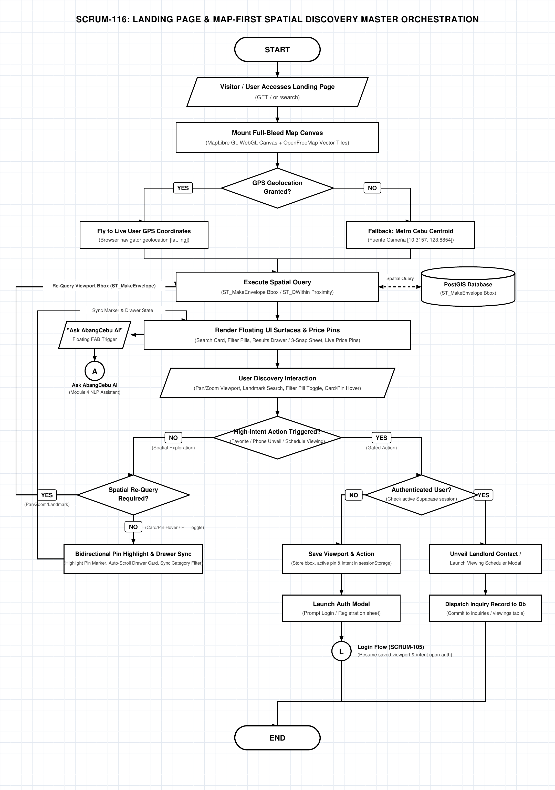
SPRINT 2 / ARTIFACT SPOTLIGHT
SCRUM-116 · Landing Page Master Orchestration & Spatial Discovery Flowchart
Ticket contents and artifact provenance
DONE
• Map initialization and location choice
• Spatial query to price pins and results surfaces
Local flowchart; attachment linkage not independently checked
Map-first spatial discovery · diagram excerpt
OPEN JIRA ISSUE ↗
ABANG CEBU AI / JIRA SNAPSHOT 16 OCT 2026 14

Slide 15
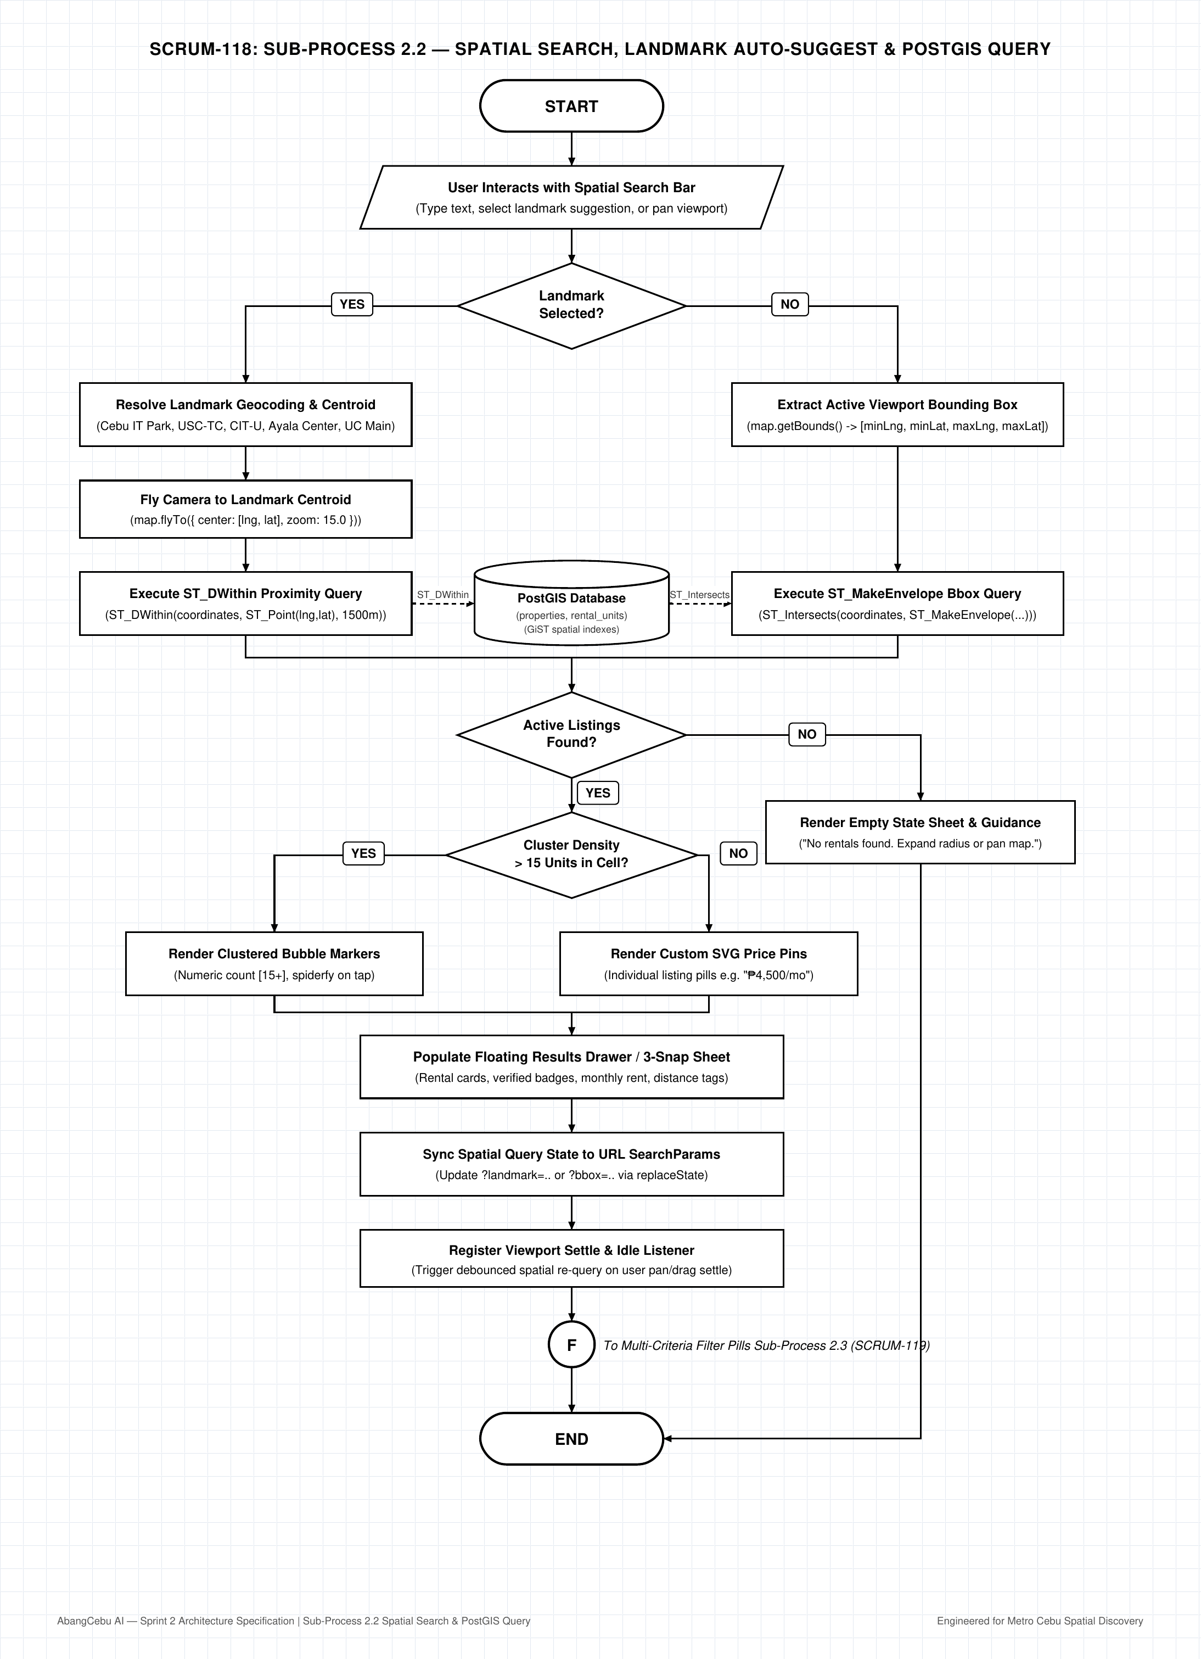
SPRINT 2 / ARTIFACT SPOTLIGHT
SCRUM-118 · Sub-Process 2.2: Spatial Search, Landmark Auto-Suggest & PostGIS Query Flowchart
Ticket contents and artifact provenance
DONE
• Landmark auto-suggest and viewport query
• PostGIS search specification, not implementation
Local PNG; Jira lists matching editable .drawio attachment
Spatial search query · diagram excerpt
OPEN JIRA ISSUE ↗
ABANG CEBU AI / JIRA SNAPSHOT 16 OCT 2026 15

Slide 16
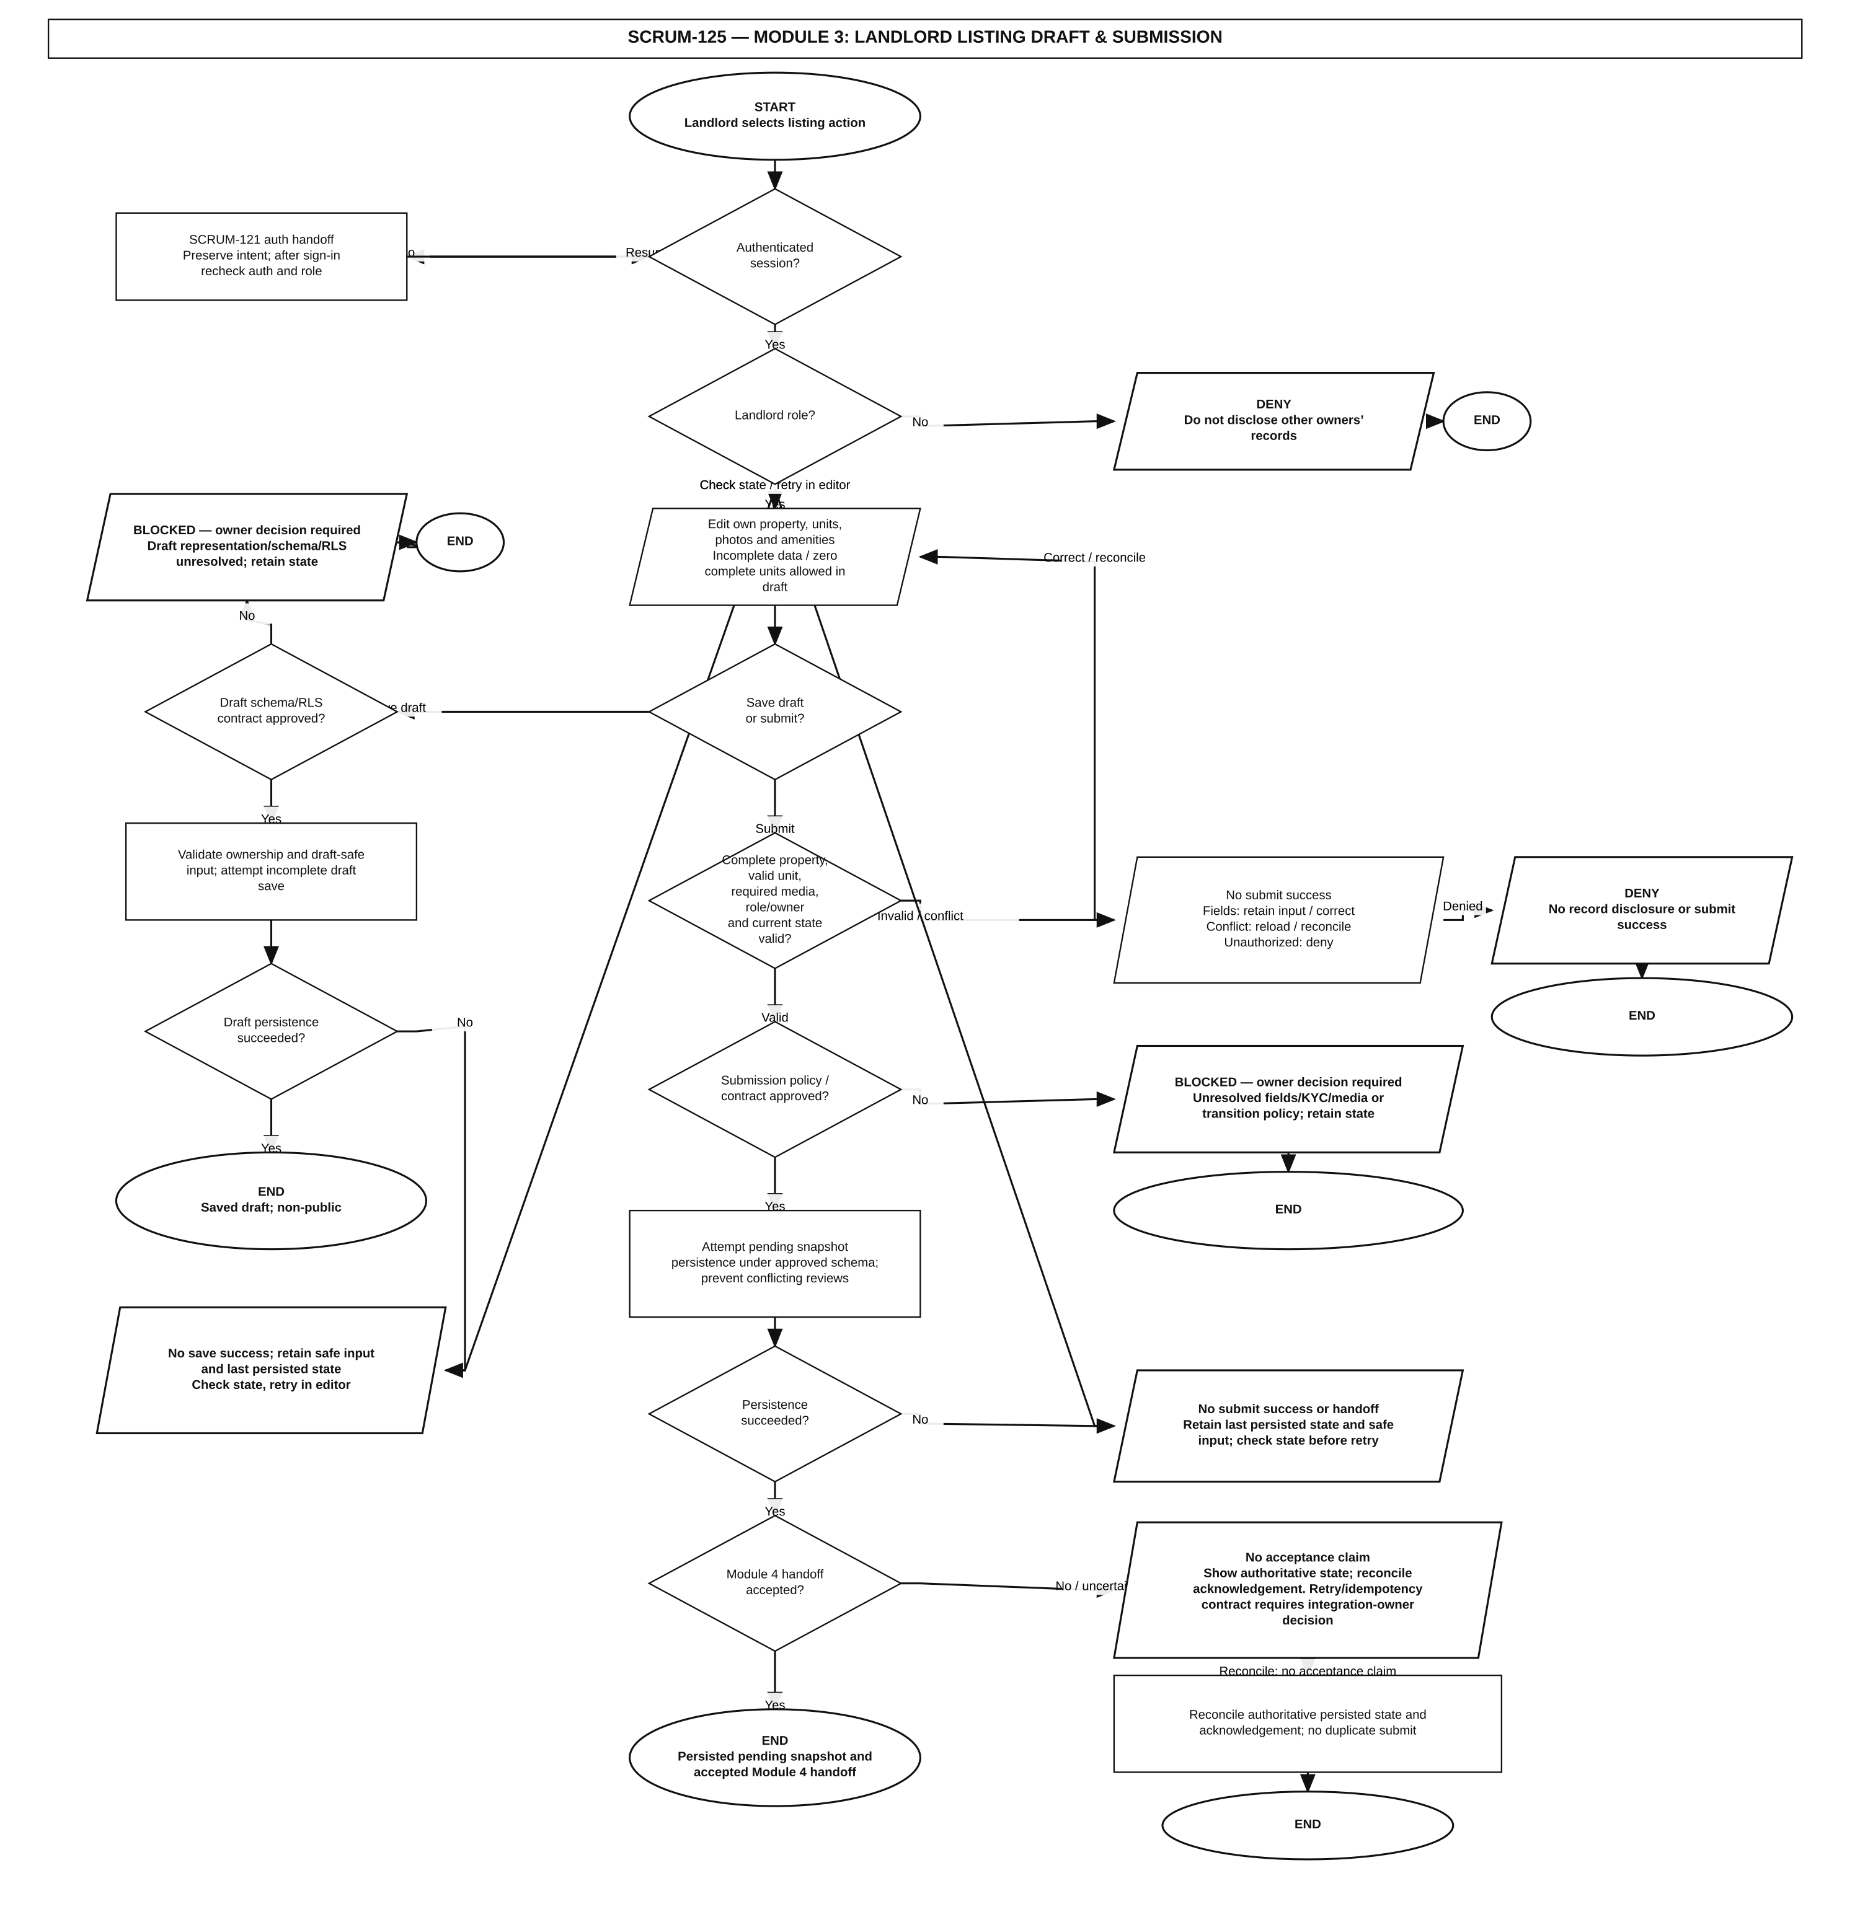
SPRINT 2 / ARTIFACT SPOTLIGHT
SCRUM-125 · Module 3: Landlord Onboarding & Listing Management Flowcharts
Ticket contents and artifact provenance
IN DEV
• Draft and submit listing flow
• Ticket remains In Development
Local draft; acceptance and Jira publication not verified
Landlord listing draft/submission · local draft
OPEN JIRA ISSUE ↗
ABANG CEBU AI / JIRA SNAPSHOT 16 OCT 2026 16

Slide 17
INVENTORY / SPRINT 2
Sprint 2 · ticket register
1–6 of 20 / appendix page 1 of 4
SCRUM-104
Sign Up Module & Flowchart: Registration & PKCE Verification
DONE
SCRUM-105
Log In Module & Flowchart: Authentication & Session Token Lifecycle
DONE
SCRUM-106
Password Reset Module & Flowchart: Self-Service Recovery Workflow
DONE
SCRUM-107
Sign Out Module & Flowchart: Session Termination & Multi-Tab Sync
DONE
SCRUM-108
Error Handling & Suspension Module & Flowchart: Failure Taxonomy & UX States
DONE
SCRUM-109
Authentication Master Test Plan & Test Matrix
DONE
ABANG CEBU AI / JIRA SNAPSHOT 16 OCT 2026 17

Slide 18
INVENTORY / SPRINT 2
Sprint 2 · ticket register
7–12 of 20 / appendix page 2 of 4
SCRUM-110
Sign Up Module Test Plan & Registration Test Cases
DONE
SCRUM-111
Log In Module Test Plan & Session Token Test Cases
DONE
SCRUM-112
Password Reset & Sign Out Module Test Cases
DONE
SCRUM-113
Route Guards & Middleware Security Test Cases
DONE
SCRUM-114
Authentication Baseline Latency & Load Strategy
DONE
SCRUM-116
Landing Page Master Orchestration & Spatial Discovery Flowchart
DONE
ABANG CEBU AI / JIRA SNAPSHOT 16 OCT 2026 18

Slide 19
INVENTORY / SPRINT 2
Sprint 2 · ticket register
13–18 of 20 / appendix page 3 of 4
SCRUM-117
Sub-Process 2.1: Map Initialization, Viewport & Geolocation Flowchart
DONE
SCRUM-118
Sub-Process 2.2: Spatial Search, Landmark Auto-Suggest & PostGIS Query Flowchart
DONE
SCRUM-119
Sub-Process 2.3: Multi-Criteria Filter Pills & URL State Sync Flowchart
DONE
SCRUM-120
Sub-Process 2.4: Bidirectional Pin Marker & 3-Snap Gesture Drawer Flowchart
DONE
SCRUM-122
FUNCTION SPECIFICATION DOCUMENT FOR ABANG CEBU
DONE
SCRUM-125
Module 3: Landlord Onboarding & Listing Management Flowcharts
IN DEV
ABANG CEBU AI / JIRA SNAPSHOT 16 OCT 2026 19

Slide 20
INVENTORY / SPRINT 2
Sprint 2 · ticket register
19–20 of 20 / appendix page 4 of 4
SCRUM-126
Module 4: Admin KYC Verification & Listing Moderation Flowcharts
IN DEV
SCRUM-127
Module 5: Renter Favorites, Contact & Viewing Inquiry Flowcharts
IN DEV
ABANG CEBU AI / JIRA SNAPSHOT 16 OCT 2026 20

Slide 21
SPRINT 3 / FUTURE
Build, then verify
No Jira start/end dates
35
35
Ready
tickets in sprint
Jira status ≠ independent acceptance or implementation audit.
ABANG CEBU AI / JIRA SNAPSHOT 16 OCT 2026 21

Slide 22
SPRINT 3 / PLANNED WORK
Implementation has not started in Jira
35 tickets Ready; 0 Done. No Jira start or end date recorded.
Platform + data
EC2 staging, CI/CD, IAM, monitoring, migrations, RLS and PostGIS.
Application
Authentication, RBAC, shared UI, map search and listing interfaces.
Verification
Carry-over review, auth/RBAC QA, accessibility, load and system tests.
ABANG CEBU AI / JIRA SNAPSHOT 16 OCT 2026 22

Slide 23
INVENTORY / SPRINT 3
Sprint 3 · ticket register
1–6 of 35 / appendix page 1 of 6
SCRUM-134
Provision AWS EC2 staging environment for Next.js app
READY
SCRUM-135
Set up GitHub Actions CI pipeline (tsc, lint, build)
READY
SCRUM-136
Automate deployment from main to EC2 staging
READY
SCRUM-137
Define IAM least-privilege roles and policies for staging
READY
SCRUM-138
IAM access review and security audit of staging
READY
SCRUM-139
Set up monitoring, logging and uptime alerts for staging
READY
ABANG CEBU AI / JIRA SNAPSHOT 16 OCT 2026 23

Slide 24
INVENTORY / SPRINT 3
Sprint 3 · ticket register
7–12 of 35 / appendix page 2 of 6
SCRUM-140
Implement core listing tables migration
READY
SCRUM-141
Implement engagement tables migration (inquiries, saved_listings, reviews, audit_logs)
READY
SCRUM-142
Apply Row Level Security policies as migrations
READY
SCRUM-143
Create PostGIS search functions (viewport bbox and landmark radius)
READY
SCRUM-144
Seed Metro Cebu landmarks and sample listings
READY
SCRUM-145
Configure Supabase Storage buckets and database backups
READY
ABANG CEBU AI / JIRA SNAPSHOT 16 OCT 2026 24

Slide 25
INVENTORY / SPRINT 3
Sprint 3 · ticket register
13–18 of 35 / appendix page 3 of 6
SCRUM-146
Complete Database Specification workbook (.xlsx)
READY
SCRUM-147
Implement sign-up and email verification (PKCE)
READY
SCRUM-148
Implement login, session refresh and Remember Me
READY
SCRUM-149
Implement logout and multi-tab sign-out sync
READY
SCRUM-150
Implement password reset and recovery
READY
SCRUM-151
Implement RBAC middleware and route guards
READY
ABANG CEBU AI / JIRA SNAPSHOT 16 OCT 2026 25

Slide 26
INVENTORY / SPRINT 3
Sprint 3 · ticket register
19–24 of 35 / appendix page 4 of 6
SCRUM-152
Implement standard API error contract and auth error handling
READY
SCRUM-153
Build shared UI component library (Tailwind v4 tokens)
READY
SCRUM-154
Implement login, registration and password reset pages
READY
SCRUM-155
Implement MapLibre map canvas with Metro Cebu viewport and Locate Me
READY
SCRUM-156
Implement landing page, search bar and landmark auto-suggest
READY
SCRUM-157
Implement filter pills, URL state sync and results drawer
READY
ABANG CEBU AI / JIRA SNAPSHOT 16 OCT 2026 26

Slide 27
INVENTORY / SPRINT 3
Sprint 3 · ticket register
25–30 of 35 / appendix page 5 of 6
SCRUM-158
Module 6: AI Rental Assistant Flowcharts and Specification
READY
SCRUM-159
Define AI assistant API contract, prompt policy and evaluation set
READY
SCRUM-160
Extend Function Specification Document with Modules 3 to 5
READY
SCRUM-161
Review and close Sprint 2 carry-over (SCRUM-125, 126, 127)
READY
SCRUM-162
Execute authentication test plan against staging
READY
SCRUM-163
Execute RBAC and route guard tests
READY
ABANG CEBU AI / JIRA SNAPSHOT 16 OCT 2026 27

Slide 28
INVENTORY / SPRINT 3
Sprint 3 · ticket register
31–35 of 35 / appendix page 6 of 6
SCRUM-164
Browser, mobile and usability testing of auth pages and map UI
READY
SCRUM-165
Write test plans for Modules 3, 4 and 5
READY
SCRUM-166
Execute k6 load tests on staging (steady-state and burst)
READY
SCRUM-167
System test plan and first end-to-end run (auth to map to listing)
READY
SCRUM-168
Sprint 3 review, retrospective and reporting
READY
ABANG CEBU AI / JIRA SNAPSHOT 16 OCT 2026 28

Slide 29
METHOD / SOURCE
How to read this deck
Snapshot: 16 Oct 2026 · board 1 · sprint IDs 4, 70, 72
All 82 issue keys appear once in the appendix and link to Jira.
The status labels are current Jira workflow states at snapshot time. They are not proof of code, tests, approval, or deployment. Visuals are local artifacts and are captioned with their verification limits.
Jira board: https://abangcebuai.atlassian.net/jira/software/projects/SCRUM/boards/1/backlog
ABANG CEBU AI / JIRA SNAPSHOT 16 OCT 2026 29

