Slide 1
Graduation Project: 3D Track Recovery for Table Tennis Using a Single Camera
progress report
2020/05/05
管謹中

Slide 2
Introduce
A system including:
Ball detection
Falling point detection
Score counting
3D track recovery

Slide 3
System structure
RGB image
Ball detection
Ball trace
Segment method
Ball area
Falling point

Slide 4
System structure
Scoring system
RGB image
Ball detection
Ball trace
Segment method
Ball area
Falling point

Slide 5
System structure
Scoring system
3D track recovery
RGB image
Ball detection
Ball trace
Segment method
Ball area
Falling point

Slide 6
System structure
3
4
Scoring system
3D track recovery
RGB image
Ball detection
Ball trace
Segment method
Ball area
Falling point
2
1

Slide 7
3D information recovery
Recovery depth information.

Slide 8
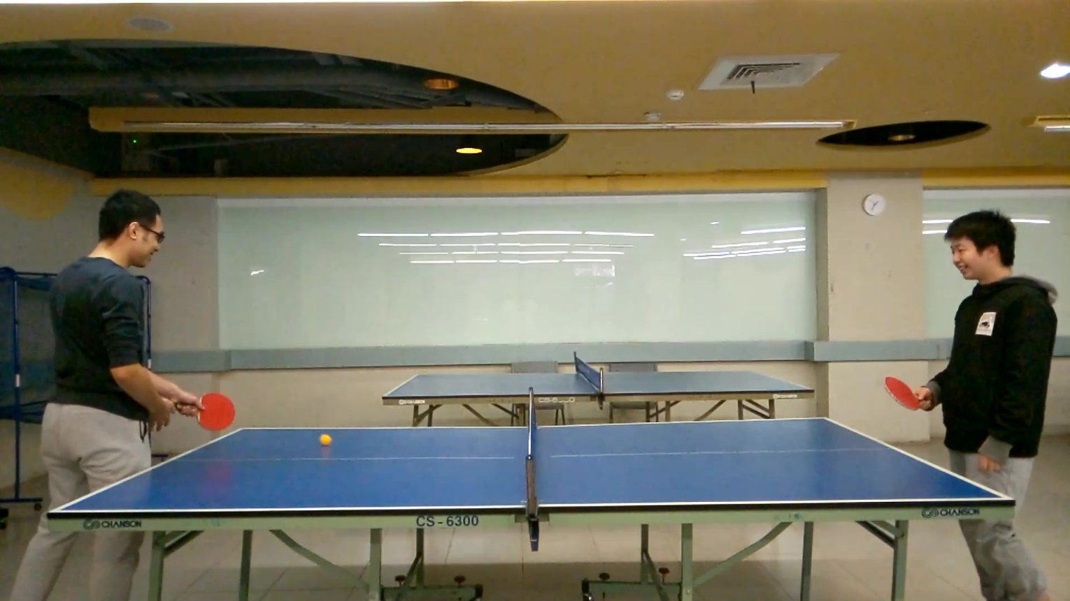
Origin image

Slide 9
Known parameter
table’s length and width
Ball’s diameter
Diameter
4.5cm
274cm
152.5cm

Slide 10
Diameter
4.5cm
(431,769)
1050 pixel
274cm
(1481,750)
(88,920)
1729 pixel
274cm
(1817,897)

Slide 11
Only 11 pixel from farthest to nearest
- quantization error
Diameter
4.5cm
D = 17 pixel
1050 pixel
274cm
152.5cm
1729 pixel
274cm
D = 28 pixel

Slide 12
Using segmentation method to find the area
Color space segmentation(HSV, RGB)
CNN structure segmentation
RGB image
Mask

Slide 13

Inscribed circle
Compute the Inscribed circle’s diameter.
Diameter(pixel)
Inscribed circle
Predict mask

Slide 14
Model structure (segmentation)
Input
(3*80*80)
MobileNet v2
Upsample layer
Output
(1*80*80)
RGB image
Output
(32*10*10)
Input
backbone
model
output
MSE loss
Label
(1*80*80)
label

Slide 15
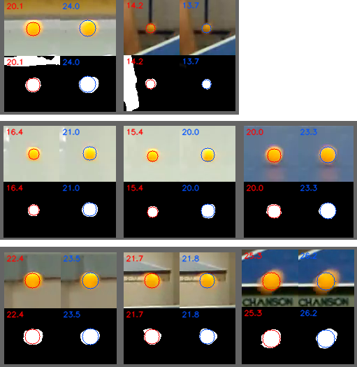
Comparison (HSV vs CNN )
Noise
Area
Normal

Slide 16
3D position computing
Calculate 3D position using depth information.

Slide 17
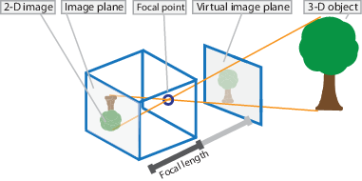
Pinhole camera model

Slide 18
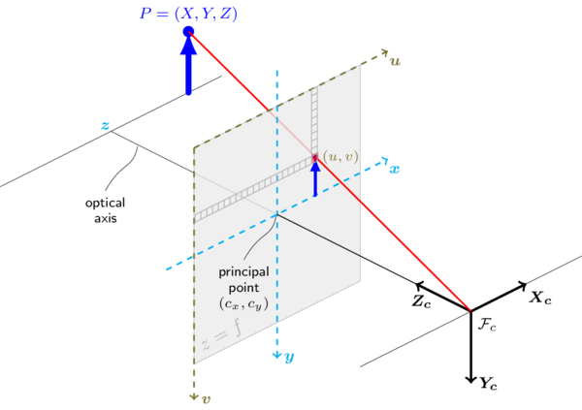

Pinhole camera model
intrinsic parameters
extrinsic parameters

Slide 19
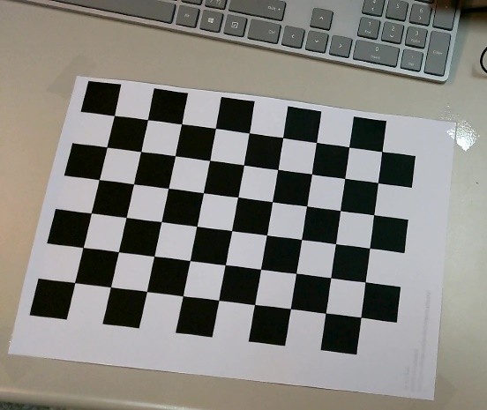
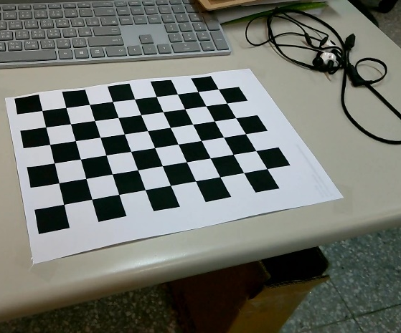
Calibration using chessboard image
✔
intrinsic parameters
extrinsic parameters

Slide 20
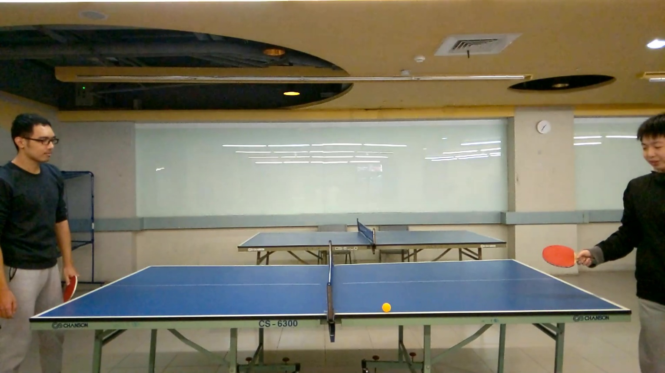

Slide 21
World coordinate
Z
(0, 0, 0)
(274, 0, 0)
X
Y
(0, 152, 0)
(274, 152, 0)

Slide 22
World coordinate
Image coordinate
intrinsic parameters
World coordinate
Z
(0, 0, 0)
(274, 0, 0)
X
Y
intrinsic parameters
extrinsic parameters
✔
✔
(0, 152, 0)
(274, 152, 0)

Slide 23
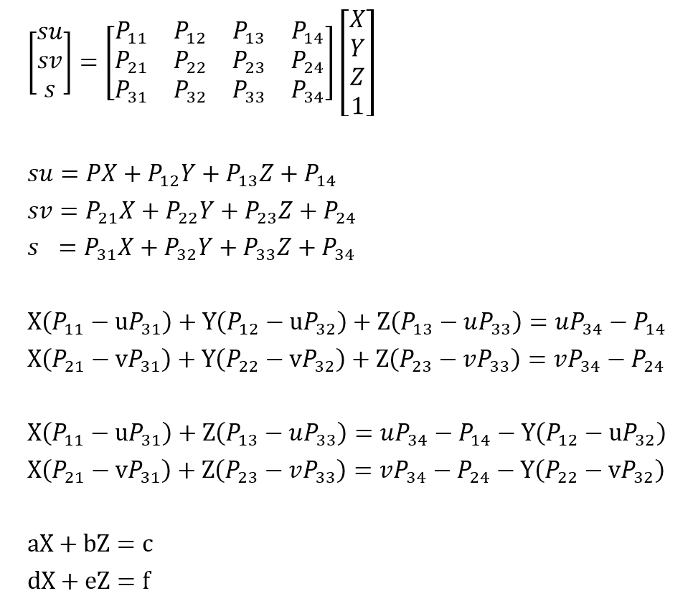
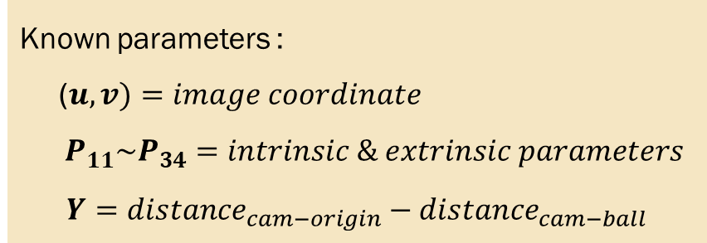
Equations
Known parameters :
($u,v)=image coordinate$
$P_{11}\sim P_{34}=intrinsic \& extrinsic parameters$
$$Y={{distance}_{cam−origin}−distance}_{cam−ball}$$

Slide 24
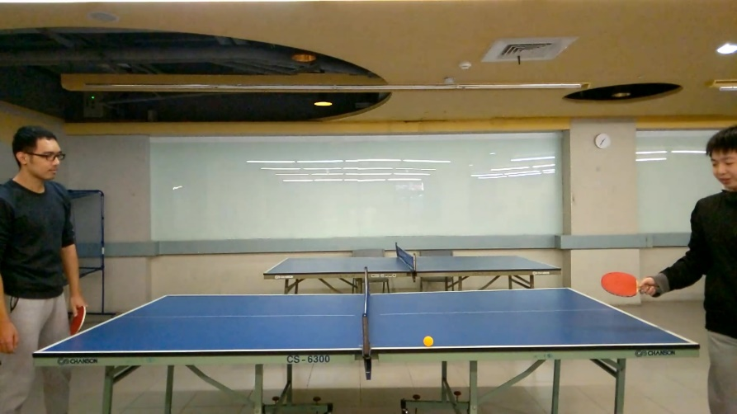
Experiment
World coordinate
Image coordinate
Z
(0, 0, 0)
(274, 0, 0)
(431,769)
(1481,750)
X
Y
(88,920)
(1817,897)
(0, 152, 0)
D = 28 pixel
(274, 152, 0)
(1115,890)
(?, 152, ?)

Slide 25
Test
Z
X
Y
Real (159, 152, 0)
Estimate (162, 152, 1)

Slide 26
Result1
video
Origin data draw.py

Slide 27
Data smooth
Origin data (e.g. we want to smooth the value ‘3’)
1 | 2 | 3 | 4 | 5 | 6 | 7 | 8 | 9 | 10
Get part of the data (i.e. value ‘1’~’5’ )
1 | 2 | 3 | 4 | 5 | 6 | 7 | 8 | 9 | 10
Remove the min and max value (e.g. remove 2, 5)
1 | 2 | 3 | 4 | 5 | 6 | 7 | 8 | 9 | 10
Average the remains
1 | 2 | 3 | 4 | 5 | 6 | 7 | 8 | 9 | 10

Slide 28
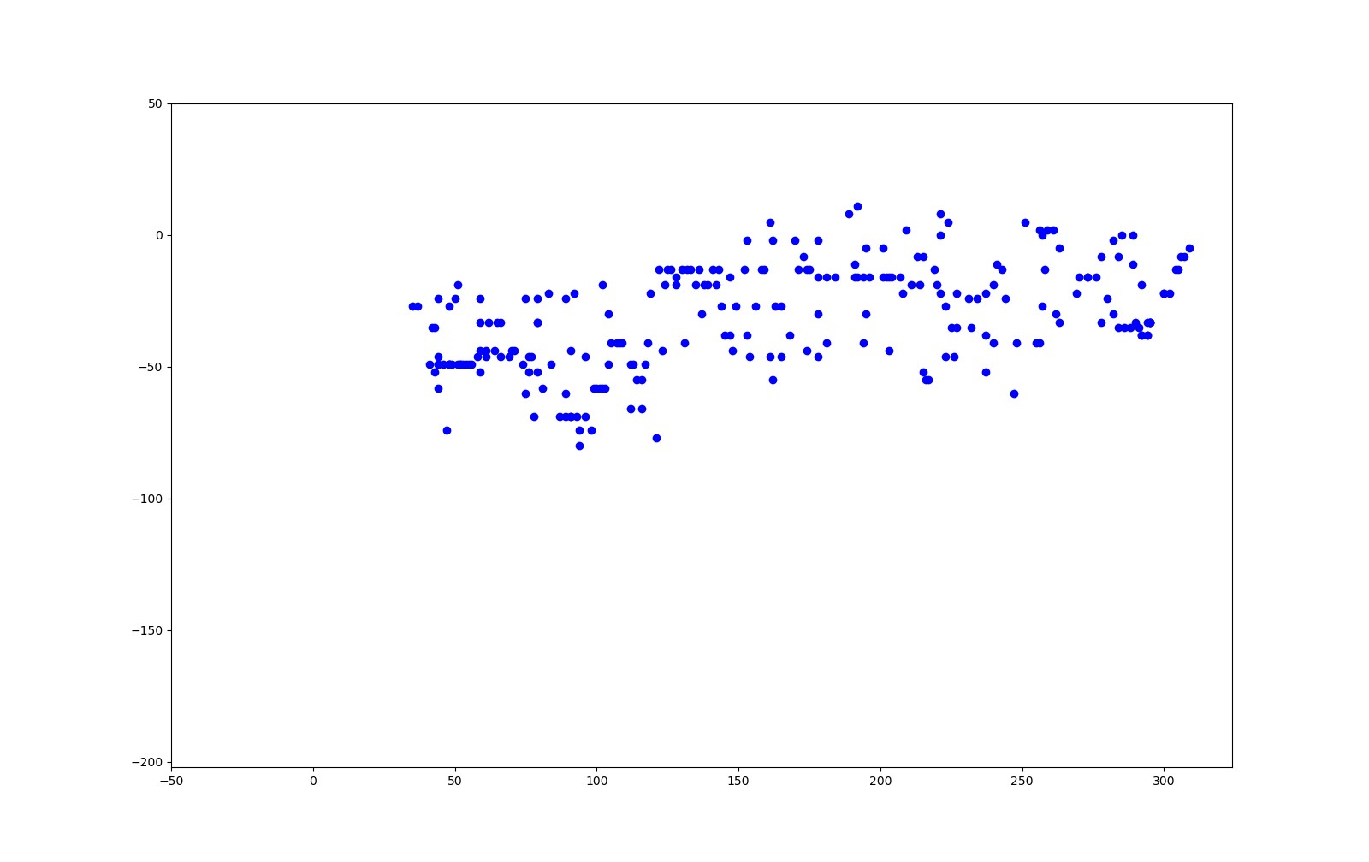
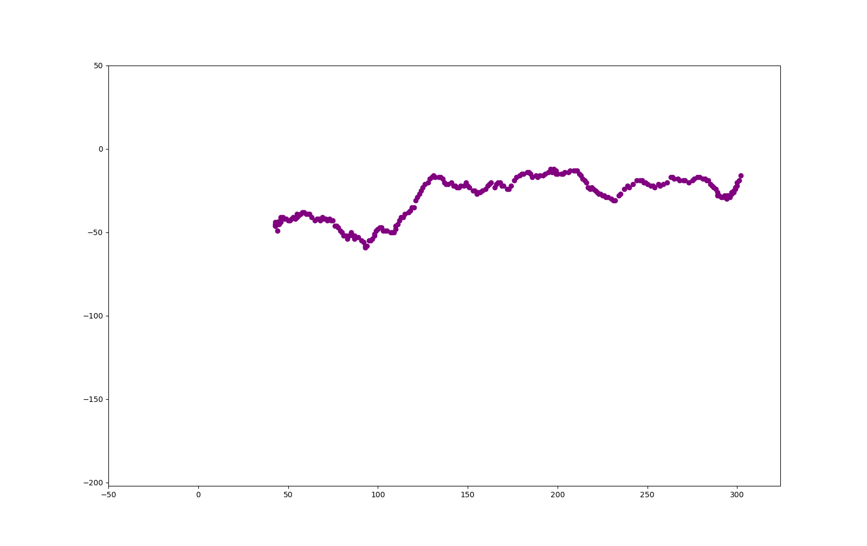
Data smooth
Origin
Smooth
y
y
x
x

Slide 29
Result2
Smooth data draw.py

Slide 30
Fit line
Smooth
Fit line
X
y
Y
x

Slide 31
Result3
Fit line draw.py

Slide 32

Fit falling point
y
Fit line
X
Y
x
y
x
Fit one point

Slide 33
Result4
Fit falling point draw.py

Slide 34
End

