Slide 1
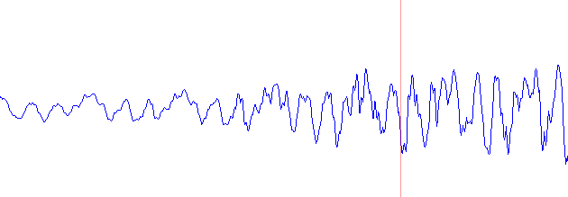

l = 0
Hanning Filter (HF)
FFT
Noise Estimator (D)
SS Method (SS)
IFFT
HF
FFT
D
$$y=x[0:(32x4)]$$

Slide 2


Hanning Filter (HF)
FFT
Noise Estimator (D)
SS Method (SS)
IFFT
HF
FFT
SS
IFFT
$$y=\{y,tail+y1[0:31]\}$$
$$tail=y1[32:63]$$

Slide 3
Constraint and Definition
Mono
Fs : Freq Sampling = 8000 Hz
Ts : Sampling Period = 1/Fs = 0.125 ms
NB : Total Bit per Sample = 16 bit
NS : Total Sample per Process = 64 sample
Tb = NS x Ts = 8 ms
Real Time → Tp <= Tb, Tp: Processing Time

Slide 4
Ada 2 jenis Tp
Tpd : HF+FFT+D
Tpss : HF+FFT+SS+IFFT
Syarat Real Time → Tpd <= Tb and Tpss <= Tb

Slide 5
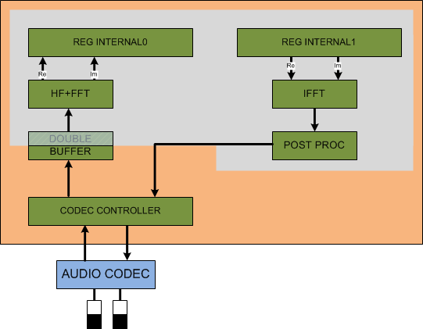

Slide 6
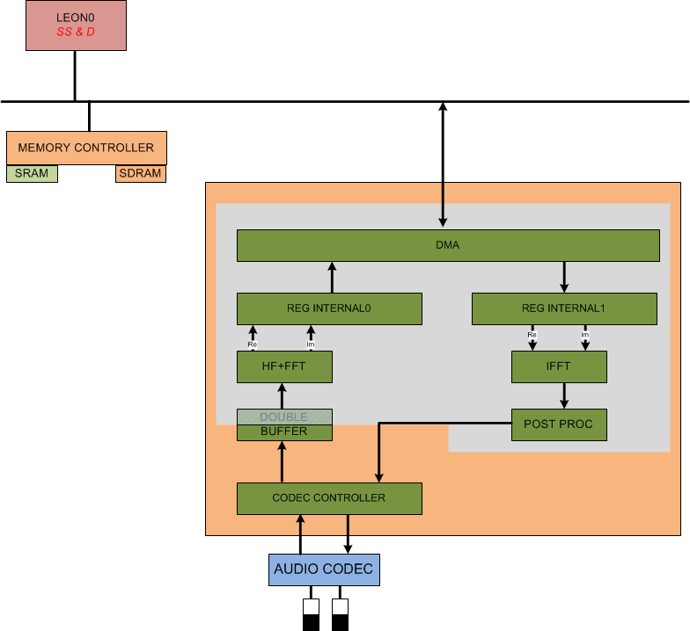

Slide 7
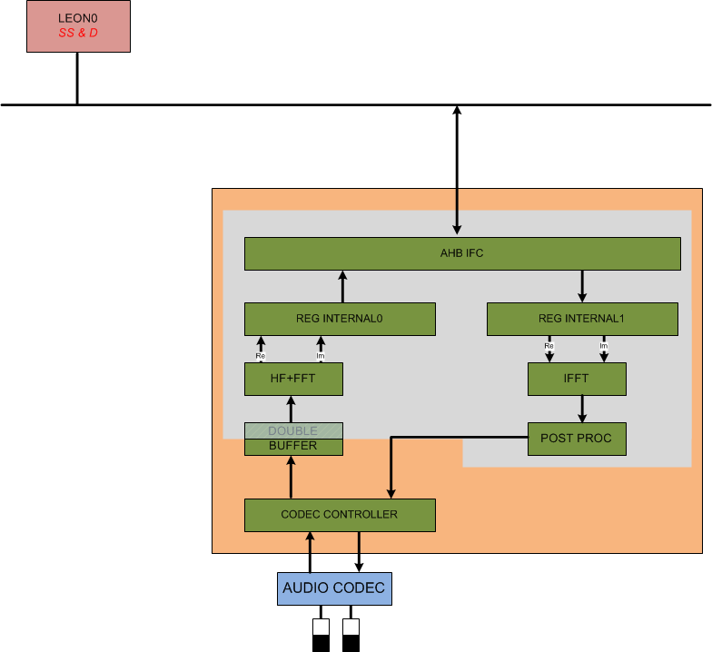

Slide 8
Timeline dan Pembagian Tugas
Modal :
Model fungsional (Scilab, Octave, C)
C sudah proven jalan di Tsim
Audio Codec bisa pakai model fungsional C dulu

