Slide 1
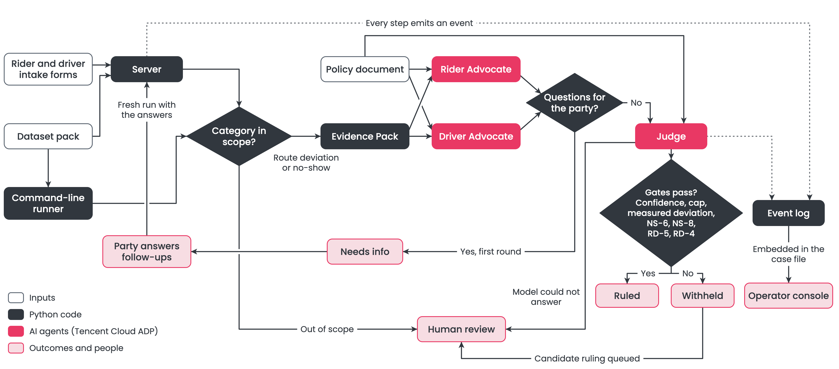
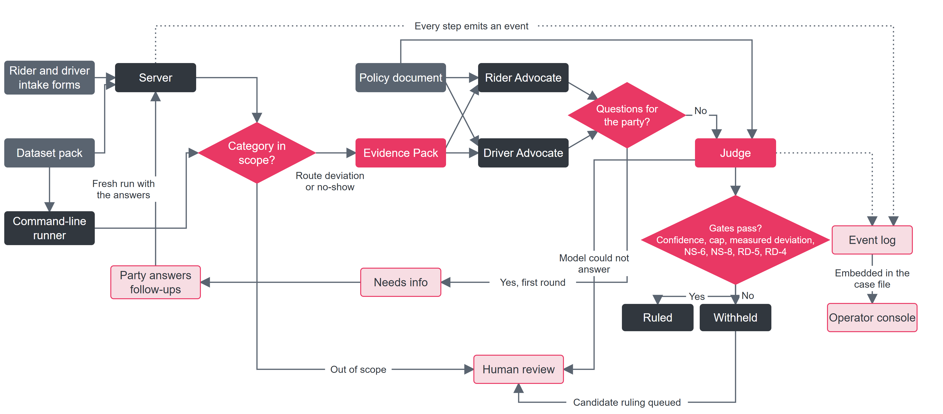
System architecture, as built
Gates pass? Every check must hold, or a person decides.
Confidence Judge's confidence at least 0.65
Cap no automatic decision above SGD 50
Measured deviation a route ruling needs a measured detour and a readable fare
NS-6, NS-8, RD-4, RD-5 are rules in the project policy (docs/policy.md):
NS-6 contested no-show with no GPS proof of the driver: only a full refund of a fee of SGD 10 or less, to a rider with a clean record, is automatic
NS-8 a no-show refund cannot exceed the cancellation fee charged
RD-4 a route refund cannot exceed what the trip records prove was overpaid
RD-5 a route refund cannot be less than a proven overcharge of SGD 1 or more

Slide 2
Agents argue, a Judge rules, code guards the money
Evidence Pack
computed in Python
Rider Advocate
argues the rider
Driver Advocate
argues the driver
Judge
rules + confidence
Gates in code
cap, confidence, NS/RD
Ruled: the party gets a plain-language decision. Withheld: a person decides, and the party sees only “still under review”.
No AI arithmetic
Rules enforced in code
Every step observable
Every number comes from the Evidence Pack. Agents cite fields, never calculate.
SGD 50 cap, 0.65 confidence floor and four money gates. A prompt is a request, code is a guarantee.
A timestamped event strip shows who sent what to whom. One click opens the full payload.

Slide 3
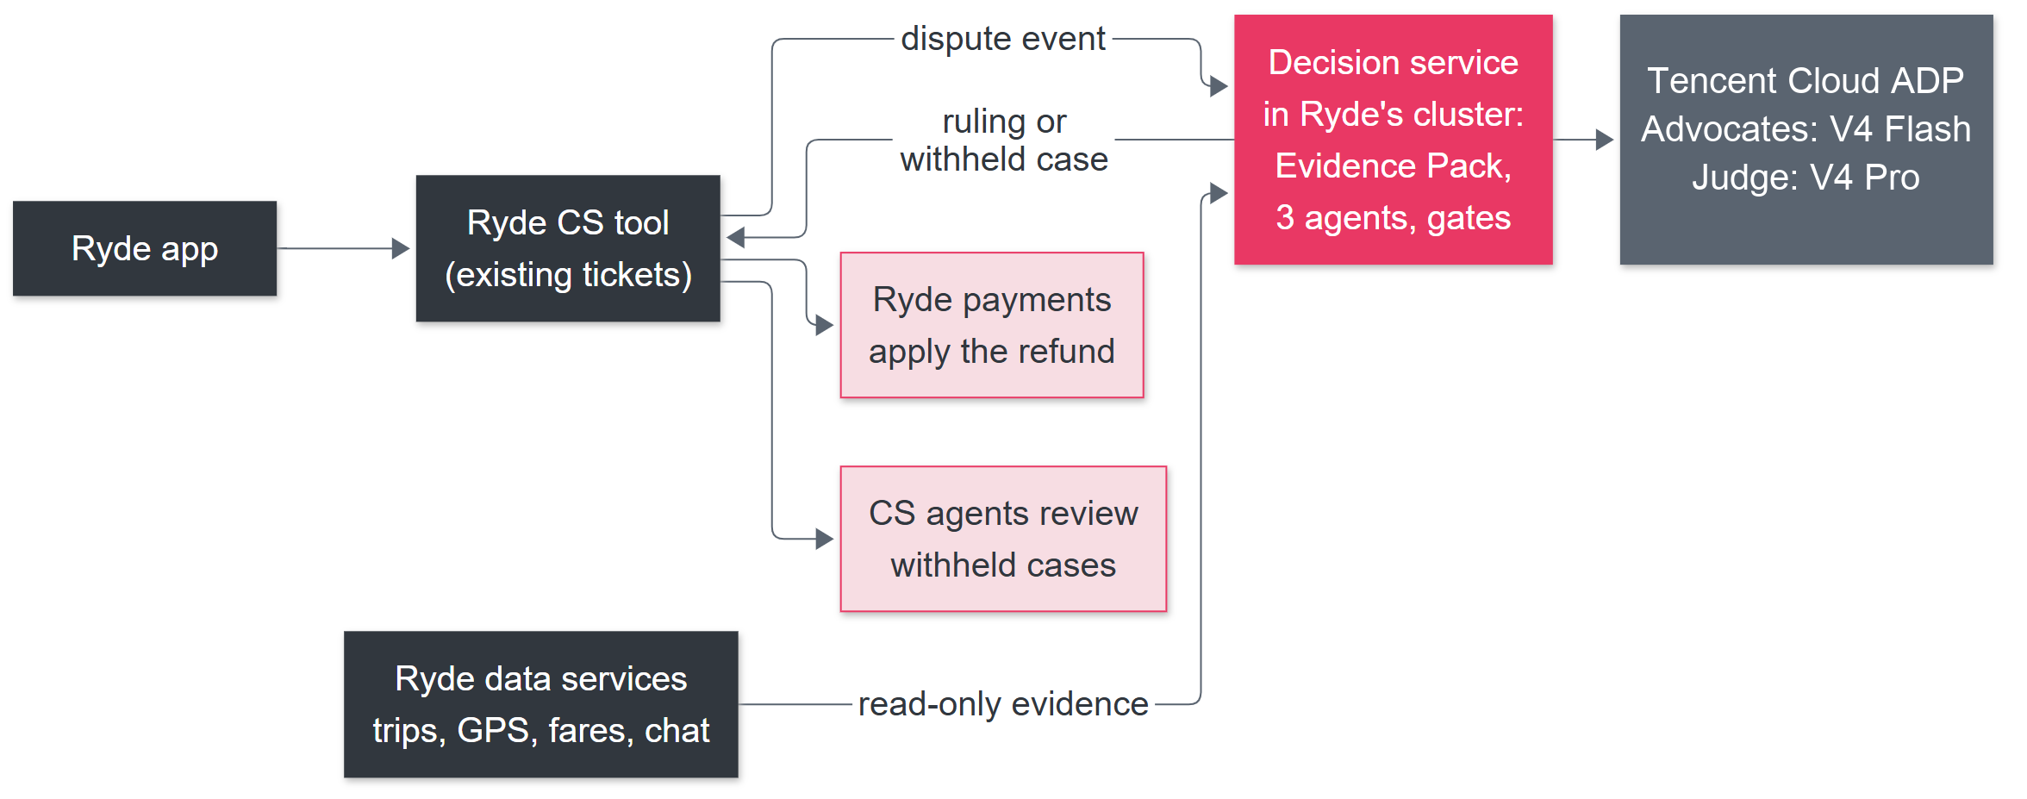
Proposed deployment in Ryde’s system
Ryde keeps the money and the customer: the service only recommends. Rollout: shadow, assist, limited autonomy, expand.
Runs on Ryde’s own infrastructure: only the model calls leave, to Tencent Cloud ADP.

