Slide 1
DIGITAL NATIVE TRACK · RYDE
Multi-Agent Autonomous Dispute Resolution
Three AI agents gather the evidence, argue both sides and rule. Code guards the money.
Tencent Cloud “AI CAN DO IT” Hackathon Singapore 2026
Notes:
0:00-0:40. Name the case study first: Digital Native track, Ryde, Multi-Agent Autonomous Dispute Resolution. One-line pitch: a Rider Advocate and a Driver Advocate build their cases, a Judge rules with a confidence score, and the AI never does the maths and never gets the last word on money.

Slide 2
Disputes are slow, inconsistent and costly
VERIFIED · RYDE 1H 2026 RESULTS
ASSUMPTION · OUR ESTIMATE
S$6.7M
~1,300
revenue in six months, up 17%
route-deviation and no-show disputes a month
S$2.2M
~S$120k
operating loss: every cost line matters
a year of support time, about 2 full-time people
The bigger cost is felt by riders and drivers: 24–72 hours to resolve, and different agents give different answers to similar cases.
Verified: Ryde 1H 2026 results, 8 Oct 2026, unaudited. Ryde publishes no trip or dispute data. Assumed: 15% take rate, S$15 fare, 1% dispute rate, 40% in scope, S$7.50 a dispute.
Notes:
0:40-1:30. Say which numbers are real. Verified from Ryde's published first-half 2026 results: revenue S$6.7M up 17%, operating loss S$2.2M. Everything under the pink ASSUMPTION label is ours, because Ryde publishes no trips, support cost or dispute volumes. Derivation: mobility revenue S$4.5M for six months, about S$9M a year; at an assumed 15% take rate and S$15 fare that is about 4 million trips a year; 1% become disputes, 40% of those are in our two categories, about 1,300 a month. At 12 minutes and S$7.50 each that is about S$120k a year. The human cost is the 24-72 hours and the inconsistency named in the challenge statement.

Slide 3
Agents argue, a Judge rules, code guards the money
Evidence Pack
computed in Python
Rider Advocate
argues the rider
Driver Advocate
argues the driver
Judge
rules + confidence
Gates in code
cap, confidence, NS/RD
Ruled: the party gets a plain-language decision. Withheld: a person decides, and the party sees only “still under review”.
No AI arithmetic
Rules enforced in code
Every step observable
Every number comes from the Evidence Pack. Agents cite fields, never calculate.
SGD 50 cap, 0.65 confidence floor and four money gates. A prompt is a request, code is a guarantee.
A timestamped event strip shows who sent what to whom. One click opens the full payload.
Notes:
1:30-2:10. The idea in one breath. Python computes the evidence first. Two advocates argue, the Judge weighs both and applies the policy by rule ID. Gates written in Python decide whether a ruling is delivered at all: the confidence floor, the SGD 50 cap, an unmeasured deviation, and the no-show and route money rules. Withheld rulings go to a human and the party only sees a neutral message. Then cut to the demo.

Slide 4
LIVE DEMO · ABOUT 2 MIN 40
Demo starts here: 2:10 in the video
1
File it
Rider form → route deviation
2
Watch the agents
Case file + event strip (RD-0109)
3
See the gate hold
SGD 55 refund > SGD 50 cap
4
Human decides
Approve → party status page
5
Clear case, no human
NS-0202 ruled alone: SGD 6.61
Notes:
2:10-4:50 (about 2 min 40). Record the demo on the real Tencent model, or on the replay with its recording date shown on screen. Never present a mock run as a real ruling. Beats: file the dispute (20s); case file and event strip on RD-0109 (50s); the gate holds the SGD 55 refund against the SGD 50 cap and the rider sees only 'still under review' (40s); reviewer approves and the party status page updates (30s); NS-0202 is decided alone, refund SGD 6.61 (20s).

Slide 5
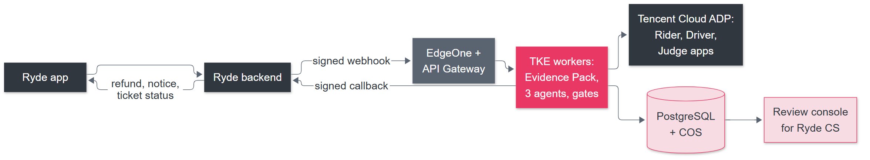
Deploy on Tencent Cloud, plug in with one webhook
Ryde keeps the money: the service recommends, Ryde’s payments execute any refund.
ROLLOUT, EARNED WITH DATA
1 Shadow
2 Assist
3 Limited autonomy
4 Expand
AI rules, customers see nothing
A CS agent accepts or edits
Narrow slices, kill switch
More cases, only on data
Proposal. Product names and Singapore availability to be confirmed with Tencent Cloud. Integration contract: tools/deployment/openapi.json.
Notes:
4:50-5:30. The decision core is unchanged; only storage, transport and identity change. Ryde sends a signed webhook when a dispute is created, our workers read evidence read-only, run the three ADP apps, and send a signed callback. Ryde keeps the money. Rollout starts in shadow mode so customers see nothing while we measure agreement with human decisions.

Slide 6
A lean build: about S$90k once, S$26k a year
S$90k
S$2.2k
8 months
one-off
a month to run
to limited autonomy
2 engineers × 3 months, plus PM, QA and legal review. Covers evidence connectors, payments callback, single sign-on, privacy review.
Cloud infrastructure S$0.5k · model calls S$0.5k (about S$0.38 a case) · a tenth of an engineer S$1.2k. Breakdown on slide 8.
3 build · 2 shadow · 3 assist. We measure before we trust.
Sized for about 1,300 in-scope cases a month, small next to Ryde’s roughly S$10.8M of annualised expenses.
Model rates and some cloud prices verified from Tencent Cloud pages; the rest are estimates (slide 8). Annualised expenses = verified 1H 2026 total expenses S$5.4M × 2.
Notes:
5:30-6:15. Model rates and a few cloud prices are verified from Tencent Cloud's published pages; everything else is an assumption and slide 9 shows which is which. Ryde has an operating loss of S$2.2M, so we sized the deployment lean: about S$90k one-off (two engineers for three months plus review), and about S$2.2k a month to run, which is S$26k a year. Rollout is eight months to limited autonomy. The full breakdown is on the reference slide.

Slide 7
Doing nothing costs about S$400k over three years
S$397k
if nothing changes
S$280k
with our system, build included
Payback by dispute rate (% of trips)
Rate | Payback
0.5% | not in 3 years
1% (base) | month 21
1.5% | month 15
2% | month 13
ASSUMPTIONS: 1% of trips disputed, 40% in scope, S$7.50 each, 10% yearly volume growth, AI decides 60%. Reference: Uber ≈ 1.3 support contacts per 100 trips, all topics (slide 9).
Notes:
6:15-7:00. Start from the do-nothing line: at our base assumptions the in-scope disputes cost about S$400k over three years if handled by hand, growing with Ryde's volume. With our system the same period costs about S$280k: the S$90k build, about S$2.2k a month to run, and the manual work that remains. The lines cross around month 21, the payback, and the gap at month 36 is about S$117k. The dispute rate is the swing factor, and no platform publishes it: the closest reference is Uber, whose total support contacts, all topics, are about 1.3 per 100 trips, so 1% disputed is already generous and the rate that breaks even over three years is about 0.6%. Shadow mode measures Ryde's real rate before anything is switched on. Faster answers, one standard and fewer lost riders are not priced.

Slide 8
Reference: running-cost breakdown
Infrastructure (Singapore) | US$/mo | Basis
EdgeOne Basic plan | 57 | Verified
TKE managed-cluster fee (L5) | 15 | Verified
2 worker nodes, 2 vCPU / 4 GB | 120 | Estimate
PostgreSQL, 2 vCPU / 4 GB, HA | 150 | Estimate
Load balancer | 20 | Estimate
API Gateway | 5 | Estimate
COS, logs, SSM/KMS | 20 | Estimate
Total | 387 | ≈ S$500
Model (ADP) | Usage/mo | + $50 plan
DeepSeek-V3.1 (base) | $342 | $392
DeepSeek-V4-Pro | $132 | $182
DeepSeek-V4-Flash | $11 | $61
GPT-5.5 | $473 | $523
About S$2.2k a month
Model S$507 + infrastructure S$500 + 0.1 engineer S$1,200. Range S$1.8k (V4-Flash) to S$2.4k (GPT-5.5).
Tokens per case: about 50k in, 3.5k out (our estimate: 33 KB policy in every call, 3 calls a run, ~30% re-run). 1,333 cases a month. S$1 = US$0.7727.
Verified = Tencent Cloud published prices (ADP, EdgeOne, TKE); Estimate = no Singapore price retrieved, confirm in the pricing calculator. Model rates per 1k tokens.
Notes:
Reference slide, not shown in the video timeline: keep for Q&A. Verified lines come from Tencent Cloud's published ADP, EdgeOne and TKE pages. Estimates are placeholders until exact Singapore prices are pulled from the pricing calculator: CVM, TencentDB for PostgreSQL, load balancer, API Gateway tiers and storage/logging. Token usage per case is our estimate because the repo does not record real usage; the model actually used by the three ADP apps should be confirmed. The 0.1 engineer (S$1,200) is the largest line and is an assumption.

Slide 9
Reference: dispute-rate sensitivity and benchmarks
Disputes, % of trips | Growth 0% | Growth 10% | Growth 17%
0.25% | −102k · none | −94k · none | −89k · none
0.5% | −39k · none | −24k · none | −13k · none
1% | +86k · m22 | +117k · m21 | +140k · m20
1.5% | +211k · m16 | +258k · m15 | +292k · m15
2% | +337k · m13 | +399k · m13 | +445k · m13
REFERENCE POINTS
Grab: publishes no dispute or contact rate.
Uber: about 1.3 support contacts per 100 trips, all topics (3M tickets a week ÷ about 288M trips a week). Disputes are a subset.
Ryde (verified): revenue +17%, mobility +8%.
Cells: 3-year net saving in S$k (build included) · payback month. Break-even rate over 3 years: about 0.66% of trips at flat volume, 0.59% at 10% growth.
Sources: Uber engineering blog (Feb 2024); Uber FY2025 10-K (Q4 trips 3,751M); Ryde 1H 2026 results. The Uber figure is derived from figures two years apart: a rough indicator only.
Notes:
Reference slide, not shown in the video timeline: keep for Q&A. No platform publishes its dispute rate; Grab does not, and the closest public reference is Uber's total support-contact rate of about 1.3 per 100 trips across all topics, derived from its engineering blog and 10-K. Disputes are a subset of contacts, so the 1% base is generous, and the table shows what happens at lower and higher rates and at different volume growth. Shadow mode replaces all of this with Ryde's measured rate.

Slide 10
Reference: how it plugs into Ryde
Ryde does | The service does
Sends dispute.created with trip id, category, claim | Reads evidence read-only, builds the Evidence Pack, runs the agents
Shows status in its own ticket screen | Returns ruling.issued, ruling.withheld, needs_info or human_review
Applies the refund (wallet or original method), idempotently | Never moves money, never talks to the rider’s app
Opens the case file inside its CS tool, behind SSO | Records every reviewer decision and who made it
Trip and category are pre-filled from the rider’s session: no one picks a trip by hand.
The party view stays a five-key allowlist: no confidence, no model text.
Callbacks are signed and at-least-once; every write carries an idempotency key.
Contract: tools/deployment/openapi.json (proposal, not a deployed API).
Notes:
Reference slide, not shown in the video timeline: keep for Q&A. The rider never leaves the Ryde app. They see 'Report a problem with this trip', and the outcome shows up as a ticket status. The same fail-closed party view we show today is what the callback carries. Ryde keeps the money: the service only recommends, and Ryde's payments apply any refund, keyed by the dispute id.

Slide 11
Reference: controls and honest limits
CONTROLS FROM DAY ONE
HONEST LIMITS
SGD 50 cap and 0.65 confidence floor, enforced in code
Kill switch that withholds every ruling
PII redaction before any model call
Singapore data residency, retention and a delete job
Every reviewer decision logged with who made it
Policy is synthesised: Ryde ops, legal and finance adopt it before autonomy
17 labelled cases show consistency, not real-world accuracy
No platform publishes its dispute rate; ours is an assumption until shadow mode
Needs a paid ADP plan; capacity is about model calls per minute ÷ 4
Some cloud prices are estimates (slide 8)
Notes:
Reference slide, not shown in the video timeline: keep for Q&A. Earn autonomy with data, not claims. Shadow mode is the first deliverable: it produces the first real accuracy number and the human-override data without risking a customer. Say the limits out loud: the policy is ours, 17 cases show consistency not accuracy, and the dispute rate and some prices are assumptions.

Slide 12
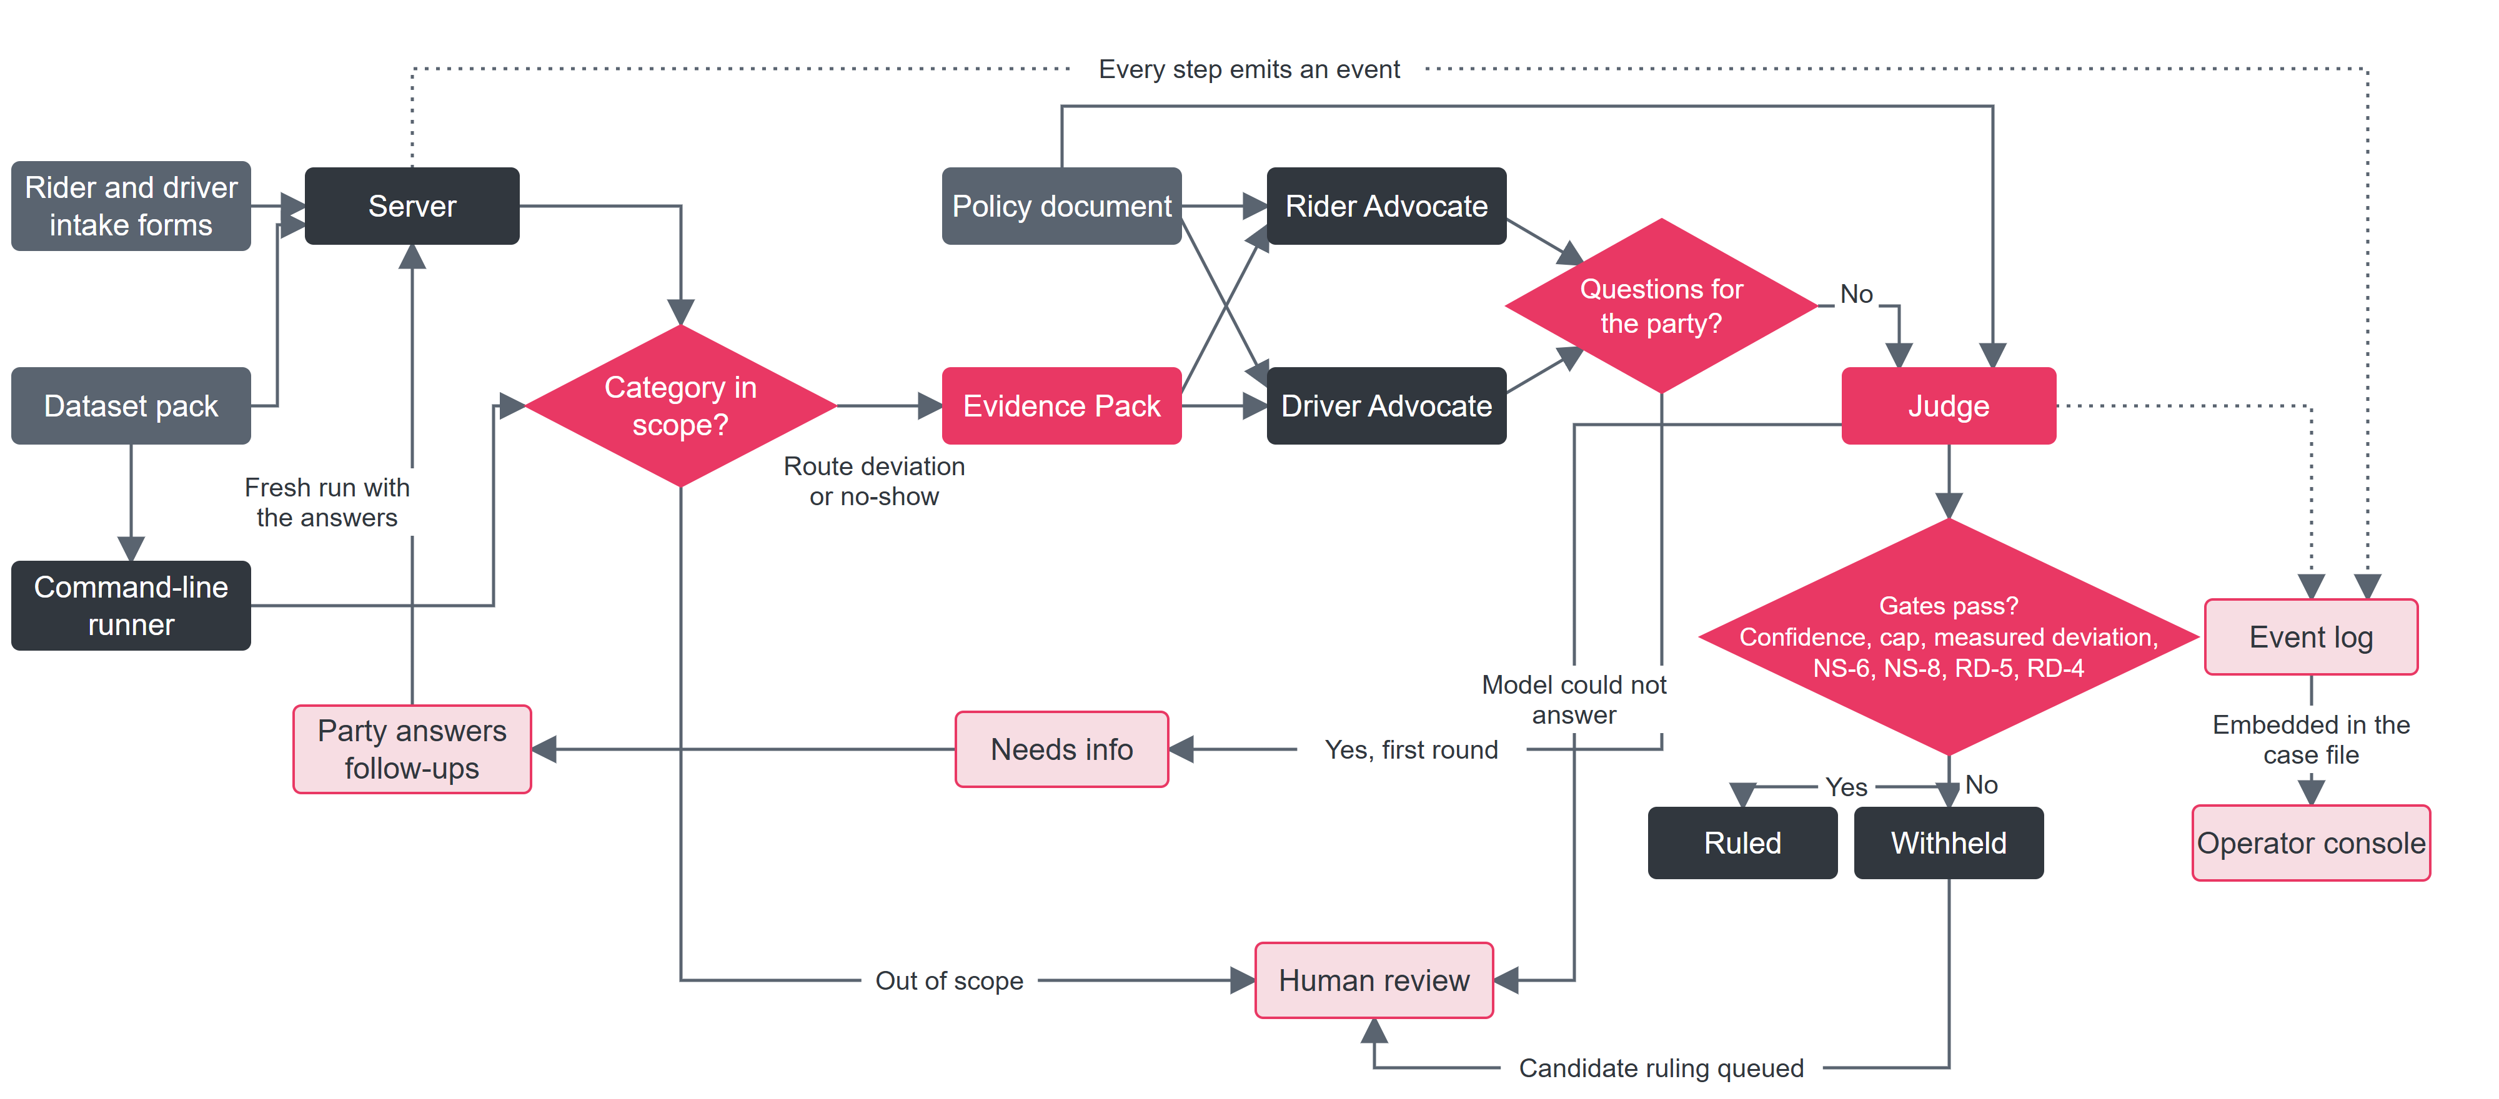
Reference: system architecture
Notes:
Reference slide, not shown in the video timeline: keep for Q&A. This is the diagram from docs/architecture.md, re-laid out to fit a slide with the same nodes and edges. Walk it left to right: a dispute enters through the intake forms or the command-line runner; a category check sends anything outside route deviation and no-show to human review before any agent runs; the Evidence Pack is computed in Python; the two advocates argue with the policy; if they need more, the party is asked once and the run restarts with the answers; the Judge rules; the gates decide whether the ruling is delivered or withheld for a human; every step lands in the event log that the operator console shows.

