Slide 1
Coordinate Transformations
LLA, ECEF, LTP, Camera Coordinate and Image Coordinate

Slide 2
World Geodetic System
A unified geodetic system for the whole world. It describes earth as a spheroidal model.
The latest revision is WGS 84 (aka WGS 1984, EPSG:4326), established by US Department of Defense in 1984 and last revised in 2004, now being used in Global Positioning System (GPS).
WGS defines several earth parameters: polar radius, equatorial radius, mass of earth, gravitational constant, rotation rate, etc..
In this system, we use latitude, longitude and altitude to locating.
Notes:
A unified geodetic system for the whole world became essential in the 1950s for several reasons:
International space science and the beginning of astronautics.
The lack of inter-continental geodetic information.
The inability of the large geodetic systems, such as European Datum (ED50), North American Datum (NAD), and Tokyo Datum (TD), to provide a worldwide geo-data basis
Need for global maps for navigation, aviation, and geography.
Western Cold War preparedness necessitated a standardized, NATO-wide geospatial reference system, in accordance with the NATO Standardization Agreement

Slide 3
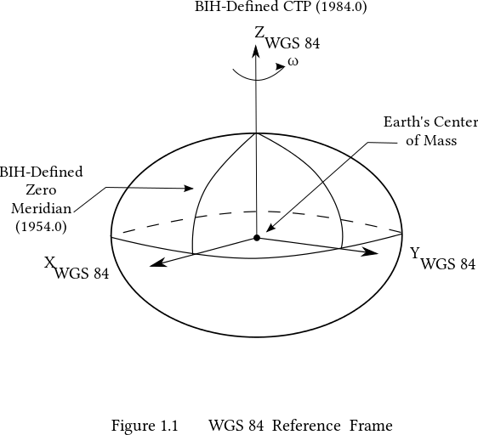
World Geodetic System – Earth Model
Polar Radius = 6356752.3142 m
Equatorial Radius = 6378137 m
Image@wiki

Slide 4
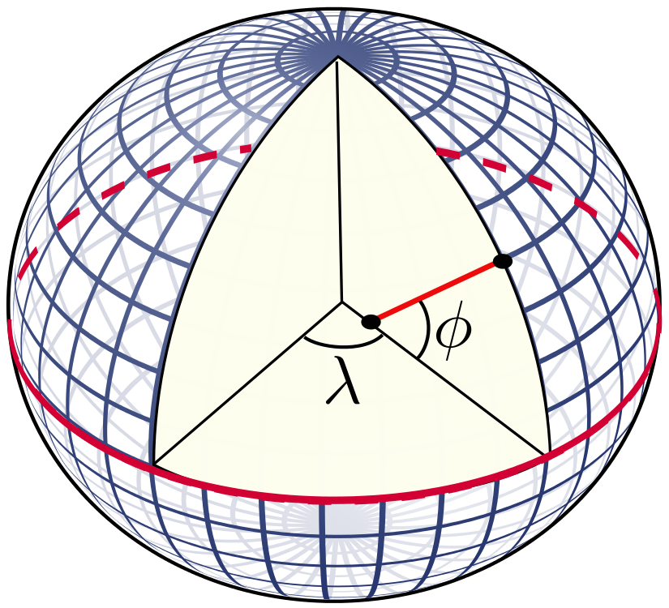
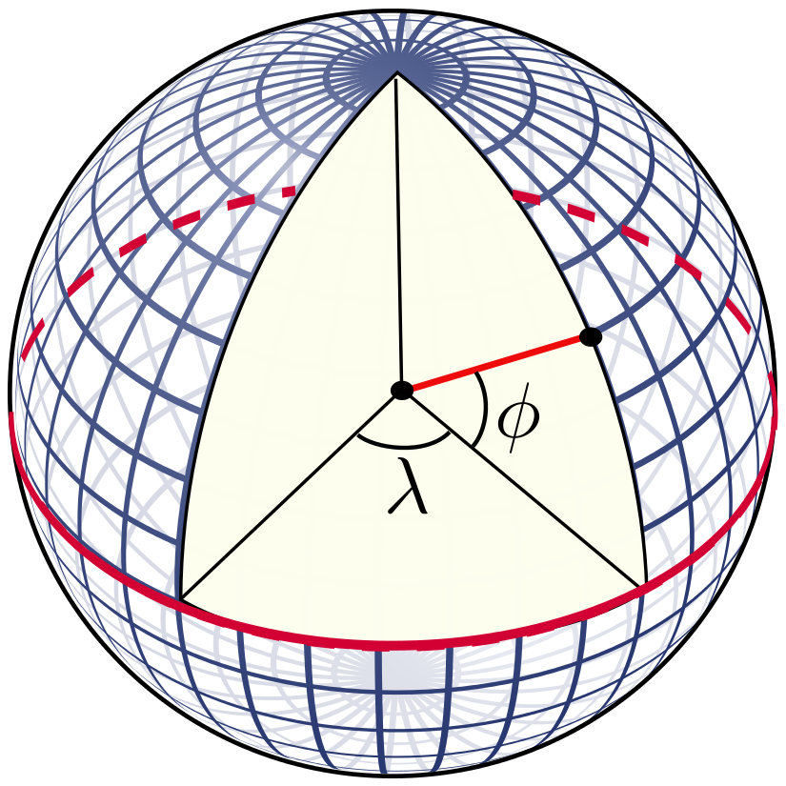
World Geodetic System – Latitude and Longitude
λ = longitude
Φ = geodetic latitude
Φ = geocentric latitude →
The flattening of earth
~= 1/298

Slide 5
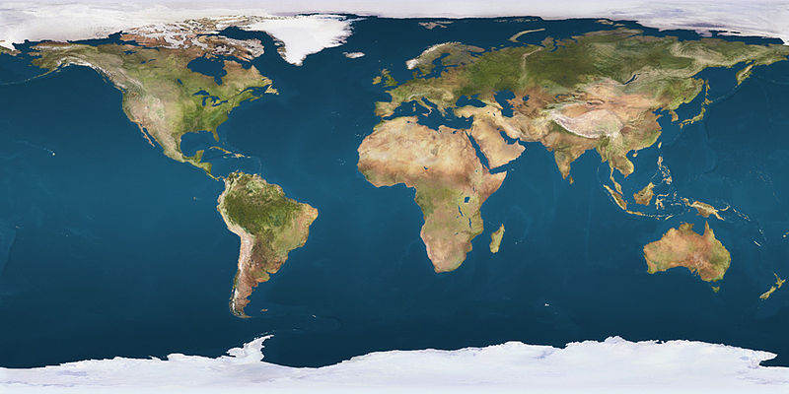
World Geodetic System – Latitude and Longitude
Latitude +90
Equator
Longitude -180
Prime Meridian

Slide 6
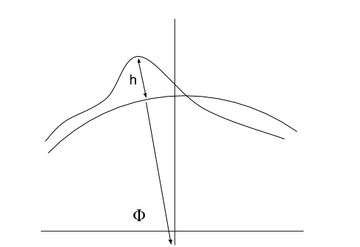
World Geodetic System –Altitude
Altitude
Earth Spheroidal Surface
Terrain Surface
Geodetic Latitude

Slide 7
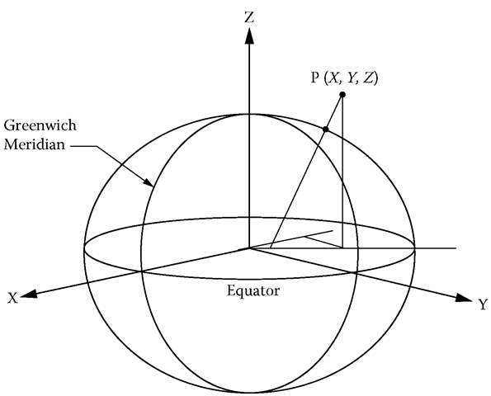
Earth-Centered, Earth-Fixed (ECEF)
A unified geodetic Cartesian coordinate system.
Intermediate step in converting velocities from WGS coordinate to the local tangent coordinate system.
Its "z-axis" is aligned parallel to the direction of the Conventional Terrestrial Pole (CTP).
Its "x-axis" is the intersection of the WGS84 Reference Meridian Plane and the plane of the CTP Equator.

Slide 8
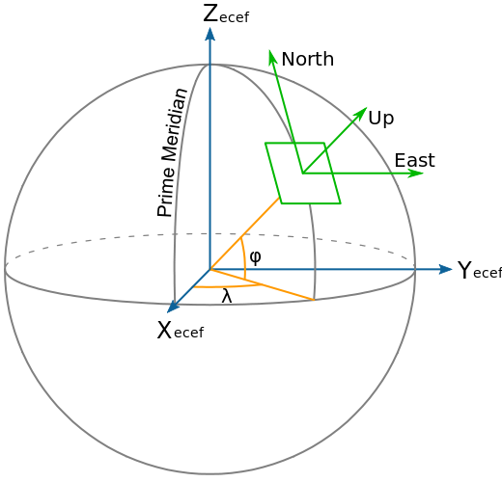
Local Tangent Plane (LTP)
A local Cartesian coordinate system with a given origin.
Also called North East Down (NED), North East Up (NEU), Up North East (UNE), etc..
Intermediate step in converting velocities from WGS coordinate to the camera coordinate system.

Slide 9
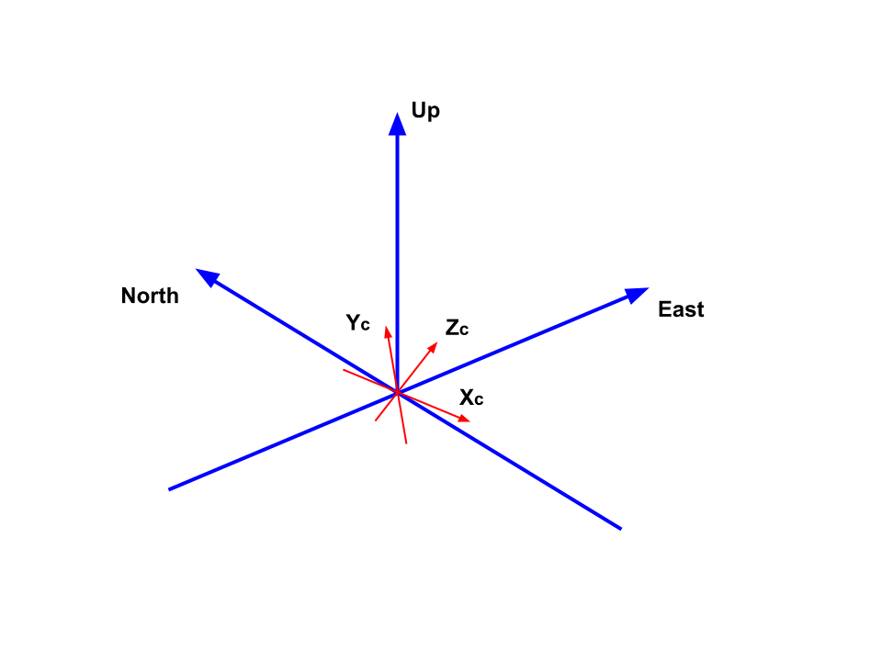
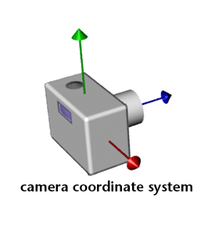
Camera Coordinate
A local Cartesian coordinate system, origin is camera center.
Intermediate step in converting velocities from WGS coordinate to the image coordinate system.

Slide 10
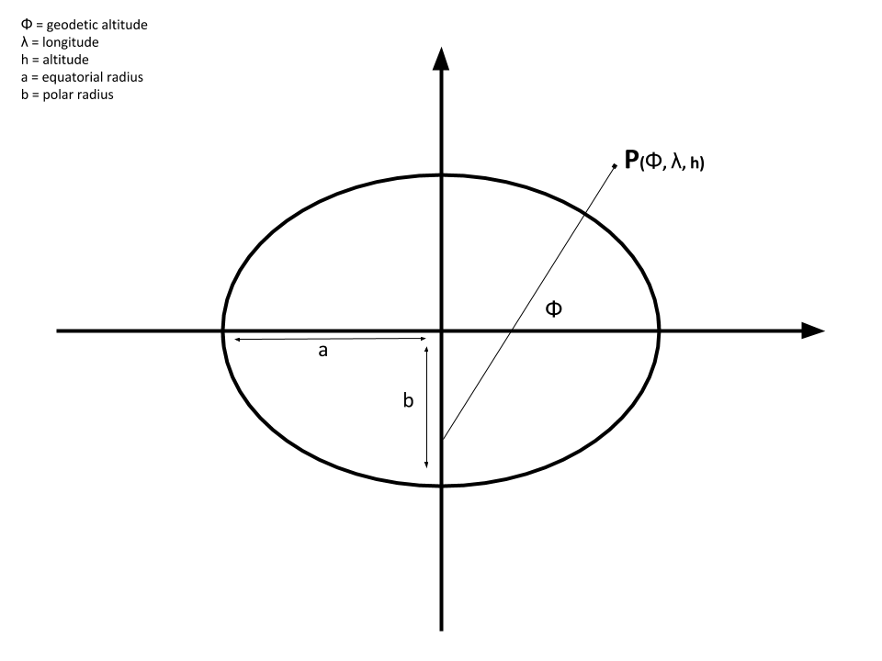
Coordinate Transformations
LLA → ECEF → ENU → Camera Coordinate → Image Coordinate

Slide 11
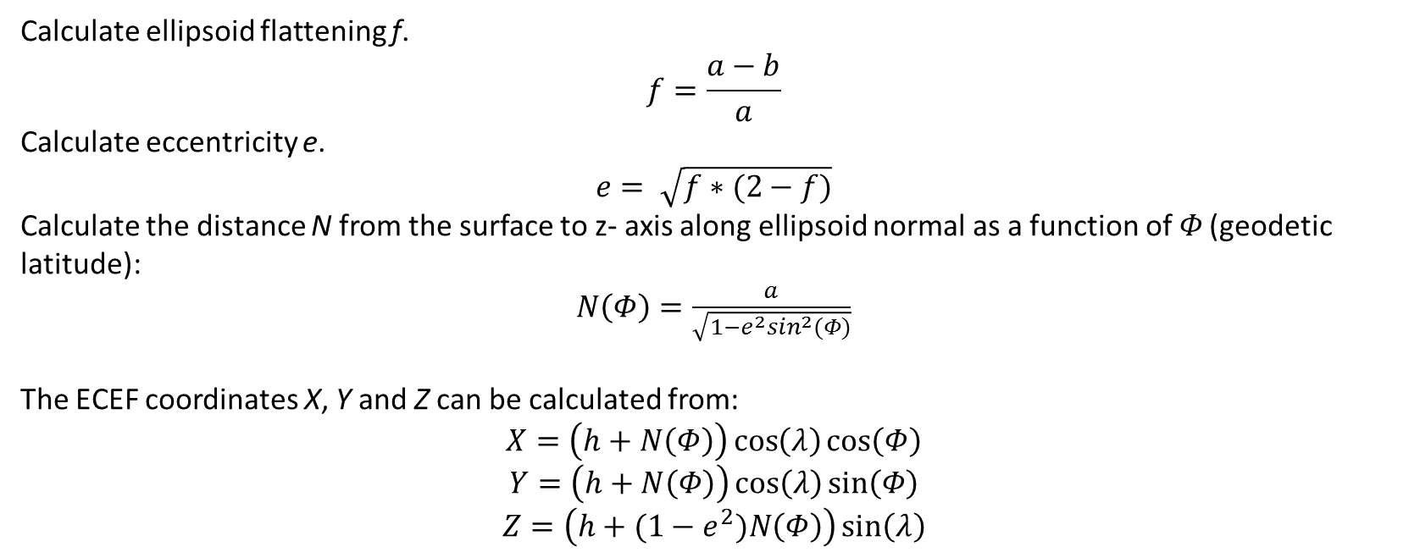
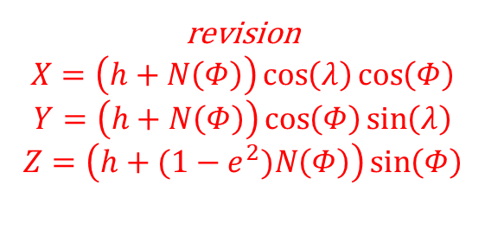
Coordinate Transformations: LLA → ECEF
Calculate ellipsoid flattening f.
$$f=\frac{a−b}{a}$$
Calculate eccentricity e.
$$e= \sqrt{f∗(2−f)}$$
Calculate the distance N from the surface to z- axis along ellipsoid normal as a function of 𝛷 (geodetic latitude):
$N\left(Φ\right)=\frac{a}{\sqrt{1−e^{2}\sin^{2}(Φ)}}$
The ECEF coordinates X, Y and Z can be calculated from:
$$X=\left(h+N\left(Φ\right)\right)\cos\left(λ\right)\cos\left(Φ\right)$$
$$Y=\left(h+N\left(Φ\right)\right)\cos\left(λ\right)\sin\left(Φ\right)$$
$$Z=\left(h+(1−e^{2})N\left(Φ\right)\right)\sin\left(λ\right)$$
revision
$$X=\left(h+N\left(Φ\right)\right)\cos\left(λ\right)\cos\left(Φ\right)$$
$$Y=\left(h+N\left(Φ\right)\right)\cos\left(Φ\right)\sin\left(λ\right)$$
$$Z=\left(h+(1−e^{2})N\left(Φ\right)\right)\sin\left(Φ\right)$$

Slide 12
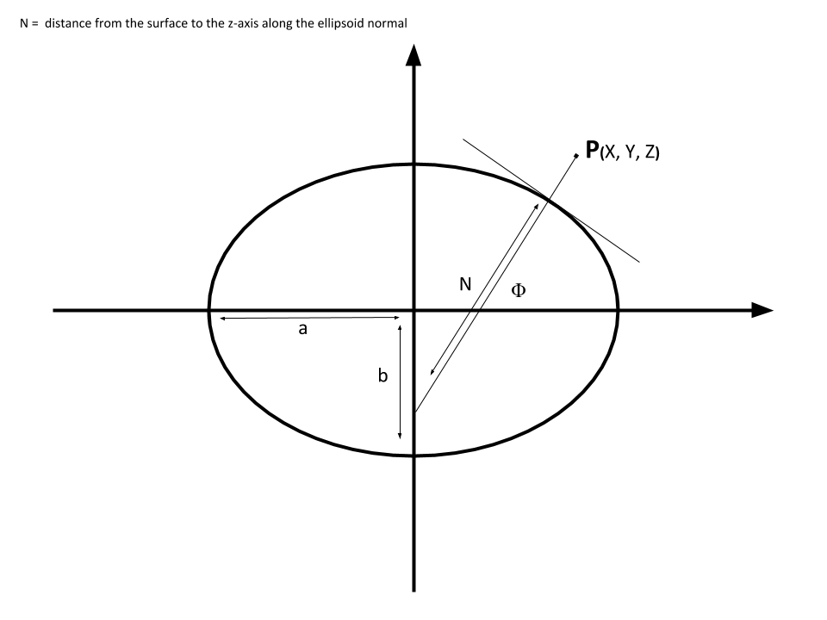
Coordinate Transformations: LLA → ECEF

Slide 13
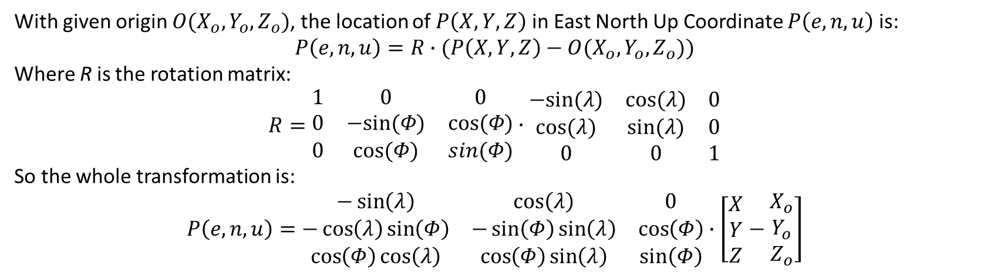
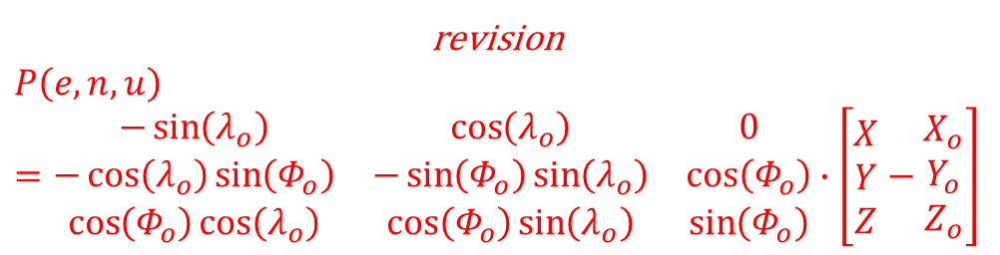
Coordinate Transformations: ECEF → ENU
With given origin $O(X_{o},Y_{o},Z_{o})$, the location of $P\left(X,Y,Z\right)$ in East North Up Coordinate $P\left(e,n,u\right)$ is:
$$P\left(e,n,u\right)=R∙(P\left(X,Y,Z\right)−O(X_{o},Y_{o},Z_{o}))$$
Where R is the rotation matrix:
$$R=\begin{matrix}1 & 0 & 0 \\ 0 & −sin⁡(Φ) & cos⁡(Φ) \\ 0 & cos⁡(Φ) & sin(Φ)\end{matrix}∙\begin{matrix}−sin⁡(λ) & cos⁡(λ) & 0 \\ cos⁡(λ) & sin⁡(λ) & 0 \\ 0 & 0 & 1\end{matrix}$$
So the whole transformation is:
$$P\left(e,n,u\right)=\begin{matrix}−\sin\left(λ\right) & \cos\left(λ\right) & 0 \\ −\cos\left(λ\right)\sin\left(Φ\right) & −\sin\left(Φ\right)\sin\left(λ\right) & \cos\left(Φ\right) \\ \cos\left(Φ\right)cos\left(λ\right) & \cos\left(Φ\right)\sin\left(λ\right) & \sin\left(Φ\right)\end{matrix}∙\left[\begin{matrix}X \\ Y \\ Z\end{matrix}−\begin{matrix}X_{o} \\ Y_{o} \\ Z_{o}\end{matrix}\right]$$
revision
$$P\left(e,n,u\right)=\begin{matrix}−\sin\left(λ_{o}\right) & \cos\left(λ_{o}\right) & 0 \\ −\cos\left(λ_{o}\right)\sin\left(Φ_{o}\right) & −\sin\left(Φ_{o}\right)\sin\left(λ_{o}\right) & \cos\left(Φ_{o}\right) \\ \cos\left(Φ_{o}\right)cos\left(λ_{o}\right) & \cos\left(Φ_{o}\right)\sin\left(λ_{o}\right) & \sin\left(Φ_{o}\right)\end{matrix}∙\left[\begin{matrix}X \\ Y \\ Z\end{matrix}−\begin{matrix}X_{o} \\ Y_{o} \\ Z_{o}\end{matrix}\right]$$

Slide 14
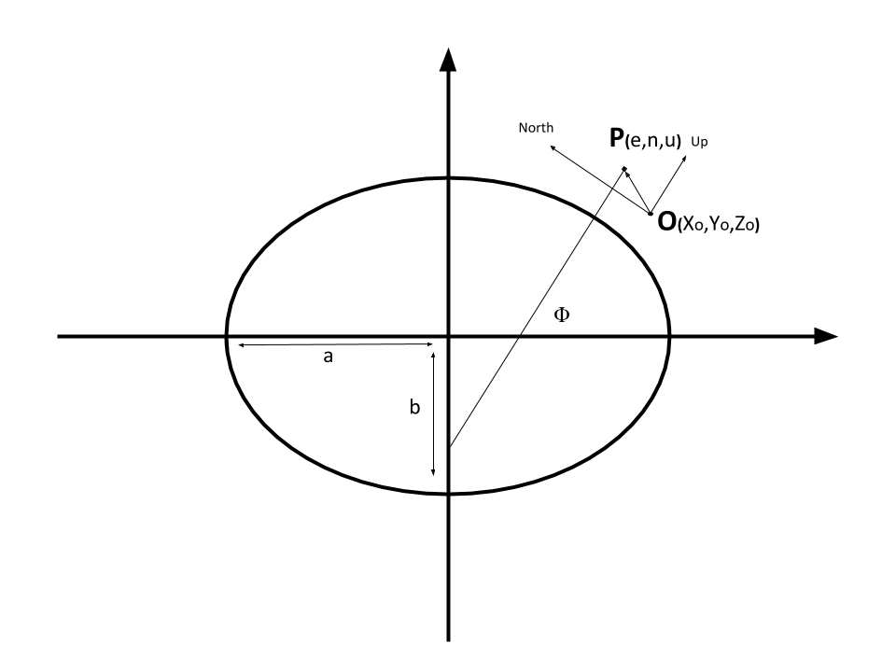
Coordinate Transformations: ECEF → ENU

Slide 15
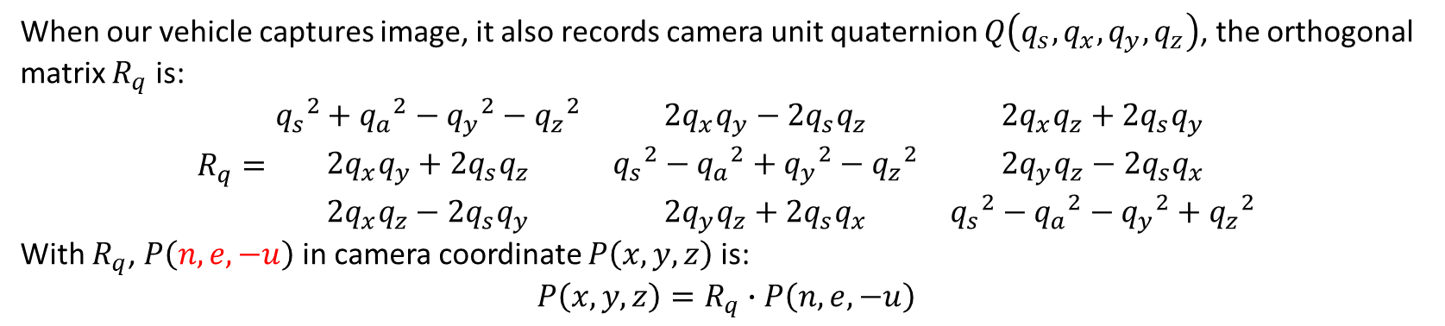
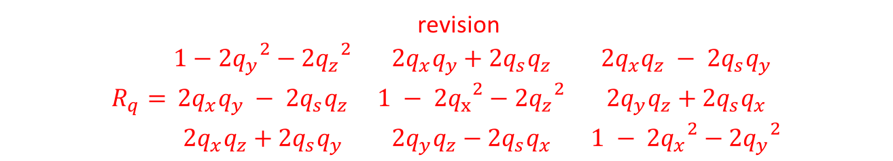
Coordinate Transformations: ENU → Camera Coordinate
When our vehicle captures image, it also records camera unit quaternion $Q\left(q_{s},q_{x},q_{y},q_{z}\right)$, the orthogonal matrix $R_{q}$ is:
$R_{q}=\begin{matrix}{q_{s}}^{2}+{q_{a}}^{2}−{q_{y}}^{2}−{q_{z}}^{2} & 2q_{x}q_{y}−2q_{s}q_{z} & 2q_{x}q_{z}+2q_{s}q_{y} \\ 2q_{x}q_{y}+2q_{s}q_{z} & {q_{s}}^{2}−{q_{a}}^{2}+{q_{y}}^{2}−{q_{z}}^{2} & 2q_{y}q_{z}−2q_{s}q_{x} \\ 2q_{x}q_{z}−2q_{s}q_{y} & 2q_{y}q_{z}+2q_{s}q_{x} & {q_{s}}^{2}−{q_{a}}^{2}−{q_{y}}^{2}+{q_{z}}^{2}\end{matrix}$
With $R_{q}$, $P\left(n,e,−u\right)$ in camera coordinate $P\left(x,y,z\right)$ is:
$$P\left(x,y,z\right)=R_{q}∙P\left(n,e,−u\right)$$
revision
$$R_{q}=\begin{matrix}1−{2q_{y}}^{2}−{2q_{z}}^{2} & 2q_{x}q_{y}+2q_{s}q_{z} & 2q_{x}q_{z} − 2q_{s}q_{y} \\ 2q_{x}q_{y} − 2q_{s}q_{z} & 1 − {{2q}_{x}}^{2}−{{2q}_{z}}^{2} & 2q_{y}q_{z}+2q_{s}q_{x} \\ 2q_{x}q_{z}+2q_{s}q_{y} & 2q_{y}q_{z}−2q_{s}q_{x} & 1 − {{2q}_{x}}^{2}−{{2q}_{y}}^{2}\end{matrix}$$

Slide 16
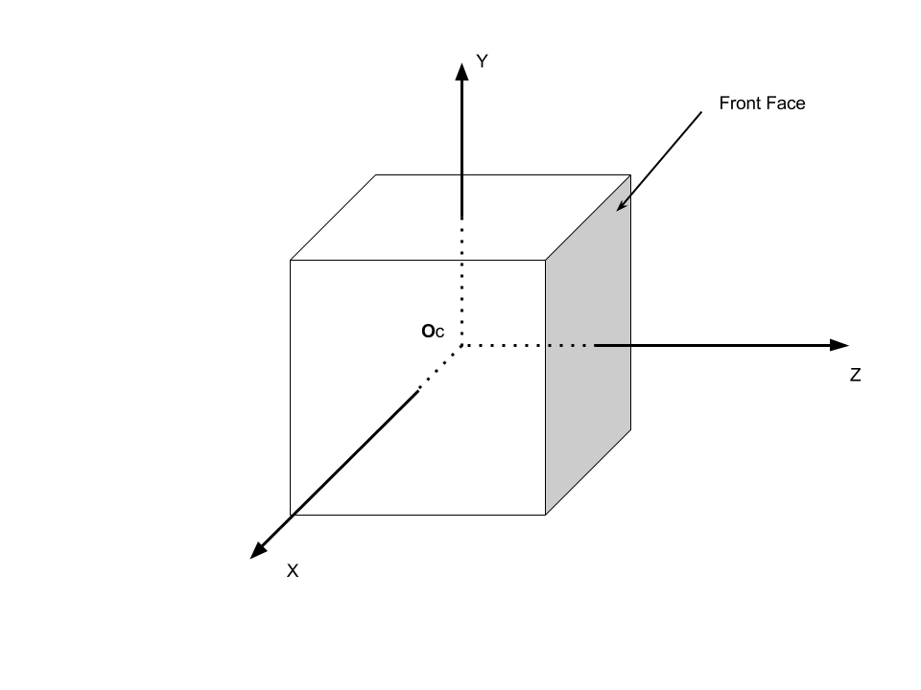
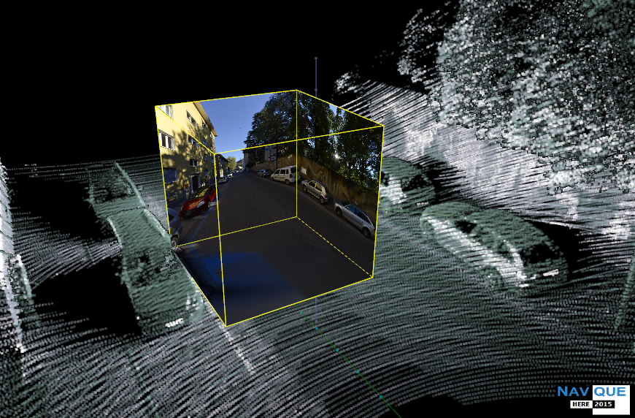
Coordinate Transformations: Camera Coordinate → Image Coordinate
We use “cube” system to present 6 images around camera. In this cube, each face image has field of view (FOV) of 90 degrees and aspect ratio equals 1.
Revision: Y axis here is heading towards ground, it should be a right hand system

Slide 17
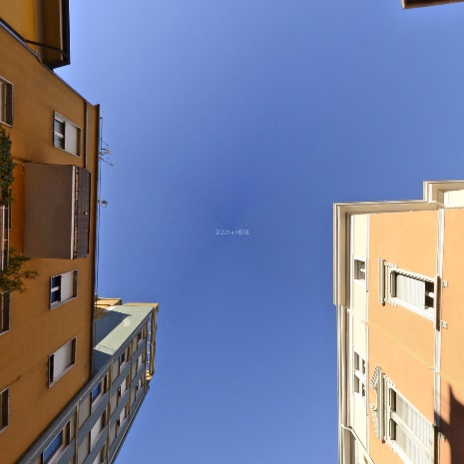
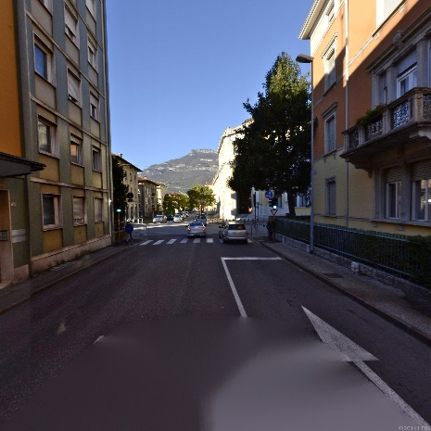
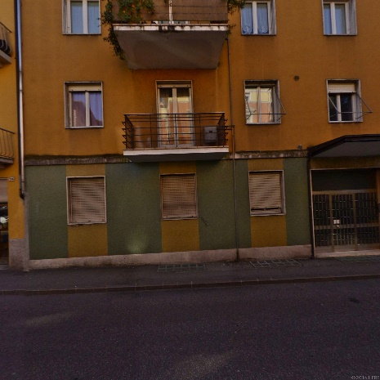
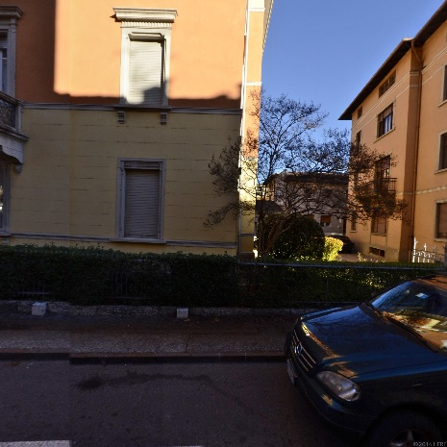
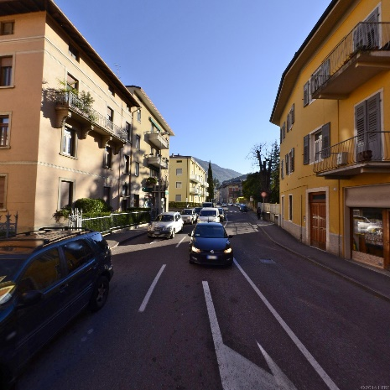
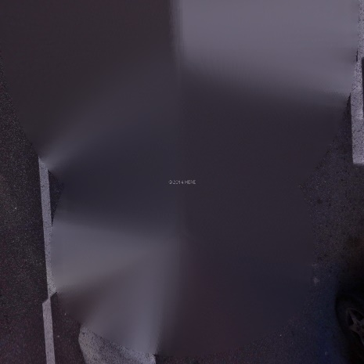
Coordinate Transformations: Camera Coordinate → Image Coordinate
Top
Front
Left
Right
Back
Bottom

Slide 18
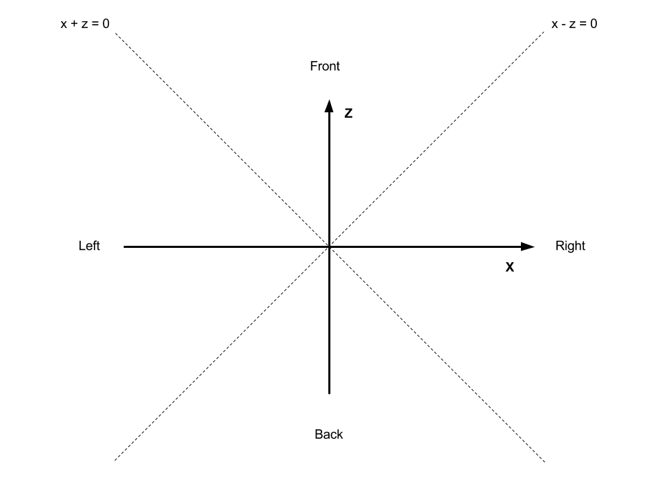
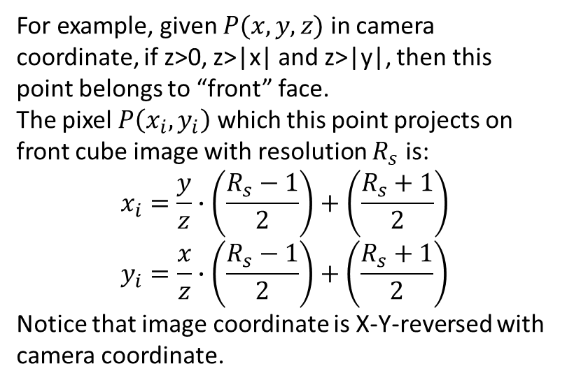
Coordinate Transformations: Camera Coordinate → Image Coordinate
For example, given $P(x,y,z)$ in camera coordinate, if z>0, z>|x| and z>|y|, then this point belongs to “front” face.
The pixel $P\left(x_{i},y_{i}\right)$ which this point projects on front cube image with resolution $R_{s}$ is:
$$x_{i}=\frac{y}{z}∙\left(\frac{R_{s}−1}{2}\right)+\left(\frac{R_{s}+1}{2}\right)$$
$$y_{i}=\frac{x}{z}∙\left(\frac{R_{s}−1}{2}\right)+\left(\frac{R_{s}+1}{2}\right)$$
Notice that image coordinate is X-Y-reversed with camera coordinate.

Slide 19
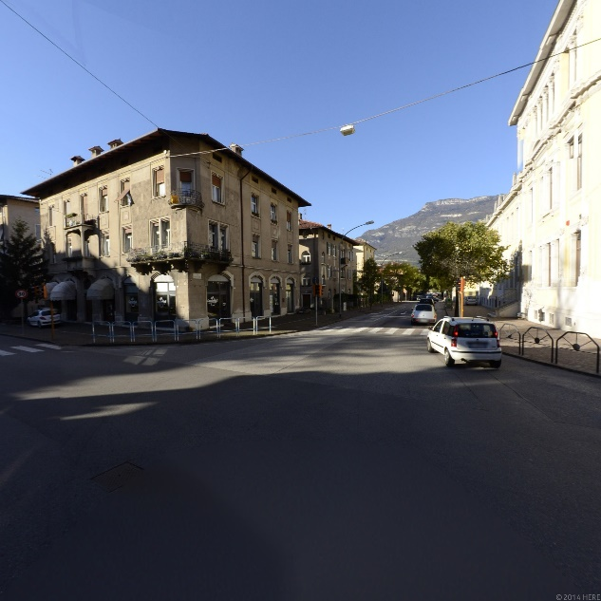
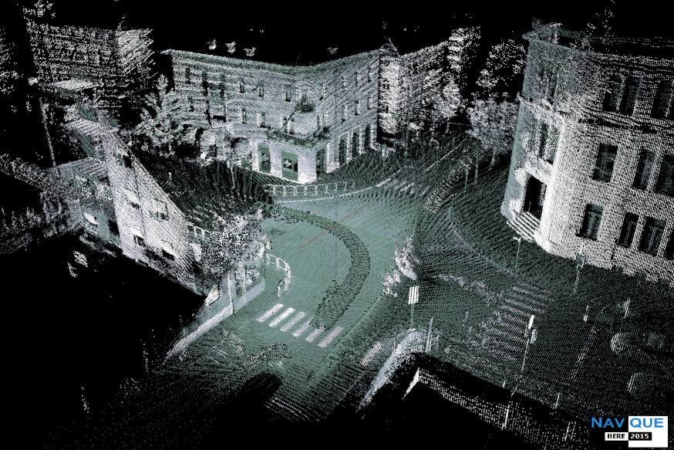
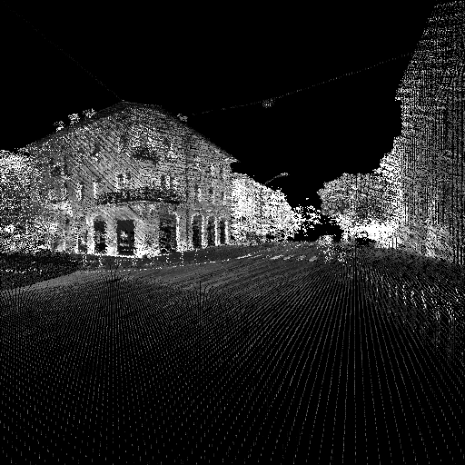
Project: coordinate transformations
With given point cloud and camera parameters, return the front view of point cloud intensity projection.
Point cloud sample:
45.887308 11.040492 245.240114 40
latitude longitude altitude intensity
Camera parameters:
45.887269, 11.040389, 247.614169, -0.696910, -0.675713, 0.172945, 0.166786
latitude longitude altitude camera quaternion

