Slide 1

Hermod
Sprint 3 Demo
github.com/hermodapp
hermodapp.com
Russell Weas, Jonathan Pence, Do Thien An Duong, Simon Jeon

Slide 2
Project Focus
hermodapp.com
What is Hermod?
Instant and seamless customer interaction.
Features include:
Automated customer interaction through QR codes.
Ability to create, customize, and serve forms to get detailed customer feedback.
Streamlines business operations by tying specific QR codes to various business locations/processes.
Configurable scan behavior.
Notes:
an

Slide 3
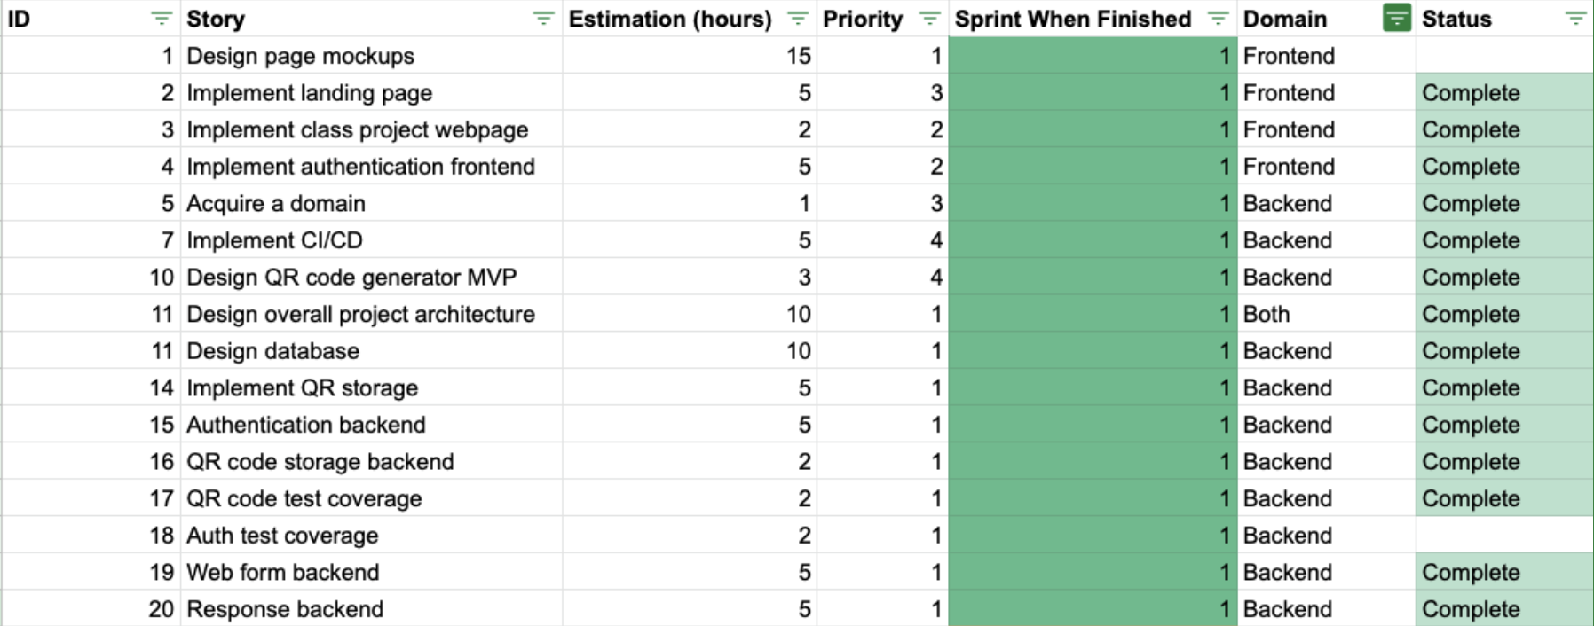
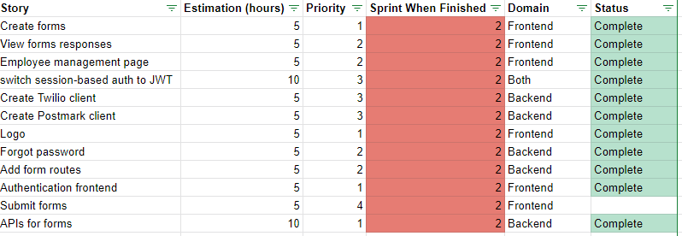
Backlog Comparison
hermodapp.com
Sprint 1
Sprint 2
Notes:
sprint 1 setup a strong base & basic functionality - sprint 2 expanded on that: setup backend integration with third-party API’s, CRUD api nearly complete for every foreseen route, significant progress on frontend progress

Slide 4
Backlog Comparison cont.

Slide 5
Project Contributions / Reflections
hermodapp.com

Slide 6
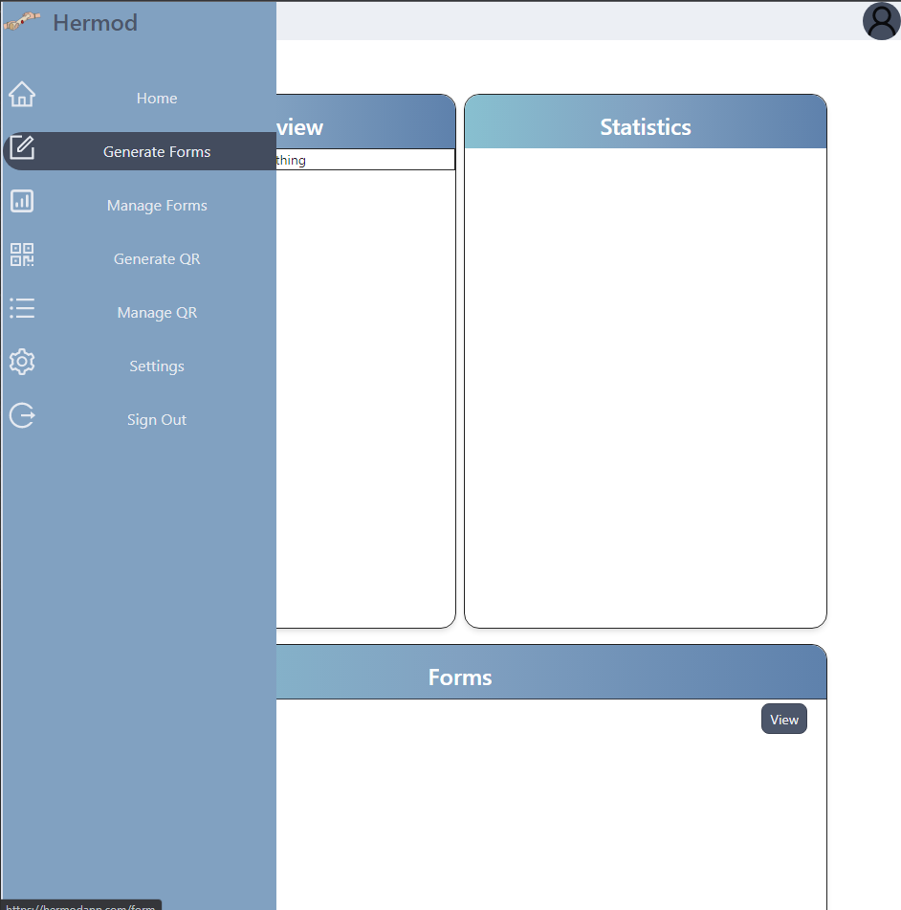
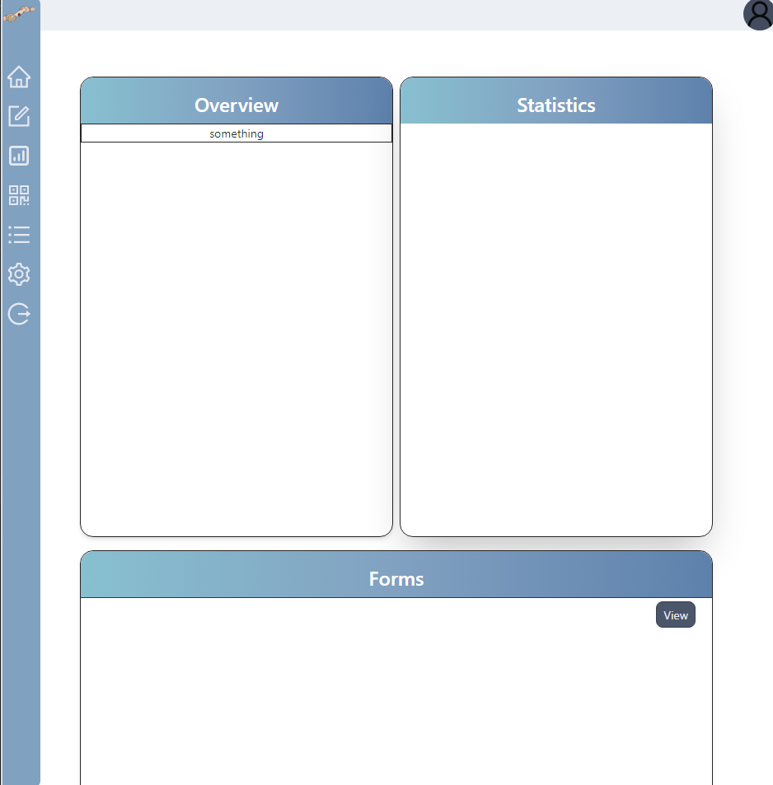
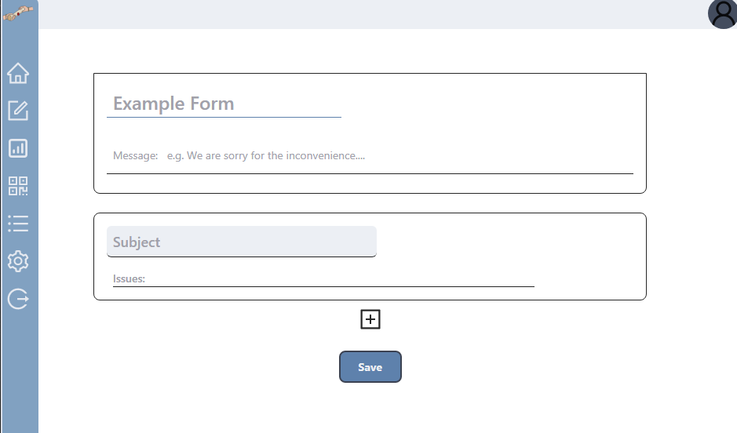
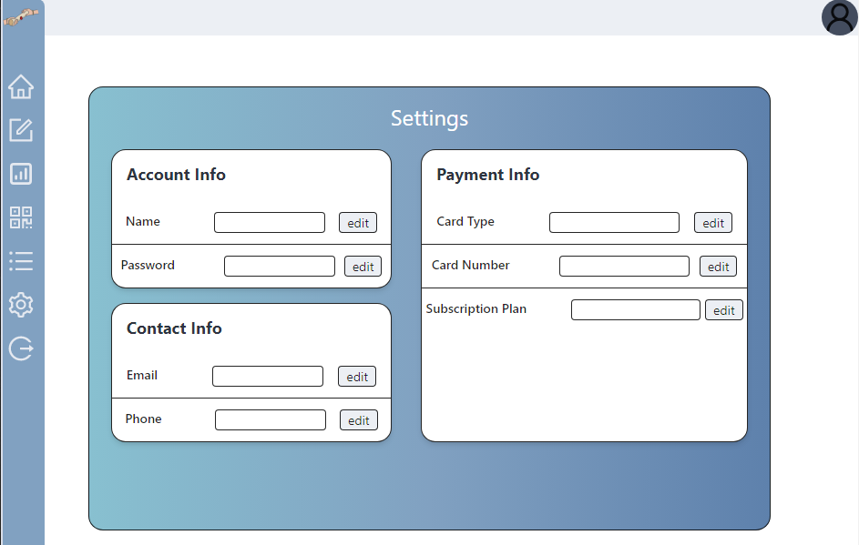
Contributions - Simon
Frontend
hermodapp.com
Integrated Frontend and Backend when submitting forms
Pair programming:
Implementing use of API to POST/GET form data
Implement submit form functionality
Implement retry attempts using axios
Implement manage form and generate form functionality
Implement manage qr and generate qr functionality
Reflections: pair programming have its advantages (i.e. when two programmers are trying to work together to figure out an issue and implement exactly what the group wants without the two programmers’ code conflicting each other) but it definitely delayed our plans in reaching our designated time goals.

Slide 7
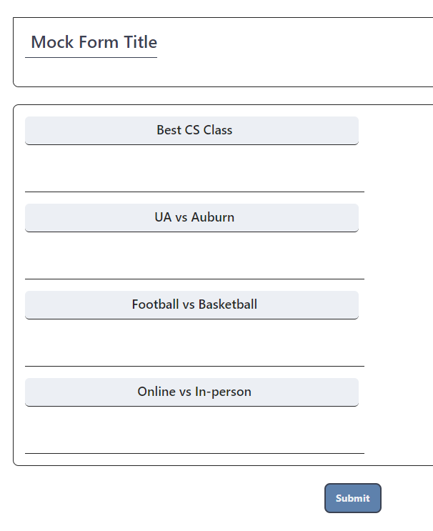
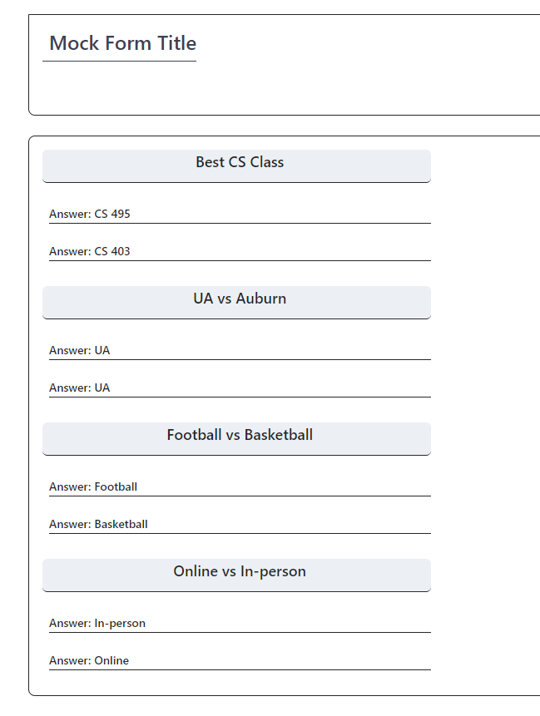
Contributions - An
Frontend
hermodapp.com
Integrating JWT Auth to the frontend
Form Submission
View Responses
Integrating with the backend
Reflections: I underestimated the time it takes to coordinate with the backend code as well as integrate the backend with the frontend. Will allocate more time for this next sprint

Slide 8
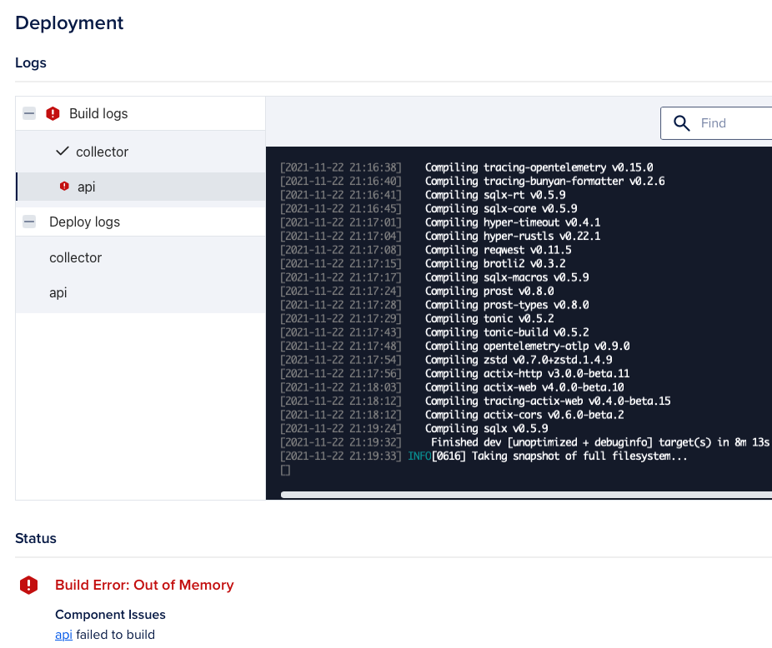

Contributions - Russ
Backend
hermodapp.com
Went through deployment hell
Digital Oceans Apps only works for very small apps
(Attempted) to learn Kubernetes in two weeks
Landed on Docker Swarm + Traefik proxy
Real-time diagrams of server performance
Notes:
QoL: more github action checks for pull requests, github badges with tools like codecov & auto doc generation
accidentally pushed my phone number to Github in a test, validation of non-emergency phone numbers.
Solution: more unit tests!!!

Slide 9
Contributions - Jonathan
Backend
hermodapp.com
Added form editing, submission, response viewing
Added checks to ensure users may only modify resources they own
Implemented Postmark client
Added password reset feature
Made the logo
Reflections:
Need to consider how SQL migrations will affect data already in database
Difficulty in communicating how to link frontend to the API
Need to document more
Notes:
Extended basic form feature implemented last sprint; users can now submit responses to forms, and form owners can view those responses and edit the forms.
I added checks to ensure that users can only modify their own resources, so now some random can’t just add fields to your forms.
I implemented the Postmark client, so now we can send emails. As an extension of this, I implemented a forgotten password request feature. Finally, I made the logo.
For reflections: I found that I need to consider how my SQL migrations will be affected by the current database data. I ran into time-consuming bugs because of constraints that I had difficulty debugging.
Secondly, I had difficulties effectively communication about API boundaries with the front-end. I think more granular planning would help alleviate this. Finally, I need to document more; a lot of the instructions
I give about the API have been extemporaneous, which tends to be inconsistent and inaccurate.

Slide 10
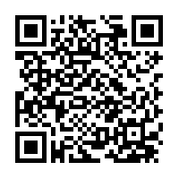
Demo
Generate Form
Go to
www.hermodapp.com
Log in (use default)
Id: russ
Pass: russ
Click Save (check console log to see data passing to backend)
Dashboard
Generate Form
View Server Log
User Submit Responses
View Responses
Go to
honeycomb.io
Go to https://hermodapp.com/form/submit?id=e72a0a7b-861b-42bd-a4a7-f9fc14a31a22
Go to https://hermodapp.com/form/view?id=e72a0a7b-861b-42bd-a4a7-f9fc14a31a22

Slide 11
Questions?

