Slide 1

Hermod
Sprint 2
github.com/hermodapp
hermodapp.com
Russell Weas, Jonathan Pence, Do Thien An Duong, Simon Jeon

Slide 2
Project Focus
hermodapp.com
What is Hermod?
Instant and seamless customer interaction.
Features include:
Automated customer interaction through QR codes.
Ability to create, customize, and serve forms to get detailed customer feedback.
Streamlines business operations by tying specific QR codes to various business locations/processes.
Configurable scan behavior.
Notes:
simon

Slide 3
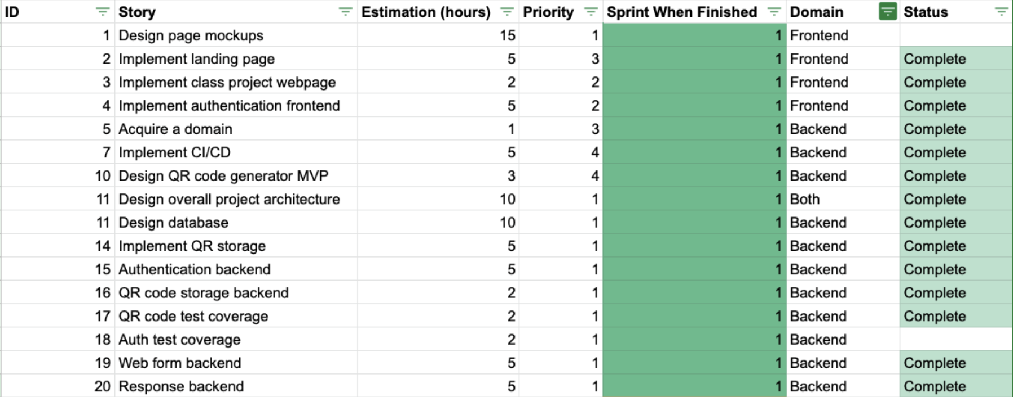
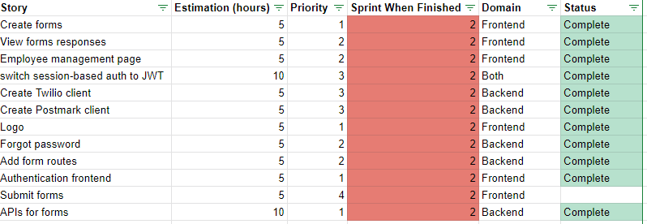
Backlog Comparison
hermodapp.com
Sprint 1
Sprint 2
Notes:
an

Slide 4
Project Contributions / Reflections
hermodapp.com

Slide 5
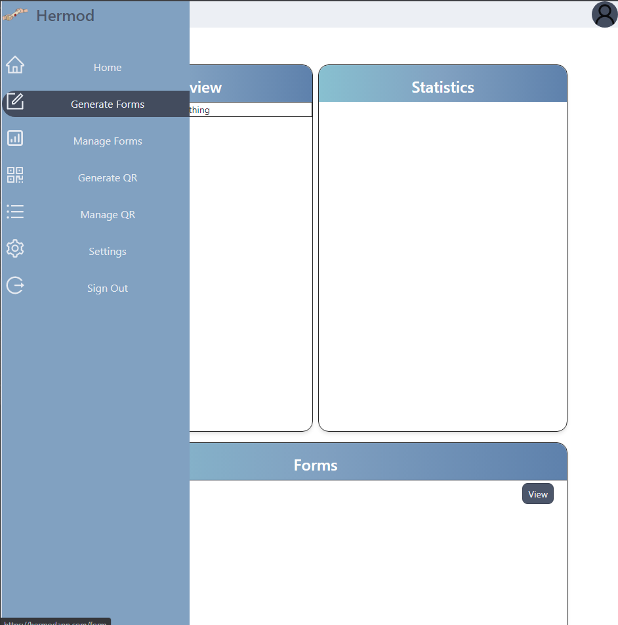
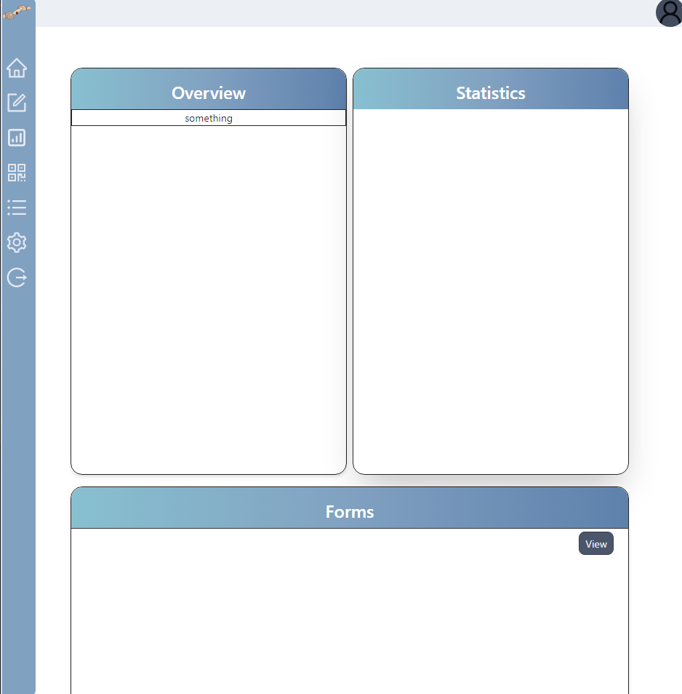
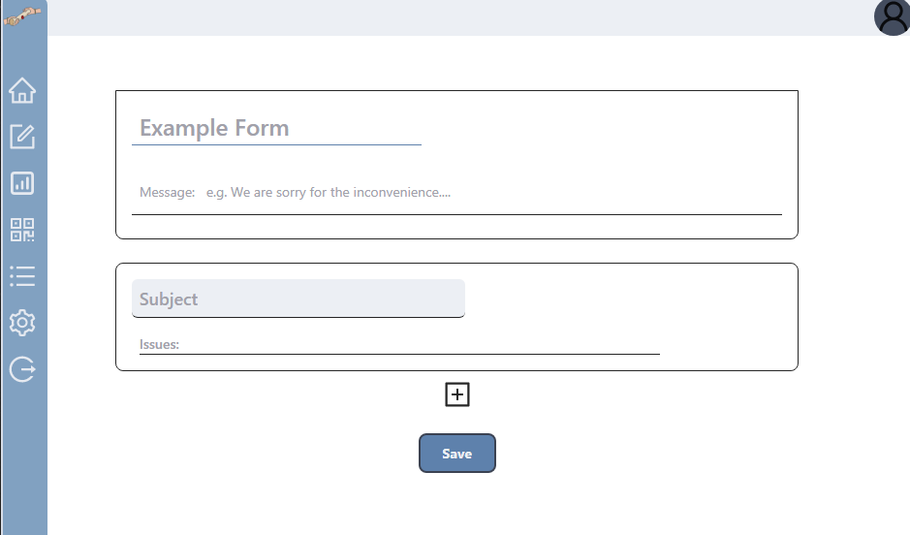
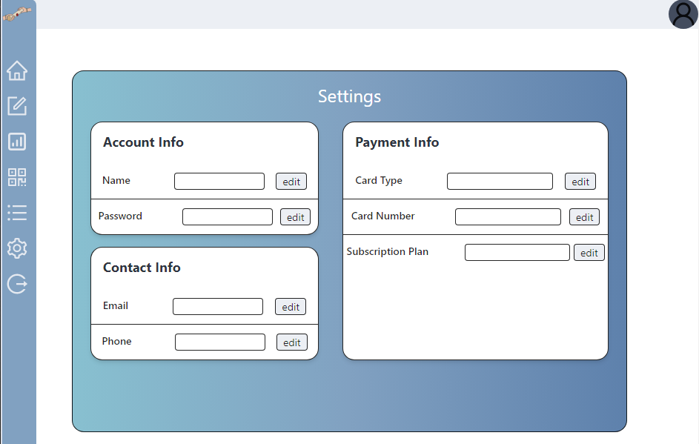
Contributions - Simon
hermodapp.com
Implemented interactive dashboard layout
Implemented layout designs throughout dashboard pages
Form generation using react hooks
Integrating Frontend + Backend
Reflections: react hooks are a great tool but need time to understand its implementation, difficulty in understanding the linkage between frontend and backend

Slide 6
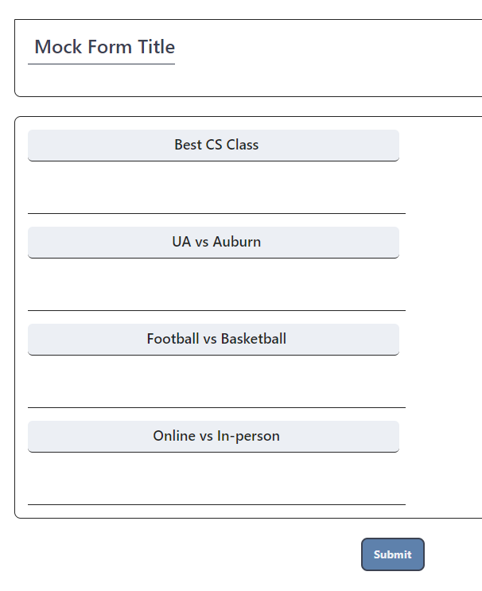
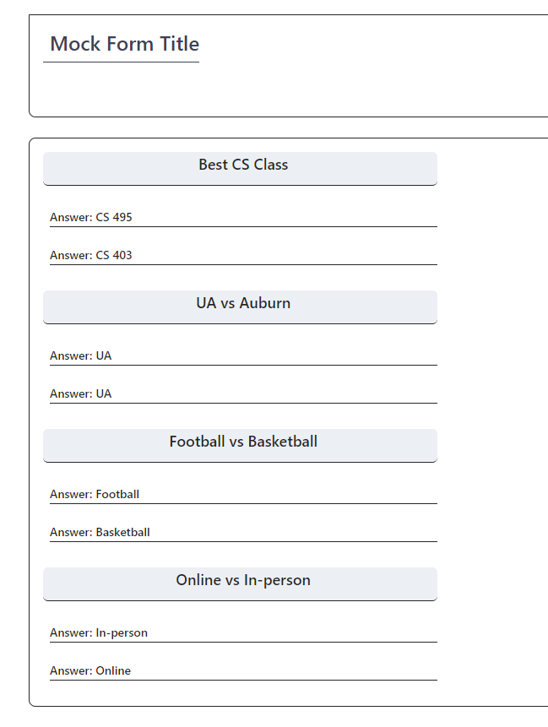
Contributions - An
hermodapp.com
Integrating JWT Auth to the frontend
Form Submission
View Responses
Integrating with the backend
Reflections: I underestimated the time it takes to coordinate with the backend code as well as integrate the backend with the frontend. Will allocate more time for this next sprint

Slide 7
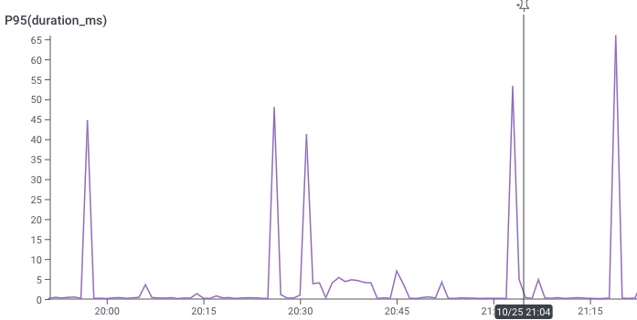
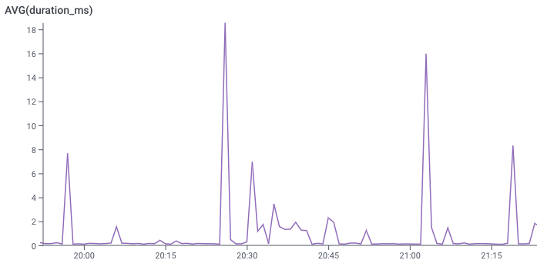

Contributions - Russ
hermodapp.com
Implemented JWT-based authentication
Added various REST routes
Created Twilio API client in Rust
Telemetry/monitoring dashboard [tracing-actix-web#46]
Quality-of-life improvements
Reflections: Working within real-life domains has unexpected edge cases and pitfalls!
Code quality badges in Github README
Real-time diagrams of server performance
Notes:
accidentally pushed my phone number to Github in a test, validation of non-emergency phone numbers.
Solution: more unit tests!!!

Slide 8
Contributions - Jonathan
hermodapp.com
Added form editing, submission, response viewing
Added checks to ensure users may only modify resources they own
Implemented Postmark client
Added password reset feature
Made the logo
Reflections:
Important to consider how SQL migrations will affect data already in database
Difficulty in communicating how to link frontend to the API
Need to document more

Slide 9
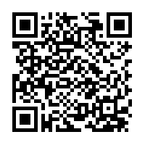
Demo (3min)
Generate Form
Go to
www.hermodapp.com
Log in (use default)
Id: russ
Pass: russ
Click Save (check console log to see data passing to backend)
Dashboard
Generate Form
View Server Log
User Submit Responses
View Responses
Go to
honeycomb.io
Go to https://hermodapp.com/form/submit?id=e72a0a7b-861b-42bd-a4a7-f9fc14a31a22
Go to https://hermodapp.com/form/view?id=e72a0a7b-861b-42bd-a4a7-f9fc14a31a22

Slide 10
Questions?

