Slide 1
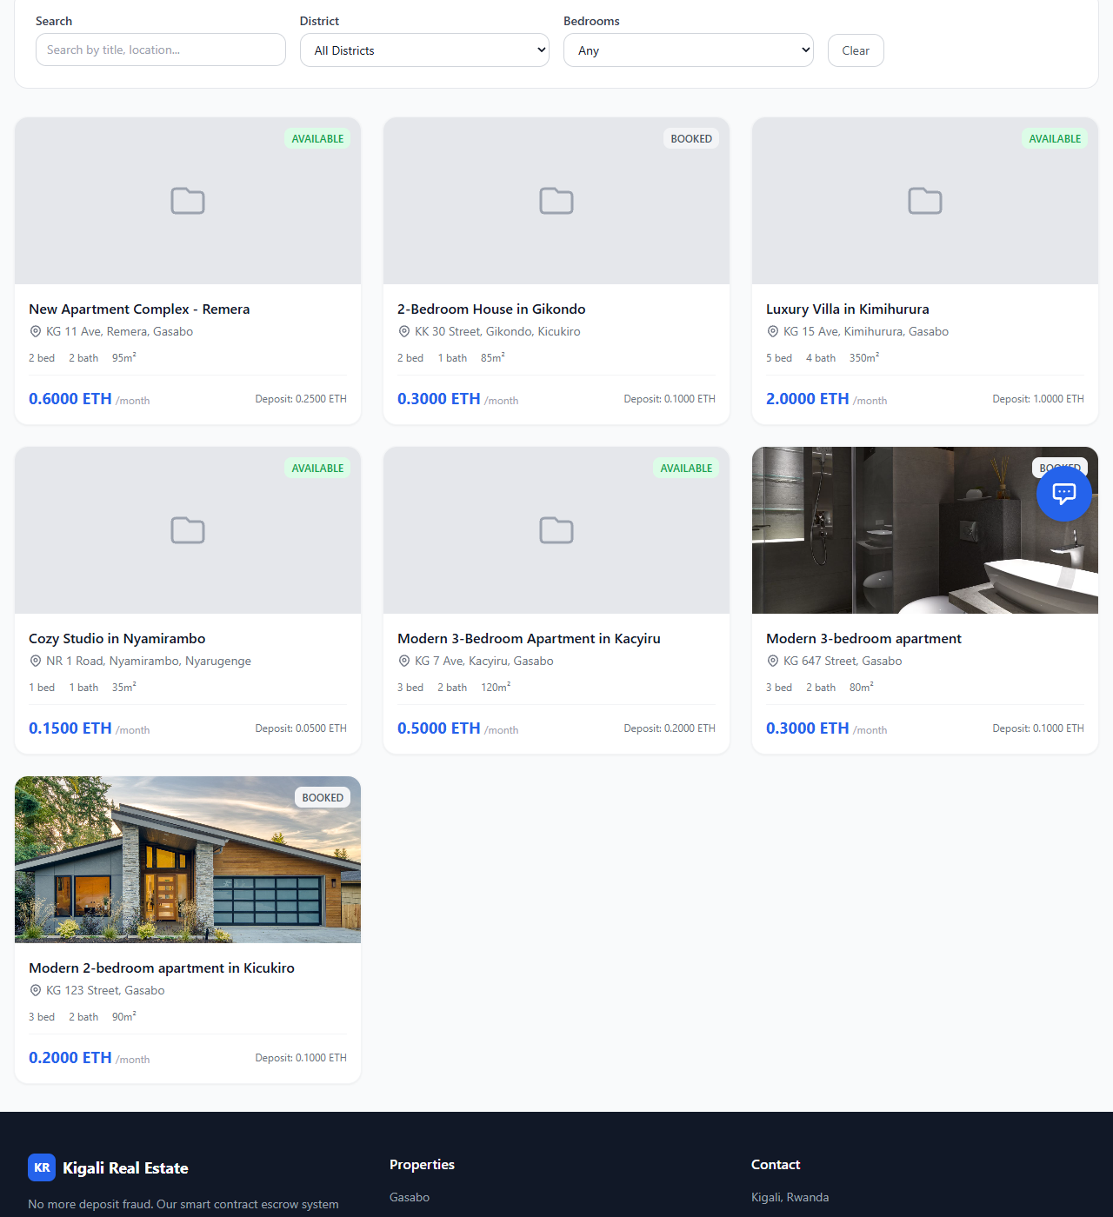
CAPSTONE PROJECT DEFENSE
Blockchain-based real estate booking platform for secure rental deposits in Kigali
A focused 5-slide defense summary covering the literature review, old system, proposed new system, and full system architecture.
Literature review
Old system
New system
Architecture
Kigali Real Estate Booking Platform | Defense Deck
01

Slide 2
LITERATURE REVIEW
Existing studies support digital booking, but trust and deposit safety remain the main gap.
Online real estate platforms
Blockchain escrow
Identity and verification
Mobile money context
Prior work shows that digital listing systems improve property discovery, reduce search time, and make location/pricing information easier to compare. However, listing platforms alone do not guarantee safe deposit handling.
Blockchain literature highlights immutability, transparency, and programmable conditions. Smart contracts can hold funds until agreed events occur, reducing dependency on informal trust between parties.
KYC, property document checks, and role-based access are repeatedly recommended for reducing impersonation, fake listings, and owner/tenant abuse in digital marketplaces.
Rwanda's rental users need familiar payment paths. A practical platform must support non-crypto users through MoMo/card flows while preserving escrow accountability.
Literature gap addressed by this thesis: combine property booking, verification, local payment usability, and smart-contract escrow in one Kigali-focused system.
Kigali Real Estate Booking Platform | Defense Deck
02

Slide 3
OLD SYSTEM
The traditional rental booking system depends on manual trust before payment risk is controlled.
1. Search manually
2. Inspect property
3. Pay deposit
4. Resolve issues informally
Tenant searches through agents, contacts, social media posts, or informal referrals.
Tenant visits or communicates with the owner/agent with limited digital verification.
Deposit is paid directly by cash, mobile money, or bank transfer before handover assurance.
If fraud, double-booking, or dispute occurs, recovery depends on informal negotiation.
Deposit theft
Fake ownership
Double booking
Weak evidence
Money holder can disappear or refuse refund.
Weak document verification enables impersonation.
No automatic date conflict protection.
Limited transaction and dispute audit trail.
Kigali Real Estate Booking Platform | Defense Deck
03

Slide 4
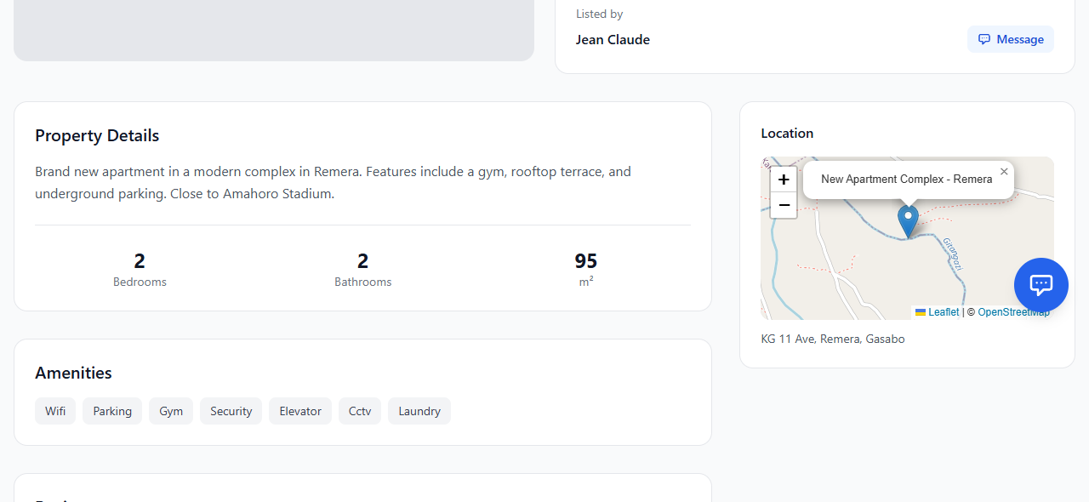
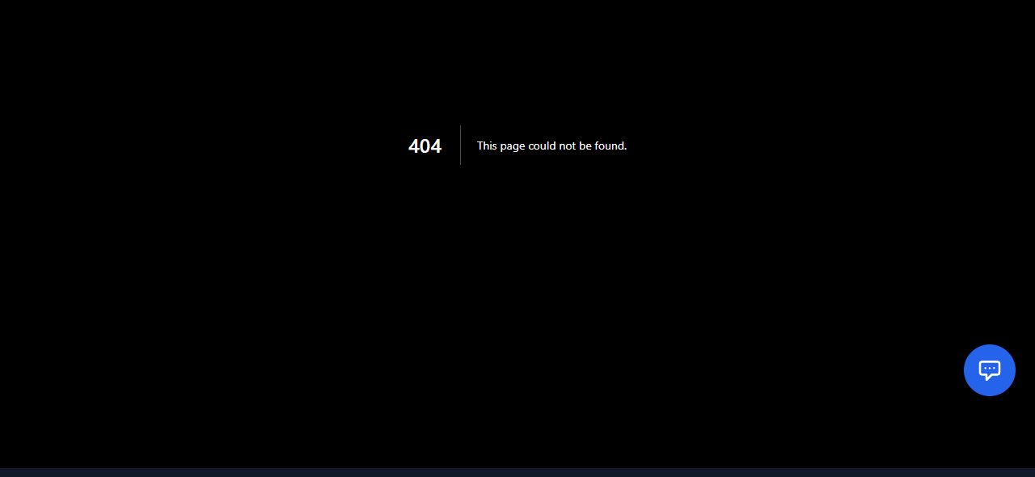
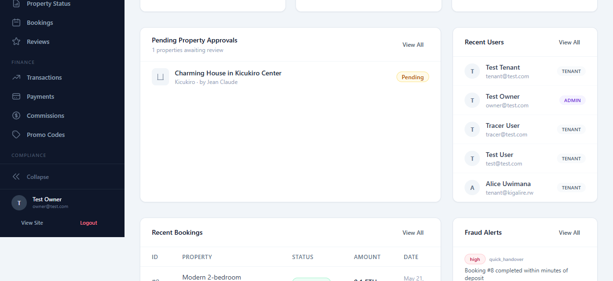
NEW SYSTEM
The proposed system makes booking conditional, verified, and auditable.
Verified listing
Digital booking
Escrow locking
Conditional release
Owner uploads property details and documents; admin approves before tenant trust is requested.
Tenant selects property, dates, and preferred payment method through the web/PWA interface.
ETH, MoMo, or card payment leads to a tracked escrow record and transaction hash.
Funds release only after handover confirmation or admin dispute decision.
Kigali Real Estate Booking Platform | Defense Deck
04

Slide 5
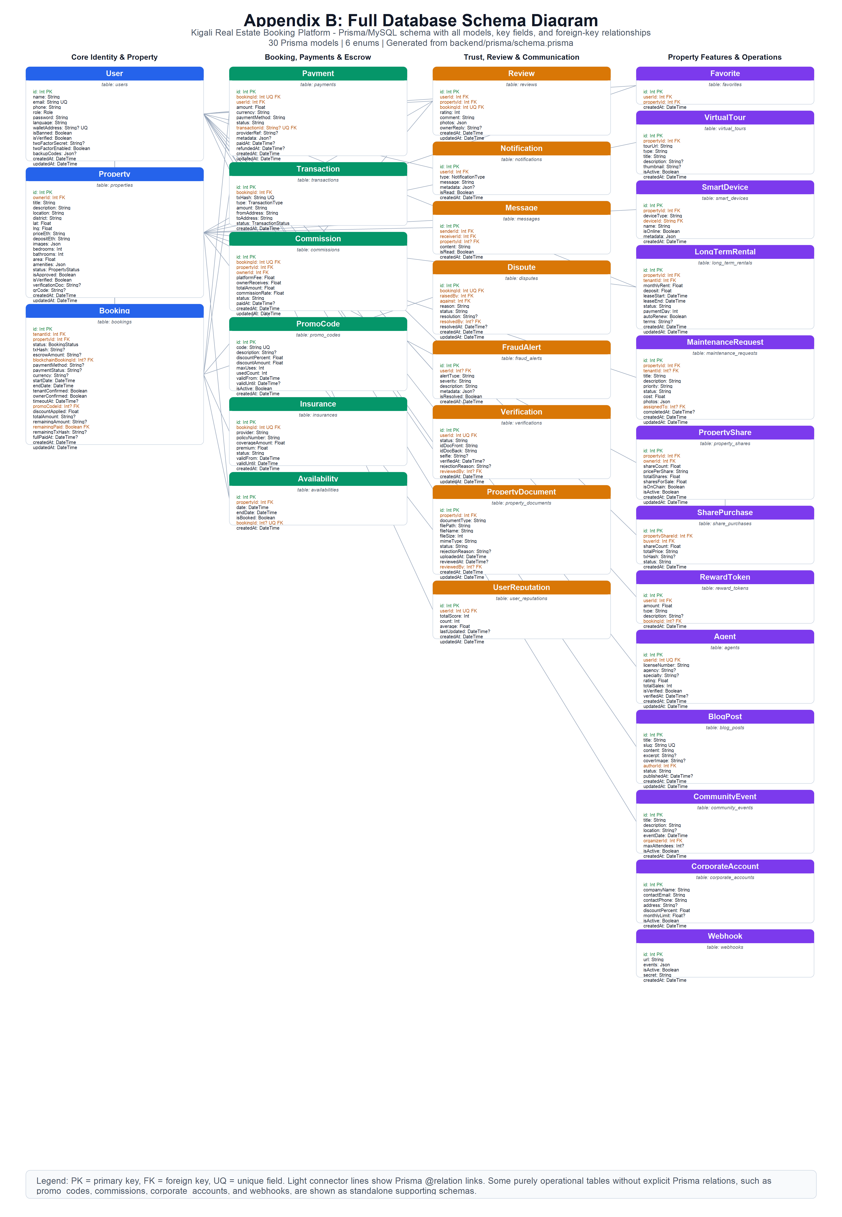
SYSTEM ARCHITECTURE
The architecture connects a user-facing PWA to API services, database records, and blockchain escrow.
MySQL + Prisma
Frontend PWA
Backend API
Users, properties, bookings, payments, disputes, documents
Admin layer
Next.js 14 + React
Search, booking, wallet, KYC, admin pages
Express + TypeScript
Auth, properties, booking, payments, fraud, notifications
Approvals, fraud alerts, dispute resolution, reports
Ethereum escrow
RealEstateEscrow.sol
Lock, release, refund, dispute
Key architectural contribution: payment trust is enforced by escrow logic, while usability remains in familiar web and payment channels.
Kigali Real Estate Booking Platform | Defense Deck
05

