Slide 1
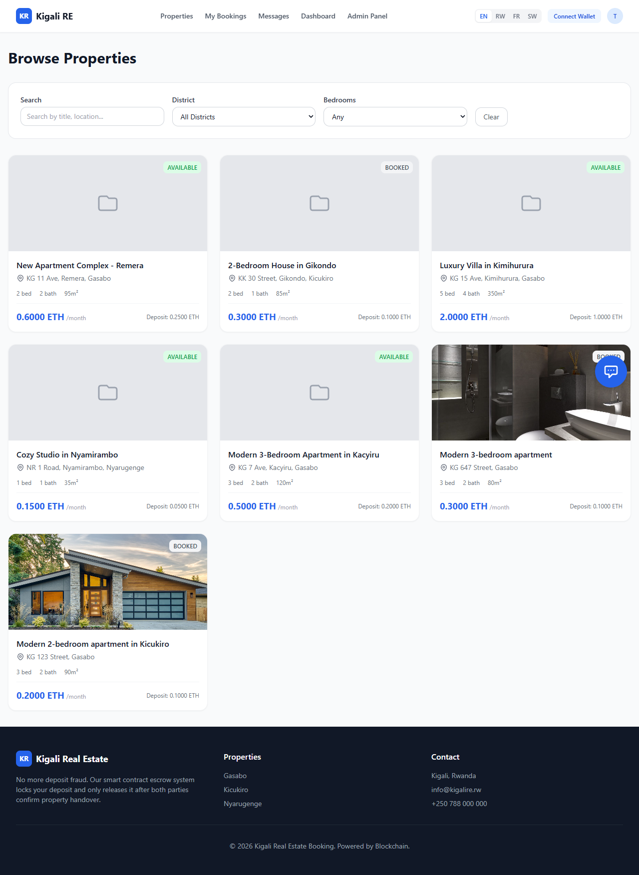
CAPSTONE PROJECT DEFENSE
Blockchain-based real estate booking platform for safer rental deposits in Kigali
A full-stack web dApp that combines verified listings, multi-payment booking, smart-contract escrow, fraud monitoring, and administrative dispute resolution.
80+
27
4
API endpoints
Data models
Core services
15 route files
Prisma + MySQL
Web, API, DB, chain
Bachelor of Technology Capstone Project | Defense
01

Slide 2
PROBLEM FRAMING
Traditional rental booking leaves tenants and owners exposed before trust is established.
Deposit payments are often made before property handover is independently guaranteed.
Deposit theft
Core user risk
Property ownership and listing legitimacy can be difficult to verify digitally.
Owner can take funds before delivery
Disputes are slow, informal, and often biased toward the party holding the money.
Double booking
Operational risk
Manual booking channels create room for double-booking, impersonation, and weak audit trails.
Same property/date conflict
No audit trail
Governance risk
Weak recovery and dispute evidence
Kigali Real Estate Booking Platform | Defense Deck
02

Slide 3
RESEARCH OBJECTIVES
The project translates rental-market vulnerabilities into four testable system objectives.
Analyze
Design
Develop
Evaluate
Identify financial friction and fraud patterns in Kigali residential booking.
Create smart-contract escrow for conditional locking and release of rental deposits.
Build a user-friendly decentralized booking application for non-technical users.
Assess security, technical effectiveness, and user acceptance against deposit fraud.
Defense focus: show how each objective moved from research problem to implemented, verifiable system behavior.
Kigali Real Estate Booking Platform | Defense Deck
03

Slide 4
METHODOLOGY
A design-science approach links the problem analysis to a working, verified artifact.
1. Problem analysis
2. Architecture design
3. Prototype build
4. Technical evaluation
Map rental fraud risks: deposits, identity, double-booking, and dispute gaps.
Specify smart-contract escrow, API, database, roles, and payment flows.
Implement Next.js frontend, Express API, Prisma schema, and Solidity contract.
Compile, deploy, test endpoints, verify escrow transaction, and prepare UAT framework.
The artifact is evaluated through objective completion, technical verification, and a prepared user acceptance study framework.
Kigali Real Estate Booking Platform | Defense Deck
04

Slide 5
SOLUTION ARCHITECTURE
The platform separates user experience, booking logic, verified records, and escrow settlement.
MySQL database
Prisma ORM
Users, listings, bookings, payments, reviews, documents
Frontend PWA
Backend API
Admin controls
Next.js 14 + React
Properties, booking, KYC, wallet, admin UI
Express + TypeScript
Auth, properties, bookings, payments, fraud, notifications
Approvals, fraud alerts, disputes, reports, commissions
Ethereum escrow
Hardhat + Solidity
Lock, release, refund, dispute, fee
Design principle: tenants can use familiar web and mobile payment flows while high-risk deposits receive blockchain-backed accountability.
Kigali Real Estate Booking Platform | Defense Deck
05

Slide 6
ESCROW MECHANISM
Smart-contract escrow changes the booking from trust-first to condition-first.
Completed
Owner receives deposit minus platform fee.
Created
Locked
Confirmed
Disputed
Booking request is recorded with tenant, owner, property, amount, and timeout.
Deposit is submitted and held by the RealEstateEscrow contract.
Tenant and owner both confirm handover before funds are released.
Admin reviews evidence and resolves on-chain outcome.
Refunded
Timeout, cancellation, or admin decision returns funds.
Contract controls: ReentrancyGuard, Pausable, configurable 2.5% fee, timeout refund, admin dispute resolution.
Kigali Real Estate Booking Platform | Defense Deck
06

Slide 7
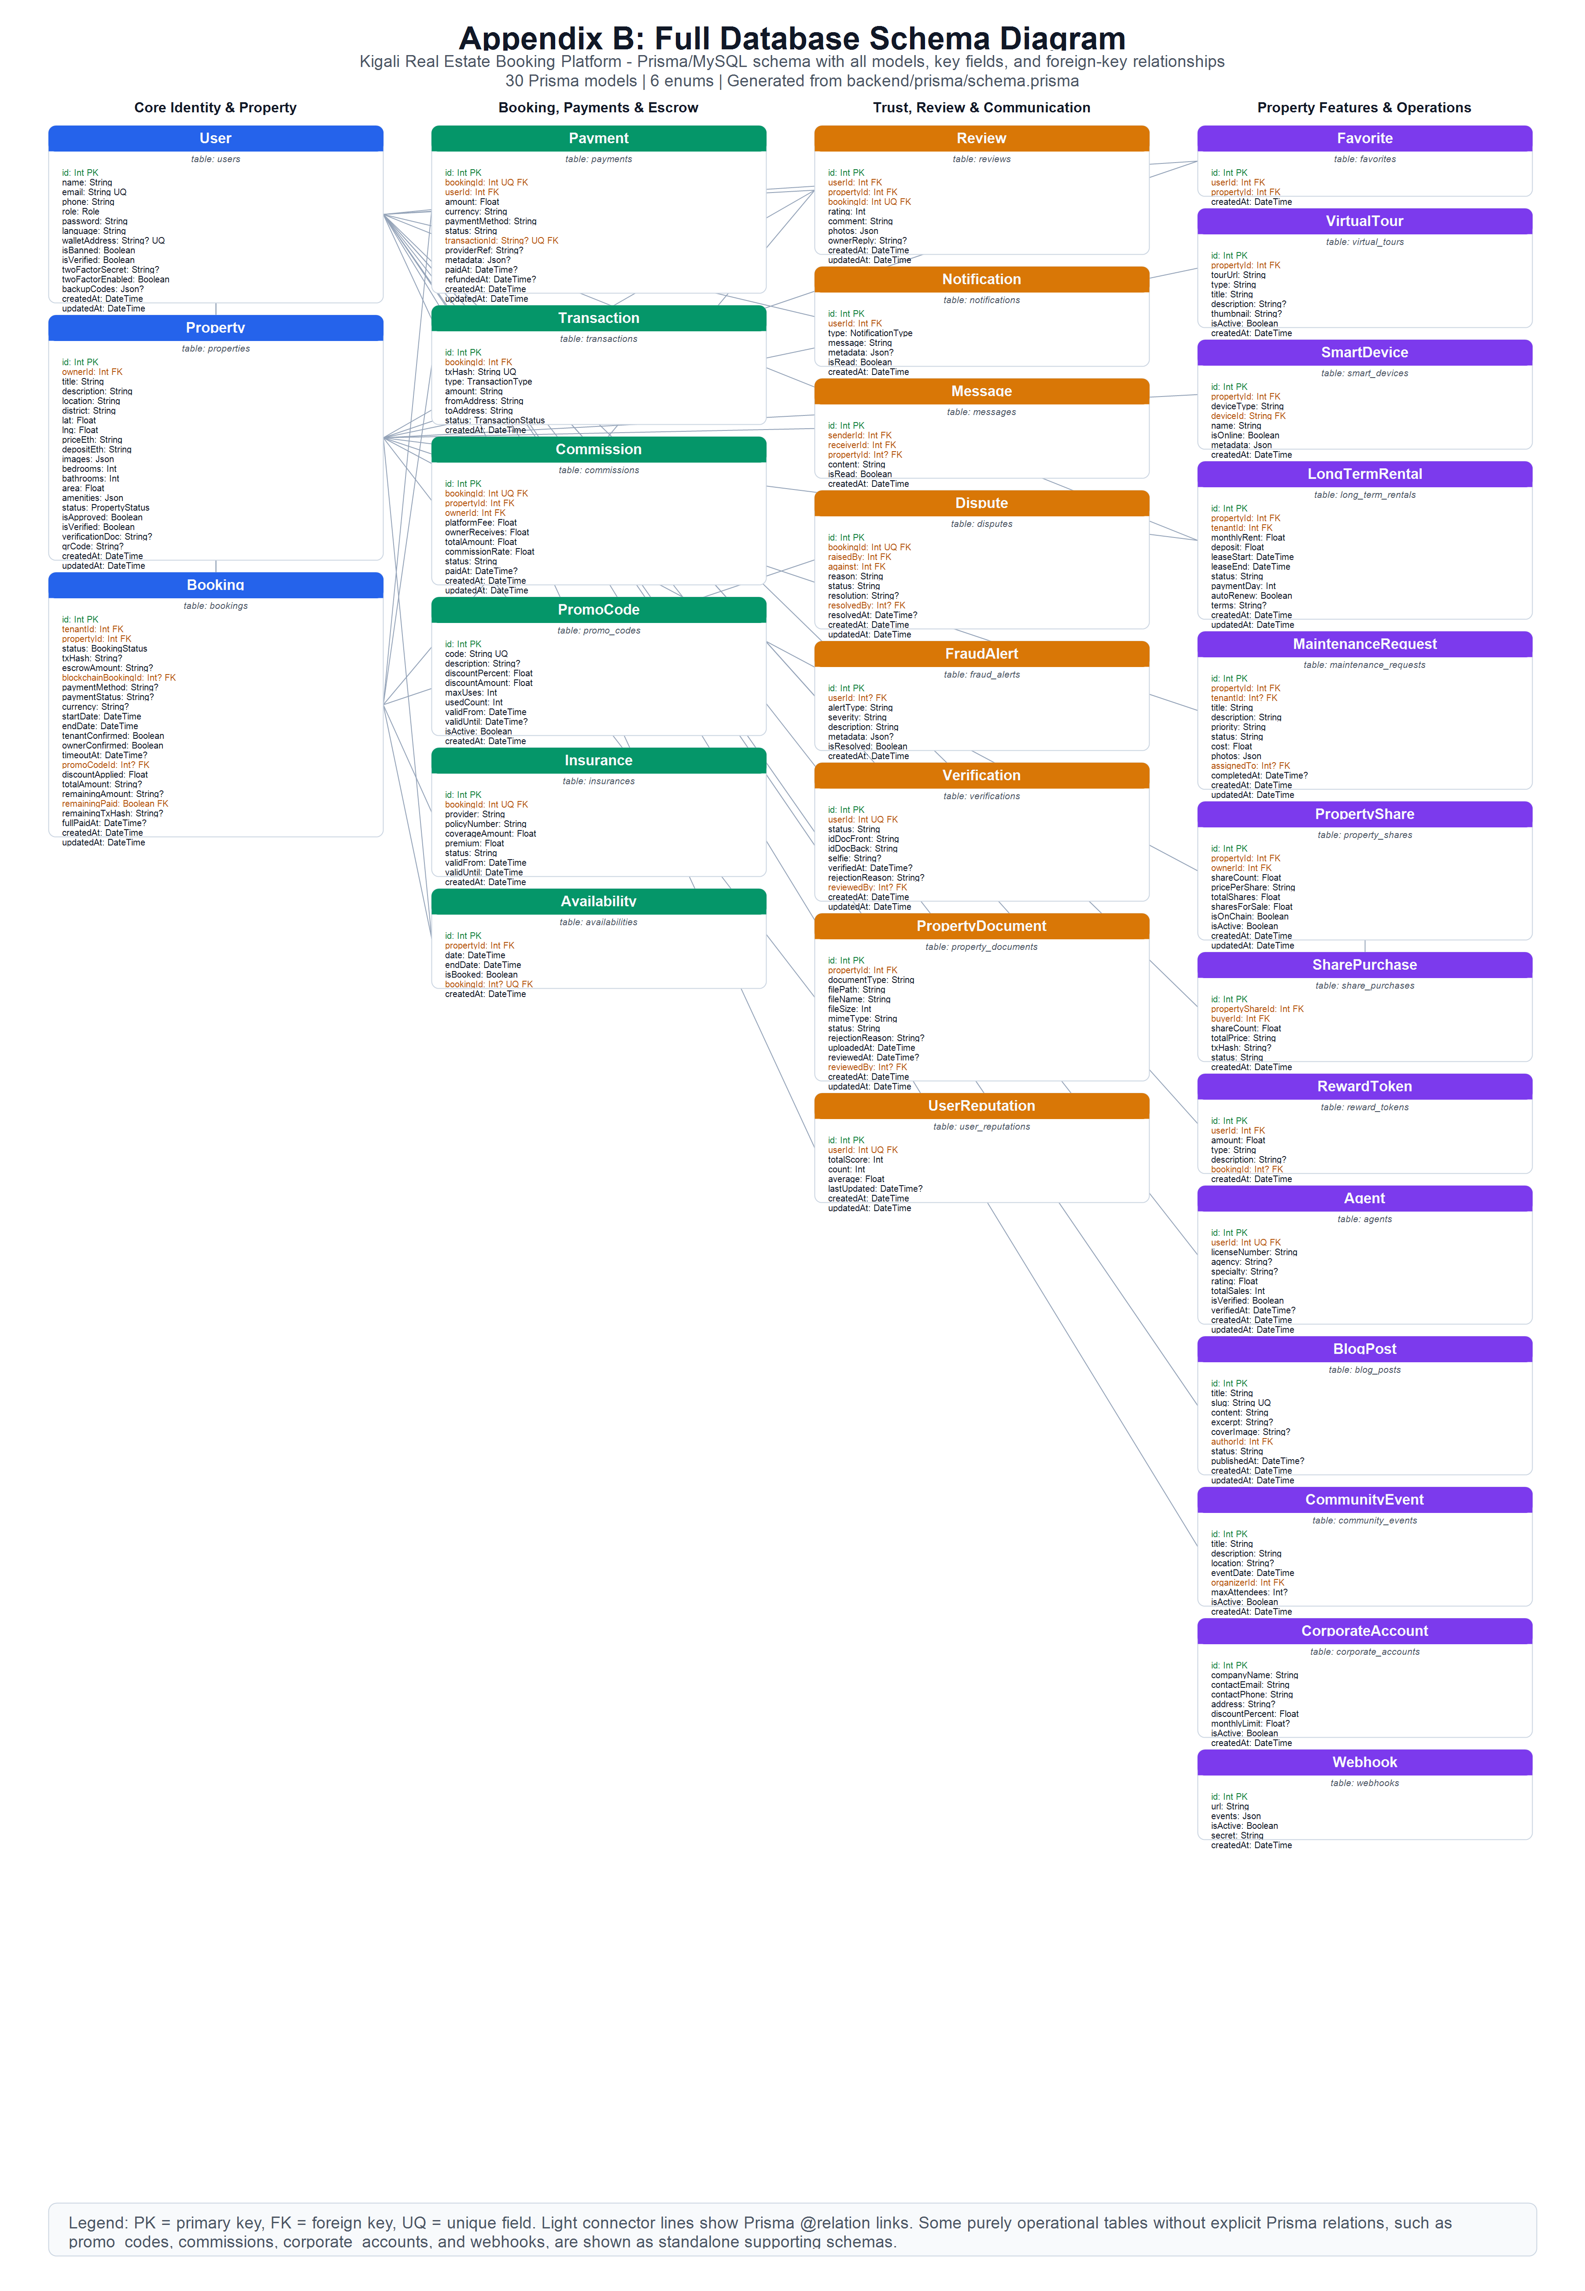
DATA MODEL
The data model supports trust workflows, not only property listing.
Core entities
User + Verification
Roles, KYC, wallet, 2FA
Property + Documents
Approval workflow and ownership evidence
Booking + Payment
Lifecycle, dates, method, transaction hash
Dispute + FraudAlert
Exception handling and automated monitoring
Review + Message
Post-booking trust and communication
Kigali Real Estate Booking Platform | Defense Deck
07

Slide 8
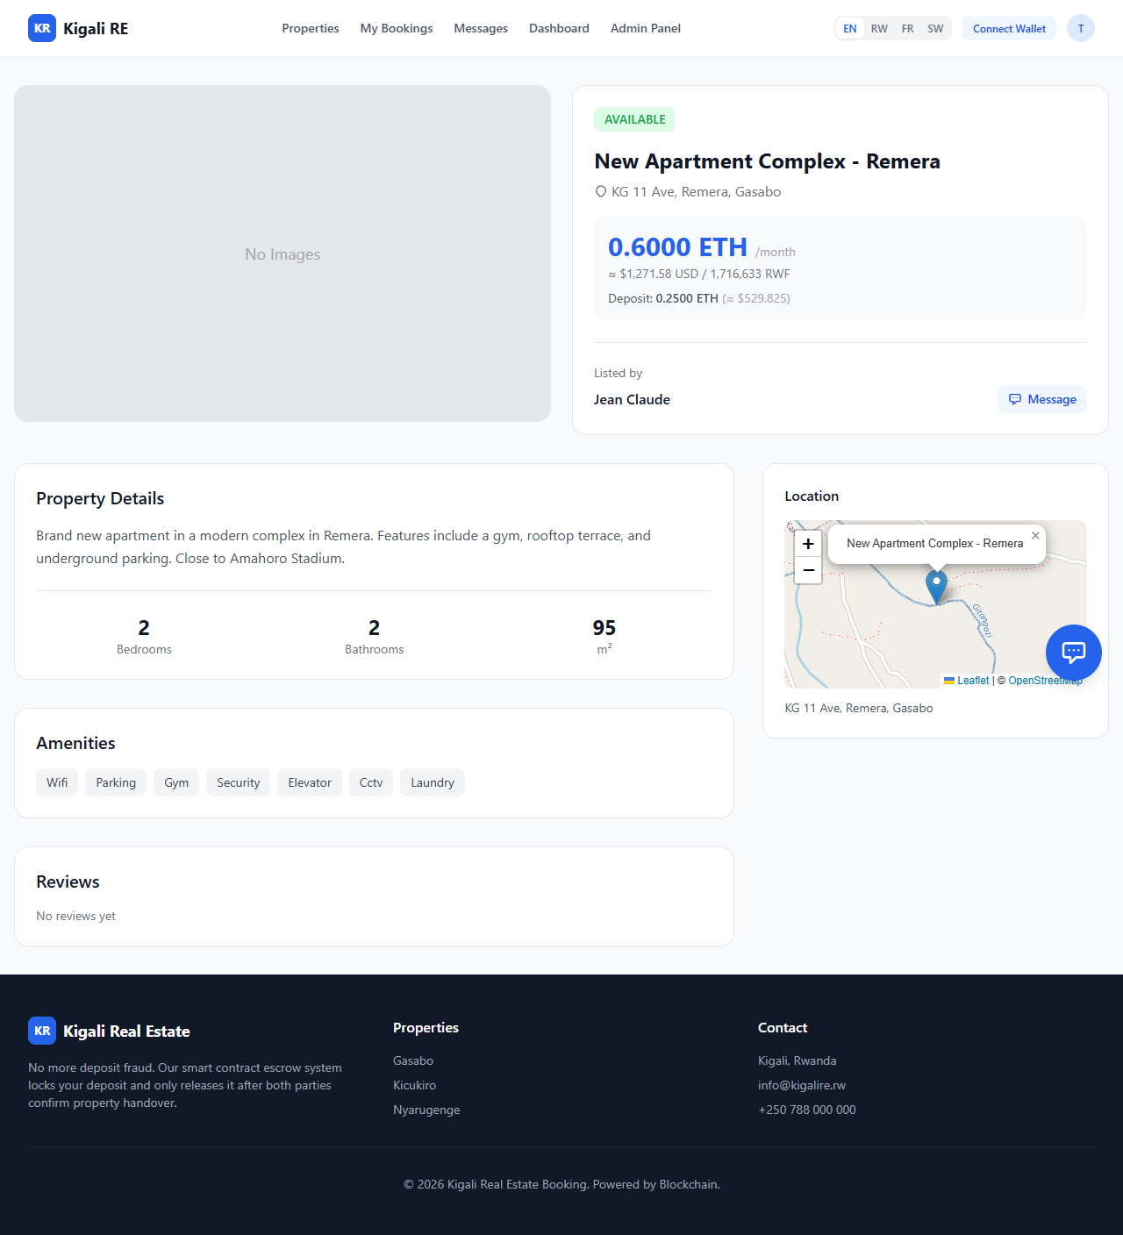
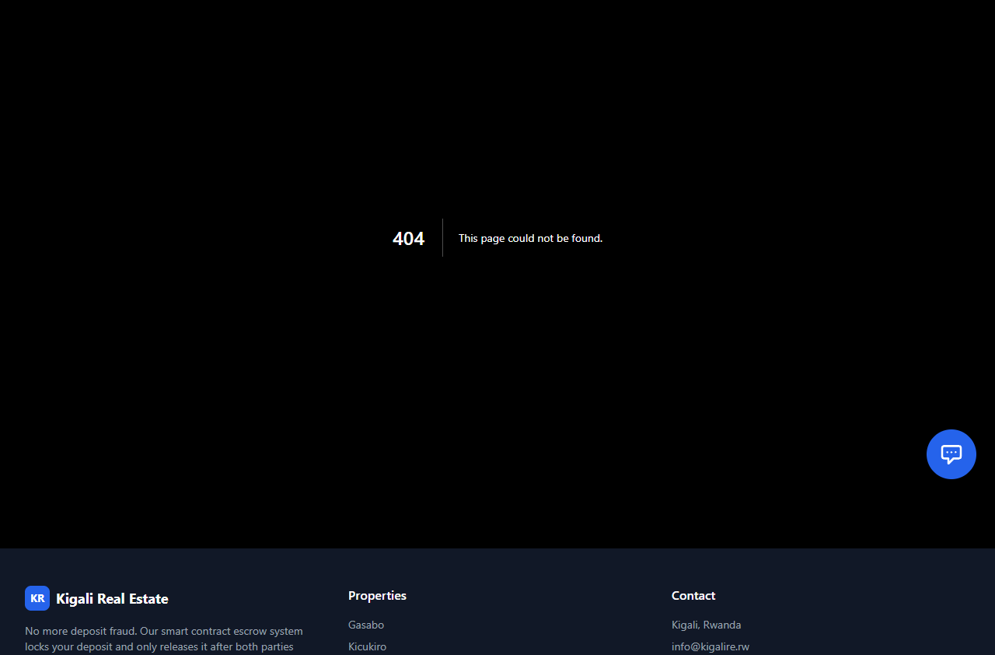
USER EXPERIENCE
The interface makes decentralized booking usable through familiar screens and payment options.
Search
Book
Pay
Browse Kigali listings with district and property context.
View property details, request dates, and start deposit flow.
Use wallet, MTN MoMo, or card while escrow is tracked.
Kigali Real Estate Booking Platform | Defense Deck
08

Slide 9
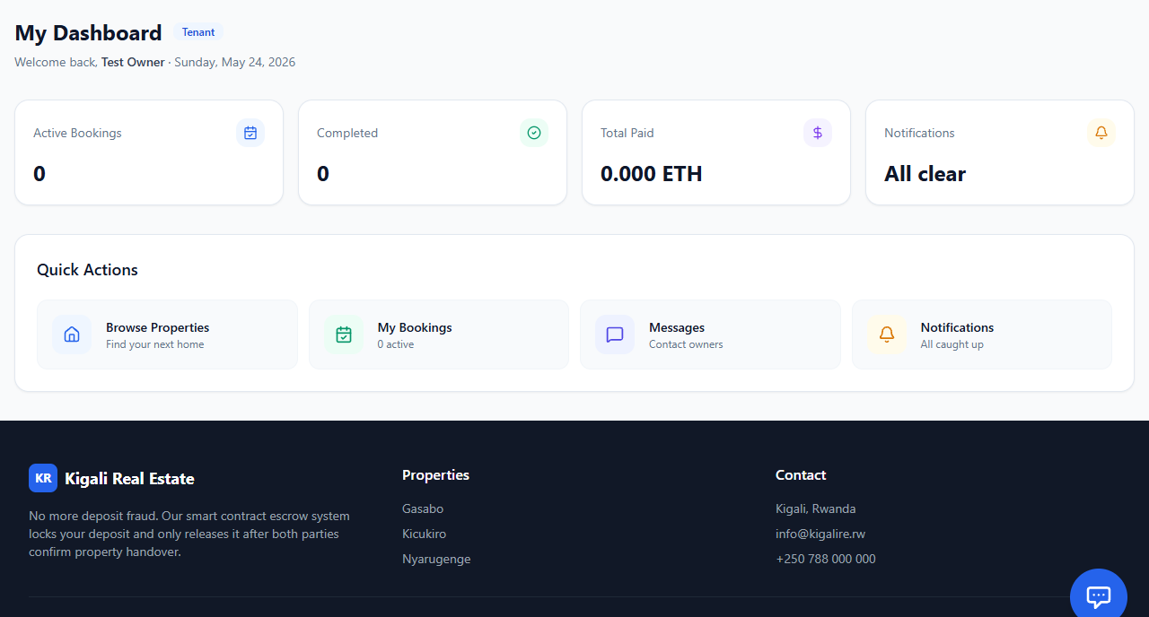
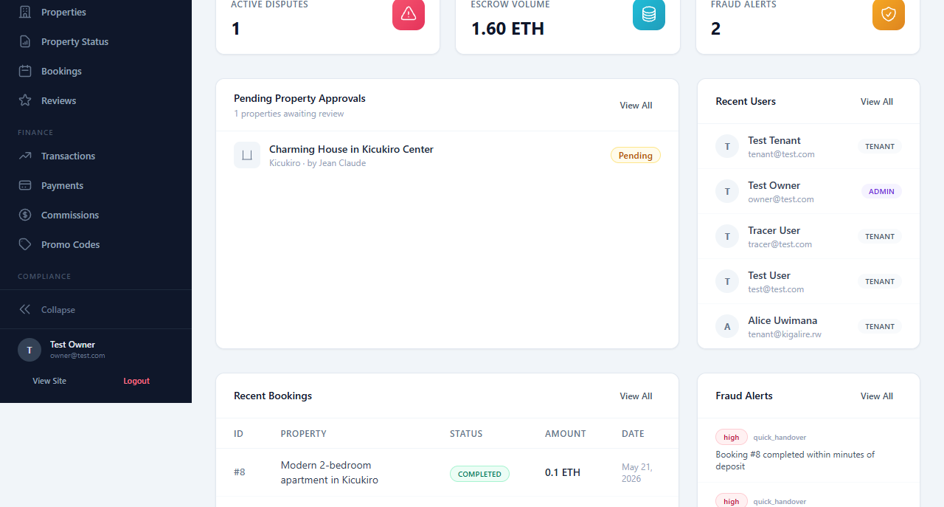
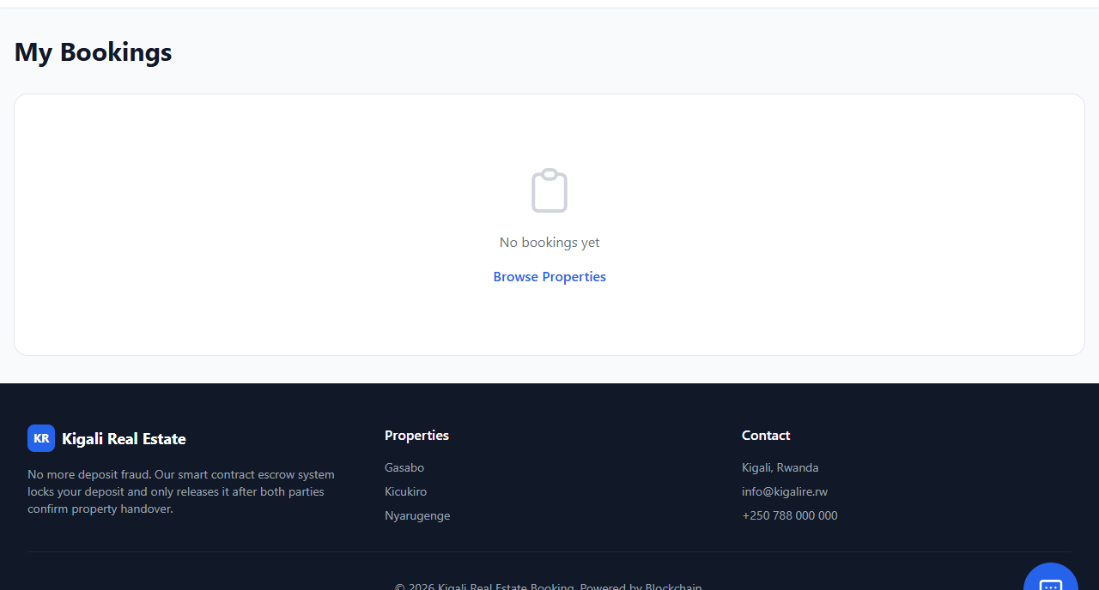
IMPLEMENTATION EVIDENCE
The prototype is operational across frontend, backend, database, and blockchain services.
32
15
0
1
Frontend pages
Route files
TypeScript errors
Verified escrow tx
PWA build generated successfully
80+ backend endpoints
Backend compile check passed
Deposit locked on-chain
Kigali Real Estate Booking Platform | Defense Deck
09

Slide 10
SECURITY DESIGN
Security controls are layered around identity, input, payment, and smart-contract risk.
JWT + refresh tokens
92
Smart-contract safeguards
Role-based access
88
OpenZeppelin ReentrancyGuard
Zod input validation
90
Pausable emergency control
KYC + property docs
82
Dual handover confirmation
2FA + rate limits
76
Timeout-based refund
Admin dispute resolution
Fraud detection rules
74
Kigali Real Estate Booking Platform | Defense Deck
10

Slide 11
EVALUATION
The system has technical evidence now; live user validation is the next research step.
Technical verification
User acceptance framework
Production evidence
Passed
Prepared
Pending
Backend TypeScript compile: zero errors
UAT methodology for 12-20 users
No live user study completed yet
Frontend production build: 32 static pages
SUS usability questionnaire
No fraud-prevention metrics over time
Blockchain escrow deployment and test tx
Perceived security questionnaire
Load testing still required
Database synced with 27 Prisma models
Comparative analysis against traditional agents
Native mobile app not completed
Kigali Real Estate Booking Platform | Defense Deck
11

Slide 12
OBJECTIVE ASSESSMENT
Two objectives are fully achieved; two are substantively built with clear remaining validation gaps.
Objective
Status
Defense evidence
Analyze vulnerabilities
Achieved
Architecture addresses deposit theft, double-booking, dispute bias, KYC, impersonation, and fraud signals.
Design escrow architecture
Fully achieved
RealEstateEscrow contract deployed and verified with booking state machine and conditional release.
Build user-friendly dApp
Partially achieved
Responsive PWA completed; native mobile app and biometric/offline features remain out of scope.
Evaluate effectiveness
Partially achieved
Technical evaluation and instruments delivered; live Kigali user study remains pending.
Kigali Real Estate Booking Platform | Defense Deck
12

Slide 13
LIMITATIONS AND FUTURE WORK
The next phase moves from verified prototype to field-tested platform.
Current limitations
Near-term work
Product maturity
Research extension
No completed live user study
Responsive web app, not native mobile
No long-term production fraud dataset
Conduct UAT with Kigali tenants and owners
Run load and security tests
Deploy staging environment
Add native mobile app
Improve offline support
Expand MoMo/Card production integrations
Measure fraud reduction over time
Compare escrow trust against agent-mediated booking
Study blockchain comprehension
Most important next evidence: real users completing end-to-end bookings and reporting whether escrow increases perceived deposit safety.
Kigali Real Estate Booking Platform | Defense Deck
13

Slide 14
DEFENSE CLOSE
The contribution is a working trust layer for rental booking, not only another listing website.
By locking deposits in escrow, verifying property evidence, and giving administrators auditable dispute and fraud tools, the platform directly addresses the highest-risk moment in Kigali rental booking: paying before trust is proven.
Escrow
PWA
UAT
Core innovation
User access
Next evidence
Condition-based release
Mobile-friendly web
Field validation
Thank you. Questions?
Bachelor of Technology Capstone Project | Defense
14

