Slide 1
Resource Dependencies and Terraform Modules

Slide 3
Dependencies

Slide 4
Resource Dependencies in Terraform
When Terraform changes infrastructure, many of the changes have to be made in a specific order.
This order is determined by resource dependencies.
Implicit Dependencies
Terraform and the Azure provider determine automatically based on the configuration.
Explicit Dependencies
User defines using depends_on meta argument
This is done when terraform can’t detect a dependency and user wants to override the default execution plan
Notes:
Can anyone remember other meta arguments?
For example, if a virtual machine (VM) resource references a network interface (NIC), the provider "knows" to create the NIC before attempting to create the VM.

Slide 5
Implicit Dependency example
resource "azurerm_resource_group" "rgs" {
count = length(var.rg_names)
name = "${var.prefix}_${var.rg_names[count.index]}"
location = var.region
tags = var.tags
}
resource "azurerm_virtual_network" "vnet" {
count = length(var.rg_names)
name = lookup(var.vnets[count.index], "name")
address_space = [lookup(var.vnets[count.index], "address")]
location = var.region
resource_group_name = azurerm_resource_group.rgs[count.index].name
}
Notes:
Swap the blocks and it will still work..
https://learn.hashicorp.com/terraform/azure/dependencies_az

Slide 6
Dependencies
Demo
Notes:
Create a vnet inside resource groups

Slide 7
Modules

Slide 8
Modules
Root Module vs Sub Module
Notes:
Explain the difference between a root module and a sub module for clarity moving forward.

Slide 9
Modules
A module is a container for multiple resources that are used together.
Ligthtweight abstractions
Distributable
Can be Nested
Composable
Local or Remote
Better Organization
Encapsulation
Reusability
Notes:
https://www.terraform.io/docs/modules/composition.html
Composition over deep-nesting
Similar to a library or a package
other benefit of using modules is to encapsulate configuration into distinct logical components

Slide 10
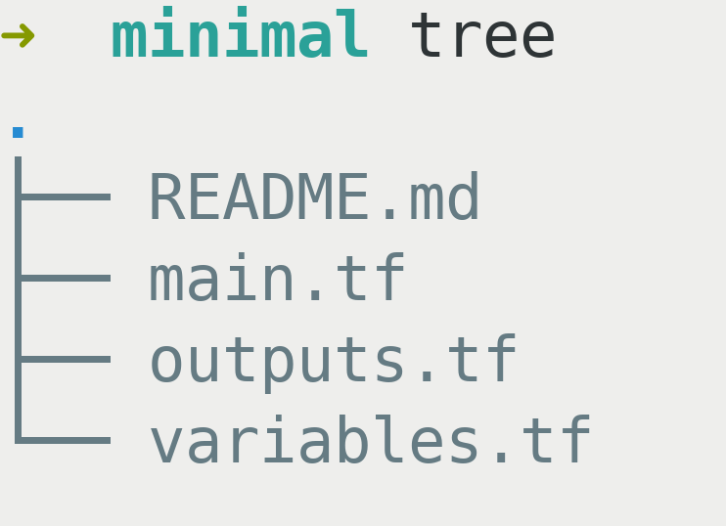
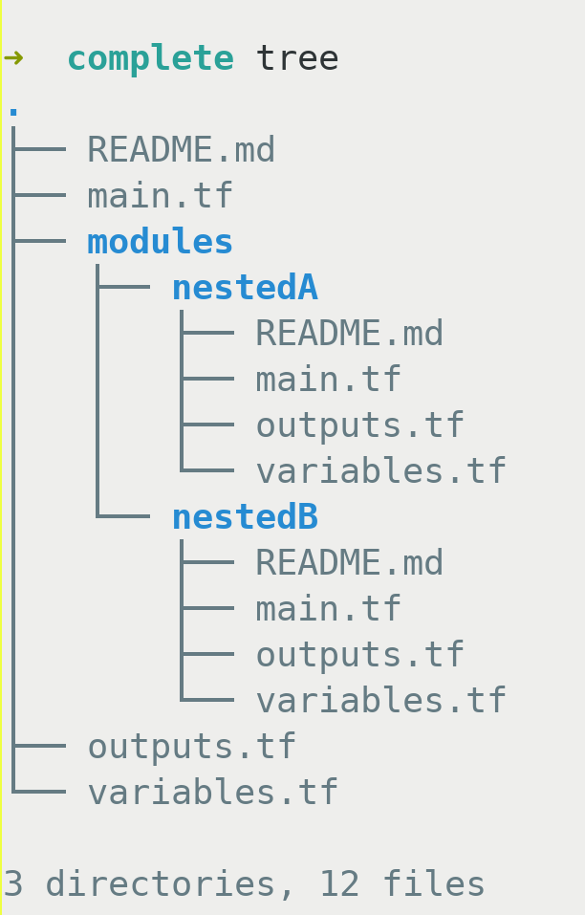
Root Module is the only requirement and acts as the entry point.
Minimal Structure
Nested Example
Notes:
https://learn.hashicorp.com/terraform/modules/creating-modules
There aren’t any .tfvars because we will be passing in the values. Placing data inside makes modules less reusable.

Slide 11
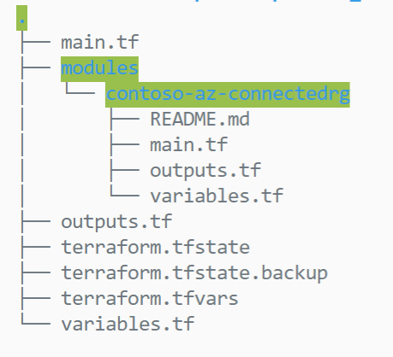
Module block to call a module
# main.tf from calling module
provider "azurerm" {
version = "~>2.0.0"
features {}
}
module "connectedrg" {
# or remote git repo with ?ref=version
source = "./modules/contoso-az-connectedrg"
rg_names = var.rg_names
vnets = var.vnets
}
Notes:
Module sources can be remote git repos, private registries, etc.

Slide 12
Module structuring – Common pattern
Resource Modules
(Opinionated encapsulated wrapper with minimal variables and sensible defaults)
Stack Modules
(Composed of Resource Modules Only)
VNET
1 Tier Web Application with SQL Database
Storage Account
App Service Plan
SQL Database
2 Tier Web Application with SQL Database, Storage and Private Networking
App Service
Front Door

Slide 13
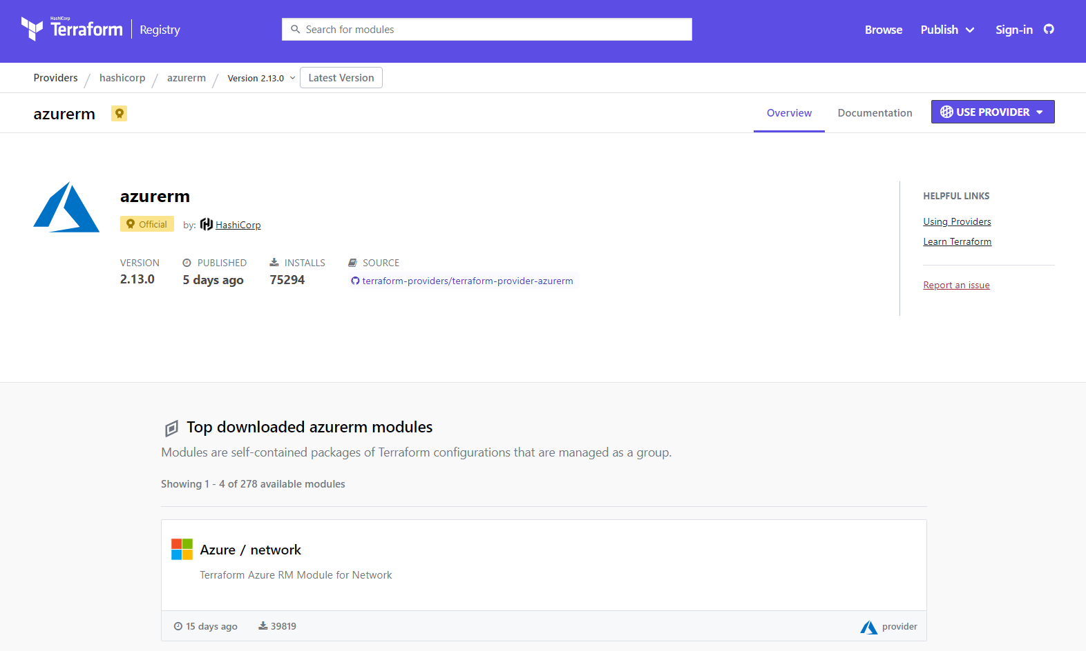
Terraform public registry
Notes:
Don’t mutate the modules from official registry. If planning to do so, then make it custom and manage it separately in your own module source because version upgrades to original module will break changes if you accidentally update them.
It’s best not to mutate community maintained / official modules.

Slide 14
Other ways to reference modules
Git repository
Public
Private (requires authentication token)
HTTP Server
Stored as zip / tar
Cloud blob storage
Private registry in Terraform Cloud
Supports built in versioning

Slide 15
Modules
Demo
Notes:
Show both local and remote flow. (re init as needed)

Slide 16

Ask
Discuss
Comment

