Slide 1


software in
UNIVERZITET DŽEMAL BIJEDIĆ U MOSTARU
FAKULTET INFORMACIJSKIH TEHNOLOGIJA MOSTAR
SEMINAR
Mentor:
Iris Memić
Student:
Ernad Husremović

Slide 2
Contents
Open source software (OSS) definition
OSS phenomenon
OSS licenses
OSS projects
Software piracy
OSS adoption in region - Slovenia
OSS in Bosnia and Herzegovina
Conslusion

Slide 3
Open source software (OSS) definition
Bruce Perens, the creator of the Open Source (OSS) definition
Main policy areas regarding Open Source (OSS) are:
“Freedom to create, distribute, and use software”
Richard Stallman, the founder of the Free Software (FS) movement
“The Free Software Movement is a social movement
for computer users' freedom”
The Open Source philosophy cites practical, economic benefits.

Slide 4
OSS phenomenon
OSS, the new paradigm of software development
The social aspect as the core of the new paradigm
Linus's Law, as described by Eric Raymond:
“Given enough eyeballs, all bugs are shallow”

Slide 5
OSS licenses
FOSS (free and open source) licenses:
copyleft (“viral”)
  GNU GPL v2 & v3
permissive (“business friendly”)
  MIT, BSD, ASL

Slide 6
OSS business models
service based
  expertise and support
open core
  community (OSS)
  enterprise version (closed software)
“mixed” models

Slide 7

OSS projects: Linux kernel
First release:
Finnish computer science student
Linus Torvalds in 1991.
History:
v 2.2.0, January 1999 - 2 milion lines of code (LOC)
v 2.4.0, January 2001 - 3 miliions LOC.
v 2.6.0, December 2003 - 6 milion LOC
v 3.2, 2012, 15 milion LOC

Slide 8
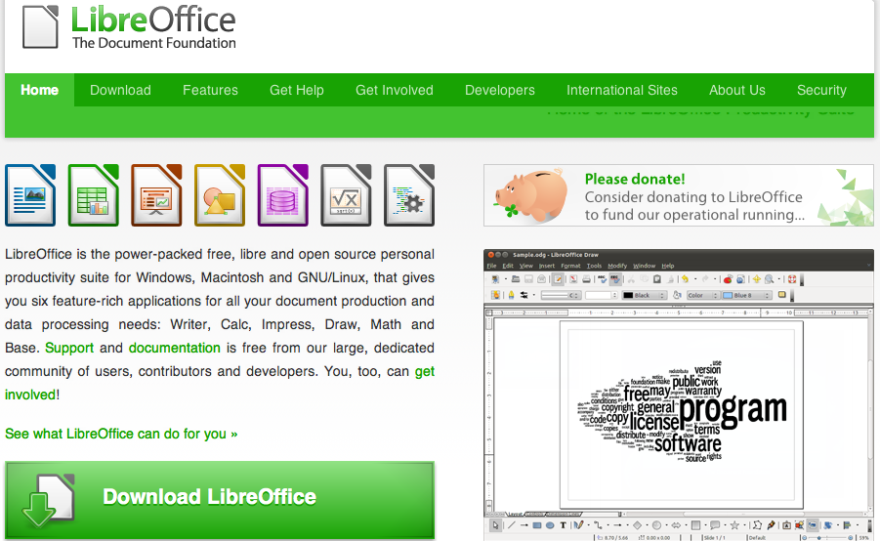
OSS projects: LibreOffice

Slide 9
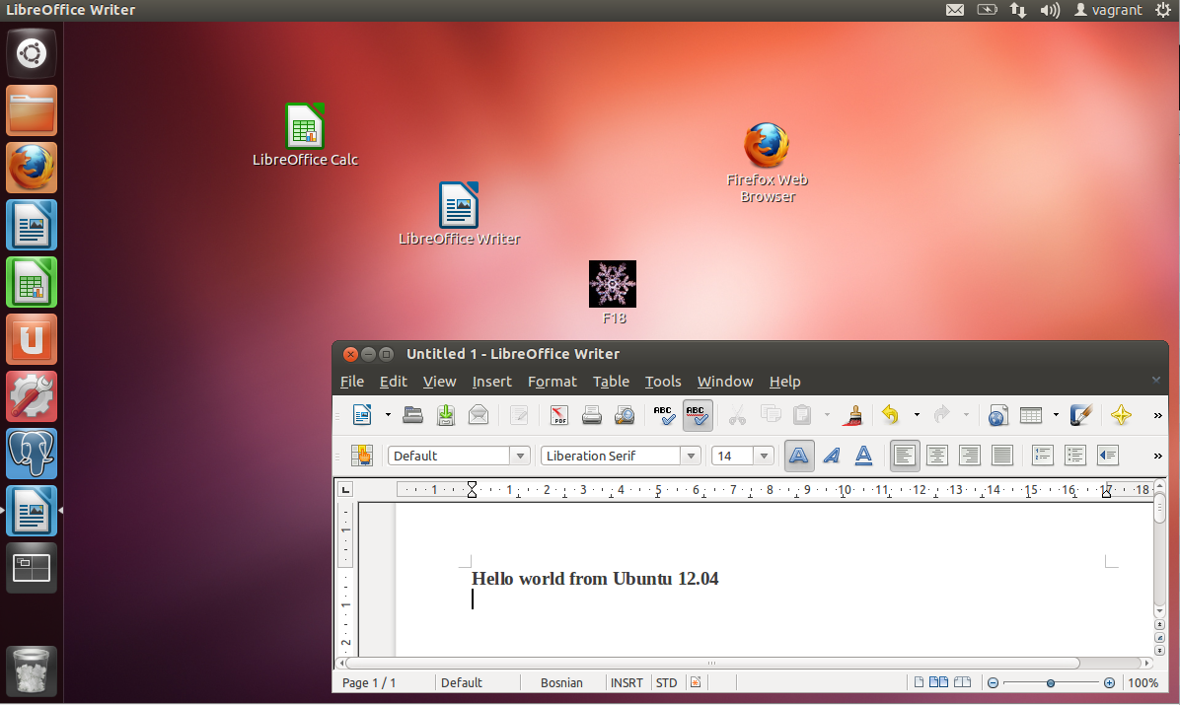
OSS projects: Ubuntu Linux OS

Slide 10
Software piracy
Software “Lock-in” - high costs of leaving a particular software environment
Software piracy as an instrument for market dominance
Software piracy full accounting for top-tier vendors:
  costs - lost of revenue due to unauthorized software usage
  benefits - market dominance

Slide 11
OSS adoption in region - Slovenia
Slovenia government's strategic moves
Building local capacities in IT and today's economy in general
Education has the central role in OSS adoption strategy

Slide 12
OSS in Bosnia and Herzegovina
Anti-OSS Government moves
  Law about fiscal systems
  => “Windows-only” fiscal systems
  Action on combating the software piracy
  => top-tier vendor's private police
Monocultural IT education
  no care about vendor neutrality
  low interest and lack of knowledge about OSS

Slide 13
Conclusion
BiH policy makers do not recognize the potential of the OSS.
“OSS ignorance syndrome”
BiH society “lives” in the IT past.
OSS is all about the knowledge.
As we live in “Information Age”, OSS adoption is the question of basic competitivness in today's world.

Slide 14
Questions ?
Thank you!
hernad@bring.out.ba
http://hernad.bring.out.ba

