Slide 1


Describing a Company

Slide 2
CONTENTS
1. Objectives
2. Vocabulary
3. Functional Content
4. Production
5. Delayed Feedback

Slide 3
Objectives
Part 01
* Enable learners to describe “companies”
* Discuss the state of a business
* Usage of Adverbs of Time
* Usage of Present Continuous Tense
* Conduct SWOT Analysis
* Usage of Superlatives and Comparatives in describing a company.
* Conduct PESTLEG Analysis

Slide 4
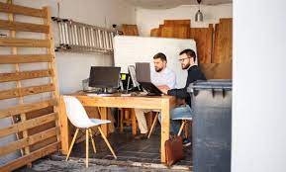

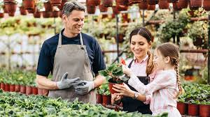
What type of company would you like to work in?

Slide 5


Vocabulary
1. The amount of money a company recieves from sales during a specific period is called turnover
2. Profit is the amount of money left after removing costs
3. A company that has 50% or more owned by another is called a subsidiary
4. We call employees the workforce of a company.
5. The amount of sales or customers that a company has in a market are refered to as the market share
6. The cost of a company’s shares is its share price
These are some of the words we can use to describe companies as well as their performance

Slide 6
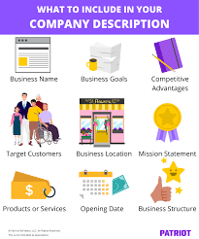

Slide 7
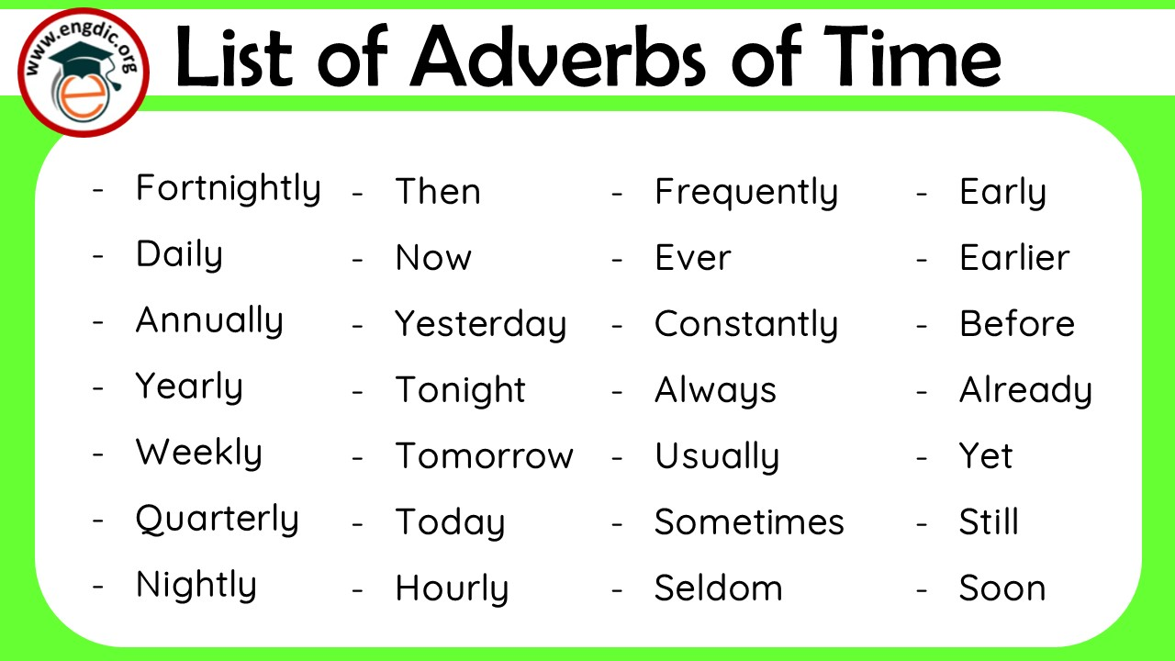
Obj 1: Adverbs of time
On a weekly basis we attend staff meetings online or in-person. The main goal for this is to report on whether we met our daily sales targets.
Our company usually wins the company awards in our industry at the industry conference that is held annually as we are the market leader.
We are constantly reminded by our management on the importance of understanding our company culture because this has always been our source of competitive advantage.

Slide 8
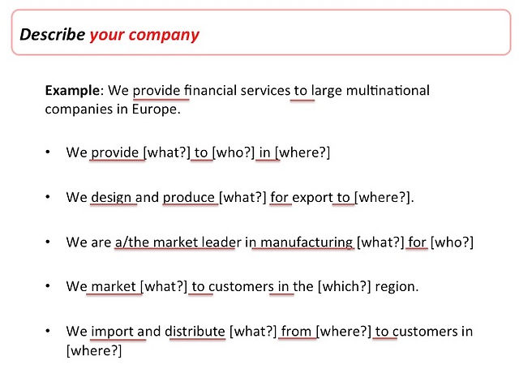


Slide 9

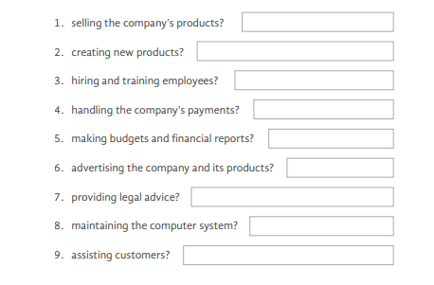
Obj 2: Present Continuous Tense:
Which department is responsible for

Slide 10
SWOT Analysis
PART.02
Using the vocabulary and tense that we discussed earlier, we will take the task of conducting an analysis that looks at our company’s current state of affairs internally and externally

Slide 11
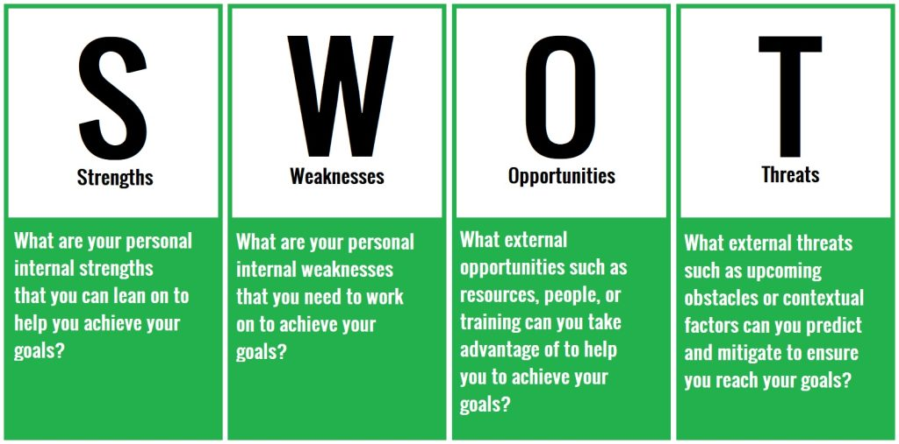

Slide 12

Strengths
These refer to the things that our company is doing right. These factors are internal and are mostly determined by the systems our company puts in place to achieve the goals and objectives as set by the vision of our company.
Activity
What are the strengths that you think set your company apart form the rest of your market?

Slide 13
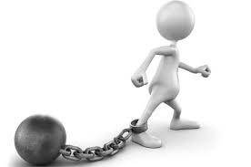
Weaknesses
Various things hold us back from from becoming the best versions of ourselves, however, the most important things usually require us to look into the mirror before blaming others for our failures.
Activity
What are the weaknesses that are holding your company back from fulfilling its full potential?

Slide 14
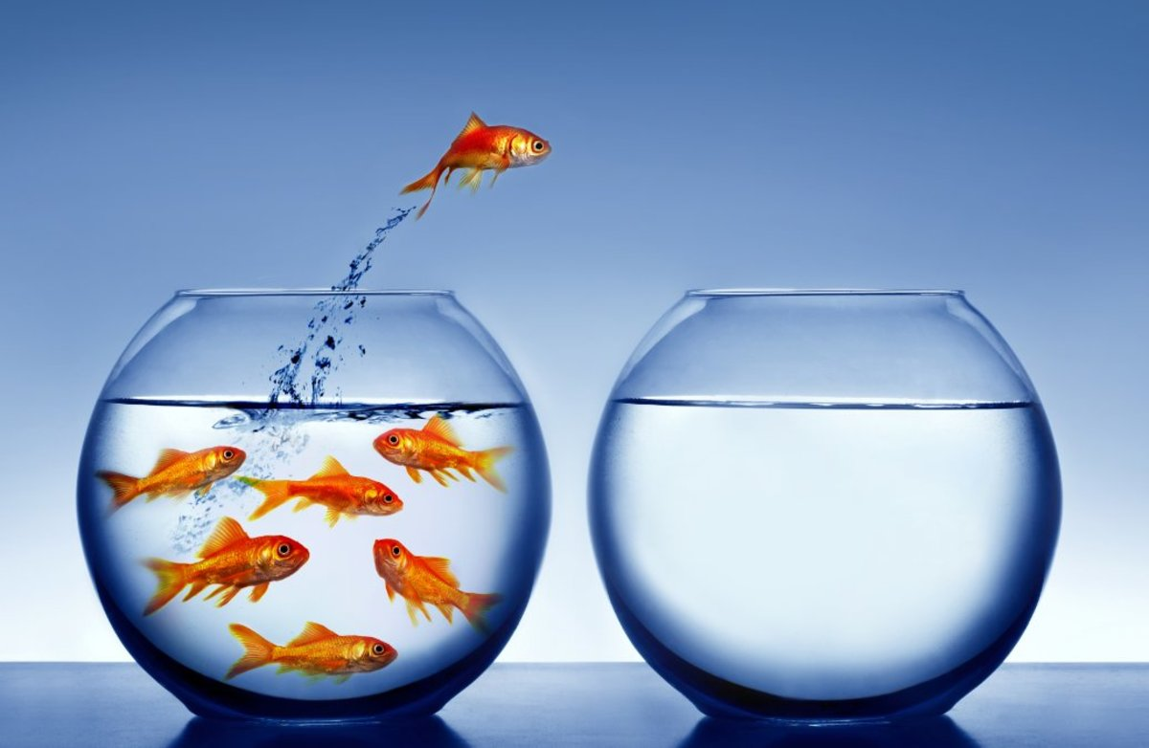
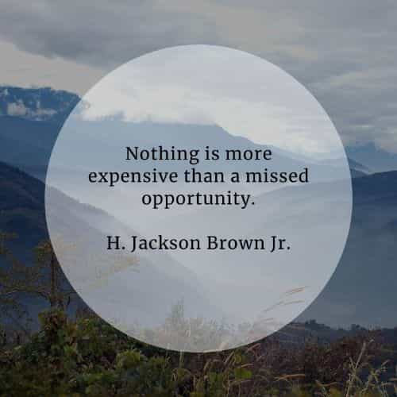
Opportunities
Activity
What are the opportunities that your company cannot afford to miss?

Slide 15
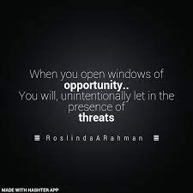
Threats
Activity
What threats may result from the opportunities that you mentioned in the previous task?

Slide 16
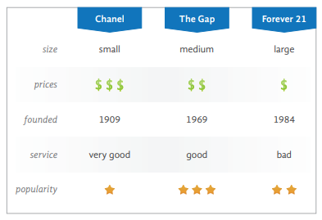
Obj 3: Superlatives and Comparatives
Using the information on the table, ask questions to practice the following comparatives and superlatives:
larger/largest smaller/smallest
more/less expensive most/least expensive
cheaper/cheapest older/oldest
newer/newest better/best
more/less popular most/least popular

Slide 17
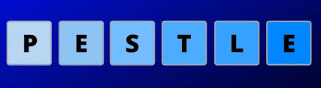
PESTLEG
PART.03
The environment in which our companies operate shapes greatly how the companies adapt as well as their structure among other things. In this section, we will venture to describe how our company manages to mitigate these external factors.

Slide 19
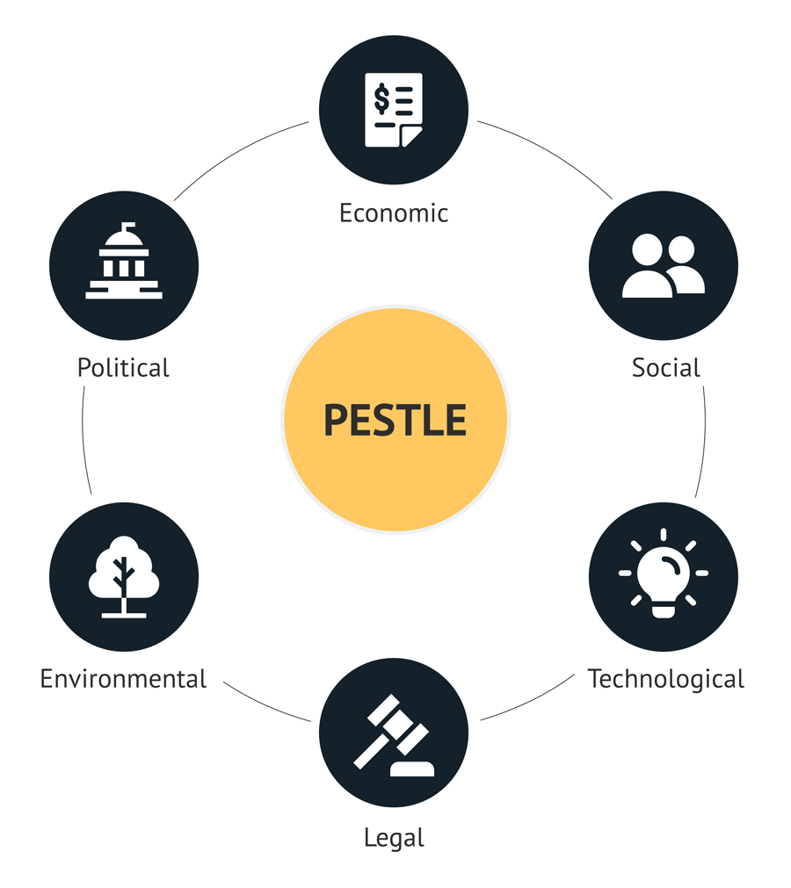
The traditional model consisted of these 6 factors, however, recently a 7th element was added which is Global Factors, modifying this to PESTLEG

Slide 20
Brainstorming for pestleg examples

Slide 21
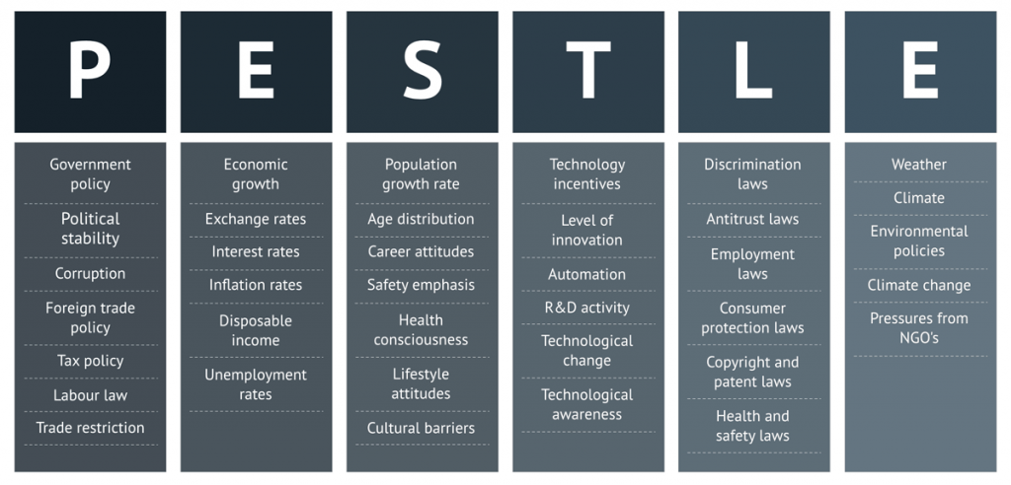

Slide 22
Delayed feedback

Slide 23
Questions?

Slide 24
THANK YOU FOR YOUR ATTENTION

