Slide 1


Business Organisation

Slide 2
CONTENTS
1. Objectives
2. Vocabulary
3. Functional Content
4. Production
5. Delayed Feedback

Slide 3

Objectives
Part 01
* To create a departmental/functional organogram
* Discuss thefunctions of the Marketing and HR Departments
* Usage of Simple Present vs Present Progressive
* Role play as interviewer and interviewee
* Usage of Simple Past and Past Progressive in an interview.
* Conduct Competitor Analysis

Slide 4

Which departments do they belong to and why?

Slide 5
Discuss which departments spend more money than they bring in or save?

Slide 6
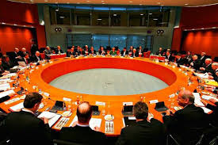
Vocabulary
1. The structure of a company showing the relationships between and among departments is called an organogram
2. Incentives and bonus’ are usually monetary motivational tools used to increase productivity and morale in a company
3. Companies conduct Training and Development
as a way to upskill their employees
4. When we take time away from work with full benefits it is called a Paid Holiday.
5. The time we are entitled to take a break from our jobs is regarded as Annual Leave days
6. The varying levels of authority - Hierarchy
Activity:
Give practical examples from your company of each scenario indicated in the vocabulary.
Which other terms have a simillar meaning to those in the vocab

Slide 7
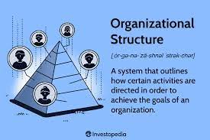
PART.02
Activity:
Is it easy for decisions to be made in your company?

Slide 8


Organisation Structure
This refers to how a company is divided according to its specific functions.
Depending on the culture of the company, some structures are hierarchical in nature. This means that they have many levels such from the general employee to top management. Such is evident in traditional companies.
Activity:
Identify the number of levels in your company structure, stating them in general.

Slide 9
Organisation Structure
This refers to how a company is divided according to its specific functions.
Depending on the culture of the company, some structures are hierarchical in nature. This means that they have many levels such from the general employee to top management. Such is evident in traditional companies.
Activity:
Identify the number of levels in your company structure, stating them in general.

Slide 10
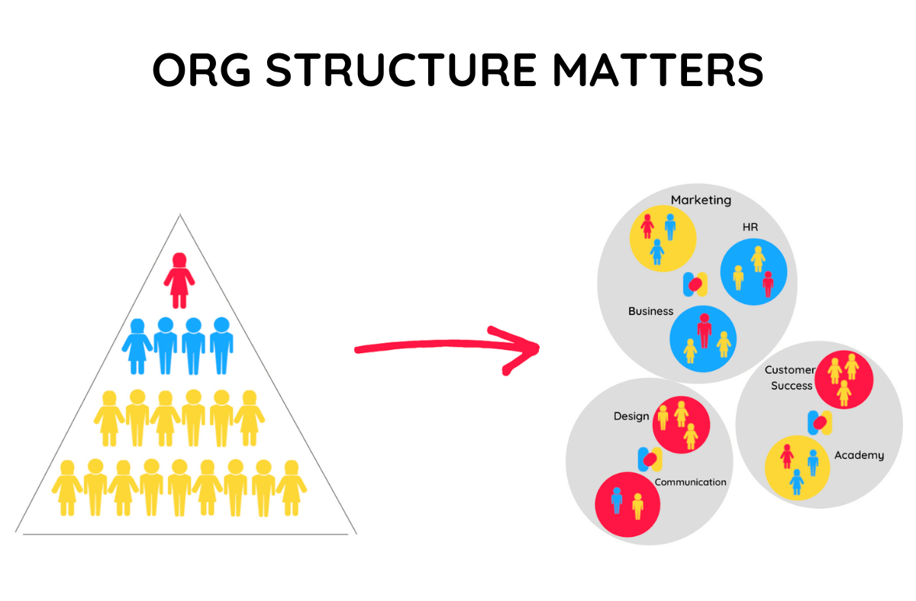

Activity:
Discuss the two structures indicated below describing the pro’s and con’s of each

Slide 11
Obj. 1 Organisation Structure
Activity:
* Do we have management in a Flat Structure?
* If yes, what is the purpose?
* Create your company Organogram

Slide 12
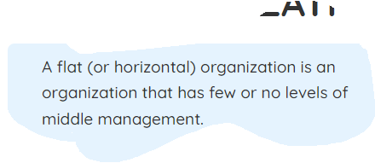
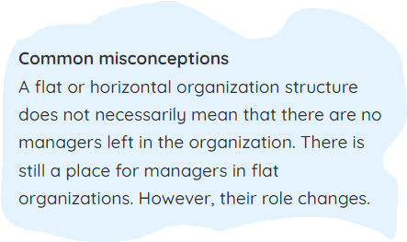
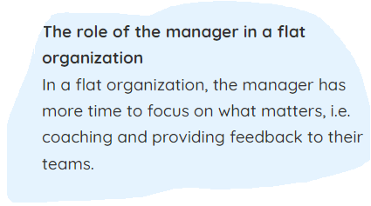
Organisation Structure
Activity:
* Do we have management in a Flat Structure?
* If yes, what is the purpose?

Slide 13
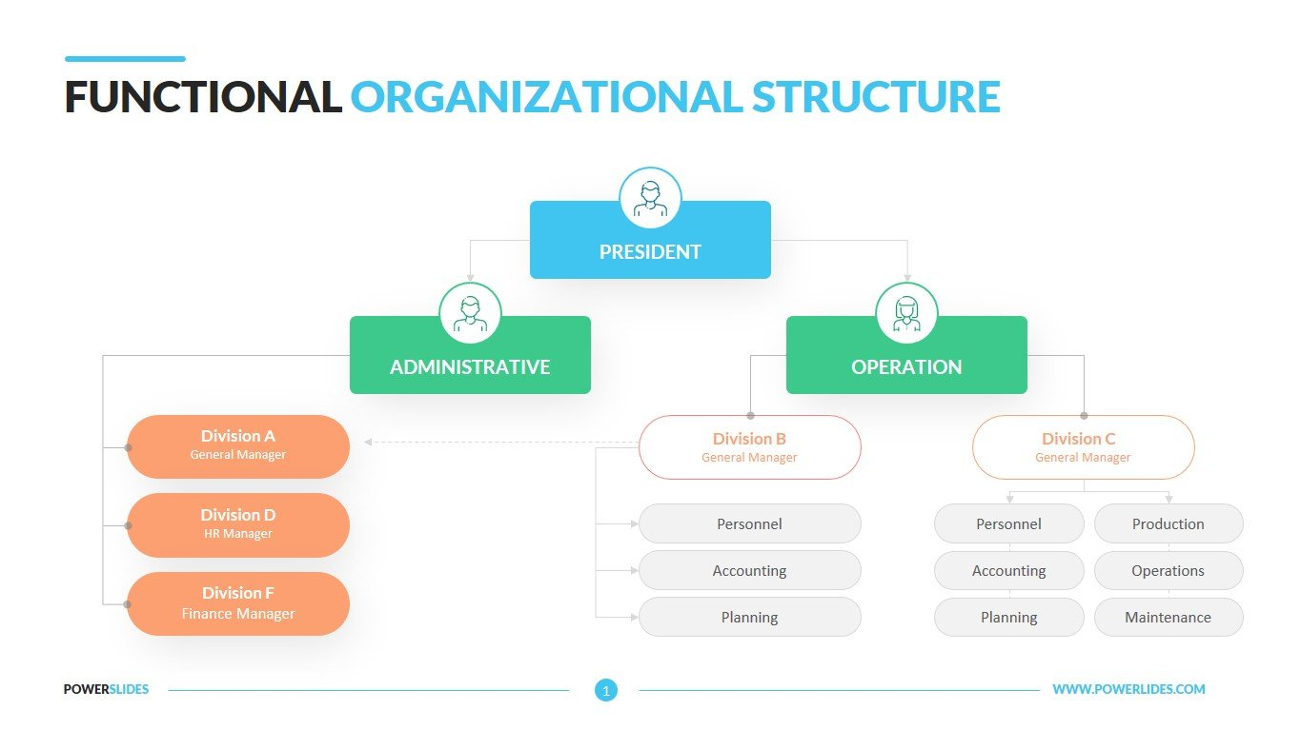

Slide 14
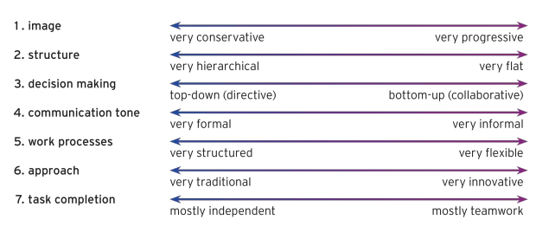
Organisation Structure
Activity:
Comparing the tall hierchy and the flat structure, which characteristics belong to which structure and why?

Slide 15
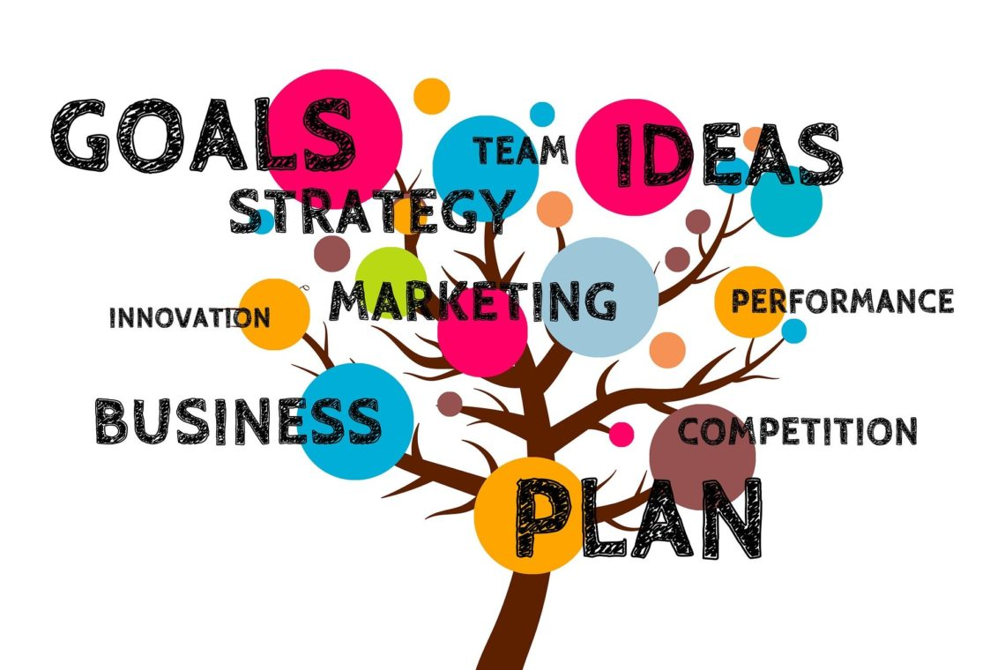
PART.03
Activity:
What comes to mind when you hear the term Marketing Department?

Slide 16

Marketing Department
"IF YOU DON'T HAVE A STRATEGY, YOU'RE PART OF SOMEONE ELSE'S STRATEGY." (ALVIN TOFFLER)
Activity:
Do we need the marketing department? Why?

Slide 17
Activity:
Do we need the marketing department? Why?

Slide 18
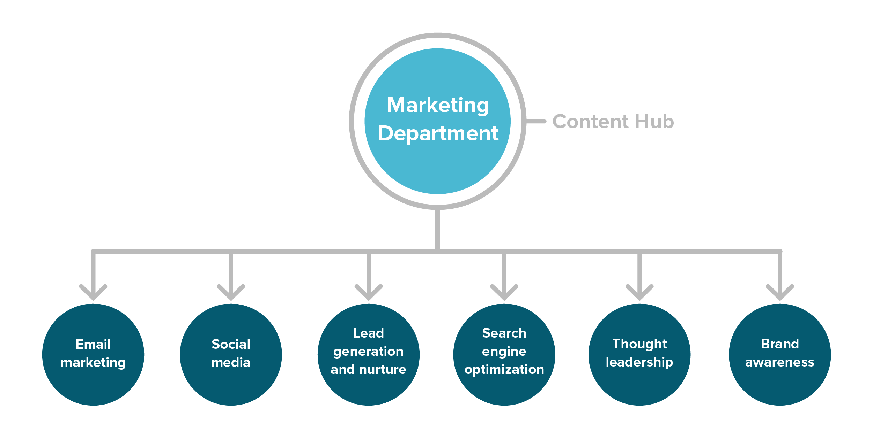

Slide 19

PART.04
Activity:
What are the main functions of the HR Department?

Slide 20
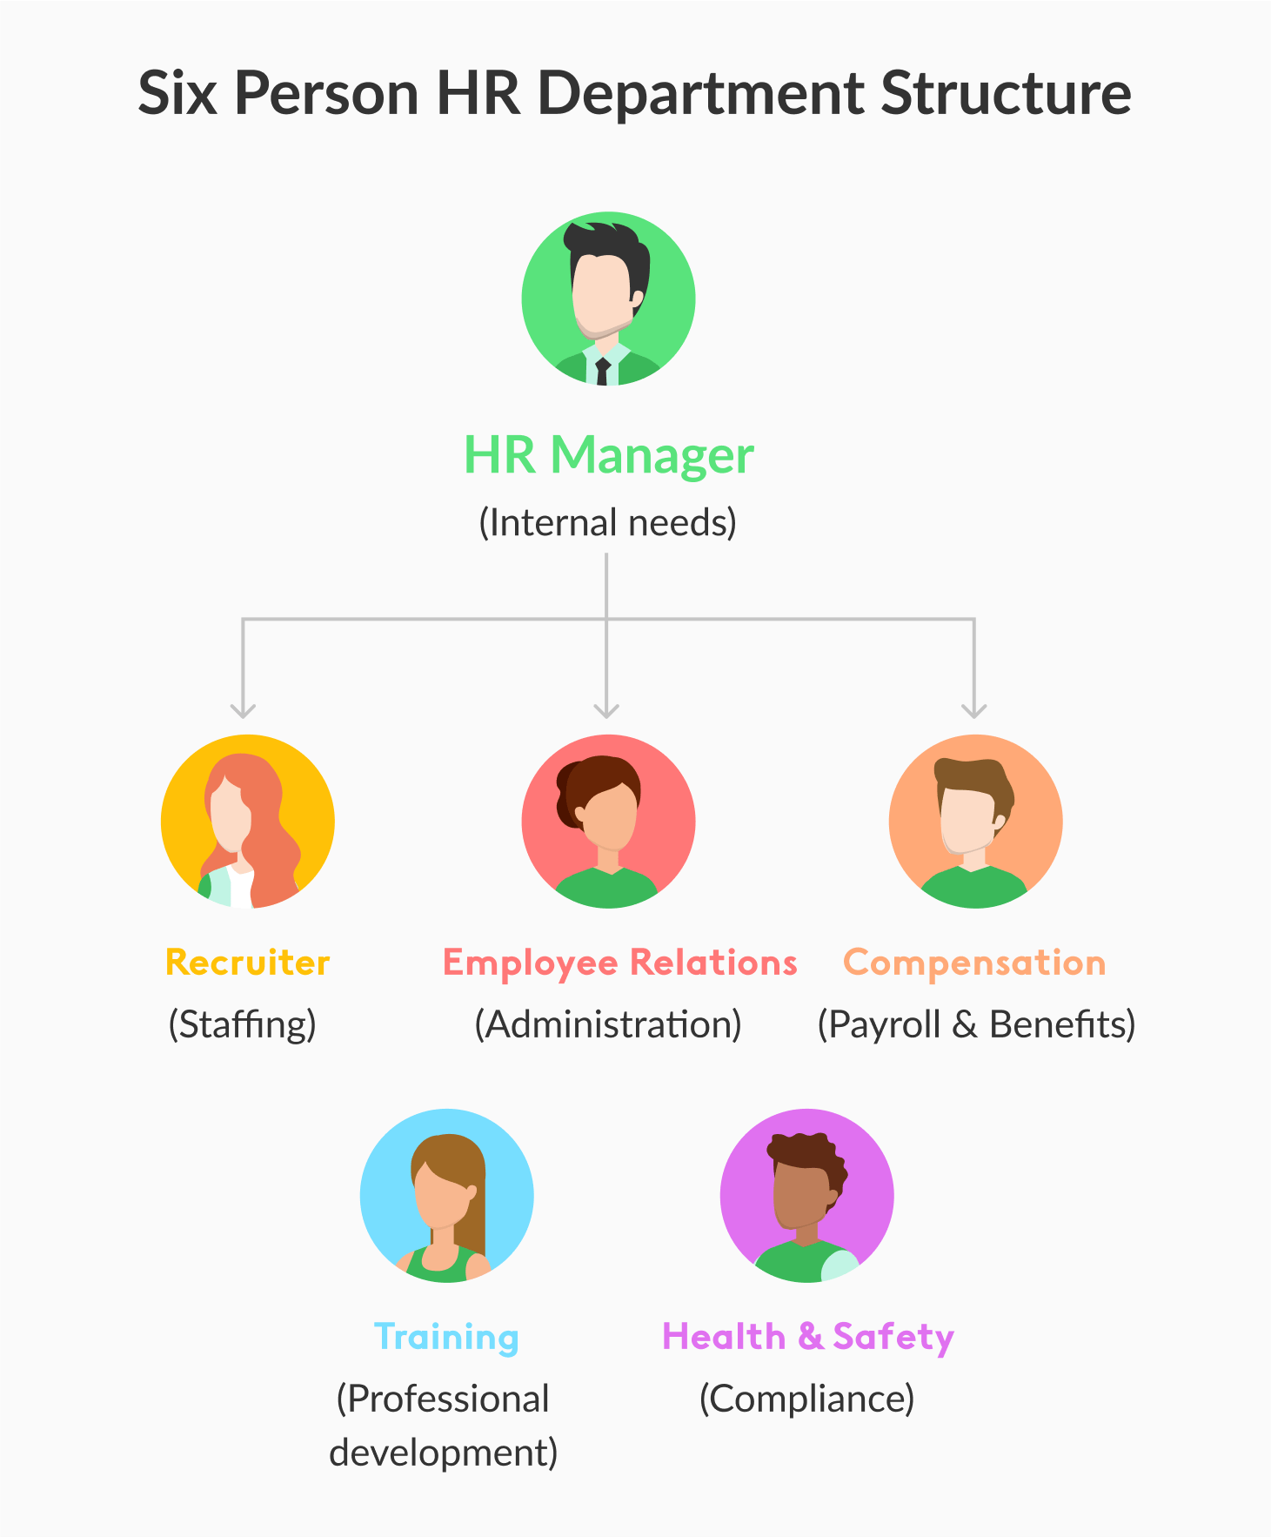

Slide 21

Obj 2: Simple Present vs Present Progressive :
What I’m responsible for in my current job
“As administrative support for the company’s VP, I efficiently organize their schedule so they can effectively steer the team.
I do this by maintaining detailed records, paying close attention to events they need to attend, and clearly communicating any time conflicts with them.
I’m also responsible for assisting client’s and co-worker’s on calls in a clear and friendly manner.
I saw that data entry was an important skill you’re looking for. I’m extremely experienced in Microsoft Excel and use my skills to create concise reports that summarize important metrics to my manager.”
Activity:
Using the present continuous, discuss your current role in your company.

Slide 22
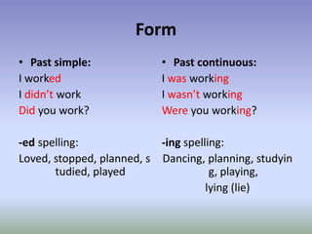
Obj 3: Simple Past vs Past Progressive
Activity:
Using the Past continuous, discuss the role you played in your previous job company.

Slide 23

Obj. 4
How would your last employer describe you?
What are your strengths?
What are your weaknesses?
Describe your work style.
What motivates you?
How do you handle stress?
What is the number one criticism about you?
How would you help this company to succeed?
Do you prefer to work individually or in a team?
How not to : http://www.youtube.com/watch?v=SP8tTGfm4jU
How to : http://www.youtube.com/watch?v=CnLQy0ACIOs

Slide 24
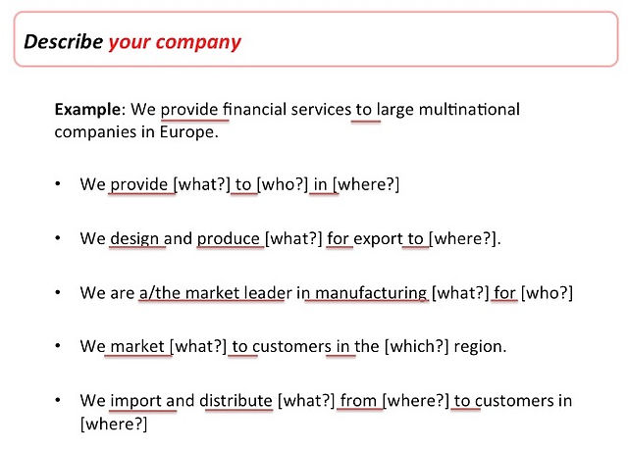


Slide 25
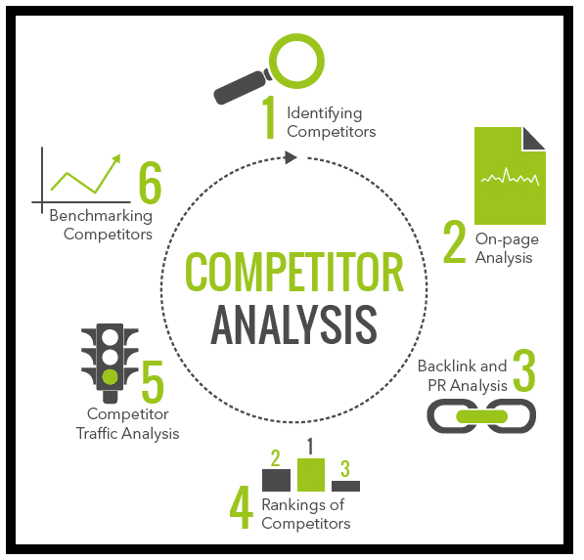
PART.05

Slide 26
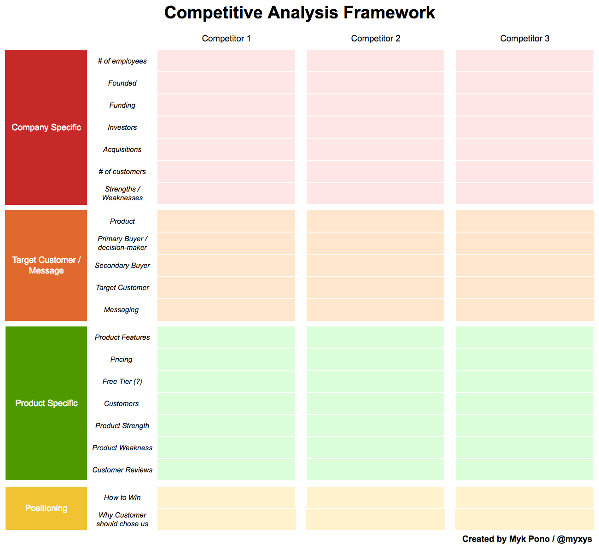

Slide 27
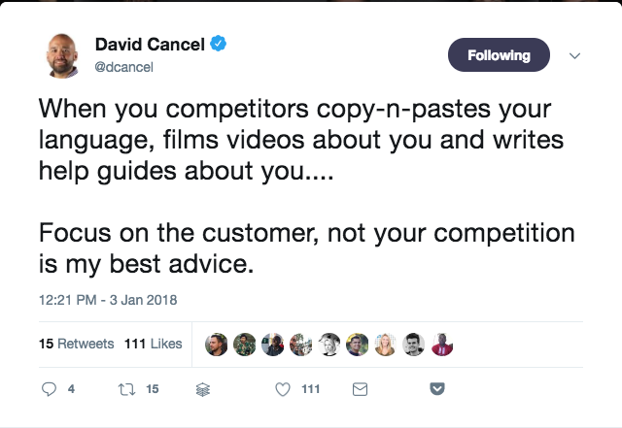
Obj. 5 Simple Present vs Present Progressive
* Identify which tense the screenshot is in.
*Convert the same screenshot into the present progressive form while retaining the same meaning.
Activity
Using the Present Contnuous, discuss how you can maintain a competitive edge in your market.

Slide 29
Delayed feedback

Slide 30
Questions?

Slide 31
THANK YOU FOR YOUR ATTENTION

