Slide 1


ENGLISH FOR BUSINESS
TuSpeaking

Slide 2

B1
BUSINESS RELATIONSHIPS

Slide 3
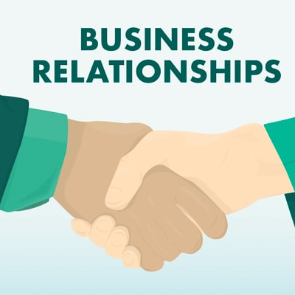
OBJECTIVES
Grammar
Conditional sentences
Past tenses
Vocabulary
Vocabulary related to my skills
Activity
Conduct a job interview

Slide 4
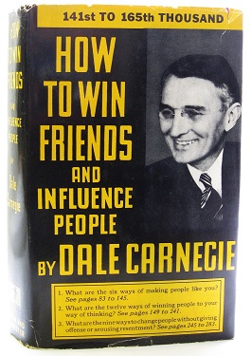
Conversation questions – Warm up
What relationships do people have at work/in business?
2. Are you good at making relationships? Why or why not?
3. Are technical skills or soft skills more important in the workplace?
"You can make more friends in two months by becoming interested in other people than you can in two years by trying to get other people interested in you."
Dale Carnegie (1888 – 1955), American self-improvement writer and speaker

Slide 5
BUSINESS RELATIONSHIPS

Slide 6
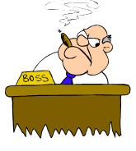
GETTING ALONG WITH YOUR SUPERVISOR/BOSS
The role of a supervisor/manager/boss
A manager is someone who supervises your productivity and manages workplace assignments and large projects.
Depending on your role, you may find that you have somewhat regular interactions with people in this position as you must directly report to them.
The supervisor regularly sets workplace goals for subordinates within an organization and communicates with higher-ups within the organization to make recommendations about renewing contracts,
The supervisor also defines or manages workplace responsibilities and suggests people for advancement or promotion.
What is the role of your supervisor?

Slide 7
GETTING ALONG WITH YOUR SUPERVISOR/BOSS Vocabulary
Benefits to Cultivating a Better Relationship With Your Boss
You get better feedback
You become more trusted
You are more likely to get promotions and raises.
You feel more motivated at work
What does your supervisor/manager/boss expect from you?
Commitment
loyalty
hard-work
honesty
competency
reliability
What other benefits can you think of?

Slide 8
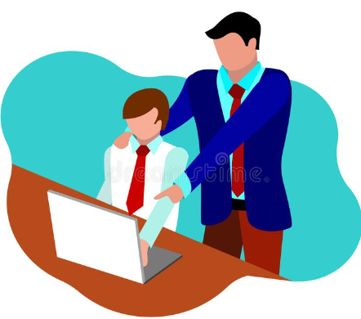
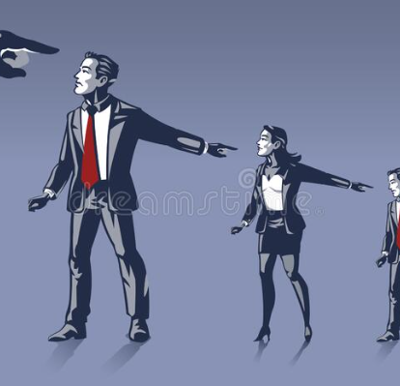
GETTING ALONG WITH YOUR EMPLOYEES/SUBORDINATES
Strong employee/employer relations can take many forms.
What works for one business may not work for another.
Employers should, therefore, not try to model their employee/employer relations on someone else’s ideals.
Employers should find out what works for them, and then strive to maintain a good relationship with their team.
When you make strong employee/employer relations a priority, you set your business on the road to success.

Slide 9
GETTING ALONG WITH YOUR EMPLOYEES/SUBORDINATES
Useful phrases to use when speaking with your employees
You have great potential.
My expectations for you are …
How can I help you?
How can I be of assistance?
Great job!
What do you think about this?
What are your thoughts?
Let’s try it your way.

Slide 10
GETTING ALONG WITH YOUR EMPLOYEES/SUBORDINATES
WAYS OF DEVELOPING GOOD RELATIONSHIPS WITH YOUR EMPLOYEES
Avoid micromanaging
Embrace diversity
Be fair
Delegate work to others
Set reasonable goals
Include employees in decision making
Conduct performance reviews
Can you think of other ways of developing good relations with your employees?

Slide 11


GETTING ALONG WITH YOUR CO-WORKERS
Getting along with colleagues can not only make working more pleasant, but it can also help boost your career.
Good manners, respect, and general kindness toward your colleagues go a long way.
Resist oversharing or talking about sensitive topics that can alienate colleagues.
Activity - Describe a good co-worker.

Slide 12
BUSINESS RELATIONSHIPS Part 2 – Carry out a job interview

Slide 13

Soft skills
Interpersonal skills
Adaptability
Active listening
Attention to detail
Can you think of any other soft skills?

Slide 14
Technical skills
CAD software
Video editing
Programming languages (such as Java, Python, or C++)
Operating systems (such as Windows, Linux, or macOS)
Can you think of any other technical skills?

Slide 15

Vocabulary
Interviewer - the person who conducts the job interview
Candidate - the person who is being interviewed for the job
Resume/CV - a document summarizing the candidate's work experience, skills, and education
Cover letter - a letter sent with a resume/CV that explains why the candidate is interested in the job and how they are qualified for it
Job application - a document used to apply for a job
Qualifications - the skills, education, and experience needed for a particular job
Experience - previous work or life experience that relates to the job
Skills - specific abilities and knowledge that are relevant to the job

Slide 16

Vocabulary
Strengths - positive qualities or attributes that the candidate possesses
Weaknesses - areas in which the candidate needs improvement
Reference - a person who can provide a recommendation for the candidate
Salary - the amount of money paid to the employee for their work
Benefits - additional compensation or perks offered to employees, such as health insurance, vacation time, or retirement plans
Performance review - a meeting between the employer and employee to discuss the employee's job performance
Job offer - an offer of employment given to a candidate who has successfully completed the interview process.

Slide 17

Job interview questions
Can you tell me about yourself?
Sure, I'm a recent college graduate with a degree in marketing. I've completed several internships in the field and I'm excited to start my career. In my free time, I enjoy hiking and reading.
What are your strengths?
One of my strengths is my ability to work well in a team. I enjoy collaborating with others and I think that my communication skills help facilitate teamwork. Another strength of mine is my attention to detail, which allows me to catch mistakes and ensure that my work is of high quality.
What are your weaknesses?
I would say that one of my weaknesses is public speaking. It's not something that comes naturally to me, but I've been working on it by practicing in front of a mirror and taking public speaking courses.
Why do you want to work for this company?
I'm excited about the work that this company is doing in the field of sustainable energy. I've always been interested in environmental issues, and I think that this company's mission aligns with my values.

Slide 18
Job interview questions
Can you tell me about yourself?
Sure, I'm a recent college graduate with a degree in marketing. I've completed several internships in the field and I'm excited to start my career. In my free time, I enjoy hiking and reading.
What are your strengths?
One of my strengths is my ability to work well in a team. I enjoy collaborating with others and I think that my communication skills help facilitate teamwork. Another strength of mine is my attention to detail, which allows me to catch mistakes and ensure that my work is of high quality.
What are your weaknesses?
I would say that one of my weaknesses is public speaking. It's not something that comes naturally to me, but I've been working on it by practicing in front of a mirror and taking public speaking courses.
Why do you want to work for this company?
I'm excited about the work that this company is doing in the field of sustainable energy. I've always been interested in environmental issues, and I think that this company's mission aligns with my values.

Slide 19

Job interview questions – Ask and answer the questions
Can you tell me about yourself?
What are your strengths?
What are your weaknesses?
What skills do you have?
What motivates you?
What experience do you have?

Slide 20
Job interview questions – Brainstorm some interview questions for your own role, then interview your partner for your job
What
When
How
Why
Where
Have you
Did you

Slide 21
FEEDBACK

Slide 22
Thank you

