Slide 1

Business English
Tuspeaking

Slide 2


Product Marketing - Describing What My Company Offers
Discover how to articulate the features and benefits of a product and how they address customers' needs and pain points. Let's dive in!

Slide 3
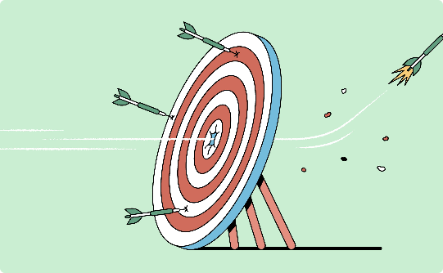
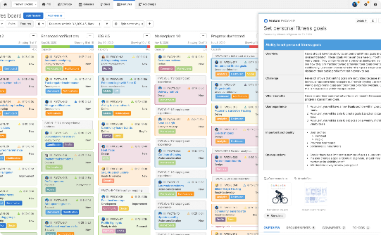
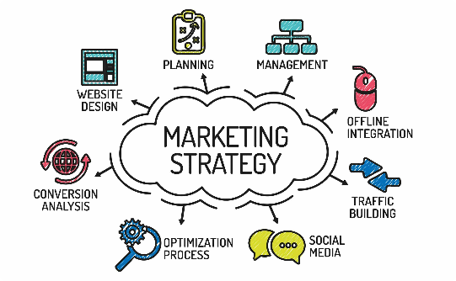
Why Product Marketing Matters
Effective product marketing is crucial to maximizing sales and growing your business. Learn why it's so important and how to do it well.
Understanding Your Target Market
Highlighting Product Features
Crafting A Winning Marketing Strategy
Highlighting the unique features of your product helps differentiate it from others and generates interest.
Identifying your target market helps you tailor your message and product offerings to their specific needs and preferences.
A successful marketing strategy requires careful planning, a deep understanding of your target market, and a message that resonates with them.

Slide 4
Identifying Your Target Audience
Identifying your target audience is crucial to crafting a successful marketing message. Learn how to identify your ideal customer and effectively target them.
Age Group
Interests and Behaviors
Determine the typical age range of your target audience.
Understand the interests and behaviors of your target audience to effectively target them.
Demographics
Location
Consider the education level, income bracket, and other relevant demographics of your target audience.
Understand where your target audience is located to tailor your message to their specific geographic location.

Slide 5
Unique Value Proposition
Learn how to develop your unique value proposition and effectively market your products.
How to Communicate Your Value Proposition
Develop a clear and concise message that communicates your unique value proposition.
1
2
3
What Makes Your Product Unique?
Benefits of Communicating Your Unique Value Proposition
Determine the unique value proposition of your product.
Effectively communicating your unique value proposition leads to increased awareness and sales.

Slide 6
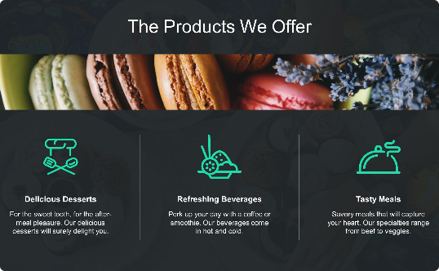
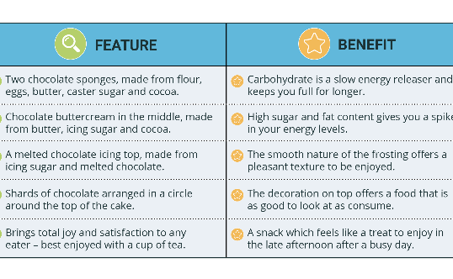
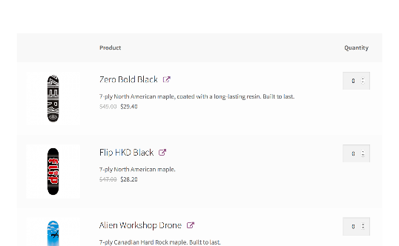
Product Offerings and Features
Learn how to effectively organize and communicate the offerings and features of your products.
Product Offerings
Product Features
Product Bundles and Promotions
Effectively organizing and communicating the different offerings your company provides is crucial to success.
Highlighting the unique features of each product generates interest and helps differentiate it from others.
Creating product bundles and promotions is an effective way to boost sales and generate interest in your products.

Slide 7

Crafting an Effective Product Message
The right message can make all the difference. Learn how to craft an effective product message that resonates with your target audience.
Clear and Concise Messaging
Use Creative Language and Imagery language
1.
2.
Develop a message that clearly and concisely communicates the benefits and unique features of your product.
Use creative language and imagery that resonates with your target audience to generate interest and differentiate yourself from the competition.
3
Be Different
Make sure your message sets you apart from your competition and strikes a chord with your target audience.

Slide 8
let’s take a closer look
An example will be provided in the next slide.

Slide 9
Features of Our Product
User-Friendly Interface
Multi-Device Compatibility
Our product has an intuitive design that simplifies the workflow of your business process, saving you time and effort in the long run.
Our product is accessible on every device, whether it's a smartphone or a desktop computer. It provides consistent performance without any limitations.
Customization
Automation
Our product offers a wide range of customization options that let you tailor it to your company's specific needs, so you can have a unique experience that fits you perfectly.
Our product automates repetitive tasks, allowing you to focus on more important aspects of your business. It streamlines the process of data management and reduces the risks of errors.

Slide 10
Benefits of Our Product
Improves Decision-Making
Our product provides insights into your business data, allowing you to make informed decisions based on current and accurate information.
1
2
3
Boosts Productivity
Reduces Cost
Our product's efficient workflow saves the user time and energy. It replaces manual processes with automation, allowing for more output in less time.
Our product streamlines business processes, eliminating the need for extra staff or multiple products. This saves money and reduces complexity, leading to a better return on investment.

Slide 11



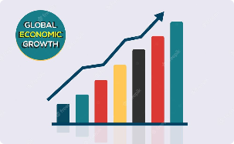
Customer Needs and Pain Points
Reducing Frustration with Difficult Processes
Managing Stress
Reducing Risk
Scaling Businesses in the Digital Era
Business operations and management often lead to high-stress levels among employees. Our product deals with the automation and management of tasks, leaving one less burden for your team to worry About.
Errors can make or break business deals. Our product is designed to automate repetitive procedures, thus reducing the risk of errors and saving time for auditors.
Business processes are often tedious, long, and frustrating. We want to make those processes as simple and seamless as possible to reduce frustration levels.
Our world is more digitalized than ever, making those who do not keep up fall behind. Our product is helping businesses survive and grow in the digital age.

Slide 12


How Our Product Addresses These Needs and Pain Points
1
Process Management
2
Intuitive Design
Our product automates the tedious and repetitive business processes, leaving more time for productive and strategic work.
Our software has an easy-to-use interface that requires little to no training or experience, reducing frustration and stress among employees.
3
Real-Time Insights
4
Flexibility and Customization
Our product tracks data in real-time, providing insight that optimizes decision-making and helps prevent costly mistakes.
Our product provides a range of tools that can be tailored to meet the specific needs of your company. This allows you to fully customize the software to optimize your processes.

Slide 13
Discussion Questions:
1. How Can We Identify Our Customers' Needs?
2. How Can We Effectively Communicate The Benefits Of Our Product?
Notes:
Answers such as; Market research, customer feedback, and the use of predictive analytics can all give a clear understanding of customers' needs and preferences.
2. A customer-focused approach that highlights how the product solves their problems, combined with clear and concise messaging that uses compelling visual aids, can help to communicate the benefits effectively

Slide 14
Quote – Do you agree? Why/Why not.
"Good marketing makes the company look smart. Great marketing makes the customer feel smart." - Joe Chernov

Slide 15
Disclaimer
The content of this slide show was in part generated using AI technology and was formatted and reviewed by Learning Like a Lioness.

Slide 16

Delayed feedback

Slide 17

Thank you!

