Slide 1


Business English
Tuspeaking

Slide 2

Identify Cultural Differences in Business Practices
Gain insight on understanding different cultures in business practices and why it matters in the global economy.

Slide 3
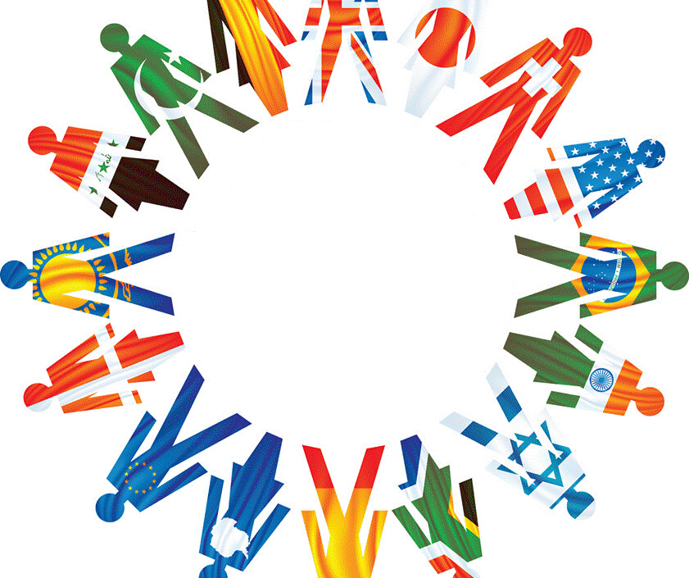
Warm-up
What are the norms for making eye contact in your culture?
What is the appropriate way to give and receive gifts in your culture?
How do you typically negotiate business deals in your culture?
What is the appropriate dress code for business in your culture?
How important is punctuality in your culture?
How do you address people in your culture?
What are the roles of men and women in business in your culture?
This Photo by Unknown Author is licensed under CC BY

Slide 4
Useful Vocabulary
Phrasal verbs:
Break the ice: To start a conversation or interaction with someone you don't know well.
Get in touch: To contact someone, usually by phone or email.
Make a scene: To cause a disturbance or commotion in public.
Put your foot in your mouth: To say something foolish or embarrassing.
Stick out like a sore thumb: To be very noticeable or different from others.
Idioms:
A bird in the hand is worth two in the bush: It is better to have something you know you can get than to risk not getting something better.
Don't judge a book by its cover: Do not make assumptions about someone or something based on their appearance.
Every cloud has a silver lining: There is always something positive to be found, even in difficult situations.
Strike while the iron is hot: Take advantage of an opportunity when it arises.
The grass is always greener on the other side of the fence: People often believe that things are better in other places than they are in their own lives.

Slide 5
Let’s put it into practice
When I was in Japan, I tried to ___ the ice with the locals by talking to them about their culture.
I ___ in touch with my friend from China by sending her a message on WeChat.
The tourist ___ a scene when he was denied entry to the temple because he was wearing shorts.
I ___ my foot in my mouth when I told my Japanese host that I didn't like sushi.
I ___ like a sore thumb in my new job because I was the only one who didn't speak the language.
Break the ice: to start a conversation or interaction with someone you don't know well.
Get in touch: to contact someone, usually by phone or email.
Make a scene: to cause a disturbance or commotion in public.
Put your foot in your mouth: to say something foolish or embarrassing.
Stick out like a sore thumb: to be very noticeable or different from others

Slide 6

Different Types of Cultural Differences in Business
1
Customs and traditions
2
Language and communication
Unspoken rules of communication and etiquette that vary between different cultures
The differences in tone, language, and nonverbal communication between cultures
3
Attitudes and beliefs
4
Values and norms
The impact of cultural attitudes and beliefs towards work ethics and decision-making in business
The way culture's view hierarchy, conflict, time management, and the role of technology in business

Slide 7
Communication and culture.
What are the different types of communication styles?
How do communication styles vary across cultures?
What are some of the cultural factors that influence communication style?
How can I adapt my communication style to be more effective when communicating with people from other cultures?
What are some common misunderstandings that can occur due to cultural differences in communication style?
How can I avoid these misunderstandings?
What are some resources that I can use to learn more about communication styles and culture?

Slide 8
Communication Styles and Etiquette
1
Direct vs. Indirect Communication
Some cultures communicate in a straightforward manner while others are more indirect, relying on context and unspoken communication.
Formal vs. Informal Communication
2
The level of formality varies between cultures, with some valuing a more formal approach to communication and others favoring a personal and informal approach.
3
Nonverbal Communication
Nonverbal communication varies, from the use of gestures, eye contact, and body language across cultures.

Slide 9



Meeting and Negotiation Customs
Punctuality and Greetings
Conflict Resolution
Negotiation Styles
Some cultures expect punctuality in meetings while others have a more relaxed approach, and the way of greeting also varies from culture to culture.
The way cultures deal with conflicts in a business setting varies, with some valuing direct confrontation while others prefer a more indirect approach.
Negotiation styles vary, with some cultures adopting a competitive and assertive approach while others focus on building relationships and reaching a mutually beneficial agreement.

Slide 10
Gift-giving and Hospitality
Business Gifts
Food and Drink Customs
Hospitality Practices
The traditions of gift-giving vary among cultures, and some countries may have specific customs and protocol surrounding gift-giving in business settings.
In some cultures, it is customary to offer food and drink to guests in a business setting and declining it may cause offense.
The level of hospitality expected in business settings varies among cultures, with some emphasizing formal settings and others valuing a more casual environment.

Slide 11
Strategies for Navigating Cultural Differences
Research the Culture
Be Respectful and Open-minded
Focus on Building Relationships
Learn as much as you can about the culture you're interacting with, including customs, language, and beliefs.
Respect differences and be willing to adapt your communication style to fit the cultural expectations of your audience.
Building relationships is critical to doing business in some cultures, so prioritize taking the time to get to know your partners and clients.

Slide 12
Let’s discuss further
What are the key cultural differences that businesses need to be aware of when doing business internationally?
How can businesses adapt their communication and business practices to different cultures?
How can businesses build trust and rapport with business partners from different cultures?
How can businesses avoid cultural misunderstandings and conflicts?
How can businesses manage cultural diversity within their workforce?

Slide 13
Read the dialogue on slide 11 and discuss
Answer the questions
Characters:
Spanish Businessperson: A confident and outgoing individual who is used to doing business in a direct and straightforward manner.
Chinese Businessperson: A more reserved and indirect individual who is accustomed to following a more formal and hierarchical approach to business.
What do you think of the different approaches to business taken by the Spanish and Chinese businessperson?
Do you think it is important to build relationships before doing business with someone? Why or why not?
What are some other cultural differences that could have led to misunderstandings between the two businesspersons?
How can businesspersons from different cultures avoid misunderstandings?
What are some benefits of doing business with people from different cultures?
What are some challenges of doing business with people from different cultures?
What advice would you give to a businessperson who is about to do business with someone from a different culture?
Who should compromise. Explain

Slide 14
Scene: A meeting between a businessperson from Spain and a businessperson from China.
Spanish Businessperson: (Shakes Chinese Businessperson's hand firmly.) Nice to meet you, Mr. Wang! I'm very excited about the opportunity to work with your company.
Chinese Businessperson: (Nods politely.) Nice to meet you too, Mr. Garcia. We are also looking forward to working with you.
Spanish Businessperson: (Gets down to business.) So, let's talk about the project. I think we can get this done quickly and efficiently if we just focus on the goals and stay focused.
Chinese Businessperson: (Pauses.) I understand your desire to be efficient, Mr. Garcia. However, it is important for us to build relationships first. We would like to get to know you better and understand your culture before we talk about business.
Spanish Businessperson: (Is taken aback.) I see. I didn't know that building relationships was so important in Chinese culture.
Chinese Businessperson: Yes. We believe that it is essential to build trust and rapport before we can do business with someone.
Spanish Businessperson: (Nods.) I understand. I'm willing to take the time to get to know you better.
Chinese Businessperson: (Smiles.) Thank you, Mr. Garcia. We appreciate your flexibility.

Slide 15
Do you agree? Explain.
"Don't assume that your way of doing things is the best way. Be open to learning from other cultures." - Heidi Smith, author of "The Cultural Compass"

Slide 16
Summary
Cultural differences in business practices can make or break a deal, but by understanding the customs and protocols of different cultures, you can avoid misunderstandings and build long-lasting relationships with partners around the world. Remember to be respectful, open-minded, and willing to adapt your approach.

Slide 17
Disclaimer
The content of this slide show was in part generated using AI technology and was formatted and reviewed by Learning Like a Lioness.

Slide 18

Delayed feedback

Slide 19

Thank you

