Slide 1

Business English
Tuspeaking

Slide 2

Breaking Down Communication Barriers in Teams and Cross-Departmental Communication
Effective communication plays a vital role in achieving success for any team or organization. Let's explore the importance of cross-department communication and common communication barriers in teams.

Slide 3


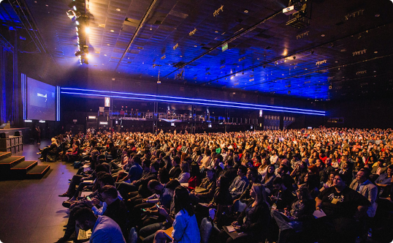
Importance of Cross-Departmental Communication
Teamwork
Partnership
Networking
Collaboration, sharing of knowledge and skills, and working synergistically are critical to achieving a common goal.
Effective communication methods build a mutually beneficial relationship with partners, creating opportunities for growth and profitability.
Facilitating networking amongst various departments of an organization fosters better collaboration, creates trust, and enhances productivity.

Slide 4
Common Communication Barriers in Teams
Ineffective Listening
Lack of Clarity
Most communication breakdowns stem from a lack of active listening, whether intentional or unintentional.
Using unclear language, jargon, or unfamiliar technical terms can cause communication breakdowns, leading to confusion and misunderstandings.
Language Barriers
Emotional Intelligence
Language barriers and cultural differences can have a significant impact on how messages are conveyed and understood, leading to misinterpretations.
The inability to understand the emotional context of a conversation, and respond appropriately, can contribute to ineffective communication and poor team dynamics.

Slide 5
Discuss the questions below
Language differences:
Jargon:
How can you ensure that everyone involved in a cross-department project understands each other, even if they speak different languages?
What are some strategies for translating jargon and technical terms into plain language?
How can you create a welcoming and inclusive environment for people from different cultures?
What are some ways to identify and define jargon that is specific to your organization?
How can you create a glossary of terms that everyone can reference?
How can you encourage people to use plain language instead of jargon?

Slide 6
Discussion continued…
Cultural nuances
Hierarchical structures:
What are some cultural norms and expectations that you should be aware of when communicating with people from other cultures?
How can you avoid making assumptions about someone's culture?
How can you build trust and rapport with people from other cultures?
How can you create a sense of equality and collaboration between departments, even if there is a clear hierarchy?
How can you encourage people from different departments to share ideas and feedback?
How can you resolve conflicts between departments?

Slide 7
Tips for Effective Cross-Departmental Communication
Assess Your Audience
Enable clear communication that is tailored to the specific need of a department, instead of using generic content or strategies that will not resonate with a particular group.
1
2
3
Implement a Communication Plan
Use Multiple Channels
A communication strategy that includes instructions and protocols for sharing information, setting goals, and reporting progress can help align departments towards a common goal.
Use a variety of channels to communicate across departments, including email, chat apps, video conferencing, and face-to-face meetings.

Slide 8

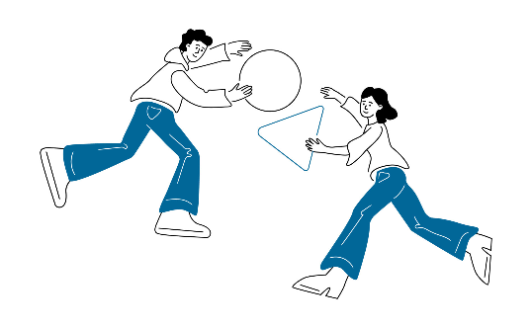
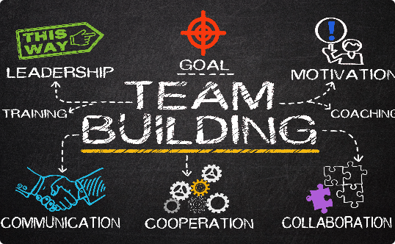
Strategies for Successful Communication in Teams
Celebrate Success
Encourage Brainstorming
Team Building Activities
Publicly acknowledge and celebrate team success to continue building relationships, and instil values of collaboration and transparency.
Brainstorming enables team members to express their ideas, collaborate and come up with better solutions.
Team-building activities encourage bonding, and help highlight individual strengths and weaknesses to foster better communication and trust, thus improving team performance.

Slide 9

Best Practices for Improving Communication Skills
1
Practice Active Listening
2
Use Constructive Criticism
Listen attentively to others, communicating an interest, and making them feel valued. Also, avoid interruptions, and ask follow up questions.
Provide feedback in a clear, compassionate, constructive, and actionable way by separating individuals from their actions and suggesting alternative behaviour.
3
Invest in Yourself
Develop excellent communication skills by investing in training, reading, writing, and practicing various communication strategies.

Slide 10
Let’s put your skills to the test.
Mime It Out Activity | Nonverbal communication | Observational skills, attention to detail
Sound Recognition Activity | Listening concentration | Focus, present moment awareness
Omit the Obvious Activity | Information filtering | Irrelevant information identification
Paraphrase Challenge | Comprehension, summarization | Listening comprehension, accuracy
The following games are effective ways to improve your communication skills. The table to your right explains the skills each game helps to improve

Slide 11
Possible Mime it out topics
Everyday activities: brushing your teeth, making breakfast, getting dressed, driving a car, etc.
Professions: doctor, lawyer, teacher, firefighter, etc.
Animals: dog, cat, horse, bird, etc.
Objects: phone, computer, book, ball, etc.
Emotions: happy, sad, angry, scared, etc.
Scenes: cooking dinner, going to the park, shopping, etc.
Tasks: playing an instrument, solving a puzzle, building a house, etc.
Stories: The Three Little Pigs, Cinderella, The Wizard of Oz, etc.
Jokes: knock-knock jokes, riddles, puns, etc.
Songs: popular songs, children's songs, etc.

Slide 12
Paraphrase challenge
Teacher will read the passage once and students will be required to paraphrase this as accurately as possible
The Importance of Listening Skills
Listening is a critical skill that is essential for success in school, work, and relationships. It involves paying attention to what someone is saying, understanding their message, and responding appropriately.
Good listeners are able to:
Pay attention to the speaker's verbal and nonverbal cues.
Understand the speaker's message, even if it is not explicitly stated.
Ask clarifying questions to ensure that they understand the message.
Respond appropriately to the speaker's message.
Poor listening skills can lead to misunderstandings, missed opportunities, and damaged relationships.

Slide 13

Conclusion
"Effective communication is the cornerstone of excellent teamwork and successful cross-departmental collaboration.“
Do you agree? Why/why not. Provide an example for your answer.

Slide 14
Disclaimer
The content of this slide show was in part generated using AI technology and was formatted and reviewed by Learning Like a Lioness.

Slide 15
Summary
Be an active listener. This means paying attention to what the other person is saying, both verbally and nonverbally.
Ask questions. If you are not sure what the other person is saying, ask them to clarify.
Be patient. It may take time for the other person to understand your message.
Be willing to compromise. Sometimes, you may need to adjust your message or approach to meet the needs of the other person.

Slide 16

Delayed feedback

Slide 17

Thank you

