Slide 1

Daily activities at work
English B1
TuSpeaking 2024, all rights reserved

Slide 2


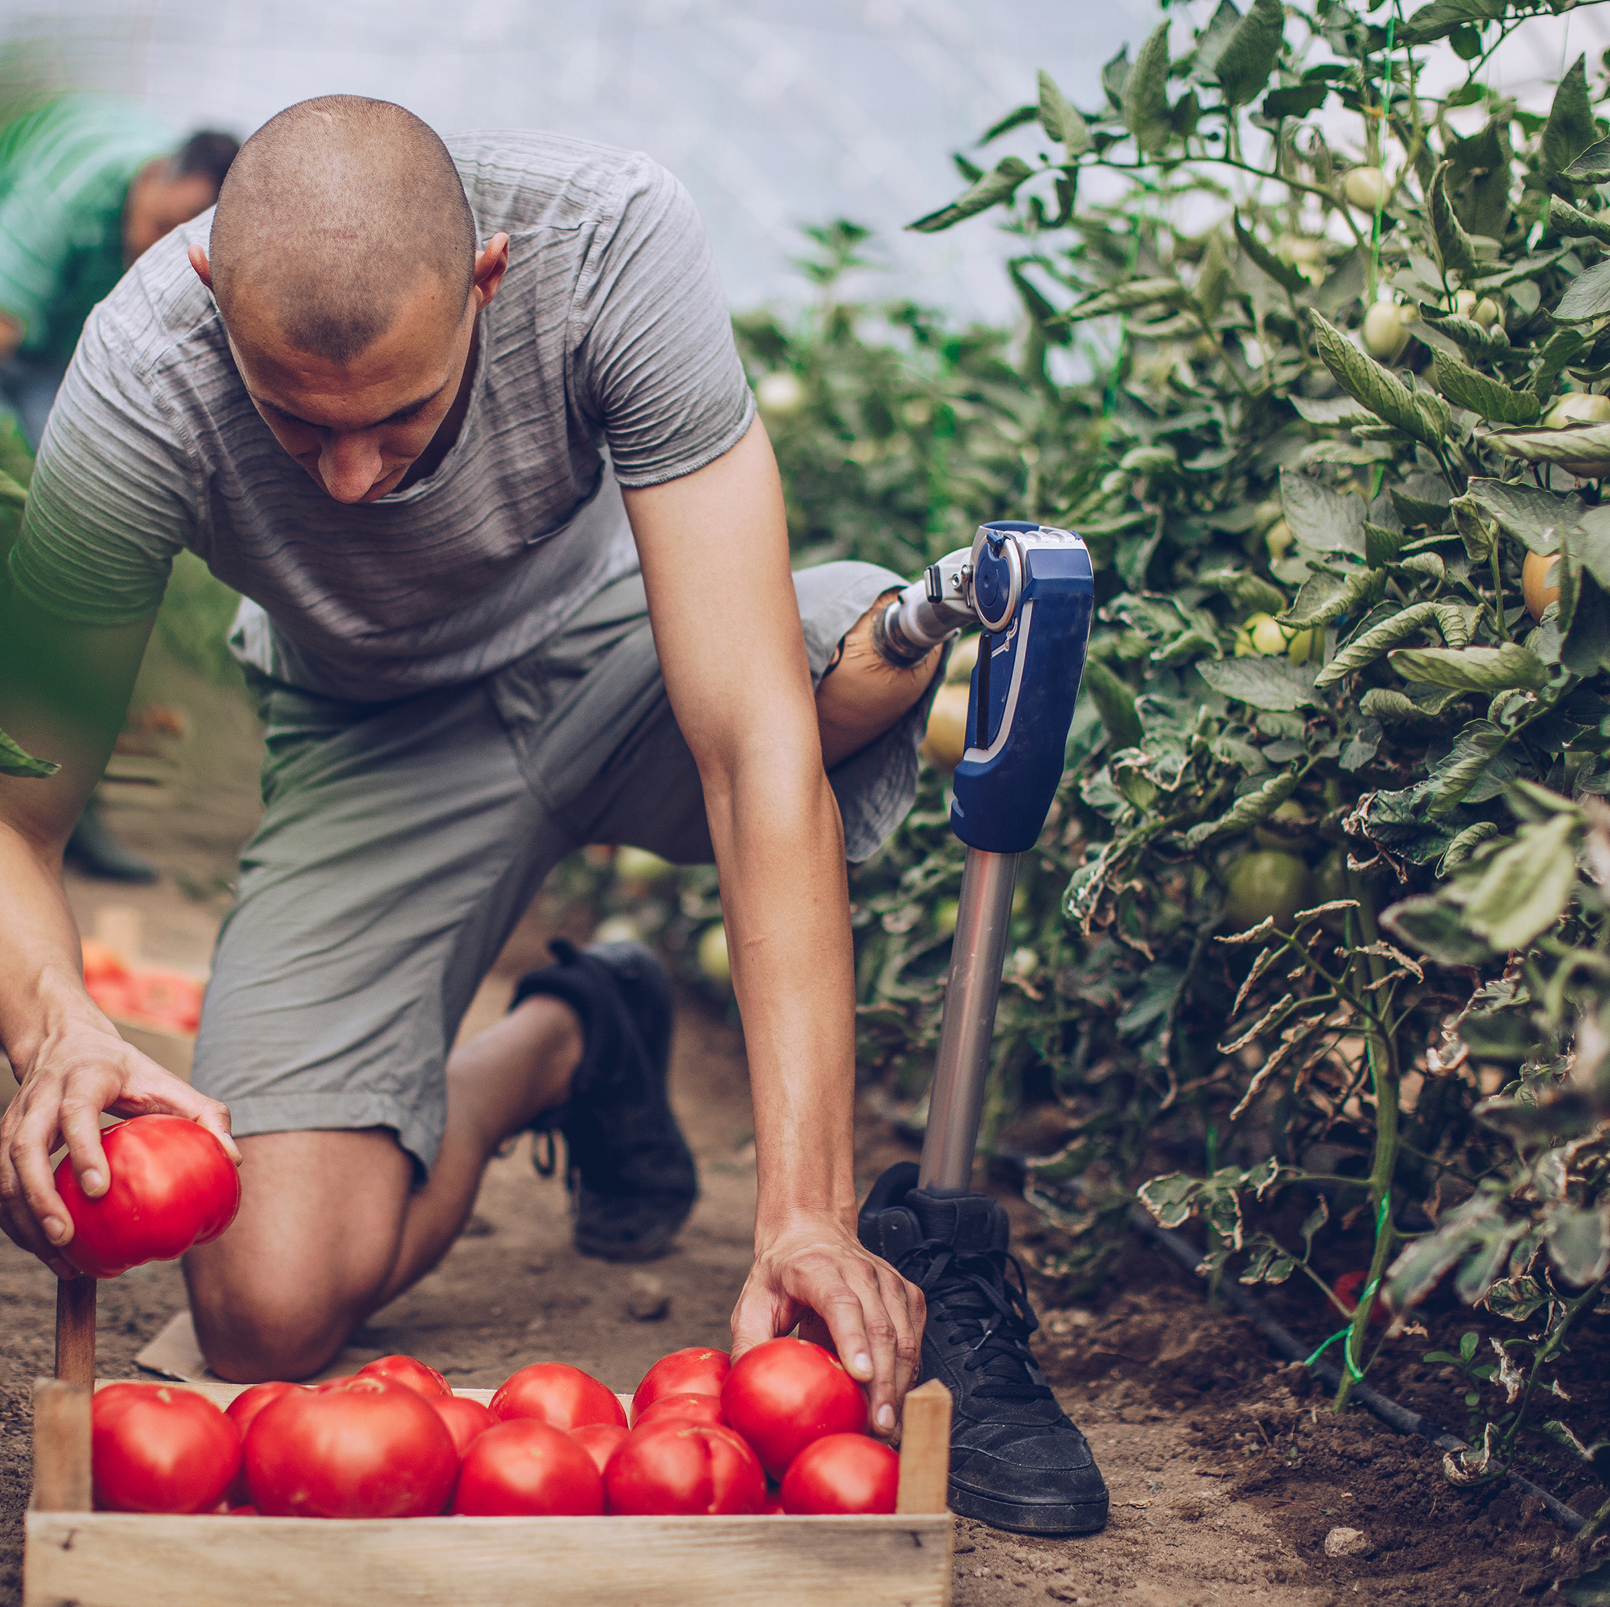
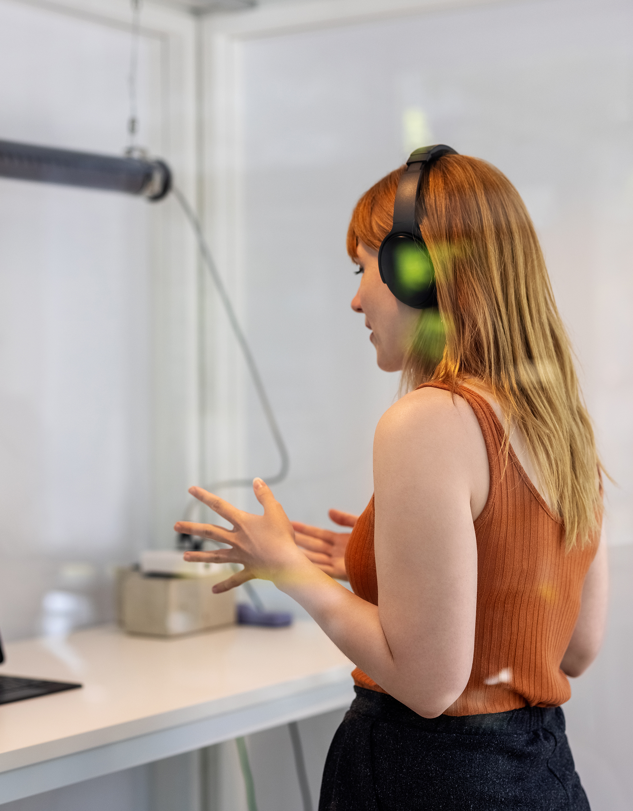


Warm up 2
What was your last job?

Slide 3

Past Simple Tense:
Usage: Past simple is used to describe completed actions or events in the past.
Structure: Subject + past simple verb
I finished the report yesterday.
She attended a conference last week.
We had a meeting in the afternoon.

Slide 4

Past Continuous Tense:
Usage: Past continuous is used to describe actions that were ongoing or in progress at a specific point in the past.
Structure: Subject + past continuous verb (was/were + present participle)
I was working on a project.
She was writing emails all morning.
They were discussing the new strategy during the meeting.

Slide 5
Integrating past simple and past continuous
The past continuous describes a long action in the past, while the past simple describes a short one.
t
I was working on a project, when you called.

Slide 6
Example sentences
While I was attending the conference, my colleague presented our latest project.
Last month, our team was working on a tight deadline, but we completed the project successfully.
When the client called, I was reviewing the proposal, and then I answered their questions.

Slide 7
Practise
Past Simple:
Can you tell me about your first job? What did you do?
Describe a project you completed at work recently.
Did you have a favourite task or responsibility in your previous job?
Past Continuous:
What were you doing when you got your last job offer?
Describe a typical day at work last week using past continuous.
Can you share a story about a challenge you were facing at work in the past?
Combining Past Simple and Past Continuous:
What were you working on when you realized you had to attend a meeting?
Describe a moment from your previous job where you were multitasking.
Can you talk about a day when you were really busy at work?
Changes at Work:
Discuss a time when your role or responsibilities at work changed.
What were you doing when you found out about a promotion or a raise?
Describe a day at work when something unexpected happened.
Work Environment:
Can you talk about a time when you were enjoying your work environment?
What were your colleagues doing when you arrived at work yesterday?
Describe a day when the office was particularly lively.
Work Achievements:
Tell me about a successful project you were a part of in the past.
Describe a moment when you felt proud of your accomplishments at work.
What were you doing when you received positive feedback from your boss?
Work Challenges:
Discuss a time when you were facing a difficult task or challenge at work.
What were you doing to overcome a work-related problem in the past?
Describe a day when you were learning new skills to handle a challenge.

Slide 8
Bringing everything together - Examples
In the Morning:
I start my day at work in the morning, arriving at the office at 8:30.
During the morning meeting, we discuss upcoming projects and share ideas.
At the Desk:
I spend most of my time at my desk, working on reports and responding to emails.
The new employee sits at the desk next to mine; she's friendly and approachable.
On a Tight Deadline:
Yesterday, I had to complete a task on a tight deadline; it was stressful but rewarding.
We often work collaboratively on projects, especially when we're on tight deadlines.

Slide 9

Bringing everything together - Examples
During Lunch Break:
I usually have lunch in the cafeteria with my colleagues.
Sometimes, I prefer to eat at my desk, especially when I have a lot of work to catch up on.
In a Productive Atmosphere:
The office is always busy and bustling with activity; it creates a productive atmosphere.
During team meetings, we brainstorm ideas and collaborate in an open and friendly environment.
At a Business Conference:
Next month, I'll be attending a business conference in Chicago.
I enjoy networking at these conferences; they provide valuable insights into industry trends.

Slide 10
Bringing everything together - Examples
On a Regular Basis:
I communicate with clients on a regular basis, ensuring their needs are met.
We have team meetings on a weekly basis to discuss ongoing projects.
In a Supportive Team:
Being part of a supportive team makes the work more enjoyable.
I received constructive feedback during our performance reviews, which helped me grow in my role.
During a Coffee Break:
We often take short breaks during the day, meeting at the coffee machine for a quick chat.
Taking short breaks during the day helps us stay refreshed and focused.
At the End of the Day:
At the end of the day, I organize my desk and make a to-do list for the next day.
Leaving work at a reasonable hour allows me to spend quality time with my family.

Slide 11

Practise yourselves – Quickfire sentences Take turns to make a sentence according to each prompt:
In the Morning……
At the Desk…..
On a Tight Deadline…..

Slide 12

Practise yourselves – Quickfire sentences
During Lunch Break…..
In a Productive Atmosphere……
At a Business Conference……
On a Regular Basis……
In a Supportive Team……
During a Coffee Break……
At the End of the Day…..

Slide 13
Delayed feedback

