Slide 1


Clear, Concise, and Courteous: Business Email Essentials
Intermediate Business English Learners

Slide 2

Objectives
By the end of this session, students will be able to:
Identify and apply the 3 C’s (Clear, Concise, Courteous) in business email writing.
Use appropriate vocabulary for internal business communication.
Apply grammar structures to express tone and politeness.
Write an effective internal business email using the learned strategies.

Slide 3

Warm-Up Activity
Task:
Think-Pair-Share:
Prompt:
"Think about the last email you received that was unclear or too long. What made it hard to understand? Now, think of a well-written email. What made it effective?"

Slide 4
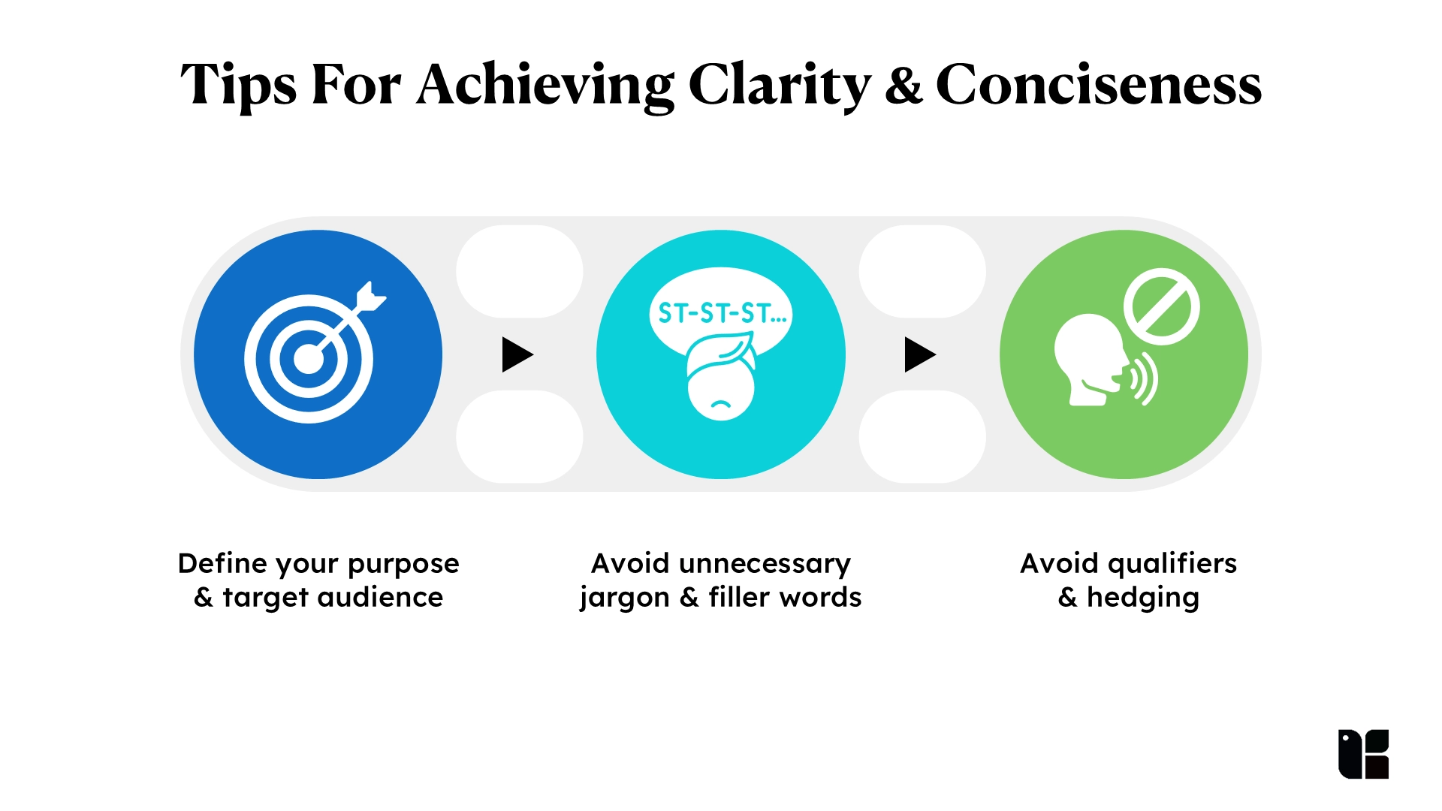
Introduction to the Topic
Why Email Writing Matters in Business
Emails are the backbone of modern business communication.
Poor email habits waste time and create misunderstandings.
Professionals are expected to write clearly, briefly, and politely.
Introduce:
The 3 C’s – Clarity, Conciseness, Courtesy.

Slide 5

Key Vocabulary
Term | Meaning
Subject line | The title of the email
Greeting | How you start the email (e.g., Dear John)
Signature | Your name and contact info at the end
Brief | Short and to the point
Redundant | Repetitive or unnecessary
To the point | Focused on the topic only
Friendly tone | Warm, respectful language
Edit | Review and improve writing
Call to action | What you want the reader to do
Follow-up | A message after the first to check progress or give more info

Slide 6

Vocabulary Exercise
Match the term to its meaning: Students choose the correct word from the vocabulary list.
A polite way to begin a message –
Asking someone to respond or act –
Ending with your name and job title –
Not adding extra or repeated words –
A summary of the email’s purpose –
Polite and respectful communication –

Slide 7
Vocabulary Exercise - Answers
Match the term to its meaning: Students choose the correct word from the vocabulary list.
A polite way to begin a message – ______Greeting
Asking someone to respond or act – ______Call to action
Ending with your name and job title – ______Signature
Not adding extra or repeated words – ______Brief
A summary of the email’s purpose – ______Subject line
Polite and respectful communication – ______Friendly tone

Slide 8

Grammar Focus
Topic: Using Modal Verbs for Politeness
(could, would, might, should)
Why It Matters:
The tone in business emails should be polite, especially when requesting or suggesting.
✍️ Structure:
Requesting:
Could you send me the report?
Would you be able to attend the meeting?
Suggesting:
We might consider revising the timeline.
You should include more details in the subject line.

Slide 9

Grammar exercice
Rewrite these informal phrases using polite modals:
Send me the report.
I want you to attend the meeting.
Change the subject line.
Reply quickly.
We need to review the document.
Add the client’s name.

Slide 10
Grammar exercice - Answers
Rewrite these informal phrases using polite modals:
Send me the report. Could you send me the report?
I want you to attend the meeting. Would you be able to attend the meeting?
Change the subject line. You might want to change the subject line.
Reply quickly. Could you reply as soon as possible?
We need to review the document. We should review the document.
Add the client’s name. You should add the client’s name.

Slide 11

Real-Life Practice Task
Task:
Write an internal company email to a colleague who forgot to attach a file.
Include:
Clear subject line
Polite greeting and tone
Brief explanation
Friendly call to action
Professional signature

Slide 12

Conclusions
Review the Essentials:
✅ Clear = Easy to understand
✅ Concise = No fluff
✅ Courteous = Respectful and polite
📬 Strong business emails reflect professionalism.
💡 Good emails = better teamwork, faster results, clearer communication.

Slide 13

Bonus Tip Section
Title:
✨ Pro Tips for Email Writing
Use bullet points for clarity
Avoid jargon
Read aloud before sending
One topic per email
Respond within 24 hours

Slide 14

Feedback

