Slide 1

Integrating sustainability into business strategy
Business English B1
TuSpeaking 2024, All rights reserved

Slide 2

Warm up
What do you think the word 'sustainability' means?
Do you think sustainability is important in today's world?

Slide 3

Conversation
Can you think of any examples of sustainability in everyday life?
Do you know any companies that try to be environmentally friendly? What do they do to help the environment?
How do you feel when you buy products from companies that are environmentally friendly?

Slide 4


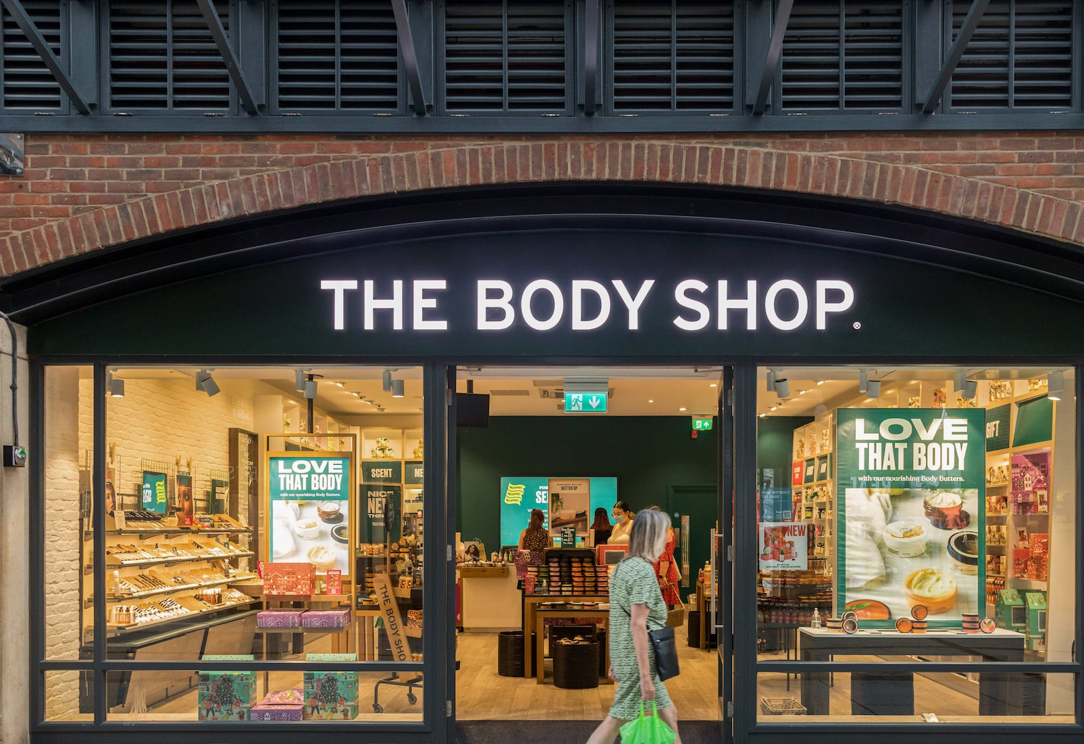
Do you recognize any of these brands? What do you know about them?

Slide 5

Vocabulary Do you know these terms?
Sustainable Development
Green Business Practices
Triple Bottom Line
Corporate Governance

Slide 6

Check, then try to make a sentence with each term
Sustainable Development
Definition: Sustainable development means improving people's lives and the economy while protecting the environment for future generations.
Green Business Practices
Definition: Green business practices involve actions that businesses take to minimize their impact on the environment, such as reducing waste, saving energy, or using recycled materials.
Triple Bottom Line
Definition: The triple bottom line is a concept where businesses focus not only on making a profit but also on social and environmental impacts. It means considering people, planet, and profit.
Corporate Governance
Definition: Corporate governance refers to the ways in which a company is directed and controlled, including ethical practices and accountability to shareholders and stakeholders.

Slide 7

Example sentences
Sustainable Development
A company that builds eco-friendly homes using renewable energy and materials is practicing sustainable development.
Green Business Practices
A restaurant that uses biodegradable packaging instead of plastic and recycles its kitchen waste is following green business practices.
Triple Bottom Line
A company that ensures fair labour practices, reduces its carbon footprint, and makes a profit is aiming for a positive triple bottom line.
Corporate Governance
A company with a transparent board of directors who make ethical decisions and report their actions clearly to the public is practicing good corporate governance.

Slide 8

Conversation
Can anyone give a different example of sustainable development?
How do you think green business practices can benefit a company beyond just being good for the environment?
Why is it important for a company to consider the triple bottom line?

Slide 9

Group Work
Divide students into small groups.
Assign each group a specific area of business (e.g., supply chain management, product design, marketing).

Slide 10

Conversation Questions for Group Discussion
How can we make the supply chain more environmentally friendly?
What kind of product designs can reduce waste or use sustainable materials?
How can marketing encourage customers to choose sustainable products?
Presentation:
Each group brainstorms and develops an idea on how to integrate sustainability into their assigned area.
Groups present their ideas to the class, explaining how their strategy would work and why it would be effective.

Slide 11

Review
Which group’s idea do you think would be the easiest for a company to implement? Why?
What was the most interesting thing you learned today?
How do you think learning about sustainability can help you in the future?

Slide 12
Delayed feedback

