Slide 1

Services
English B2
tuSpeaking 2024, All rights reserved

Slide 2





What do you know about these initiatives?

Slide 3
The Paris Agreement
Description: An international treaty adopted in 2015 to combat climate change and limit global warming to below 2 degrees Celsius.
Participants: Almost every country in the world has committed to reducing greenhouse gas emissions.

Slide 4
The United Nations Environment Programme (UNEP)
Description: UNEP coordinates the UN's environmental activities and assists developing countries in implementing environmentally sound policies and practices.
Example: The "Clean Seas" campaign aims to eliminate marine litter and plastic pollution.

Slide 5
The Global Alliance for Clean Cookstoves
Description: A public-private partnership working to create a thriving global market for clean and efficient household cooking solutions.
Impact: Reduces health problems caused by indoor air pollution and decreases deforestation for fuelwood.

Slide 6
The Billion Tree Campaign:
Description: A worldwide tree-planting initiative led by the United Nations to fight deforestation and combat climate change.
Impact: Millions of trees have been planted globally, restoring degraded lands and improving biodiversity.

Slide 7
Earth Hour
Description: An annual global event organized by the World Wildlife Fund (WWF) where individuals, communities, and businesses turn off non-essential electric lights for one hour as a symbol of commitment to the planet.
Participants: Over 190 countries and territories participate each year.

Slide 8
Grammar Focus - Conditionals
Zero Conditional: Used for general truths and scientific facts.
Example: "If you heat water to 100°C, it boils."
First Conditional: Used for real and possible situations.
Example: "If we reduce our waste, we will help the environment."
Second Conditional: Used for hypothetical situations.
Example: "If I were the mayor, I would implement more recycling programs."

Slide 9

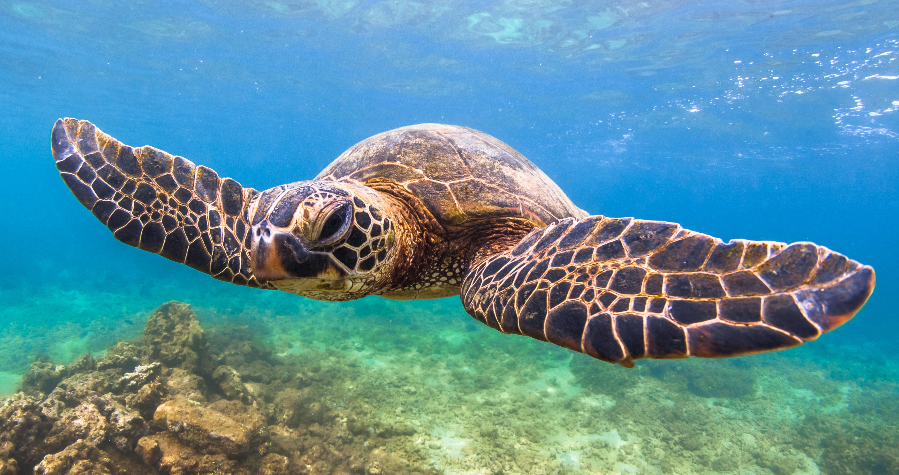


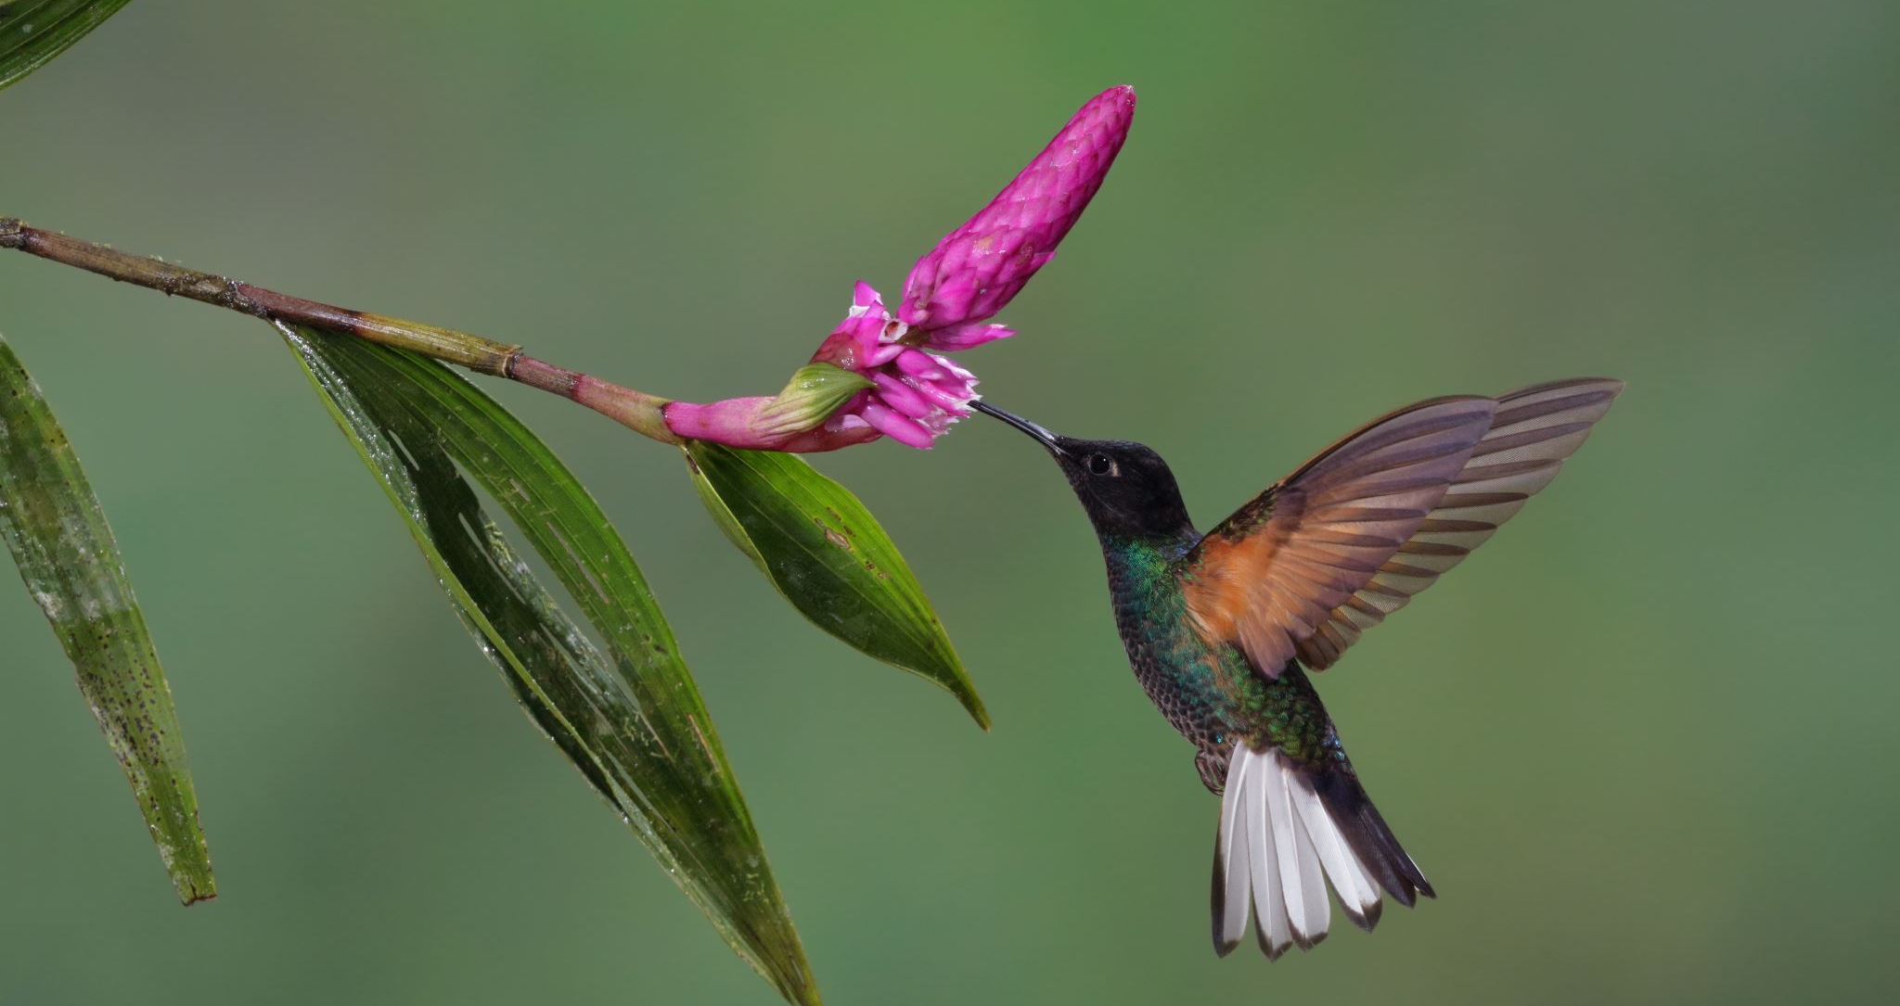

Practice Activity
Create sentences using zero, first, and second conditionals related to environmental actions.

Slide 10

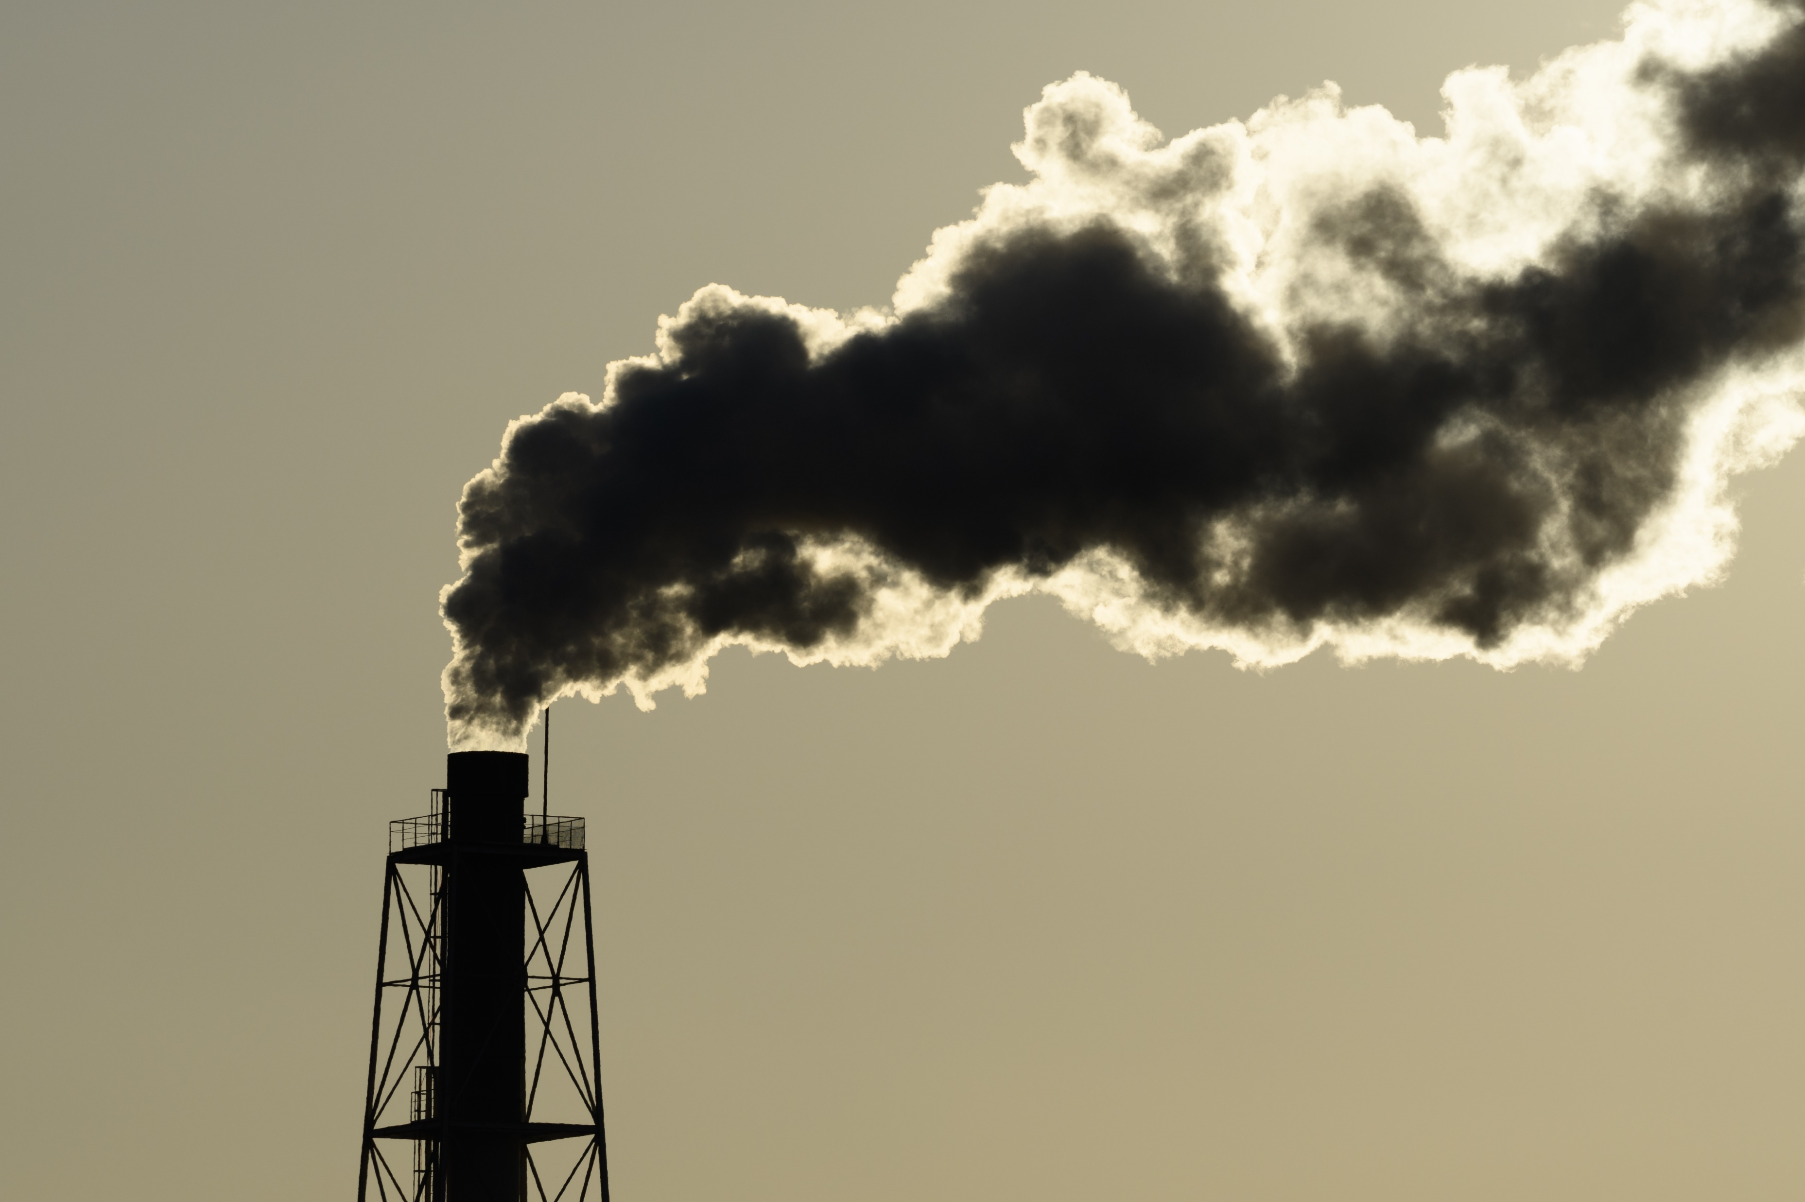
Group Activity
In groups, create a proposal for a new environmental initiative that addresses a local or global issue.
Step 1: Identify the issue your initiative will address.
Step 2: Develop a plan, including objectives, methods, and expected outcomes.
Step 3: Use conditionals to discuss potential impacts and hypothetical situations.
Step 4: Present your proposal to the class.

Slide 11
Delayed feedback
tuSpeaking 2024, All rights reserved

