Slide 1

Mass media and communication
English B2

Slide 2

Warm up
Introduction to Media:
What role does media play in your daily life?
How has your consumption of media changed over the years?
Media Preferences:
What types of media do you prefer—TV, radio, print, or online platforms?
Are there specific genres or topics in the media that you find most interesting?

Slide 3
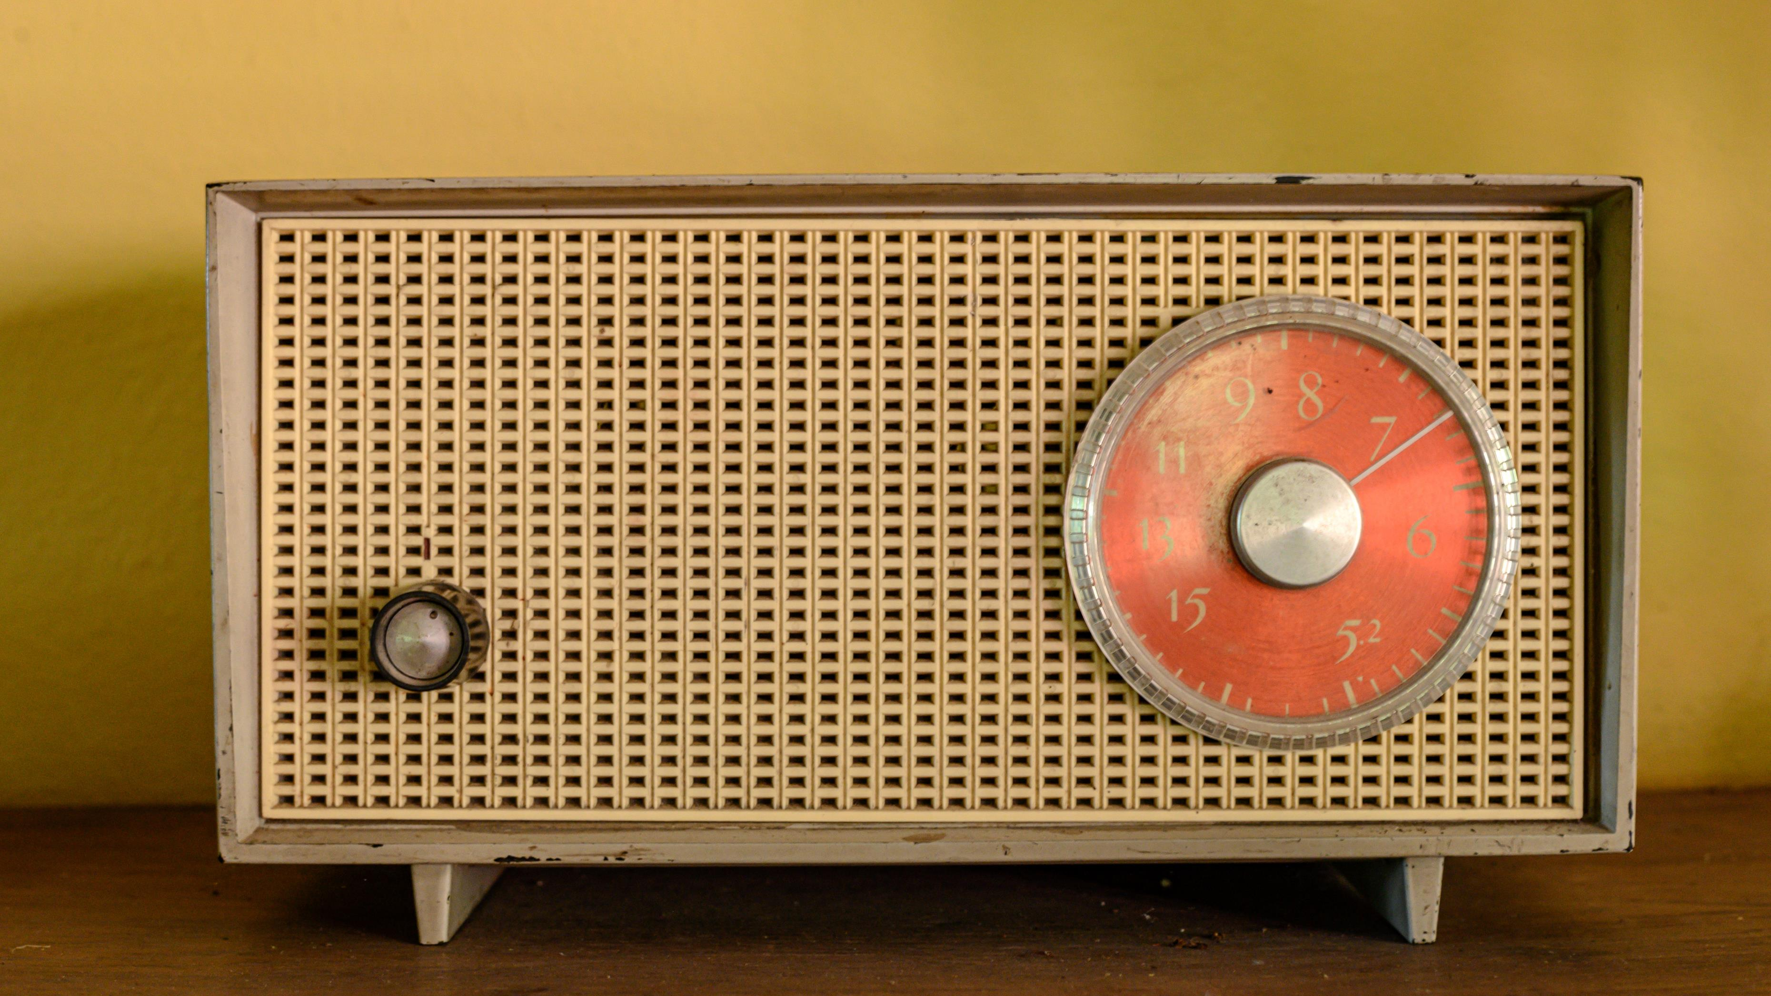
Vocabulary
Media:
Definition: The means of communication, such as newspapers, radio, television, and the internet, that reach or influence people widely.
Mass Media:
Definition: Forms of communication that reach a large audience, typically including television, radio, newspapers, and the internet.
Journalism:
Definition: The profession or practice of reporting and analysing news events through print, broadcast, or online media.
Broadcasting:
Definition: The distribution of audio or video content to a dispersed audience via radio, television, or online platforms.
Print Media:
Definition: Media that is printed on paper, such as newspapers, magazines, and brochures.
New Media:
Definition: Digital forms of communication and media, including online platforms, social media, and digital content.
Editorial:
Definition: Content expressing the opinion or viewpoint of the media outlet, often found in newspapers or online articles.
Press Release:
Definition: A written or recorded communication provided to the media for publication, often announcing news or events.
Infotainment:
Definition: Media content that combines information and entertainment, often in a way that prioritizes entertainment value.
Media Bias:
Definition: The perceived or actual bias in the selection and presentation of news stories, reflecting a particular perspective.

Slide 4
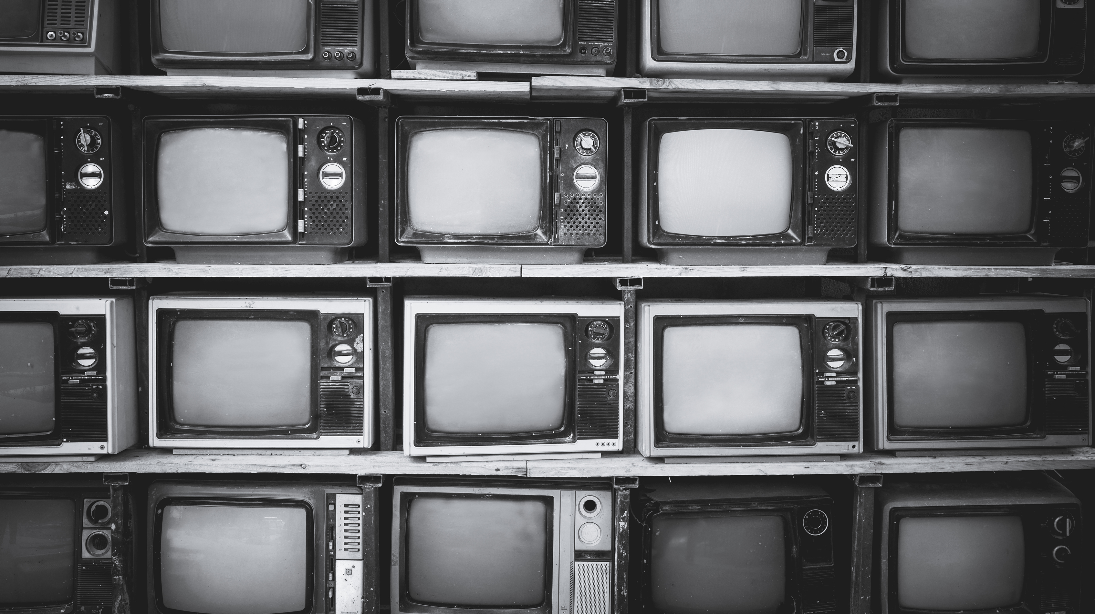
Vocabulary
Censorship:
Definition: The control or suppression of information, ideas, or artistic expression by an authority or government.
Media Literacy:
Definition: The ability to access, analyse, evaluate, and create media in various forms, promoting critical thinking and responsible use.
Clickbait:
Definition: Online content, typically in the form of headlines or thumbnails, designed to attract attention and encourage users to click for more information.
Viral:
Definition: Content, often online, that spreads rapidly and widely among users through sharing and reposting.
Podcast:
Definition: A digital audio or video file available for streaming or download, often part of a series covering various topics.
Aggregator:
Definition: A website or application that collects and displays content from various sources, providing a centralized location for users.
Caption:
Definition: A brief explanation or description accompanying an image, providing context or additional information.
Analytics:
Definition: The collection, measurement, analysis, and reporting of data related to the performance and effectiveness of media content.
SEO (Search Engine Optimization):
Definition: The practice of optimizing online content to improve its visibility and ranking in search engine results.
Meme:
Definition: A humorous image, video, or piece of text that is copied and spread rapidly by internet users.

Slide 5

1. Objective Reporting vs. Advocacy:
Discussion: Explore the balance between objective reporting and advocacy journalism. Should journalists strive to remain impartial, or is it acceptable for them to express personal opinions in their reporting?

Slide 6

2. Sensationalism in Media:
Discussion: Discuss the ethical implications of sensationalism in media. How does sensationalism impact public perception, and what responsibilities do media professionals have in avoiding sensationalistic practices?
Can you think of any other examples closer to home?

Slide 7

3. Privacy and Intrusion:
Discussion: Examine the ethical considerations surrounding the invasion of privacy by the media. When is it justified to intrude into someone's private life for the sake of a news story?

Slide 8

4. Fake News and Misinformation:
Discussion: Explore the role of media in combating fake news and misinformation. How can media organizations maintain trust, and what responsibility do they have in verifying and correcting information?

Slide 9
Delayed feedback

