Slide 1

Mass media and communication
English B2

Slide 2

Warm up
Do you prefer reading news online or in print? Why?
Have you ever encountered fake news? How did you recognize it?
What impact does advertising have on your consumption of media?
What is the most important thing for you when choosing a communication platform (e.g., Facebook, Twitter, WhatsApp)?

Slide 3

Vocabulary 2
Clarity:
Definition: The quality of being clear, easy to understand, and free from ambiguity in media messages.
Conciseness:
Definition: Expressing ideas in a clear and brief manner without unnecessary details or redundancy.
Credibility:
Definition: The trustworthiness and reliability of the source of information, crucial for effective communication.
Engagement:
Definition: The ability of media content to capture and maintain the audience's attention, involvement, and interest.
Feedback:
Definition: Responses, reactions, or opinions provided by the audience to the media content, facilitating a two-way communication process.
Inclusivity:
Definition: Ensuring that media content is designed to be accessible and relatable to a diverse audience, representing various backgrounds and perspectives.
Interactivity:
Definition: The degree to which the audience can actively engage with and participate in media content, often facilitated by digital platforms.
Message Framing:
Definition: The deliberate presentation of information in a particular way to shape the audience's perception or interpretation.
Multimodal Communication:
Definition: Using multiple modes of communication, such as text, images, audio, and video, to convey a message effectively.
Narrative Storytelling:
Definition: Presenting information or messages in the form of a story, making it more engaging and relatable for the audience.

Slide 4

Vocabulary 2
Objectivity:
Definition: Presenting information without personal bias or opinion, maintaining a neutral and impartial stance in media content.
Persuasion:
Definition: The use of techniques to influence or change the attitudes, beliefs, or behaviours of the audience through media messages.
Sensationalism:
Definition: The use of exaggerated or sensationalized content to evoke strong emotions or reactions from the audience.
Transparency:
Definition: Openness and honesty in communication, providing clear information about sources, motives, and intentions.
User Experience (UX):
Definition: The overall experience of a person using media content or platforms, encompassing usability, accessibility, and satisfaction.
Visual Communication:
Definition: Conveying information or messages through visual elements such as images, graphics, and videos.
Digital Literacy:
Definition: The ability to access, analyse, and evaluate information effectively in the digital age, including understanding media sources and content.
Ethical Journalism:
Definition: Adhering to moral principles and standards in journalism, including truthfulness, accuracy, and respect for individuals' rights and privacy.
Media Advocacy:
Definition: Using media channels to promote a cause or social issue, aiming to influence public opinion or policy.
Gatekeeping:
Definition: The process by which media professionals decide which information is selected, presented, and omitted in news coverage.

Slide 5

5. Censorship:
Discussion: Explore the concept of censorship in the media. Under what circumstances, if any, is censorship justifiable?

Slide 6
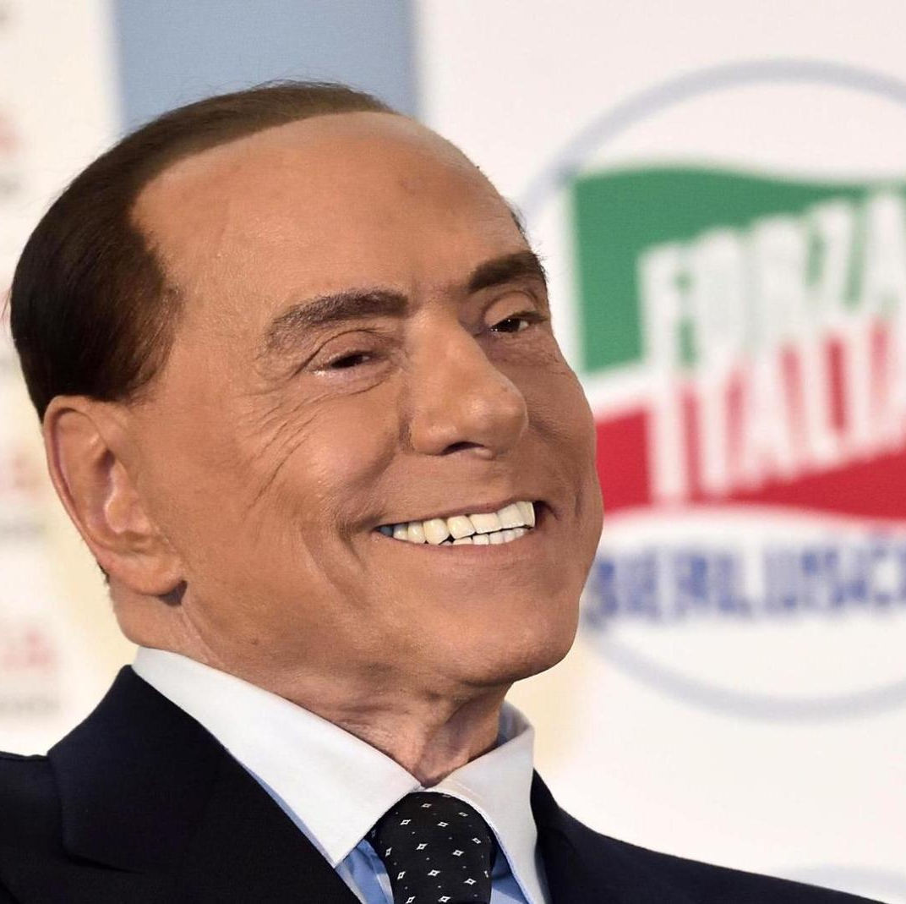
6. Media Ownership and Independence:
Discussion: Explore the ethical implications of media ownership and its potential impact on editorial independence. How can media organizations maintain integrity in the face of corporate or political influence?

Slide 7

7. Diversity and Inclusivity:
Discussion: How can media organizations promote diversity and inclusivity in their coverage? What are the ethical considerations related to representation in the media?

Slide 8

8. Whistleblowing and Anonymous Sources:
Discussion: Explore the ethical considerations surrounding whistleblowing and the use of anonymous sources in journalism. When is it justifiable for journalists to protect their sources?

Slide 9

9. Social Media and Citizen Journalism:
Discussion: How has the rise of social media impacted traditional journalism ethics? Discuss the role of citizen journalism and the challenges it poses.

Slide 10
Delayed feedback

