Slide 1
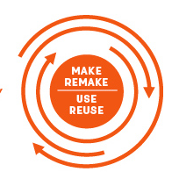
The circular
economy 2
This Photo by Unknown Author is licensed under CC BY-SA-NC

Slide 2


Let’s learn some vocabulary

Slide 3

Work out the meanings of the underlined words. [part 1/2]
Is it better to buy or lease a car?
Unfortunately, our planet does not have infinite resources for us to use. Eventually, we will run out!
Every computer has a finite amount of memory.
Do you have any proof of ownership of this car?
PRONUNCIATION TIP
infinite /ˈɪn.fɪ.nət/
finite /ˈfaɪ.naɪt/

Slide 4
Work out the meanings of the underlined words. [part 2/2]
The government is offering a cash incentive for people to use renewable energy in their homes.
In fast fashion, billions of garments are made cheaply and then thrown away every year.
As supply chain issues are getting worse, businesses are afraid that they might not get enough stock for Christmas.
To improve logistics, we have bought a new software program that tells our shipping department each time an order is processed.

Slide 5
Let’s check the answers. [part 1/2]
Is it better to buy or lease a car?
make a legal agreement to pay money to use land, a building, a vehicle or a piece of equipment for an agreed period of time
Unfortunately, our planet does not have infinite resources for us to use. Eventually, we will run out!
without limits
Every computer has a finite amount of memory.
having a limit or end
Do you have any proof of ownership of this car?
the fact that you own something
PRONUNCIATION TIP
infinite /ˈɪn.fɪ.nət/
finite /ˈfaɪ.naɪt/

Slide 6
Let’s check the answers. [part 2/2]
The government is offering a cash incentive for people to use renewable energy in their homes.
something that encourages someone to do something
In fast fashion, billions of garments are made cheaply and then thrown away every year.
pieces of clothing
As supply chain issues are getting worse, businesses are afraid that they might not get enough stock for Christmas.
the system involved in getting a product from the place where it is made to the customer
To improve logistics, we have bought a new software program that tells our shipping department each time an order is processed.
the detailed planning and organization of any large complex operation

Slide 7
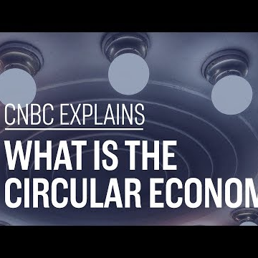
Watch the video again and complete the sentences.
The linear economy is based on a ‘take, make and …………………’ model.
In the linear economy, companies buy materials at the ………………… cost possible.
The circular economy is based on a ‘make, use and …………………’ model.
This radical model turns companies into ………………… rather than sellers of a physical product.
H&M collects old garments and ………………… them.
The circular economy can produce environmental and ………………… benefits.
Companies would have to ………………… their products and supply chains in order to become more circular.

Slide 8
Let’s check the answers.
The linear economy is based on a ‘take, make and …………………………… ’ model.
In the linear economy, companies buy materials at the ……………………….. cost possible.
The circular economy is based on a ‘make, use and ………………………… ’ model.
This radical model turns companies into ……………………..………………………………. rather than sellers of a physical product.
H&M collects old garments and …………………………... them.
The circular economy can produce environmental and ………………………………... benefits.
Companies would have to ……………………………... their products and supply chains in order to become more circular.
dispose
lowest
return
service providers
recycles
economic
redesign
Notes:
TIMESTAMPS:
00:20
00:48
01:12
01:38
01:55
02:24
02:44

Slide 9
Let’s learn some collocations

Slide 10
Match the collocations.
sign
pay
lease
manufacture
give
change
work
get
someone’s mindset
a product
on board with
a lease
a fee
on a strategy
an incentive
a car

Slide 11
Let’s check the answers.
sign
pay
lease
manufacture
give
change
work
get
someone’s mindset
a product
on board with
a lease
a fee
on a strategy
an incentive
a car

Slide 12

Discuss the following questions. Give reasons for your answers.
How circular are your consumption habits? What could you do to make them more so?
Would you lease your lighting? What are the things that you would never decide to lease and prefer to own?
How easy do you think it is to change people’s mindsets towards ownership?
Does your government give any incentives to people to encourage them to reduce waste?
Why do you think companies would move from the linear to the circular economy?

Slide 13


Let’s discuss!

Slide 14
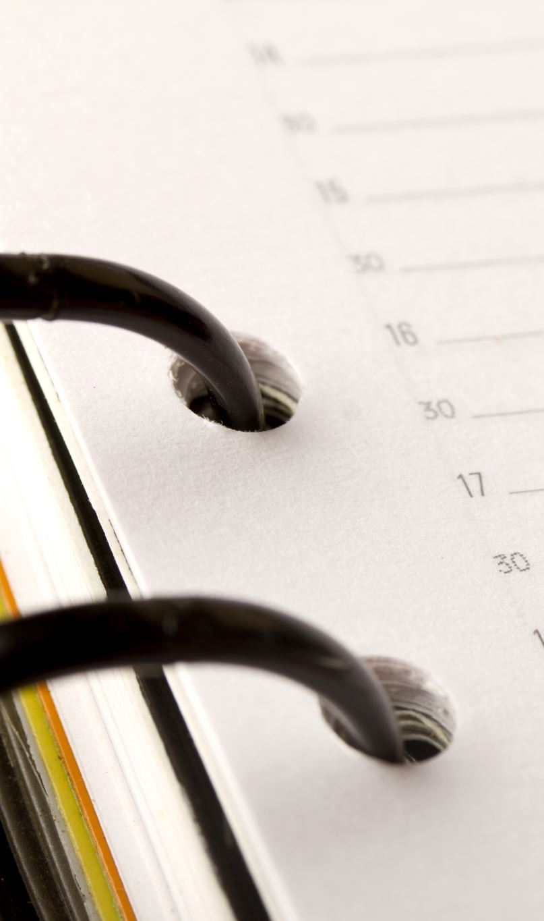
Time for a case study!

Slide 15

Read the description of a company which follows the linear model and complete the case study tasks below.
Chef’s Place is a company which produces high quality, hand-prepared frozen meals. Most of the ingredients are sourced locally. The meals are prepared by professional chefs in the company’s kitchens then packaged and delivered to customers and shops all around the country. The food is packaged in black plastic cartons with plastic film lids and cardboard covers.
Make a list of strategies the company could work on in order to become more circular.
Think about the following:
o sourcing ingredients
o production
o package design
Consider the pros, cons and challenges the company would face.
Present your ideas.
o distribution
o waste disposal
o recycling

Slide 16

Answer the following
How could a business change its model to fit the ideas of the circular economy?
What are the pros and cons of such changes?
What challenges would they face?

Slide 17
Delayed Feedback

Slide 18

Thanks

