Slide 1

Art and culture
English B2
tuSpeaking 2024, All rights reserved

Slide 2

Warm up – Can you identify the quotes?
Two roads diverged in a wood, and I— / I took the one less traveled by, / And that has made all the difference.
It is a truth universally acknowledged, that a single man in possession of a good fortune, must be in want of a wife.
All the world's a stage, / And all the men and women merely players; / They have their exits and their entrances; / And one man in his time plays many parts.
The only thing we have to fear is fear itself.
When life itself seems lunatic, who knows where madness lies? Perhaps to be too practical is madness. To surrender dreams, this may be madness. To seek treasure where there is only trash. Too much sanity may be madness — and maddest of all: to see life as it is, and not as it should be!

Slide 3

Answers
Poetry:
Two roads diverged in a wood, and I— / I took the one less traveled by, / And that has made all the difference.
The Road Not Taken by Robert Frost
Narrative (Novel):
It is a truth universally acknowledged, that a single man in possession of a good fortune, must be in want of a wife.
Pride and Prejudice by Jane Austen
Drama:
All the world's a stage, / And all the men and women merely players; / They have their exits and their entrances; / And one man in his time plays many parts.
As You Like It by William Shakespeare
Essay:
The only thing we have to fear is fear itself.
First Inaugural Address by Franklin D. Roosevelt
Narrative (Novel) - Cervantes:
When life itself seems lunatic, who knows where madness lies? Perhaps to be too practical is madness. To surrender dreams, this may be madness. To seek treasure where there is only trash. Too much sanity may be madness — and maddest of all: to see life as it is, and not as it should be!
Don Quixote by Miguel de Cervantes

Slide 4

Vocabulary
Poetry: Poetry often uses meter and rhyme. Example: 'The Road Not Taken' by Robert Frost.
Narrative: Narrative is a story with a beginning, middle, and end. Example: 'Pride and Prejudice' by Jane Austen.
Drama: Drama is written to be performed. Example: 'Romeo and Juliet' by William Shakespeare.
Essay: Essays explore ideas and arguments. Example: 'A Modest Proposal' by Jonathan Swift.

Slide 5

Identify the forms
It was the best of times, it was the worst of times, it was the age of wisdom, it was the age of foolishness.
There was a man who lived by a river, and he often said, 'God will save me!' A great flood came and the water began to rise, but the man remained confident.
To be, or not to be: that is the question: / Whether 'tis nobler in the mind to suffer / The slings and arrows of outrageous fortune, / Or to take arms against a sea of troubles.
A foolish consistency is the hobgoblin of little minds, adored by little statesmen and philosophers and divines.
Hope is the thing with feathers / That perches in the soul, / And sings the tune without the words, / And never stops at all.

Slide 6

Answers
Poetry:
Hope is the thing with feathers / That perches in the soul, / And sings the tune without the words, / And never stops at all.
Hope is the thing with feathers by Emily Dickinson
Narrative (Novel):
It was the best of times, it was the worst of times, it was the age of wisdom, it was the age of foolishness.
A Tale of Two Cities by Charles Dickens
Drama:
To be, or not to be: that is the question: / Whether 'tis nobler in the mind to suffer / The slings and arrows of outrageous fortune, / Or to take arms against a sea of troubles.
Hamlet by William Shakespeare
Essay:
A foolish consistency is the hobgoblin of little minds, adored by little statesmen and philosophers and divines.
Self-Reliance by Ralph Waldo Emerson
Short Story:
There was a man who lived by a river, and he often said, 'God will save me!' A great flood came and the water began to rise, but the man remained confident.
A Very Old Man with Enormous Wings by Gabriel García Márquez

Slide 7

Understanding Key Literary Concepts
Theme: The central topic or idea explored in a text.
Character: A person or being in a narrative, drama, or poem.
Plot: The sequence of events in a story.
Setting: The time and place in which a story takes place.
Tone: The author's attitude toward the subject.
Point of View: The perspective from which a story is told.

Slide 8

Examples
Theme: The theme of 'To Kill a Mockingbird' is racial injustice.
Character: Harry Potter is a character in J.K. Rowling's series.
Plot: The plot of 'The Great Gatsby' involves the rise and fall of Jay Gatsby.
Setting: The setting of '1984' is a dystopian future.
Tone: The tone of 'The Catcher in the Rye' is often cynical and sarcastic.
Point of View: The point of view in 'Moby Dick' is first-person, narrated by Ishmael.

Slide 9

Activity
Read the text on the following page and identify the:
Theme: The central topic or idea explored in a text.
Character: A person or being in a narrative, drama, or poem.
Plot: The sequence of events in a story.
Setting: The time and place in which a story takes place.
Tone: The author's attitude toward the subject.
Point of View: The perspective from which a story is told.

Slide 10

Excerpt from "The Yellow Wallpaper" by Charlotte Perkins Gilman:
"I lie here on this great immovable bed—it is nailed down, I believe—and follow that pattern by the hour, and I determine for the thousandth time that I will follow that pointless pattern to some sort of a conclusion. I know that is impossible, but I know it is not. I find it so hard to believe that it can be so frustrating. And yet it is true. I find it hard to believe that it is the same pattern that is so disturbing and confusing. I am amazed at how much I am affected by it. It is as though it is a part of me, like a disease that I cannot escape."

Slide 11

Literary Analysis of the Excerpt
1. Theme:
Theme: The central topic or idea explored in a text.
In the Excerpt: The theme revolves around mental illness and the struggle for self-expression. The narrator's obsession with the wallpaper and the sense of frustration and confinement reflect the broader theme of the oppression faced by women and the lack of autonomy in their lives.
2. Character:
Character: A person or being in a narrative, drama, or poem.
In the Excerpt: The narrator is the central character. Her psychological state is the focus of the text, and she is depicted as being trapped both physically in the room and mentally by her obsession with the wallpaper.
3. Plot:
Plot: The sequence of events in a story.
In the Excerpt: The plot is not fully detailed in this excerpt, but it shows a moment in which the narrator reflects on her imprisonment in the room and her fixation on the wallpaper. The broader plot of the story involves her increasing mental deterioration and the confinement imposed by her husband as a treatment for her supposed nervous condition.

Slide 12
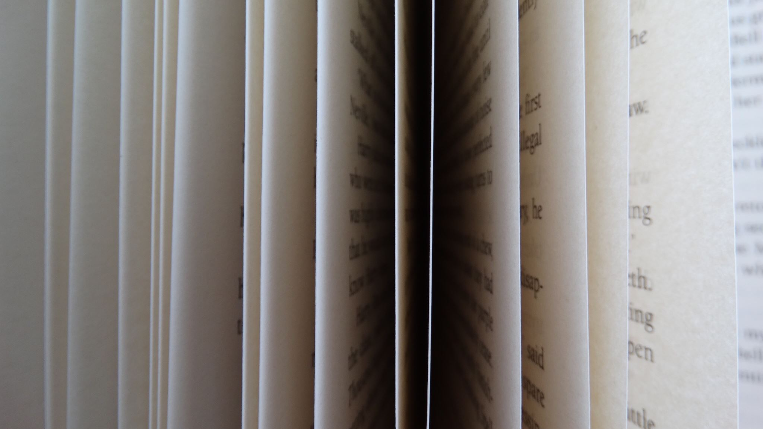
Literary Analysis of the Excerpt
4. Setting:
Setting: The time and place in which a story takes place.
In the Excerpt: The setting is primarily the narrator's room, which she describes as "immovable" and confining. The time period is early 20th century, reflecting the historical context of the story’s themes related to gender roles and mental health treatment.
5. Tone:
Tone: The author's attitude toward the subject.
In the Excerpt: The tone is one of frustration and distress. The narrator’s language conveys a sense of entrapment and confusion, reflecting her emotional and mental turmoil. The tone also hints at a critical perspective on the treatment and understanding of mental illness during the time.
6. Point of View:
Point of View: The perspective from which a story is told.
In the Excerpt: The point of view is first-person. The story is narrated from the perspective of the protagonist, allowing readers to experience her internal thoughts and feelings directly, providing an intimate glimpse into her mental state.

Slide 13
Delayed feedback
tuSpeaking 2024, All rights reserved

