Slide 1

Corporate Social Responsibility
Business English B2
TuSpeaking 2024, All rights reserved

Slide 2
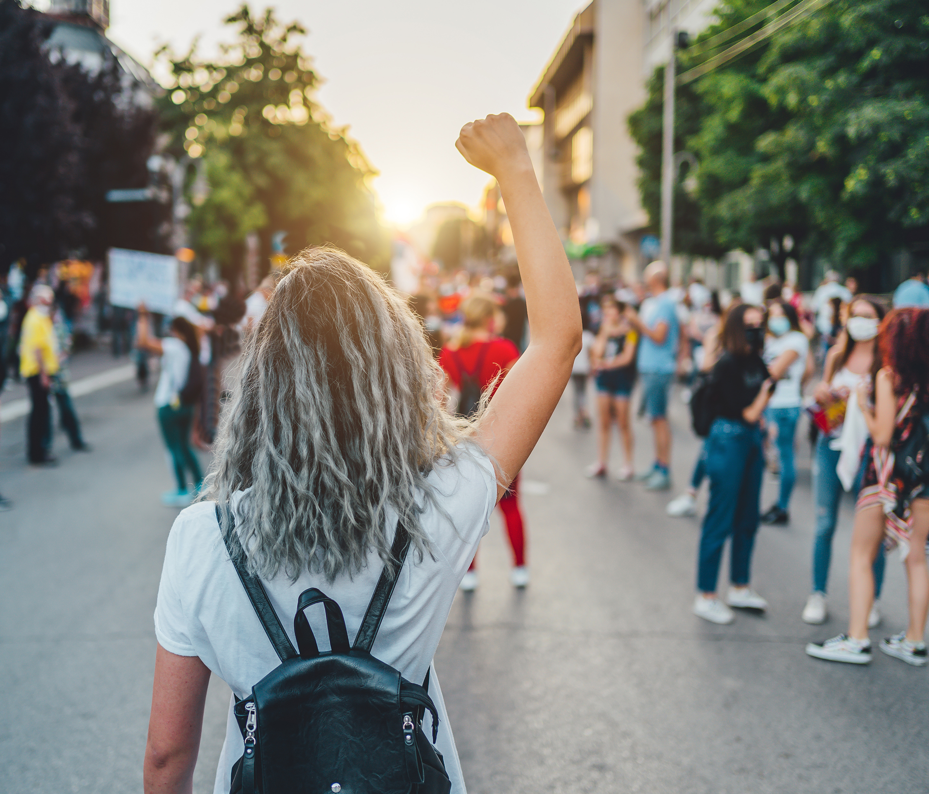


Warm up
What do you think CSR means?
Can you name any companies known for their CSR efforts?
Why might CSR be important for a company’s reputation?

Slide 3

Vocabulary
Ethical Branding: Building a brand based on ethical principles and values.
Stakeholder Engagement: Interacting with all parties affected by a company's operations, such as customers, employees, and communities.
Social Impact: The effect a company’s actions have on society and the environment.
Reputation Management: Strategies used to maintain or improve a company's reputation.

Slide 4
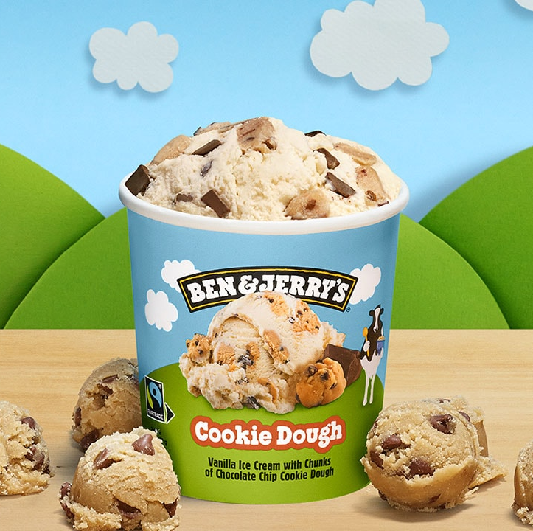
Case studies
Ben & Jerry’s Social Justice Campaigns
Ben & Jerry’s has been recognized for its strong commitment to social justice, integrating activism into its brand identity. The company has used its platform to advocate for various social issues and causes, aligning its business practices with progressive values.

Slide 5
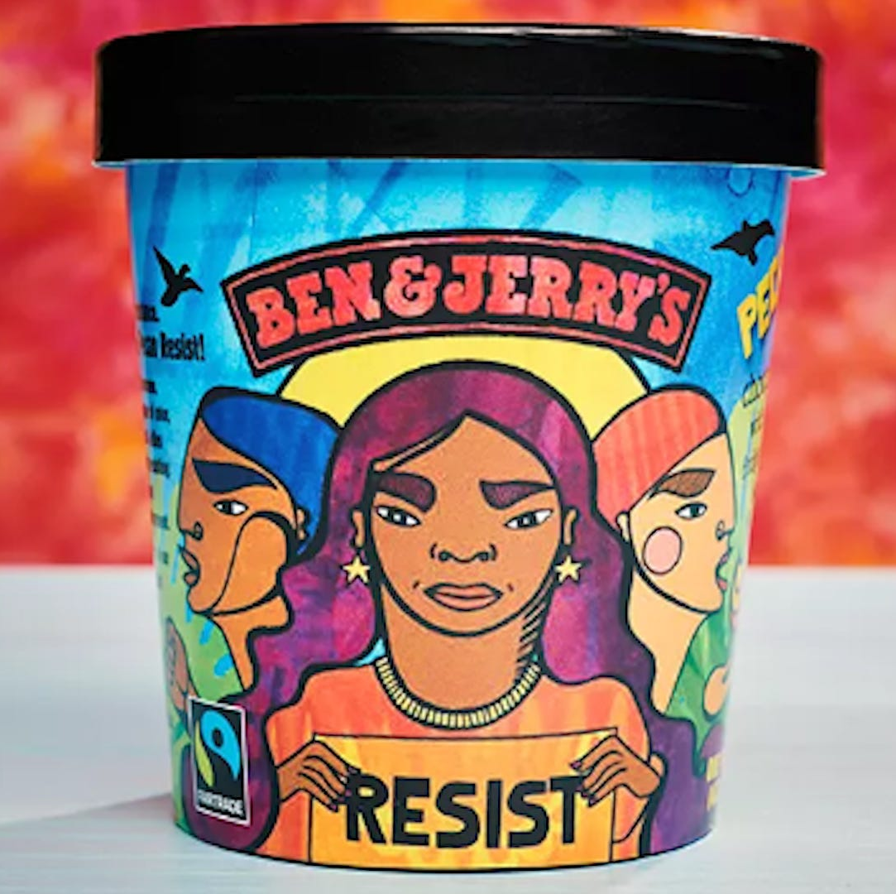
Support for Black Lives Matter:
Initiative: Ben & Jerry’s has publicly supported the Black Lives Matter movement and the fight against racial injustice. The company has used its social media channels to advocate for systemic change and has called out instances of police brutality.
Actions: They have created flavours and campaigns centred around social justice themes, such as “Justice ReMix’d,” which was designed to support criminal justice reform.

Slide 6
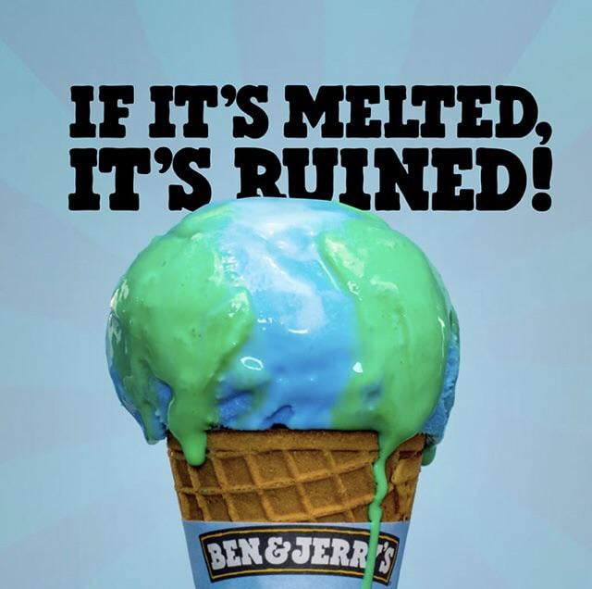
Climate Change and Environmental Advocacy:
Initiative: The company has been involved in environmental advocacy, emphasizing the need for climate action and sustainability.
Actions: Ben & Jerry’s has worked on reducing its carbon footprint, sourcing Fairtrade-certified ingredients, and supporting movements like the Paris Climate Agreement.

Slide 7
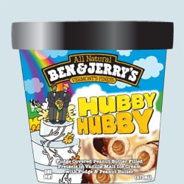
LGBTQ+ Rights:
Initiative: Ben & Jerry’s has a history of supporting LGBTQ+ rights, including celebrating Pride Month and advocating for marriage equality.
Actions: They have released special edition flavours and partnered with LGBTQ+ organizations to promote equality and acceptance.

Slide 8
Critical thinking
Effectiveness of Social Justice Campaigns:
How effective do you think Ben & Jerry’s social justice campaigns have been in influencing public opinion and societal change? Can you provide specific examples?
Brand Authenticity:
Do you believe that Ben & Jerry’s social justice efforts are authentic, or do you think they are primarily a marketing strategy? Why or why not?
Impact on Consumer Behavior:
In what ways do Ben & Jerry’s social justice campaigns affect consumer behavior? Do you think consumers are more likely to support brands with strong social justice stances?
Balancing Activism and Business:
How do you think Ben & Jerry’s manages the balance between being an activist brand and maintaining profitability? Are there any potential risks or benefits associated with this approach?
Comparative Analysis:
How do Ben & Jerry’s social justice campaigns compare to those of other companies in the same industry? What makes Ben & Jerry’s approach unique or particularly effective?

Slide 9
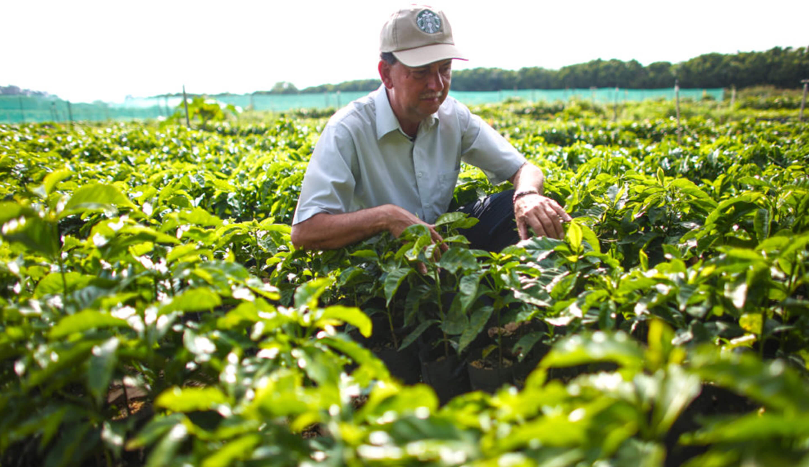
Case studies
Starbucks' Ethical Sourcing of Coffee
Starbucks has made a significant commitment to ethical sourcing practices, particularly through its Coffee and Farmer Equity (C.A.F.E.) Practices program. This initiative is aimed at ensuring that coffee is sourced in a way that supports sustainable farming practices and fair labor conditions.

Slide 10
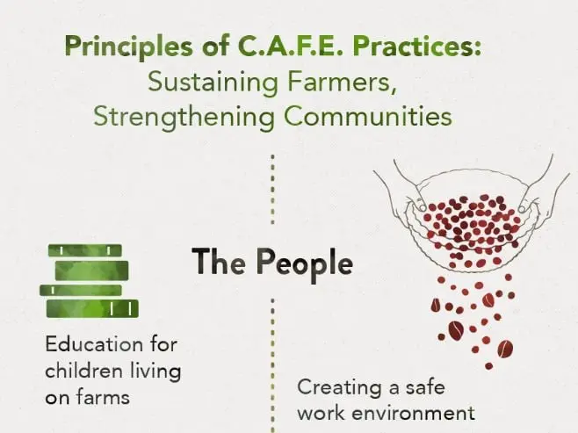
C.A.F.E. Practices
Initiative: The C.A.F.E. Practices program is Starbucks' own set of guidelines for sourcing coffee. It focuses on economic, social, and environmental sustainability.
Actions: Coffee farmers are evaluated on various criteria, including quality, social responsibility, and environmental stewardship. The program ensures that farmers receive fair wages, work in safe conditions, and use sustainable farming practices.

Slide 11
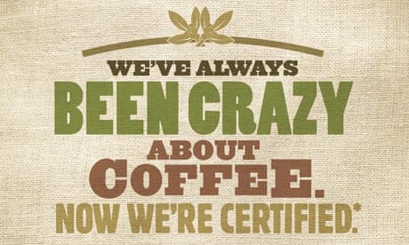
Fair Trade Certification
Initiative: Starbucks also sources coffee from Fairtrade-certified suppliers, which guarantees that farmers receive fair compensation and work under ethical conditions.
Actions: The company offers Fairtrade-certified coffee options and promotes Fairtrade practices through its retail outlets and marketing efforts.

Slide 12
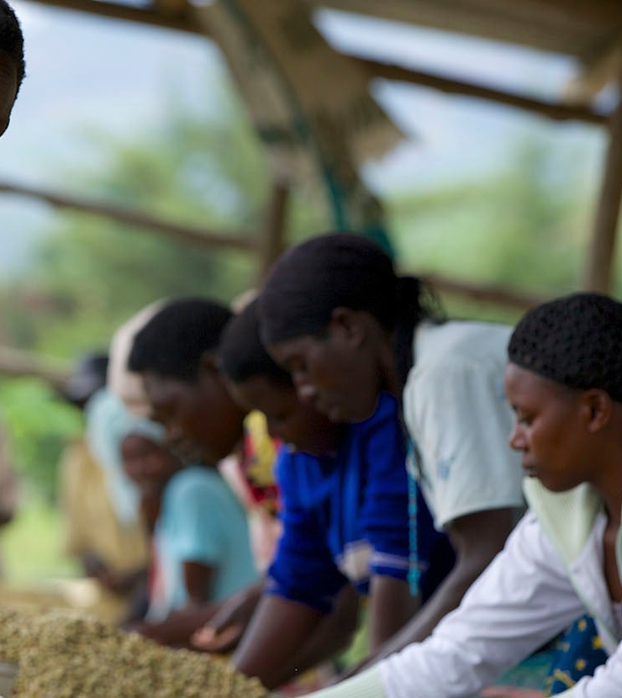
Supporting Coffee Communities
Initiative: Starbucks invests in programs that support the communities where coffee is grown, focusing on health, education, and economic development.
Actions: Initiatives include funding for farmer training programs, community development projects, and efforts to improve access to clean water and healthcare.

Slide 13
Impact on Brand Reputation
Starbucks' commitment to ethical sourcing has enhanced its reputation as a responsible and socially-conscious company. Customers who are concerned about the origins of their products and the impact on global communities appreciate Starbucks’ transparency and efforts toward sustainable practices. This has helped Starbucks differentiate itself in a competitive market and build strong brand loyalty.

Slide 14
Critical thinking
Sustainability and Business Practices:
How effective is Starbucks' C.A.F.E. Practices program in promoting sustainable and ethical coffee sourcing? What aspects of the program might need improvement?
Consumer Trust:
Do you think Starbucks’ ethical sourcing initiatives build trust with consumers? How important is it for consumers to know that their coffee is sourced ethically?
Challenges and Criticisms:
What are some potential criticisms of Starbucks' approach to ethical sourcing? Are there any challenges the company might face in implementing these practices?
Long-term Impact:
What long-term impact do you think Starbucks' ethical sourcing initiatives will have on the coffee industry and the communities involved? How might these practices influence other companies?
Comparative Impact:
How does Starbucks’ approach to ethical sourcing compare to similar efforts by other major coffee companies? Which company’s approach seems more comprehensive or effective?

Slide 15

General analytical questions
CSR and Brand Reputation:
How do CSR initiatives like those of Ben & Jerry’s and Starbucks impact overall brand reputation? What role does CSR play in shaping a company's public image?
Ethical Considerations:
Are there ethical considerations that companies should address when implementing CSR initiatives? How can companies ensure that their efforts are genuine and not just superficial?
CSR Effectiveness Metrics:
What metrics or indicators could be used to measure the success of CSR initiatives? How can companies assess whether their CSR activities are meeting their goals?
Consumer Expectations:
How have consumer expectations regarding corporate social responsibility evolved in recent years? What do you think consumers expect from companies today in terms of social and environmental responsibility?
Future Trends:
What future trends do you foresee in CSR? How might companies need to adapt their strategies to remain relevant and effective in their social responsibility efforts?

Slide 16
Delayed feedback

