Slide 1


General English
TuSpeaking

Slide 2
General English
B2-NEGOTIATIONS-CESCE

Slide 3

WARM-UP
Click icon to add picture
Here's a warm-up activity related to negotiations discussion for B2 English level:
Activity: Negotiation Role Play
Instructions:
1. Divide the class into pairs.
2. Assign each pair a scenario involving a negotiation.
Examples of scenarios could include:
- A salary negotiation between an employer and employee
- Negotiating the price of a car with a salesperson

Slide 4
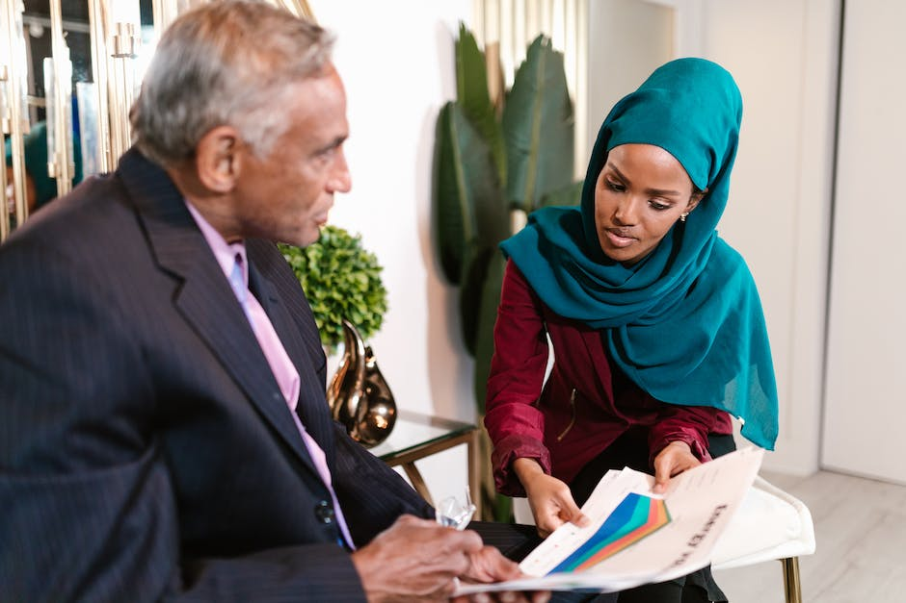
WARM-UP
Click icon to add picture
- A negotiation between two coworkers over an office project
- A landlord-tenant negotiation over rent
3. Give each pair some time to prepare their negotiation.
4. Once the pairs are ready, have them role play the negotiation in front of the class.
5. After each negotiation, have a class discussion about what went well and what could be improved.

Slide 5

WARM-UP
Click icon to add picture
Encourage the class to discuss negotiation techniques and strategies that were effective or ineffective.
This activity will not only help students practice their negotiation skills, but also improve their listening and speaking abilities in English.

Slide 6
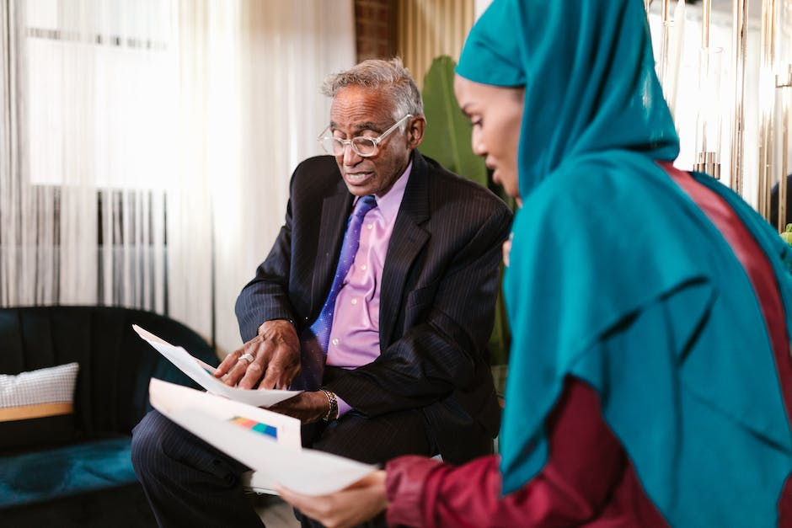
TERMS AND CONCEPTS
Click icon to add picture
1. BATNA (Best Alternative to a Negotiated Agreement) - This is the alternative option that a party has if a negotiation does not result in a mutually acceptable agreement. It is important to understand one's BATNA in order to determine a negotiation's value.
2. ZOPA (Zone of Possible Agreement) - This is the range of possible outcomes in a negotiation, that are acceptable to both parties.

Slide 7
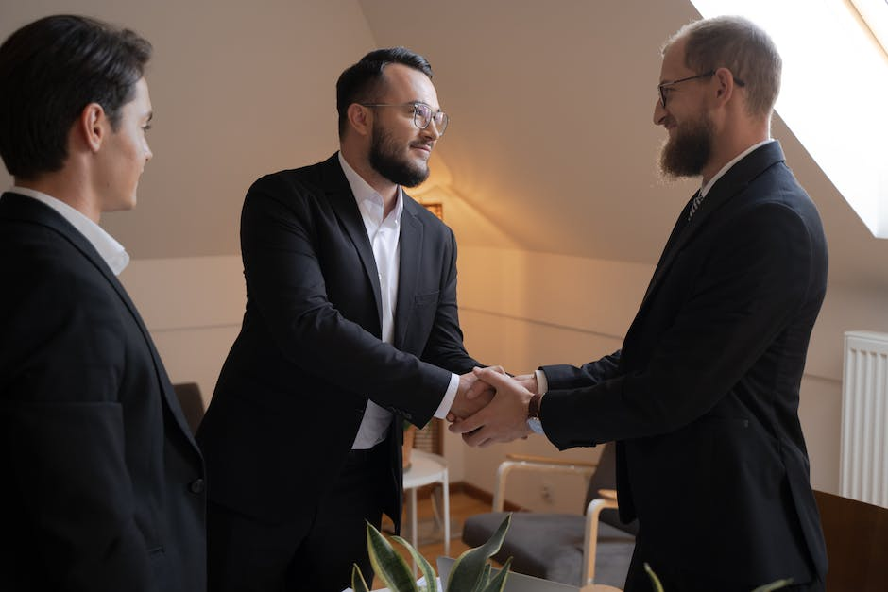
TERMS AND CONCEPTS
Click icon to add picture
Understanding the ZOPA can help to identify potential areas of agreement or identify where an agreement is not possible.
3. Reservation Price - This is the minimum acceptable outcome for a party in a negotiation. It is the lowest price or outcome that they are willing to accept.
4. Anchoring - This is a tactic in which one party sets the initial offer or price in a negotiation, which can influence the other party's perception of what is reasonable or acceptable.

Slide 8

TERMS AND CONCEPTS
Click icon to add picture
5. Distributive Negotiation - This is a negotiation in which the parties are trying to divide a limited resource, such as money or time. This type of negotiation is often competitive, with each party trying to maximize their share of the resource.
6. Integrative Negotiation - This is a negotiation in which the parties are trying to create value or find a solution that benefits both parties.

Slide 9
TERMS AND CONCEPTS
Click icon to add picture
This type of negotiation is often collaborative, with each party trying to understand the other's interests and work towards a mutually beneficial outcome.
7. Concession - This is a compromise or agreement made by one party in a negotiation to move towards a mutually acceptable outcome.
8. Deadlock - This occurs when a negotiation reaches a point where neither party is willing to make further concessions or compromise, and an agreement cannot be reached.

Slide 10
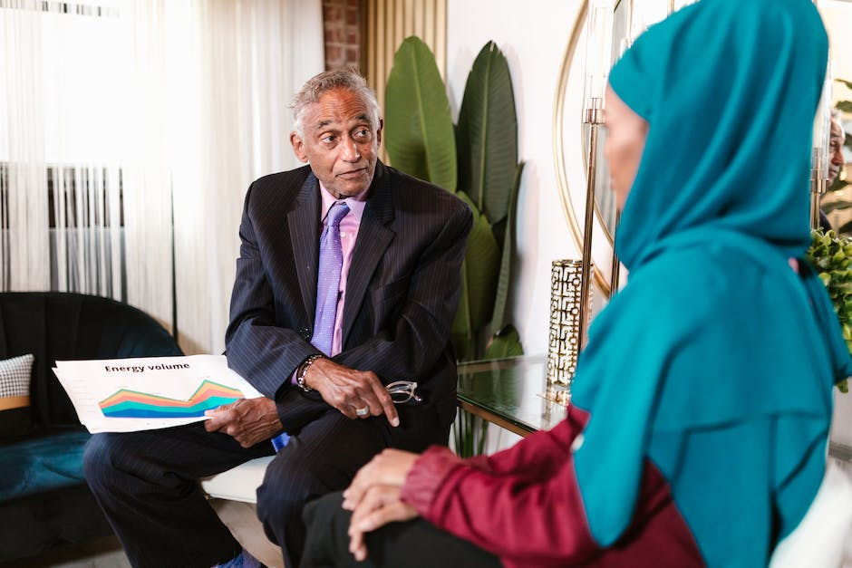
TERMS AND CONCEPTS
Click icon to add picture
9. Power - This is the ability to influence or control the outcome of a negotiation. Power can be derived from various sources, such as expertise, status, or the ability to walk away from the negotiation.
10. Escalation of Commitment - This occurs when a party becomes more committed to a particular course of action or negotiation, even when it is no longer rational or beneficial.

Slide 11

TERMS AND CONCEPTS
Click icon to add picture
This can lead to a party continuing to invest time or resources in a negotiation that is not likely to lead to a favorable outcome.

Slide 12

VOCABULARY
Click icon to add picture
Sure, here are some essential negotiation vocabulary words and examples:
1. Compromise - to find a mutually acceptable solution
Example: We need to compromise to reach an agreement that works for both of us.
2. Concession - a compromise or agreement made in order to reach a deal
Example: I am willing to make concessions on certain issues if it helps us reach a deal.

Slide 13

VOCABULARY
Click icon to add picture
3. Counteroffer - a response to an initial offer, often with a different proposal
Example: I appreciate your offer, but I would like to present a counteroffer for your consideration.
4. Deadline - a date or time by which something must be completed
Example: We need to work within the deadline to ensure we meet the project's requirements.
5. Proposal - a suggestion or plan put forward for consideration

Slide 14

VOCABULARY
Click icon to add picture
Example: I have a proposal that I think could benefit both of our companies.
6. Terms - conditions or requirements agreed upon in a negotiation
Example: Let's review the terms of the agreement to make sure we're both on the same page.
7. Win-win - a solution that benefits both parties involved
Example: Let's work together to find a win-win solution that satisfies everyone's needs.

Slide 15

VOCABULARY
Click icon to add picture
8. Bottom line - the most important or crucial aspect of a negotiation
Example: The bottom line is that we need to reach an agreement that is fair and beneficial for both parties.
9. Mediation - the involvement of a third party to help resolve a dispute
Example: We may need to bring in a mediator to help us reach a mutually acceptable solution.

Slide 16
VOCABULARY
Click icon to add picture
Walk away - to end negotiations without reaching an agreement
Example: If we can't find a solution that works for both of us, we may have to walk away from the negotiation.

Slide 17

VOCABULARY
Click icon to add picture
1. Persuasive -Having the ability to convince or influence others.
2. Compelling - Convincing, forceful, or captivating.
3. Argument - A set of reasons given in support of an idea or action.
4. Structure - A way of organizing or arranging things in a particular pattern or order.
5. Logic - Coherent reasoning or a sequence of statements.

Slide 18
VOCABULARY
Click icon to add picture
"Using persuasive language, presenting compelling arguments, and structuring their ideas logically are essential skills for anyone who wants to succeed in a debate or public speaking."
Task:
Use each of the above words in a sentence that demonstrates your understanding of their meaning.

Slide 19

STYLES AND STRATERGIES
Click icon to add picture
Discussion Questions:
1. How important is it to be aware of cultural differences in negotiation styles and strategies?
2. What are some common negotiation styles and strategies in your culture?
3. How does your culture perceive direct communication in negotiations?
4. How does your culture view the role of relationships in negotiations?
5. Can you give an example of a negotiation that went wrong due to cultural differences in styles and strategies?

Slide 20
STYLES AND STRATERGIES
Click icon to add picture
6. How can you adapt your negotiation style and strategy when negotiating with individuals from a different culture?
7. What are some effective cross-cultural negotiation strategies that you have used in the past?
8. How can cultural differences in negotiation styles and strategies be leveraged to reach mutually beneficial outcomes?
9. How can cultural awareness and understanding enhance the success of international negotiations?

Slide 21
STYLES AND STRATERGIES
Click icon to add picture
10. How do power dynamics and hierarchy play a role in negotiation styles and strategies in different cultures?

Slide 22
Discuss
Click icon to add picture
During negotiations, ethical dilemmas can arise when there is a conflict between what is morally right and what is advantageous to one's self or organization. Here are some examples of ethical dilemmas that can arise during negotiations:
1. Deception: One party may deceive the other by withholding important information or providing false information to gain an advantage.

Slide 23

Discuss
Click icon to add picture
This can be considered unethical as it violates the principle of honesty and integrity.
2. Bribery: Offering or accepting bribes to influence the outcome of negotiations is another ethical dilemma. This can be considered unethical as it violates the principle of fairness and impartiality.
3. Conflict of interest: Negotiators may have a conflict of interest where they have a personal stake in the outcome of negotiations.

Slide 24
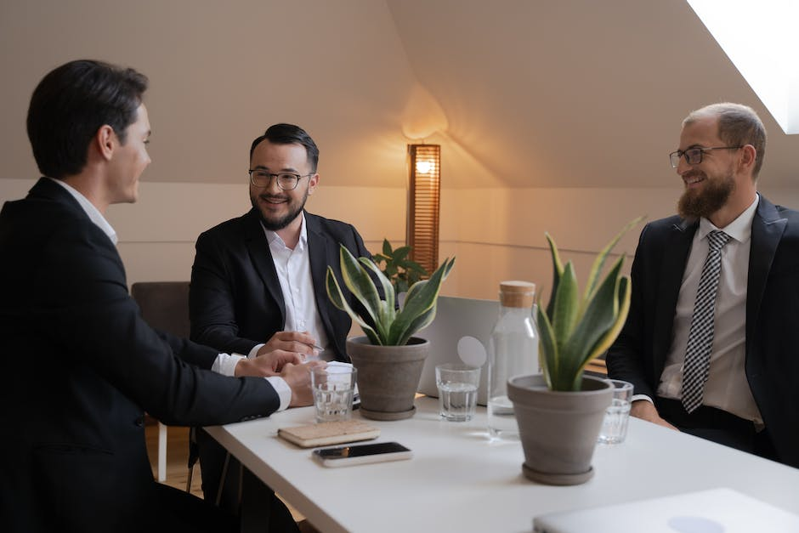
Discuss
Click icon to add picture
This can be considered unethical as it may lead to biased decision-making.
4. Pressure tactics: Using pressure tactics such as threats or ultimatums can be considered unethical as it violates the principle of mutual respect and may lead to coercion.
5. Disclosure of confidential information: Sharing confidential information that is not meant to be disclosed can be considered unethical as it violates the principle of confidentiality and may harm the other party.

Slide 25
Discuss
Click icon to add picture
In conclusion, ethical dilemmas can arise during negotiations when there is a conflict between what is morally right and what is advantageous to one's self or organization. It is important to be aware of these ethical concerns and to strive to maintain integrity and fairness in negotiations.

Slide 26
ROLE-PLAY
Click icon to add picture
Here's a negotiation role-play for B2 level students:
Role-play: Salary Negotiation
Instructions:
You are an employee who has been offered a new job. You have been through the interview process, and the employer has made an offer that you are not happy with. Your goal is to negotiate a better salary package that is more in line with your expectations.

Slide 27
ROLE-PLAY
Click icon to add picture
Scenario:
You have been offered a job as a Marketing Manager for a leading advertising agency. You have the qualifications and experience required for the role, but the salary package is not what you were expecting.
The employer has offered you a salary of £35,000 per year, which is lower than you were hoping for. You were expecting a salary of at least £40,000 per year, given your expertise and experience in the field.

Slide 28
ROLE-PLAY
Click icon to add picture
Your task is to negotiate a better salary package with the employer.
Roles:
Employee (you)
Employer
Dialogue:
Employee: Thank you for offering me the position of Marketing Manager. I'm excited about the prospect of working for your agency, but I'm concerned about the salary package you've offered.
Employer: I understand. What is your concern?
Employee: Well, I was hoping for a salary of at least £40,000 per year, given my qualifications and experience.

Slide 29
ROLE-PLAY
Click icon to add picture
Is there any room for negotiation?
Employer: We understand your concern, but we have a set salary range for this position. However, we're willing to consider your request. What salary range were you hoping for?
Employee: I was hoping for a salary range of between £40,000 and £45,000 per year.
Employer: I see. That's quite a jump from our initial offer.

Slide 30
ROLE-PLAY
Click icon to add picture
Can you justify why you think you're worth that much?
Employee: Yes, I have extensive experience in the field, and I've achieved some impressive results in my previous roles. I believe I can bring a lot of value to your agency, and I think my salary should reflect that.
Employer: I understand your point of view. Let me discuss this with my team, and I'll get back to you as soon as possible.

Slide 31

ROLE-PLAY
Click icon to add picture
Employee: Thank you. I appreciate your willingness to consider my request.
Employer: We've discussed your request, and we're willing to meet you halfway. We can offer you a salary of £37,500 per year.
Employee: Thank you for considering my request. I appreciate the offer, but I was hoping for something closer to my initial request.
Employer: We understand your position, but this is the best we can offer at this time.

Slide 32
ROLE-PLAY
Click icon to add picture
Is this something you would be willing to accept?
Employee: I appreciate your offer, but I would like some time to think it over before I make a final decision.
Employer: That's understandable. Please take your time, and let us know if you have any further questions or concerns.
Debrief:
After the role-play, discuss with the students what went well and what could have been improved.

Slide 33
ROLE-PLAY
Click icon to add picture
Ask them to reflect on their negotiation skills and strategies. What worked, what didn't, and why? Encourage them to think about how they can apply these skills in other real-life situations.

Slide 34
CONCLUDE
Click icon to add picture
1. How important is it to have a clear conclusion in a negotiation?
2. What are some effective strategies for concluding a negotiation?
3. How can you ensure that both parties feel satisfied with the conclusion of a negotiation?
4. In what ways can a poorly-concluded negotiation have negative consequences?
5. What role does compromise play in reaching a conclusion in a negotiation?

Slide 35

CONCLUDE
Click icon to add picture
6. How do cultural differences affect the way negotiations are concluded?
7. Can a negotiation be considered successful if one party feels like they didn't get what they wanted?
8. How can you handle a situation where both parties are unable to come to a conclusion?
9. How can you evaluate the effectiveness of a conclusion in a negotiation?
10. What are some common mistakes to avoid when concluding a negotiation?

Slide 36
Summary
- BATNA (Best Alternative to a Negotiated Agreement)
- ZOPA (Zone of Possible Agreement)
- Reservation Price (minimum acceptable outcome)
- Anchoring (setting initial offer or price)
- Distributive Negotiation (dividing a limited resource)
- Integrative Negotiation (creating value for both parties)
- Concession (compromise made by one party)
- Deadlock (when no agreement can be reached)

Slide 37
Summary
- Power (ability to influence or control the outcome)
- Escalation of Commitment (becoming more committed to a negotiation)
- Compromise - finding a mutually acceptable solution
- Concession - a compromise or agreement made to reach a deal
- Counteroffer - a response to an initial offer, often with a different proposal
- Deadline - a date or time by which something must be completed

Slide 38
Summary
- Proposal - a suggestion or plan put forward for consideration
- Terms - conditions or requirements agreed upon in a negotiation
- Win-win - a solution that benefits both parties involved
- Bottom line - the most important or crucial aspect of a negotiation
- Mediation - the involvement of a third party to help resolve a dispute
- Walk away - to end negotiations without reaching an agreement.

Slide 39
Summary
- Importance of being aware of cultural differences in negotiation styles and strategies
- Common negotiation styles and strategies in one's culture
- Perception of direct communication in negotiations in one's culture
- Role of relationships in negotiations in one's culture
- Example of a negotiation that failed due to cultural differences
- Adapting negotiation style and strategy when negotiating with individuals from a different culture

Slide 40
Summary
- Effective cross-cultural negotiation strategies
- Leveraging cultural differences to reach mutually beneficial outcomes

Slide 41
Disclaimer
The content of this slide show was in part generated using AI technology and was formatted and reviewed by Learning Like a Lioness.

Slide 42

Delayed feedback

Slide 43

Thank you

