Slide 1

Corporate communication
English B1
tuSpeaking 2024, All rights reserved

Slide 2

Warm up
Can you think of a time when you had to send a formal email? What was it about?
What kind of information did you include in that email?
Have you ever received a formal email? How did it look different from informal emails?

Slide 3
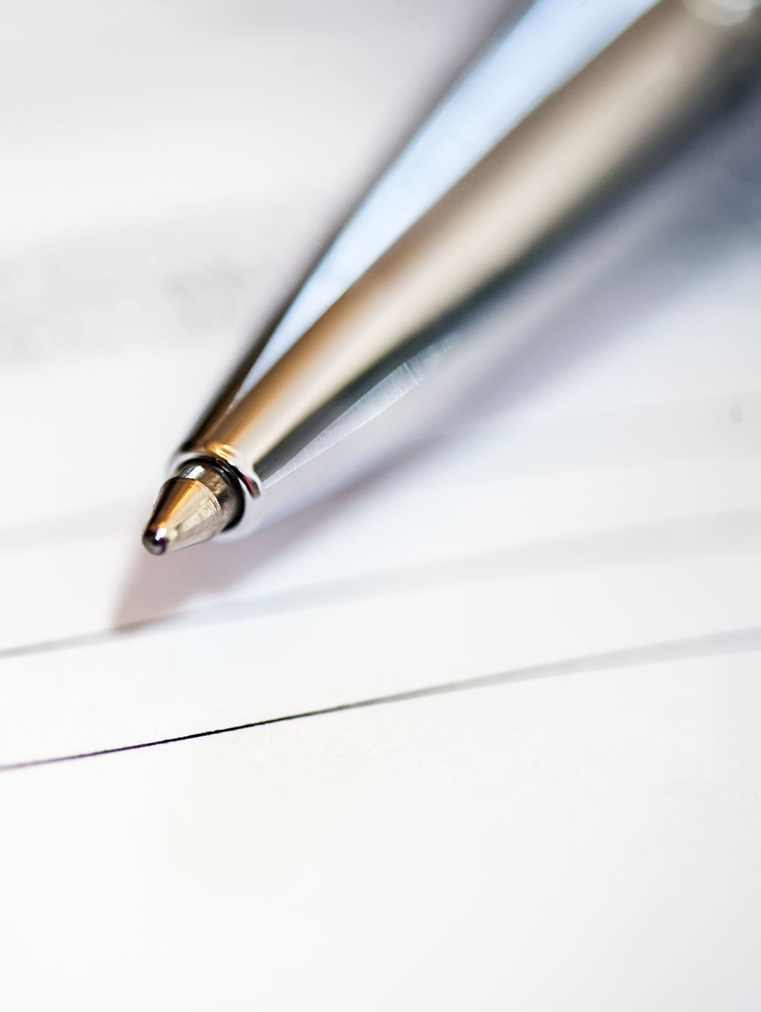
Introduction to Email Structure
Explain the Structure:
Subject Line: Brief and clear.
Greeting: Polite and appropriate (e.g., Dear [Name], Hello [Name],).
Body: Main message with clear points.
Closing: Polite ending (e.g., Best regards, Sincerely,).
Signature: Your name and contact information.

Slide 4
Example
Subject: Request for Meeting to Discuss Project Proposal
Dear Ms. Johnson,
I hope this email finds you well.
I am writing to request a meeting to discuss the upcoming project proposal for our new marketing campaign. We have developed some preliminary ideas and would like to present them to you to get your feedback and approval before moving forward.
Could we schedule a meeting sometime next week? Please let me know your availability, and I will do my best to accommodate your schedule.
Thank you for your attention to this matter. I look forward to your response.
Best regards,
Alex Parker Marketing Coordinator XYZ Company alex.parker@xyzcompany.com (123) 456-7890

Slide 5

Explanation of Structure
Subject Line: Clearly states the purpose of the email.
Greeting: Polite and professional, addressing the recipient formally.
Body:
Opening Line: Polite introduction to set a positive tone.
Main Message: Directly states the purpose of the email (requesting a meeting).
Details: Provides context and asks for a specific action (scheduling a meeting).
Closing Line: Polite sign-off thanking the recipient and expressing anticipation for their reply.
Closing: Formal closing phrase.
Signature: Includes the sender's name, job title, company name, and contact information for clarity.

Slide 6

Key Phrases for Effective Communication
Greeting Phrases:
I hope this email finds you well.
I trust you are doing well.
I hope you are having a good week.
Body Phrases:
I am writing to inform you that…
I would like to bring to your attention…
Please be advised that…
Closing Phrases:
Thank you for your attention.
I appreciate your prompt response.
Looking forward to hearing from you.

Slide 7

Pair Work or Group Activity
Scenario 1: Requesting a Meeting
You need to schedule a meeting with a colleague to discuss a new project proposal. Use phrases for making a request and suggesting a time for the meeting.
Scenario 2: Following Up
You are following up on an email you sent last week regarding a report that was due. Use phrases to politely remind the recipient and ask for an update.
Scenario 3: Clarification on Policy
You need clarification on a recent change in company policy. Write an email requesting more details and expressing your need for further information.

Slide 8

Peer Review
Once the emails are drafted, have each pair or group exchange their email with another group for peer review.
Does the email have a clear subject line?
Are the key phrases used correctly?
Is the tone appropriate and professional?
Are all parts of the email included (greeting, body, closing, and signature)?

Slide 9

Discussion Questions
Ask Groups to Consider:
Clarity and Structure:
Was the subject line clear and appropriate for the email’s purpose?
Did the email follow the correct structure (greeting, body, closing, signature)? Why is this important?
Use of Key Phrases:
How effectively were the key phrases used in the email? Did they help in making the communication clear and professional?
Were there any key phrases that seemed particularly effective or useful? Why?
Tone and Professionalism:
Did the tone of the email match the intended purpose? Was it polite and professional?
How well did the email address the recipient’s needs or concerns?
Common Issues:
Did you notice any common mistakes in the emails shared, such as issues with phrase usage or email structure?
How can these issues be addressed or corrected in future emails?

Slide 10
Delayed feedback
tuSpeaking 2024, All rights reserved

