Slide 1

Art and culture 2
English B1.2
tuSpeaking 2024, All rights reserved

Slide 2
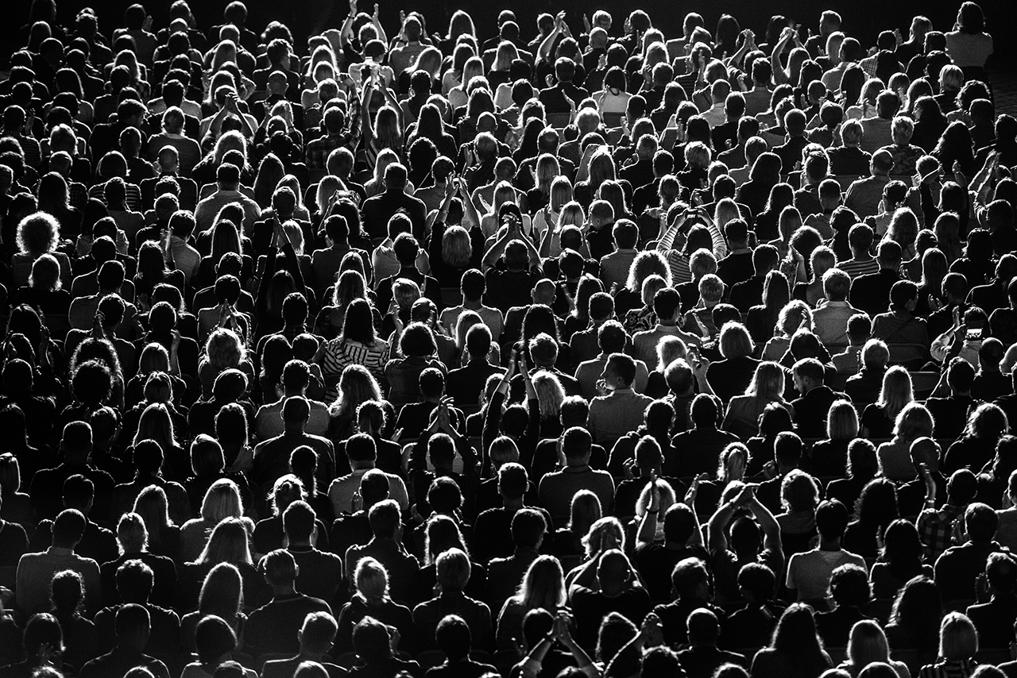
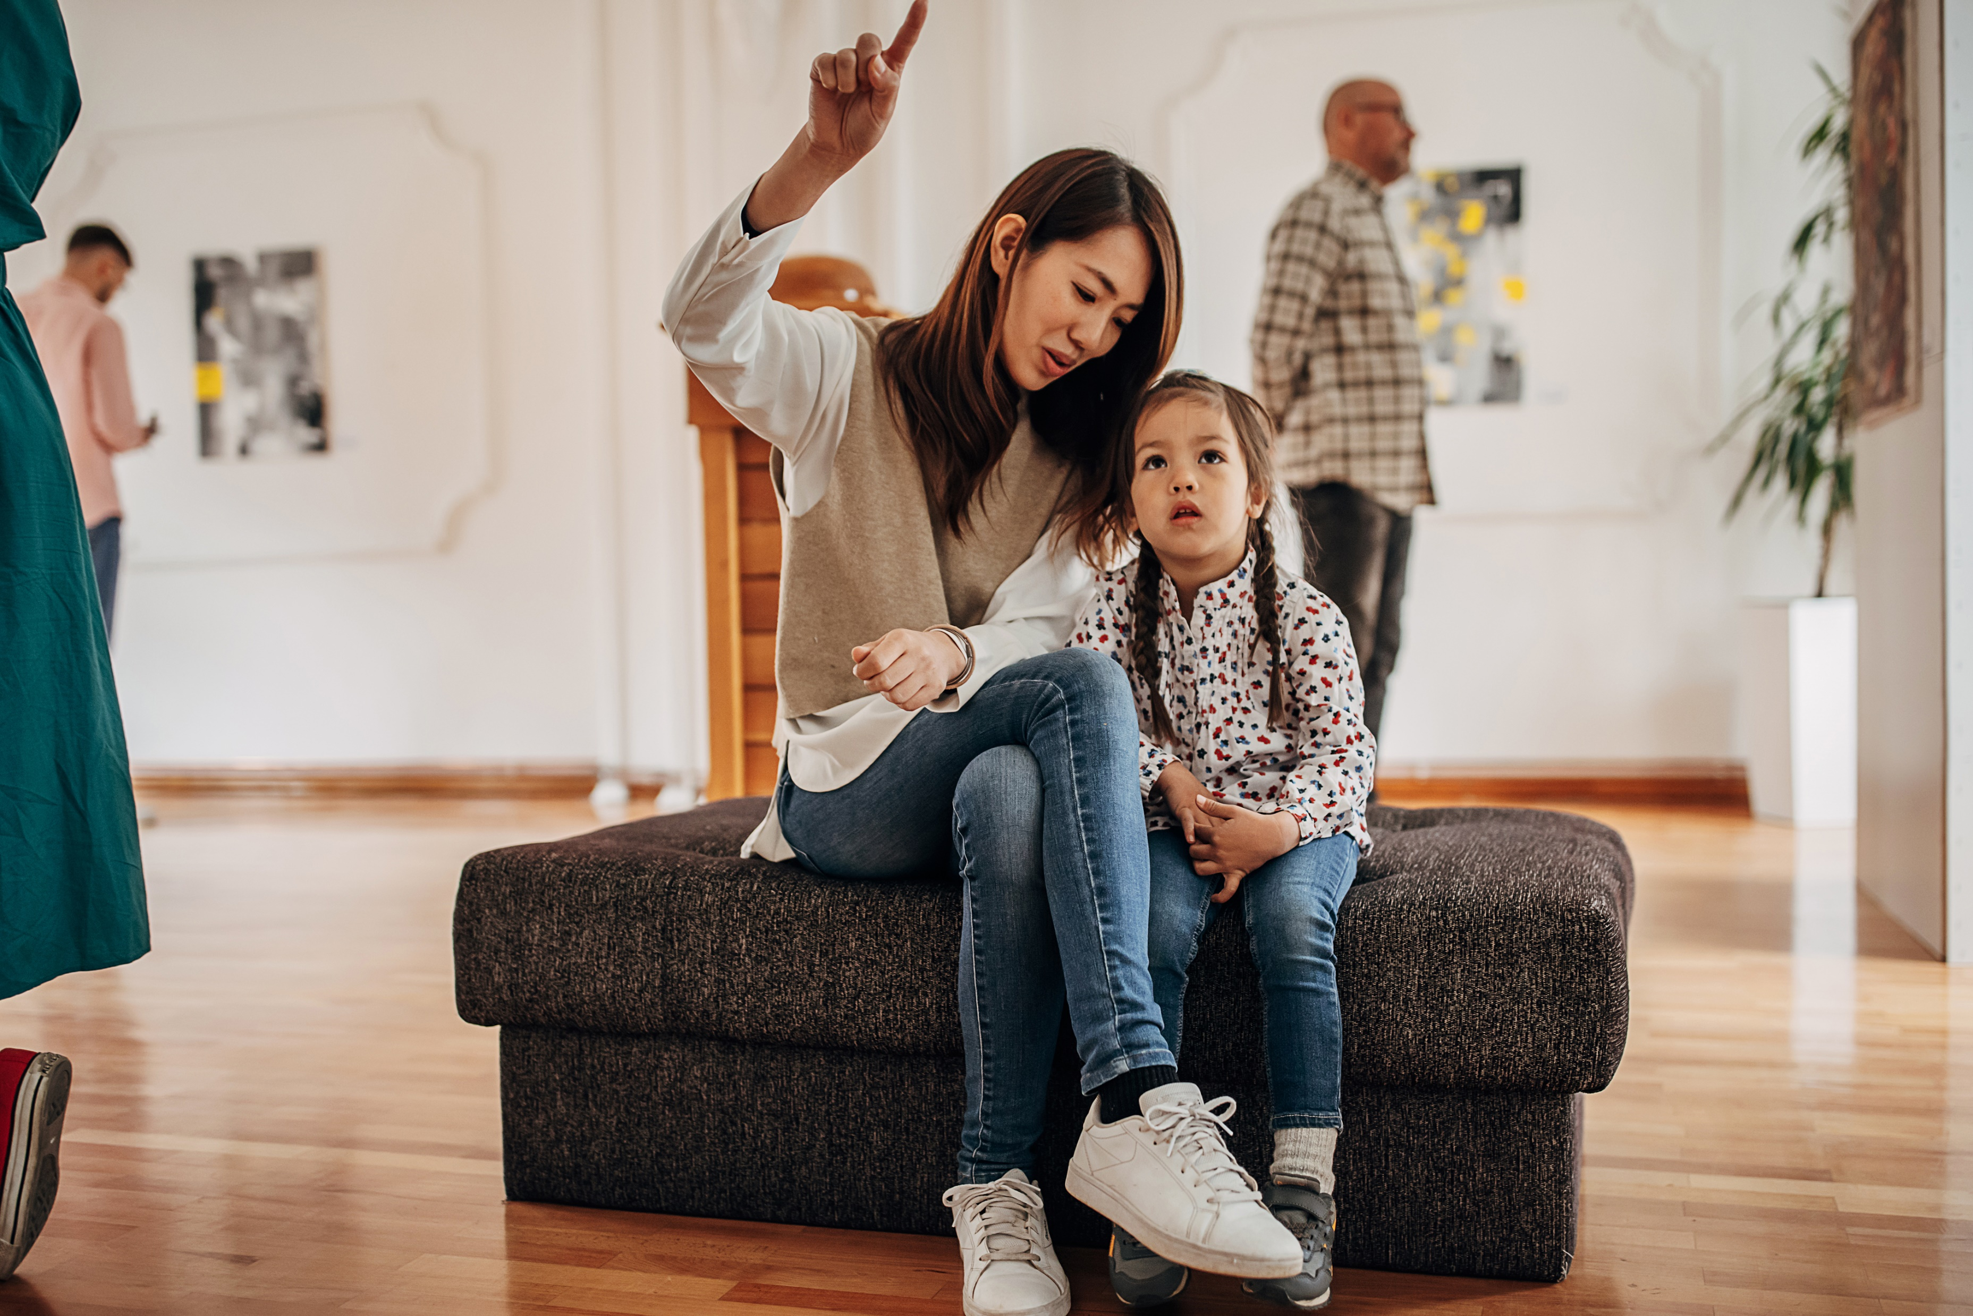


Warm up
What type of performances do you enjoy?
Vocabulary hints:
Exhibit
Performance
Audience
Director
Actor
Screening

Slide 3
Art Forms & Roles
Exhibit: A public display of art or cultural items in a gallery or museum.
Curator: A person responsible for managing and organizing exhibits in a museum or gallery.
Playwright: A person who writes plays or scripts for theater productions.
Director: The person who oversees and guides the creative aspects of a film, play, or performance.
Actor/Actress: A person who performs a role in a play, film, or television show.
Audience: The group of people who watch or listen to a performance, concert, or show.
Screening: A showing of a film, usually at a theater or festival.

Slide 4
Vocabulary
Art & Performance Settings:
Gallery: A place where art, such as paintings or sculptures, is displayed for the public.
Theater: A venue where plays, performances, or other cultural events are staged.
Festival: An organized series of performances, exhibitions, or shows focused on a specific theme (e.g., music, film, theater).
Stage: The area in a theater where actors perform.
Artistic Elements & Media:
Genre: A category or style, especially in art, music, or literature (e.g., comedy, tragedy, drama).
Installation: A type of art that is installed in a space, often interactive or immersive for viewers.
Canvas: The material on which a painting is done, often stretched on a frame.
Sculpture: A three-dimensional work of art made by carving, modeling, or constructing materials.

Slide 5
Vocabulary
Descriptive Terms:
Abstract: A style of art that doesn’t attempt to represent reality, focusing on shapes, colors, and forms.
Contemporary: Refers to art and culture that is current or modern.
Traditional: Refers to art forms and styles that are historical or passed down through generations.
Realism: A style of art or literature that aims to represent subject matter truthfully and accurately.
Cultural Engagement & Access:
Inclusive: Ensuring access and participation for all, regardless of background.
Public Access: Refers to art or performances that are available for the general public.
Commission: A request or payment for a specific piece of art or performance to be created.
Patron: A person who supports or funds artists or cultural institutions.

Slide 6
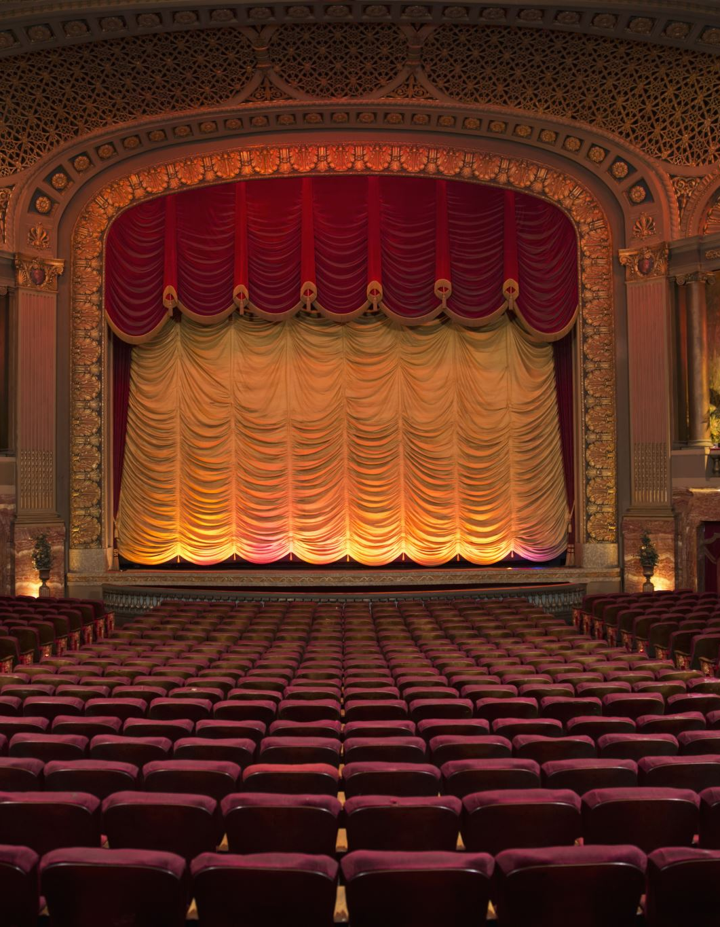
Few/Little vs. A Few/A Little
Few and little are used with countable and uncountable nouns respectively and imply that there is not enough.
A few and a little are used similarly but imply that there is some, albeit a limited amount.
Examples:
Few: Few people attended the theatre performance last night (implying it was not well attended).
Little: There’s little interest in that old art style these days.
A Few: A few tickets are still available for the concert (implying there are some but limited).
A Little: There’s a little time left to see the exhibition (implying enough time to still attend).

Slide 7

Practice
The art gallery had ___ visitors last weekend.
There are ___ art festivals in the city next month.
We have ___ time to enjoy the museum before it closes.
The museum receives ___ government support, which makes it hard to maintain exhibitions.

Slide 8
Answers
The art gallery had ___ visitors last weekend. (Answer: few)
There are ___ art festivals in the city next month. (Answer: a few)
We have ___ time to enjoy the museum before it closes. (Answer: a little)
The museum receives ___ government support, which makes it hard to maintain exhibitions. (Answer: little)

Slide 9

No- and Every- Compounds
No- and every- compounds help us talk about inclusivity, location, and accessibility in cultural settings.
No- compounds like nobody, nowhere, and nothing indicate a complete absence.
Every- compounds like everybody, everywhere, and everything refer to inclusivity or a complete presence in a location or experience.
Examples:
Nobody should feel excluded from visiting the museum.
Art is everywhere in this neighbourhood.
Everybody has a right to appreciate different art forms.
You’ll find something interesting everywhere you go in the art district.

Slide 10

Practice
____ wants to miss the opening night at the theater.
Art can be seen ____ around the world.
____ should feel excluded from public art events.
____ in the neighborhood knows about the festival.

Slide 11
Answers
____ wants to miss the opening night at the theater. (Answer: Nobody)
Art can be seen ____ around the world. (Answer: everywhere)
____ should feel excluded from public art events. (Answer: Nobody)
____ in the neighborhood knows about the festival. (Answer: Everybody)

Slide 12
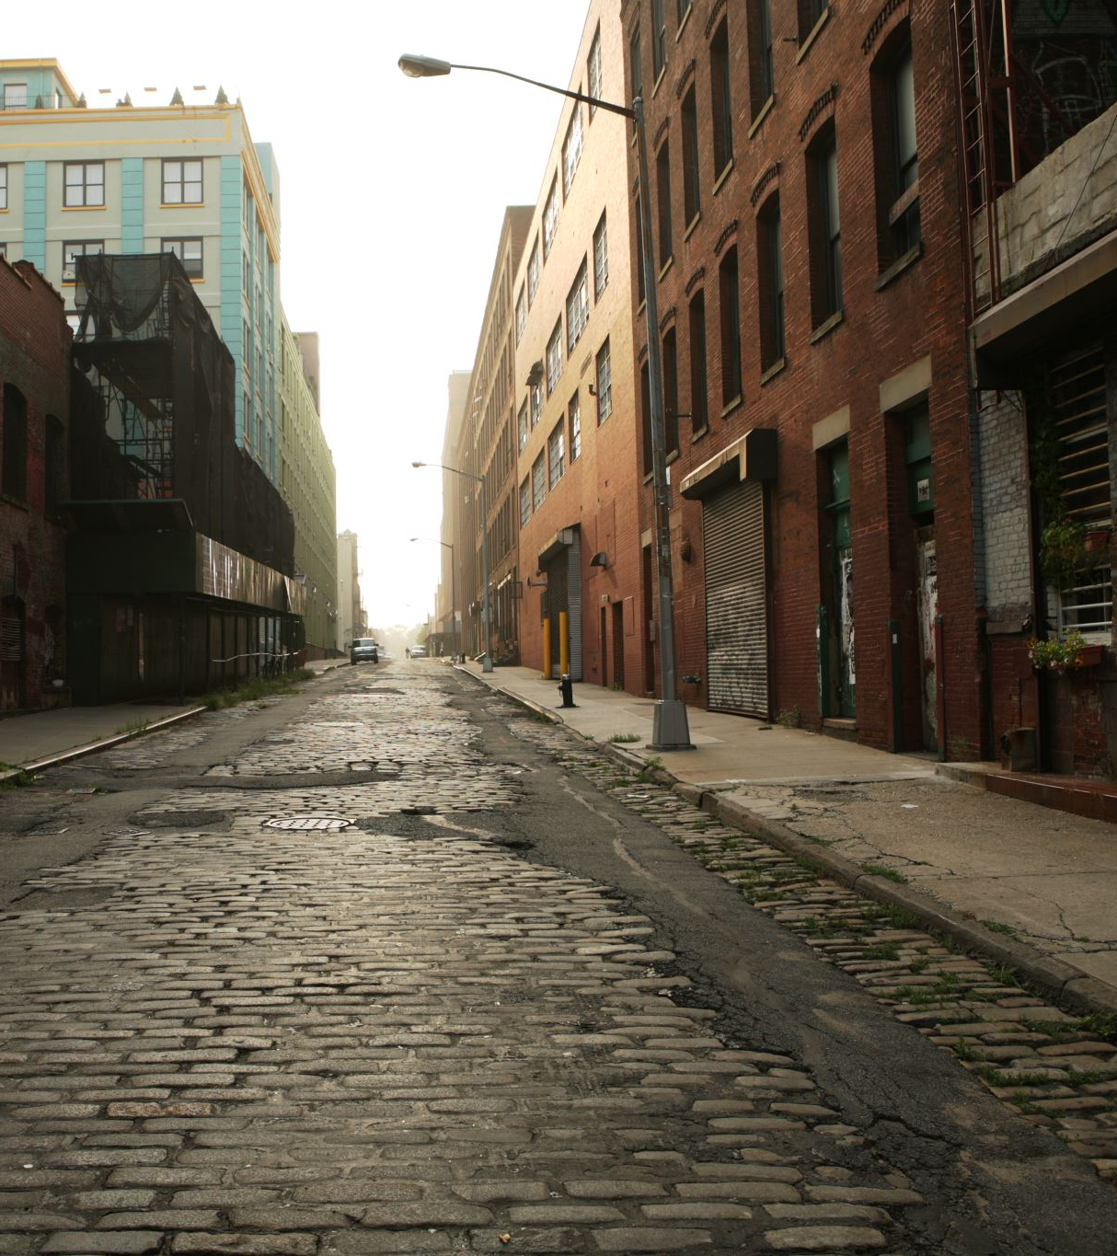
Practice together
There are only ___ seats left for the play.
____ is invited to join the art workshop.
The museum has ___ items from that period.
You will see street art ____ in the downtown area.

Slide 13
Answers
There are only ___ seats left for the play. (Answer: a few)
____ is invited to join the art workshop. (Answer: Everybody)
The museum has ___ items from that period. (Answer: few)
You will see street art ____ in the downtown area. (Answer: everywhere)

Slide 14
Discussion
How can we make cultural events accessible to everyone?
Do you think art should be everywhere in a city? Why or why not?
Is it important for everybody to have access to the arts?
What are some ways to encourage participation in cultural events?
How can we create an inclusive environment in cultural spaces?

Slide 15
Delayed feedback
tuSpeaking 2024, All rights reserved

