Slide 1

Integrating sustainability into business strategy
Business English B1
TuSpeaking 2024, All rights reserved

Slide 2

Warm up
What do you think Corporate Social Responsibility (CSR) means?
Why might it be important for a company?

Slide 3

Conversation
Can you think of any companies that do good things for society?
What do they do?
How do you think helping society could make a company look better to its customers?

Slide 4

Vocabulary
Ethical Branding: The company’s ethical branding strategy focuses on using fair trade materials and ensuring that workers are paid fairly.
Stakeholder Engagement: Effective stakeholder engagement involves listening to customers, employees, and community members to address their concerns and needs.
Social Impact: The charity’s partnership with the company had a positive social impact, helping thousands of people in need.
Reputation Management: Reputation management strategies help companies maintain a positive public image, even during a crisis.

Slide 5
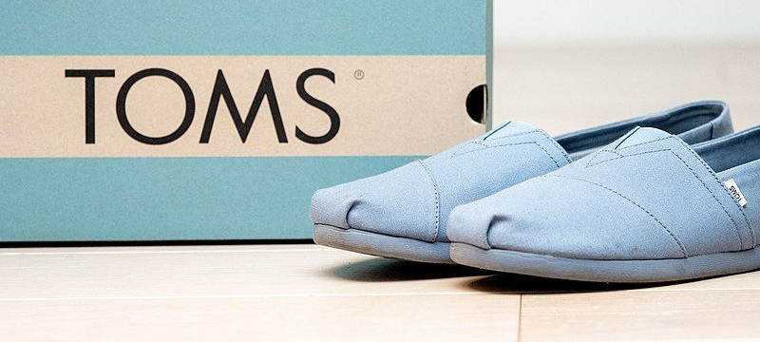
Successful CSR initiatives

Slide 6

TOMS Shoes
One for One Model:
Mission: TOMS Shoes is known for its One for One model, where for every pair of shoes purchased, the company donates a pair to a child in need.
Global Impact: This initiative has provided millions of shoes to children in over 70 countries, helping to improve health and education by protecting feet from infections and providing better access to schools.

Slide 7

Social Impact
Beyond Shoes:
TOMS has expanded its social impact efforts beyond shoes. They have introduced similar programs for eyewear, clean water, and safe birth services.
Eyewear:
For every pair of glasses sold, TOMS provides eye care services, including prescription glasses and medical treatment, to people in need.
Water:
They fund water projects to provide clean drinking water to communities around the world.
Safe Birth:
TOMS also supports programs that provide trained birth attendants and medical supplies to ensure safer deliveries for mothers in developing countries.

Slide 8
Sustainability Efforts
Sustainable Materials:
TOMS is working towards using more sustainable materials in their products. They focus on reducing their environmental impact by using recycled and eco-friendly materials.
Community and Social Justice:
Advocacy: TOMS supports various social justice initiatives, including mental health awareness and supporting marginalized communities through their grant programs and partnerships with nonprofits.

Slide 9
Conversation
What CSR activities did the company in the case study carry out?
How did these activities improve the company's reputation?
What made these CSR initiatives successful? Was it the way they were implemented or something else?

Slide 10
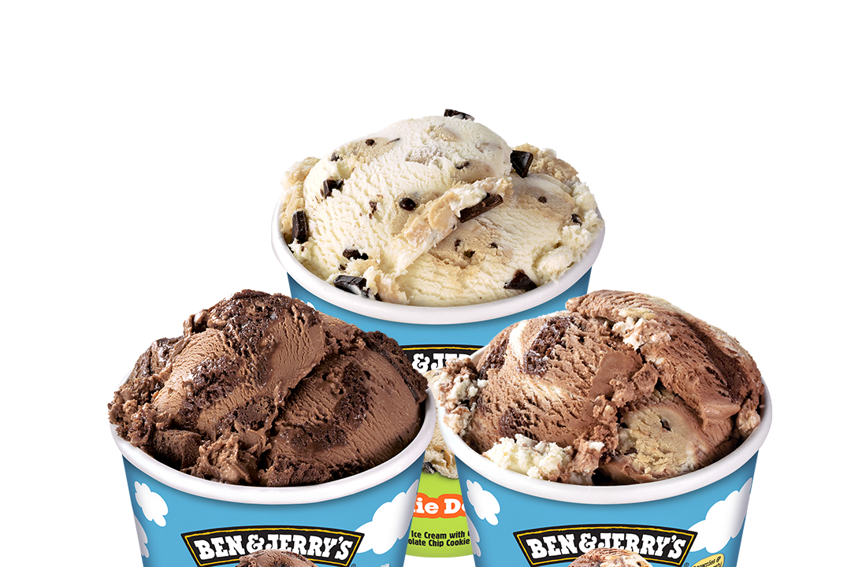
Ben & Jerry’s CSR Initiatives

Slide 11

Social and Environmental Mission
Mission:
Ben & Jerry’s has a long-standing commitment to social and environmental causes. Their mission is to make the world a better place through their business practices.
Environmental Initiatives:
The company focuses on sustainability in several ways:
Sustainable Sourcing:
They source Fairtrade-certified ingredients, including cocoa and vanilla, ensuring fair wages and working conditions for farmers.
Environmental Impact Reduction:
Ben & Jerry’s works to reduce their carbon footprint by using renewable energy in their production facilities and minimizing waste through recycling and composting.

Slide 12

Ben and Jerry’s
Social Causes:
Ben & Jerry’s actively engages in social justice issues. They have been vocal advocates for climate justice, racial equity, and LGBTQ+ rights.
Campaigns:
They run campaigns to raise awareness about various issues, such as their Justice ReMix’d flavor, which was created to support criminal justice Community Programs:
The company supports local communities through grants and donations to nonprofit organizations. Their Ben & Jerry’s Foundation funds projects related to social and environmental justice.

Slide 13
Application and Presentation
Each group prepares a short summary of their assigned CSR strategy, highlighting how it could improve a company's brand reputation.

Slide 14

Conversation questions
How could you use the CSR strategies discussed today in your own business ideas?
Which CSR strategy do you think would be the most important for a new company? Why?

Slide 15
Delayed feedback

