Slide 1

The media and the climate
B1 English

Slide 2
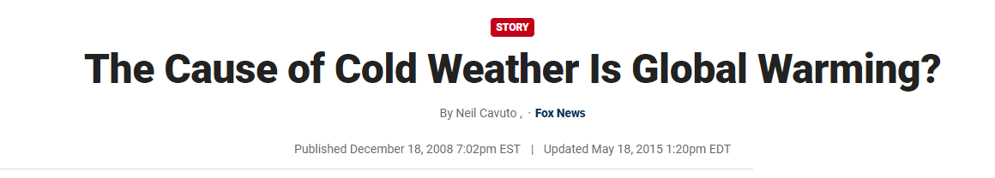
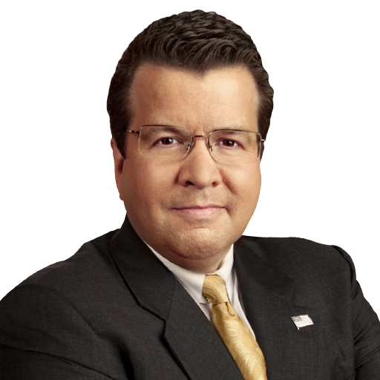
Warm up – Read the article
Did you hear the news that it snowed in Las Vegas? Yes, it's becoming a bit like a slushy city. Odd, right? And what's happening in Vegas isn't staying there.
Cold weather and storms are already common, even though it's not officially winter yet.
Adapted from:
https://www.foxnews.com/story/the-cause-of-cold-weather-is-global-warming

Slide 3
For the first time in 30 years, southern Nevada is experiencing this kind of weather. In southern California, it's the coldest it's been in the early months for two decades.
So, I'm looking at all this strange weather and asking my friend, who knows a lot about the environment. I want to know, "What's happening? I thought we could put away our warm jackets and wear something lighter?"
My friend, who cares a lot about nature, didn't like the idea. He said, "Neil, this is because of global warming."
I got confused. "Wait, doesn't global warming mean things get hotter?" But no, my friend explained that it's all connected to how humans have treated the planet.
Neil Cavuto

Slide 4
He told me last year that snow would become rare, the oceans would warm up, more hurricanes would come, and glaciers would melt. But this year, there's more snow than ever.
Vegas saw its first snow in 30 years, and some states in the Midwest and west have temperatures below zero, the earliest it's happened in any year.
My friend thinks it's all part of the changes in the climate. He's not saying something new; he just adjusted his predictions. It's like you can care about the environment and still have things stay the same.
Neil Cavuto

Slide 5
He believes that even if the Earth is getting warmer in some places, the changes in weather are all part of the same problem.
Where the earth getting warmer is warming, and the earth getting cooler is warming?
So, he's encouraging the government to spend more on environmental issues.
I wished him luck and suggested one more thing: "Bring a coat."
Neil Cavuto

Slide 6
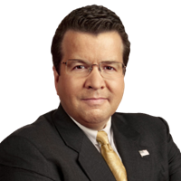
Summary
What do you think of Neil’s opinion?
Can you find any flaws in his argument?
What would you say to Neil if you met him?

Slide 7
Grammar review points
Present Simple Tense:
Used for general truths, habits, and routines.
Example: Journalists report on climate change regularly.
Modal Verbs:
Expressing ability, possibility, necessity, etc.
Example: Journalists should verify facts before reporting.
Present Continuous Tense:
Describing actions happening now.
Example: Scientists are discussing climate solutions in the latest report.
Comparatives:
Comparing differences between things.
Example: The urgency of climate change is greater than many people realize.

Slide 8
Grammar review points
Conditional Sentences:
Expressing hypothetical situations.
Example: If the media is transparent, public trust increases.
Passive Voice:
Emphasizing the action rather than the doer.
Example: Climate solutions are discussed by journalists.
Question Words:
Asking for information.
Example: How does the media cover climate change?
Expressing Cause and Effect:
Using connectors to show relationships.
Example: Due to climate change, there are significant impacts on communities.

Slide 9
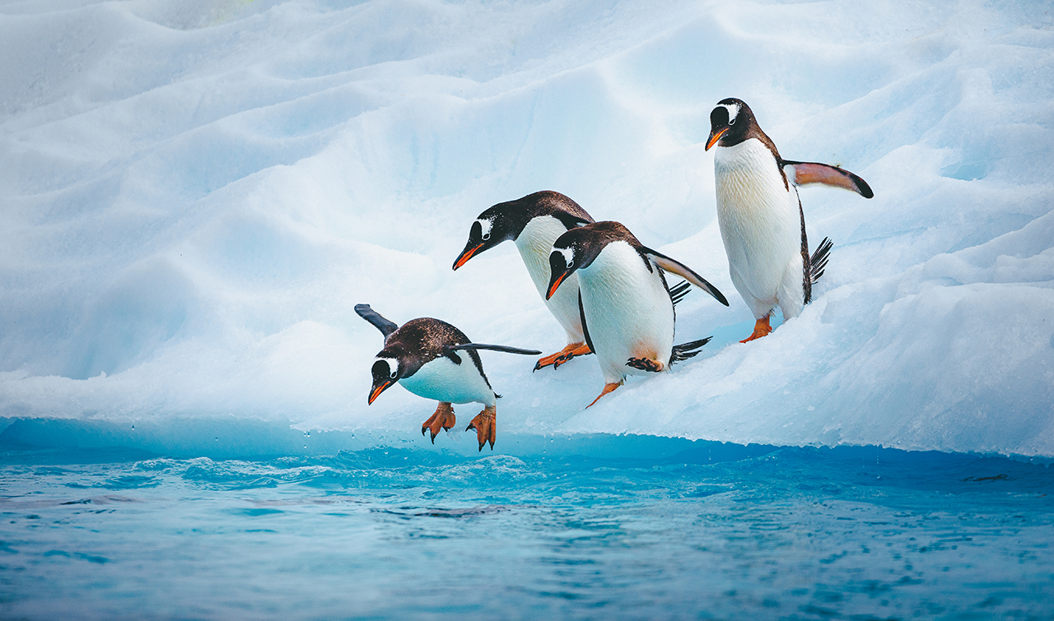
Conversation questions
Do you think it's important for the media to share accurate information about climate change, given its impact on what people know and how governments decide?
How do you think people can tell if the information they read or hear about climate change is trustworthy? Are there certain sources or methods you trust for fact-checking?
Have you ever come across false information or untrue claims about climate change? How did you realize it was false, and do you think this kind of misinformation can affect how people view the issue?

Slide 10
Delayed feedback

