Slide 1

The media and the climate
B1 English

Slide 2
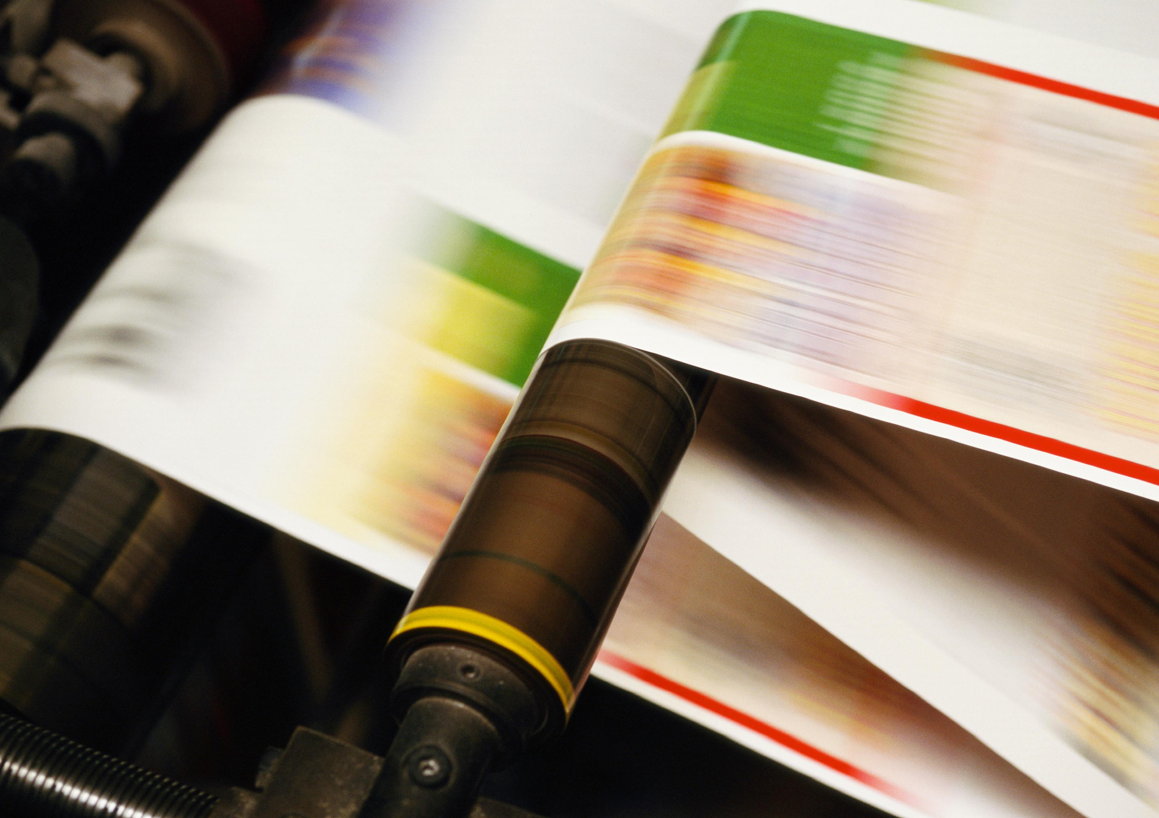
Framing
In the media, framing means how information is presented to shape how we see an issue or event. It's like putting a frame around a picture—deciding what parts to show prominently and what to keep in the background. This can really affect how people understand and feel about the news.

Slide 3
Key aspects of framing in media include:
Choosing Information:
Deciding on specific details and facts to include in a news story.
Emphasis and Prioritization:
Making certain elements stand out more to grab the audience's attention.
Language and Tone:
Using different words to create emotions and set the overall feeling of the story.
Contextualization:
Giving background information to help people understand the story better.
Visual Elements:
Selecting and showing pictures or videos that can affect how people feel and understand the news.
Cultural and Social Context:
Considering cultural and social norms, values, and perspectives when presenting the news.
Narrative Structure:
How the story is organized, including the order of information and storytelling methods, plays a role in how it's understood.

Slide 4
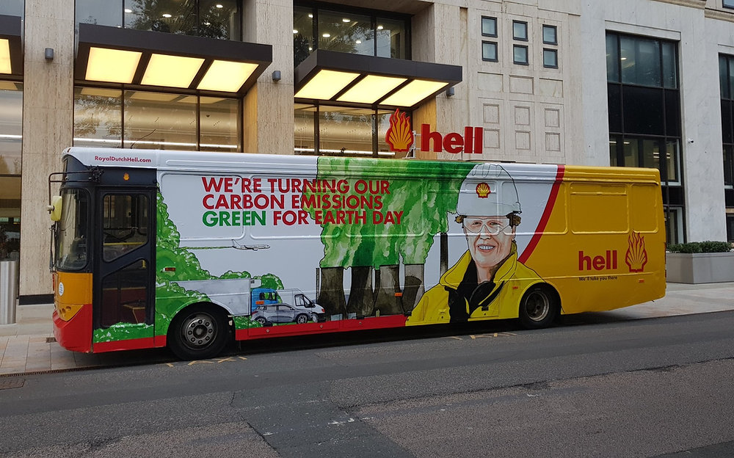
Look at the bus

Slide 5
Can you find anything untrue or misleading?

Slide 6
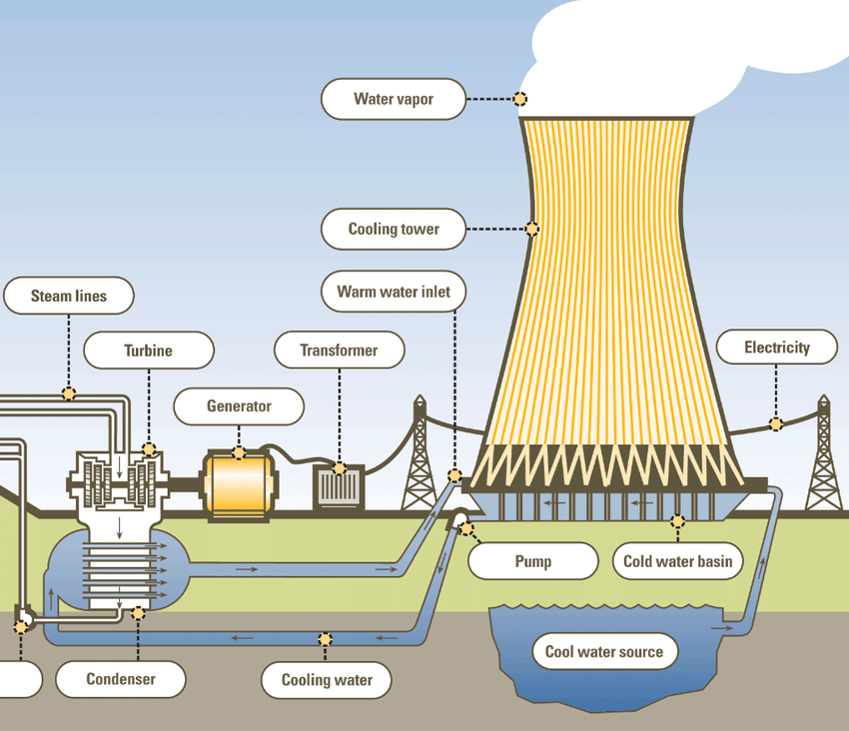
How cooling towers work
This is just water vapour. It’s not green….
So, who should we believe?
Discuss advocacy versus objectivity in climate change reporting, then choose another discussion point from the following pages.
There are 12, but you don’t need to discuss them all.

Slide 7
Discussion points – Choose topics
Advocacy in Climate Reporting:
How can journalists help people understand climate change through their reporting?
Do you think journalists should support specific climate-related issues? Why or why not?
Balancing Scientific Consensus and Scepticism:
Should journalists share both the scientific agreement on climate change and sceptical viewpoints?
What challenges might journalists face when trying to present a fair balance of opinions?
Role of Advocacy Organizations:
Do you think advocacy groups have a role in influencing how the media covers climate change?
How can journalists report information from advocacy organizations while staying accurate and unbiased?

Slide 8
Discussion points – Choose topics
Transparency in Reporting:
Do you think journalists should tell people about their own opinions on climate change? How might this affect how people see their reporting?
Framing Climate Change Solutions:
How do news outlets talk about ways to solve climate change? Do you think they might show a preference for certain solutions?
What can journalists do to make sure they show a fair picture of different ways to address climate change?
Balancing Local and Global Perspectives:
Why is it important to talk about how climate change affects different places?
What challenges do journalists face when trying to show both the big picture and how it impacts local communities?

Slide 9
Discussion points – Choose topics
Consumer Expectations and Media Coverage:
How do what people want to hear affect how the media talks about climate change?
Can talking too much about exciting or simple things lead to problems in how people understand climate news?
Avoiding False Balance:
What might happen if journalists try to show both sides of an argument, even when most scientists agree on one side?
How can journalists make sure they're being fair while also sharing the most accurate information?
The Role of Objectivity in Climate Reporting:
Is it possible for reporters to be completely neutral when talking about climate change? Why or why not?
Should journalists tell people how serious climate change is, or should they try to stay neutral? How can they balance these things?

Slide 10
Discussion points – Choose topics
Impact on Public Opinion:
How do the stories we hear about climate change in the news affect what people think and do?
Can news stories help everyone agree on what to do about climate change, or might they make people disagree more?
Editorial Policies and Guidelines:
What are the rules that news organizations follow when talking about climate change? Why do you think these rules are important?
How can news outlets make sure they're being fair and telling the truth when talking about climate change?
Inclusion of Diverse Voices:
Why is it important to hear from different kinds of people when talking about climate change?
What challenges might journalists face when trying to share the experiences and opinions of people who are usually not heard?

Slide 11
Delayed feedback

