Slide 1

Healthcare
English B1.2
tuSpeaking 2024, All rights reserved

Slide 2


Warm up
When was the last time you were sick?
What happened?
Did you see a doctor or pharmacist?
What did you take?

Slide 3

Idioms
Feeling under the weather
Explanation: This idiom means to feel slightly ill or not well, usually referring to mild symptoms like a cold or fatigue.
Example Sentence: I’m feeling under the weather today, so I think I’ll stay home and rest.
Question for Discussion: What do you usually do when you’re feeling under the weather?

Slide 4

Idioms
Back on your feet
Explanation: This idiom means to recover from an illness or injury and return to normal health or activity.
Example Sentence: After two weeks of rest, I’m finally back on my feet.
Question for Discussion: What helps you get back on your feet quickly when you're sick?

Slide 5

Idioms
Fit as a fiddle
Explanation: This idiom is used to describe someone who is in excellent health or physical condition.
Example Sentence: My grandfather is 80 years old, but he’s still fit as a fiddle!
Question for Discussion: What activities do you think help people stay fit as a fiddle?

Slide 6
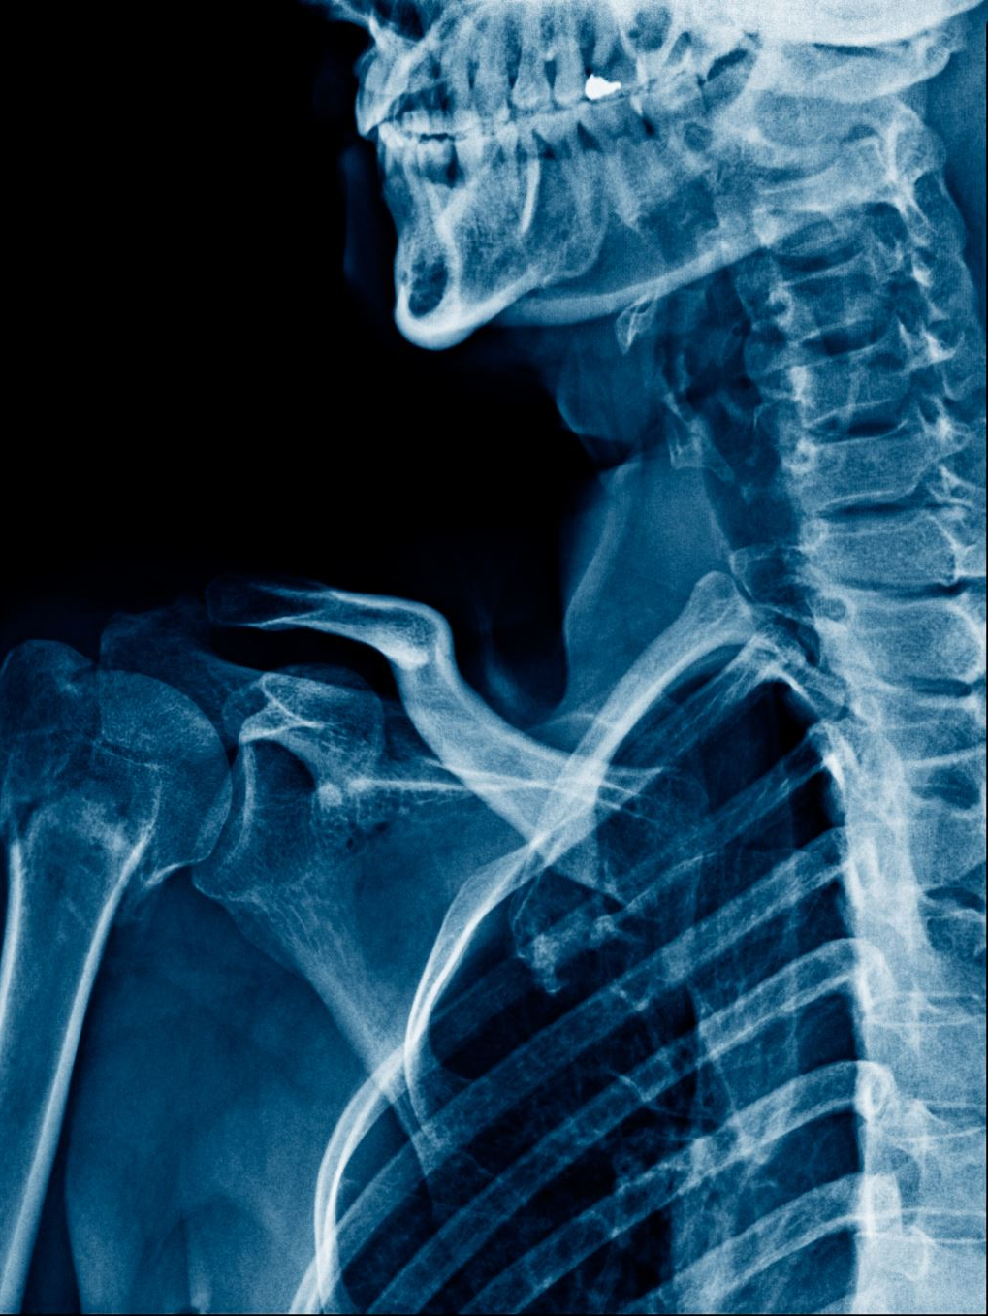
Expressions with Ache
Headache – Pain in the head or forehead.
Example: I have a headache today because I didn't sleep well.
Backache – Pain in the lower or upper back.
Example: She has a terrible backache from sitting too long at work.
Stomachache – Pain in the stomach or abdomen.
Example: I ate too much pizza, and now I have a stomachache.
Toothache – Pain in or around a tooth.
Example: My toothache was so bad that I had to see a dentist.
Earache – Pain inside the ear.
Example: The cold weather gave me an earache.

Slide 7
Name the ache
My head is pounding, and I can’t concentrate.
I’ve been sitting in the same position all day.
I just ate too many sweets, and now my stomach hurts.

Slide 8

Vocabulary
Fever – A high body temperature, usually indicating illness.
Flu – A contagious viral illness that causes fever, body aches, and fatigue.
Cold – A common viral infection that affects the nose and throat, causing congestion and coughing.
Treatment – The medical care given to a patient for an illness or injury.
Medicine – A substance used to treat or prevent illness.
Prescription – A doctor’s written order for medicine.
Backache – Pain in the back, often caused by strain or injury.
Headache – Pain in the head or forehead, often due to stress or tension.
Cough – A reflex that clears the throat or lungs of irritants.
Sore throat – Pain or irritation in the throat, often a symptom of a cold.

Slide 9

Discussion
Use the vocabulary to discuss a time when they were sick or injured. Describe:
Symptoms they experienced (e.g., headache, fever, sore throat).
Treatments they used (e.g., medicine, rest, doctor’s visit).
Have you ever had the flu? What were your symptoms?
How did you treat your backache?

Slide 10

Role play – Doctors visit
How are you feeling today?
Do you feel under the weather?
Have you been feeling 'off-colour' recently?
What symptoms are you experiencing? Do you have a headache or a stomach-ache?
Are you feeling tired, or is it more of an ache? Maybe a backache or something else?
How long have you been feeling this way?
Are you having any other symptoms, such as a fever or chills?
Could you describe your pain? Is it a dull ache or a sharp pain?
Are you getting enough rest? You’ll need to get back on your feet soon.
You might want to take it easy for a few days. Let’s make sure you're as fit as a fiddle.

Slide 11
Delayed feedback
tuSpeaking 2024, All rights reserved

