Slide 1

Human and social relations
English C1
TuSpeaking, 2024, all rights reserved

Slide 2
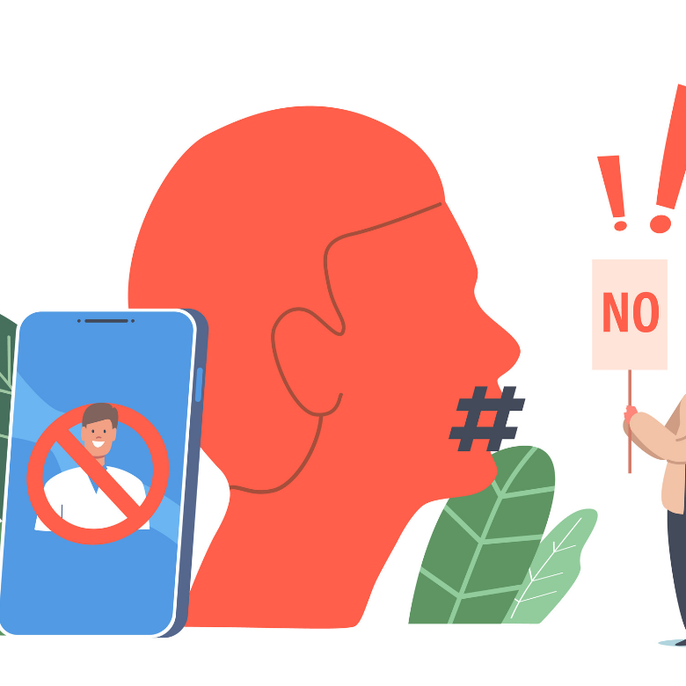
Has cancel culture gone too far?

Slide 3
Let’s get started
with a warm-up
Listen to this short quote by Steven Fry
I’m offended:
https://www.youtube.com/watch?v=NzdpxKqEUAw

Slide 4
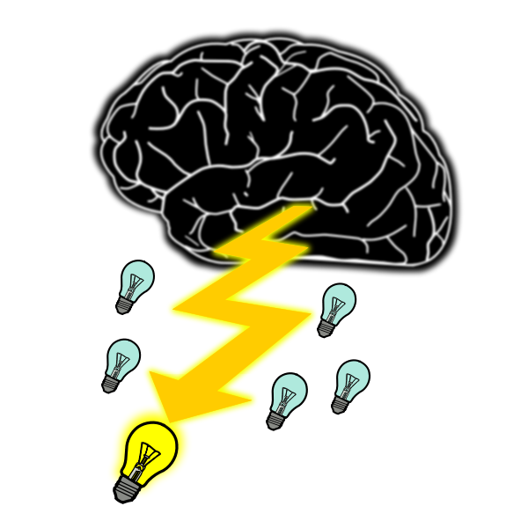
Brainstorm words you associate with the word ‘freedom’ and compare with a partner.
FREEDOM

Slide 5
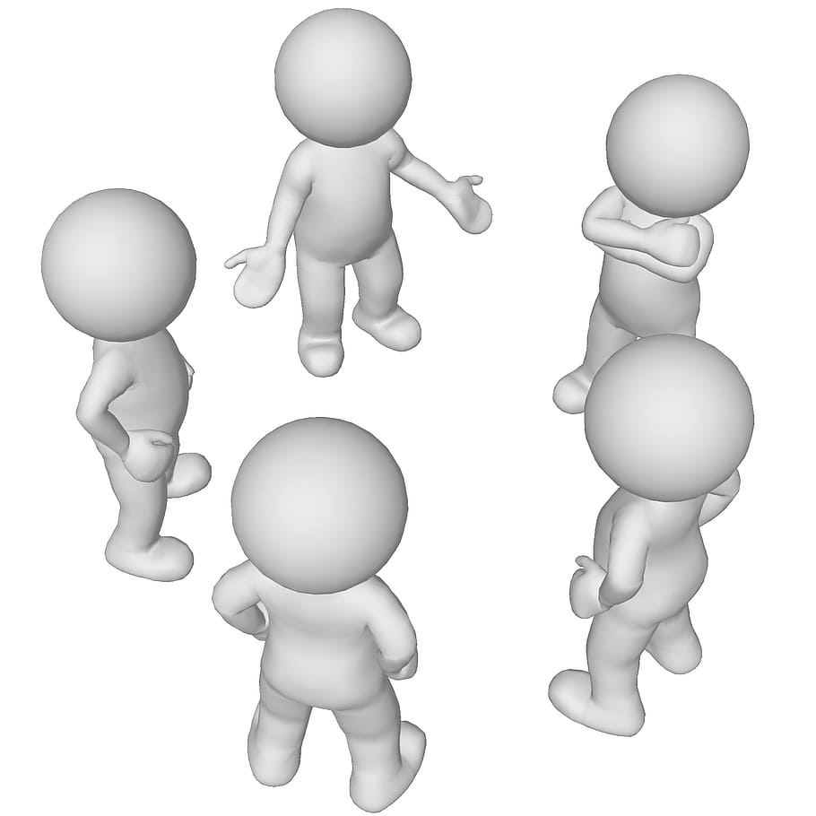
Let’s discuss some quotes!

Slide 6
Match the halves of the quotations.
“I disapprove of what you say,…
“What is freedom of expression?
“If liberty means anything at all, it means…
“Freedom of speech does not…
protect you from the consequences of saying stupid [stuff].” Jim C. Hines
the right to tell people what they do not want to hear.” George Orwell
but I will defend to the death your right to say it.” S.G. Tallentyre
Without the freedom to offend, it ceases to exist.” Salman Rushdie

Slide 7
Let’s check your answers.
“I disapprove of what you say,…
“What is freedom of expression?
“If liberty means anything at all, it means…
“Freedom of speech does not…
protect you from the consequences of saying stupid [stuff].” Jim C. Hines
the right to tell people what they do not want to hear.” George Orwell
but I will defend to the death your right to say it.” S.G. Tallentyre
Without the freedom to offend, it ceases to exist.” Salman Rushdie

Slide 8

Say whether you agree with the quotations. Give reasons for your answers.
“I disapprove of what you say, but I will defend to the death your right to say it.” S.G. Tallentyre
“What is freedom of expression? Without the freedom to offend, it ceases to exist.” Salman Rushdie
“If liberty means anything at all, it means the right to tell people what they do not want to hear.” George Orwell
“Freedom of speech does not protect you from the consequences of saying stupid [stuff].” Jim C. Hines

Slide 9

CBSN explores cancel culture and the culture wars
In a moment, you’ll watch a video titled:

Slide 10
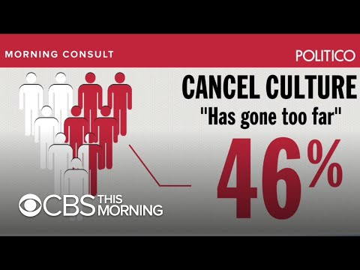
Watch the introduction to the video (to 00:30) and answer the questions.
What is cancel culture?
Can you think of any examples of cancel culture you have heard about recently?

Slide 11
Let’s check your answer.
What is cancel culture?
withdrawing support for public figures and companies after they have done or said something considered objectionable or offensive

Slide 12
Read the sentences and choose the correct option. [part 1/4]
After it was discovered that his wife was not paying her taxes, the finance minister faced a huge …………… from the public.
backup
whiplash
backlash
pileup
Panic buying during the pandemic was a perfect example of …………… .
mob mindset
mob mentality
gang culture
group therapy

Slide 13
Let’s check your answers. [part 1/4]
After it was discovered that his wife was not paying her taxes, the finance minister faced a huge …………… from the public.
backup
whiplash
backlash
pileup
Panic buying during the pandemic was a perfect example of …………… .
mob mindset
mob mentality
gang culture
group therapy

Slide 14
Read the sentences and choose the correct option. [part 2/4]
If a journalist wants to …………… a celebrity for sexual harassment, they had better make sure they have evidence.
set about
rip off
wind up
go after
What she said was offensive, but it was embarrassing to call her …………… in front of everybody.
up
out
back
off

Slide 15
Let’s check your answers. [part 2/4]
If a journalist wants to …………… a celebrity for sexual harassment, they had better make sure they have evidence.
set about
rip off
wind up
go after
What she said was offensive, but it was embarrassing to call her …………… in front of everybody.
up
out
back
off

Slide 16
Read the sentences and choose the correct option. [part 3/4]
If these students fail their exam, I will hold you …………… for that.
chargeable
answerable
understandable
accountable
Most of the staff were …………… by the tone of his email.
adjusted
suspected
offended
disrespected

Slide 17
Let’s check your answers. [part 3/4]
If these students fail their exam, I will hold you …………… for that.
chargeable
answerable
understandable
accountable
Most of the staff were …………… by the tone of his email.
adjusted
suspected
offended
disrespected

Slide 18
Read the sentences and choose the correct option. [part 4/4]
Fireman, firefighter! Who cares? It’s …………… gone mad!
fundamental rights
diplomatic rights
political correctness
political mindfulness
She took one African American history class and now she thinks she’s …………… !
awake
awakened
woken up
woke

Slide 19
Let’s check your answers. [part 4/4]
Fireman, firefighter! Who cares? It’s …………… gone mad!
fundamental rights
diplomatic rights
political correctness
political mindfulness
She took one African American history class and now she thinks she’s …………… !
awake
awakened
woken up
woke

Slide 20
Choose three words in bold that you think are connected to cancel culture and say why.
After it was discovered that his wife was not paying her taxes, the finance minister faced a huge backlash from the public.
Panic buying during the pandemic was a perfect example of mob mentality.
If a journalist wants to go after a celebrity for sexual harassment, they had better make sure they have evidence.
What she said was offensive, but it was embarrassing to call her out in front of everybody.
If these students fail their exam, I will hold you accountable for that.
Most of the staff were offended by the tone of his email.
Fireman, firefighter! Who cares? It’s political correctness gone mad!
She took one African American history class and now she thinks she’s woke!

Slide 21
Before watching the rest of the video,
think about why some people think that cancel culture has gone too far.

Slide 22
Watch the rest of the video (to 04:05) and check your answers.

Slide 23
Let’s check your answers.
Some people think cancel culture has gone too far because now people are offended by anything and everything. Society has become far too sensitive about the words we use.

Slide 24

Let’s practise the vocabulary!

Slide 25
Complete the sentences with the vocabulary in the box in the correct form. [part 1/2]
backlash call out go after hold accountable
mob mentality offend political correctness
“It’s one thing to ………………………………………………………..….…. a celebrity who has said a terrible thing, and it’s another thing to ………………………………………………………..….…. a private citizen who happened to get caught on film in a really bad moment. Those are not equivalent!”
“People are ………………………………………………………..….…. by anything and everything. We as a society have become far too sensitive about the words that we use.”
“There has been a real ………………………………………………………..….…. against cancel culture. In the name of ………………………………………………………..….…. people are being punished for words and actions that were said far long ago at a time when those words or ideas were deemed acceptable.”

Slide 26
Complete the sentences with the vocabulary in the box in the correct form. [part 2/2]
backlash call out go after hold accountable
mob mentality offend political correctness
“People are being ………………………………………………………..….…. on video for experiencing a particularly bad moment when they may have said something that was off-colour.”
“What’s sort of scary in the social media aspect of this is it can happen so swiftly, and you can develop almost kind of a ………………………………………………………..….…. and end up discouraging a deep debate on certain issues.”
Cancel culture helps to make sure that celebrities and organizations who behave offensively are ………………………………………………………..….…. for their behaviour.

Slide 27
Let’s check your answers. [part 1/2]
backlash call out go after hold accountable
mob mentality offend political correctness
“It’s one thing to ………………………………………………………..…. a celebrity who has said a terrible thing, and it’s another thing to ………………………………………………………..….… a private citizen who happened to get caught on film in a really bad moment. Those are not equivalent!”
“People are ………………………………………………………..…. by anything and everything. We as a society have become far too sensitive about the words that we use.”
“There has been a real ………………………………………………………..…. against cancel culture. In the name of ………………………………………………………..….…. people are being punished for words and actions that were said far long ago at a time when those words or ideas were deemed acceptable.”
go after
go after
offended
backlash
political correctness

Slide 28
Let’s check your answers. [part 2/2]
backlash call out go after hold accountable
mob mentality offend political correctness
“People are being ………………………………………………………..….… on video for experiencing a particularly bad moment when they may have said something that was off-colour.”
“What’s sort of scary in the social media aspect of this is it can happen so swiftly, and you can develop almost kind of a ………………………………………………………..…. and end up discouraging a deep debate on certain issues.”
Cancel culture helps to make sure that celebrities and organizations who behave offensively are ………………………………………………………..….…. for their behaviour.
called out
mob mentality
held accountable

Slide 29

Let’s discuss cancel culture!

Slide 30
Say whether you agree with the sentences. Give reasons for your answers. [part 1/2]
“It’s one thing to go after a celebrity who has said a terrible thing, and it’s another thing to go after a private citizen who happened to get caught on film in a really bad moment. Those are not equivalent!”
“People are offended by anything and everything. We as a society have become far too sensitive about the words that we use.”
“There has been a real backlash against cancel culture. In the name of political correctness people are being punished for words and actions that were said far long ago at a time when those words or ideas were deemed acceptable.”

Slide 31
Say whether you agree with the sentences. Give reasons for your answers. [part 2/2]
“People are being called out on video for experiencing a particularly bad moment when they may have said something that was off-colour.”
“What’s sort of scary in the social media aspect of this is it can happen so swiftly, and you can develop almost kind of a mob mentality and end up discouraging a deep debate on certain issues.”
Cancel culture helps to make sure that celebrities and organizations who behave offensively are held accountable for their behaviour.

Slide 32
Discuss the questions. Give reasons for your answers. [part 1/2]
What is the difference between free speech and hate speech?
What music, films or books by people who have been ‘cancelled’ do you still enjoy?
Which big companies or celebrities do you think still deserve to be held accountable for past behaviour, but have not?

Slide 33
Discuss the questions. Give reasons for your answers. [part 2/2]
Have you ever felt ostracized for an opinion you hold or something you have said?
Have you ever called out a family member, friend or colleague for behaviour you deem offensive?
What is the difference between boycotting a company or country’s products because of bad practices, and cancel culture?
Does anybody ever really get cancelled?

Slide 34
Read the following scenarios and discuss whether the people involved deserve to be ‘cancelled’. Give reasons for your answers. Think what possible consequences of being cancelled they could encounter. [part 1/2]
A famous actor hits a comedian live on television for making a joke about his wife.
A famous author tweets about her fears that transgender rights will ultimately endanger women’s rights.
A member of a royal family wears a Nazi uniform to a fancy dress party.

Slide 35
Read the following scenarios and discuss whether the people involved deserve to be ‘cancelled’. Give reasons for your answers. Think what possible consequences of being cancelled they could encounter. [part 2/2]
A member of the public is filmed verbally abusing a homeless person. The video goes viral.
A famous comedian included a racist joke in their show thirty years ago.
A long-established brand of cereal has a mascot which stereotypes a race.

Slide 36
Delayed Feedback

Slide 37
Thank you!

