Slide 1
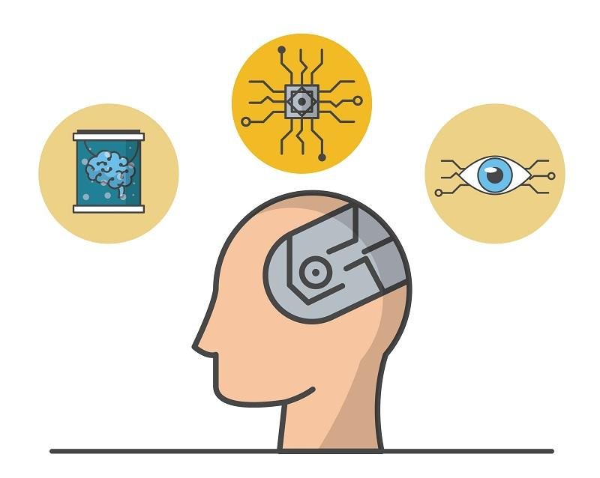
How technology
can enhance
our brain

Slide 2
LESSON OVERVIEW
This technology lesson plan touches upon melding minds with machines, that is a brain-computer interface. It is based on a very interesting video which will definitely make your students eager to talk.

Slide 3

Let’s get started
with a vocabulary warm-up

Slide 4
Choose which word doesn't belong in each line.
meld mend combine merge
impair enhance elevate improve
evoke convert transform transfigure
complex intricate elaborate intrinsic
imminent eminent approaching looming
contemplate consider debunk deliberate
legal equitable fair just
implication consequence ramification obligation

Slide 5
Let’s check the answers.
meld mend combine merge
impair enhance elevate improve
evoke convert transform transfigure
complex intricate elaborate intrinsic
imminent eminent approaching looming
contemplate consider debunk deliberate
legal equitable fair just
implication consequence ramification obligation

Slide 6
Complete the second sentence so that it has a similar meaning to the first sentence. Use the word given in brackets and no more than five words. Do not change the word given. [1/2]
The enhancement of the quality of life of people with disabilities is what technology should focus on.
Technology should ………………………………………………………………… the quality of life of people with disabilities. [BE]
New technologies aren’t accessible to the masses and only the privileged few make use of them.
There ………………………………………………………………… to new technologies and only the privileged few make use of them. [EQUITABLE]
We can’t see any imminent breakthrough that would change the way we live.
There are ………………………………………………………………… an imminent breakthrough that would change the way we live. [SIGNS]

Slide 7
Complete the second sentence so that it has a similar meaning to the first sentence. Use the word given in brackets and no more than five words. Do not change the word given. [2/2]
Scientists never contemplate the ethical implications of research they work on.
What scientists ………………………………………………………………… contemplate the ethical implications of the research they work on. [NEVER]
Melding our minds with machines appears to be an idea taken straight from a Hollywood movie.
Melding our minds with machines ………………………………………………………………… idea taken straight from a Hollywood movie. [SOUNDS]

Slide 8
Let’s check the answers [1/2].
The enhancement of the quality of life of people with disabilities is what technology should focus on.
Technology should …………………………………………………………………………………… the quality of life of people with disabilities. [BE]
New technologies aren’t accessible to the masses and only the privileged few make use of them.
There …………………………………………………………………...…… to new technologies and only the privileged few make use of them. [EQUITABLE]
We can’t see any imminent breakthrough that would change the way we live.
There are ………………………………………… an imminent breakthrough that would change the way we live. [SIGNS]
be focused on enhancing
is no equitable access
no signs of

Slide 9
Let’s check the answers [2/2].
Scientists never contemplate the ethical implications of research they work on.
What scientists ……………………………………… contemplate the ethical implications of the research they work on. [NEVER]
Melding our minds with machines appears to be an idea taken straight from a Hollywood movie.
Melding our minds with machines …………………………………………………. idea taken straight from a Hollywood movie. [SOUNDS]
never do is
sounds like an

Slide 10
Discuss the sentences. Do you agree or disagree with them? Why?
Technology should be focused on the quality of life of people with disabilities.
There is no equitable access to new technologies and only the privileged few make use of them.
There are no signs of an imminent breakthrough that would change the way we live.
Scientists never contemplate the ethical implications of the research they work on.
Melding our minds with machines sounds like an idea taken straight from a Hollywood movie.

Slide 11

Let’s learn some vocabulary

Slide 12
For each pair of sentences choose a verb from the box which can be used in both of them. You may need to change the form of the verbs. [1/6]
give keep reap remain unlock tap
Some farmers have been told only to ……………… the current harvest, but not to prepare the land for new crops.
We will all ……………… the benefits of this important research.

Slide 13
For each pair of sentences choose a verb from the box which can be used in both of them. You may need to change the form of the verbs. [2/6]
give keep reap remain unlock tap
She ……………… birth to twins.
This research might ……………… birth to a new form of intelligence.

Slide 14
For each pair of sentences choose a verb from the box which can be used in both of them. You may need to change the form of the verbs. [3/6]
give keep reap remain unlock tap
Could you slow down - I can't ……………… pace with you.
We need to ……………… pace with advancing technologies.

Slide 15
For each pair of sentences choose a verb from the box which can be used in both of them. You may need to change the form of the verbs. [4/6]
give keep reap remain unlock tap
Could you ……………… the door for me?
A chemical has been discovered that may be the key to ……………… the mysteries of this disease.

Slide 16
For each pair of sentences choose a verb from the box which can be used in both of them. You may need to change the form of the verbs. [5/6]
give keep reap remain unlock tap
He ……………… his password into the computer.
If we could ……………… into this part of the brain, it would be a major breakthrough.

Slide 17
For each pair of sentences choose a verb from the box which can be used in both of them. You may need to change the form of the verbs. [6/6]
give keep reap remain unlock tap
The doctor ordered him to ……………… in bed for a few days.
The trip to Mars still ……………… a huge technological challenge.

Slide 18
Let’s check the answers.
Some farmers have been told only to …………...……. the current harvest, but not to prepare the land for new crops.
We will all …………...……. the benefits of this important research.
She …………...……. birth to twins.
This research might …………...……. birth to a new form of intelligence.
Could you slow down - I can't ……………....…… pace with you.
We need to ……………...…… pace with advancing technologies.
Could you …………….......……. the door for me?
A chemical has been discovered that may be the key to ……………………………..…… the mysteries of this disease.
He ……………......……. his password into the computer.
If we could …………...……. into this part of the brain, it would be a major breakthrough.
The doctor ordered him to ……………….....……. in bed for a few days.
The trip to Mars still …………...…………....…. a huge technological challenge.
reap
reap
gave
give
keep
keep
unlock
unlocking
tapped
tap
remain
remains

Slide 19

When thoughts control machines
In a moment, you’ll watch a video titled:
Before watching...

Slide 20
Read the extract from the video you’re going to watch and answer the questions below.
“Imagine if you could connect your brain to the internet. You wouldn't need to type into a search engine, you could just think your query and download the relevant knowledge directly into your mind. Such a world would involve the biggest single upgrade in human intelligence since our species evolved. Seamless brain computer interfaces are a long way off but the melding of minds with machines is already under way.”
Can you imagine such a world?
What are the advantages and disadvantages of the melding of minds with machines?
Do you think this vision will come true in the near future?

Slide 21
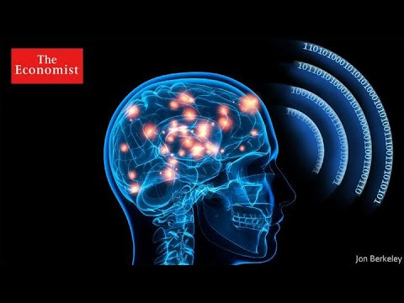
Watch the first part of the video (to 02:02) and answer the questions.
What is the neurotechnology the speaker talks about designed for?
How do the volunteers in the trial control devices?
How could this technology transform the lives of people with disabilities?

Slide 22
Let’s check your answers.
What is the neurotechnology the speaker talks about designed for?
It should help restore or replace function, or enhance independence for people who are paralysed.
How do the volunteers in the trial control devices?
The volunteers have been given brain implants that allow them to control devices using thought alone.
How could this technology transform the lives of people with disabilities?
People with disabilities could control a prosthetic limb or a robotic limb moving through space to reach and grab objects. Simply by imagining intuitive movements, people could immediately control a robotic device.

Slide 23
Watch the second part of the video (from 02:02) and note down what the figures and names below refer to.
85 billion
$6 billion
hydra
$100 million
Neuralink

Slide 24
Let’s check the answers.
85 billion
the number of neurons in the human brain
$6 billion
the amount of money allocated to the Brain Initiative
hydra
a small animal which neuron activity Prof Yuste’s team mapped in full
$100 million
the money Bryan Johnson invested in Kernel
Neuralink
Elon Musk’s company whose goal is to connect humans to computers

Slide 25

Let’s talk!

Slide 26

Discuss the questions. [part 1/2]
What do you think the potential implications of melding our minds with machines might be?
Will this technology give birth to a superhuman?
What benefits could humanity reap if superhuman intelligence was created?

Slide 27
Discuss the questions. [part 2/2]
Is it possible to ensure equitable access to this technology across society?
Are there limits that brain-computer interface scientists shouldn’t surpass?
Do you think this is the only way we can keep pace with artificial intelligence?

Slide 28
Thank you!

