Slide 1
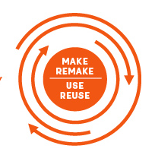
The circular
economy
This Photo by Unknown Author is licensed under CC BY-SA-NC

Slide 2
LESSON OVERVIEW
In this lesson, students discover pros and cons of the linear and circular economy and learn some new vocabulary and collocations related to the topic. They also work on a case study and come up with strategies to transform a company following a linear model into a more circular one.
Upper Intermediate

Slide 3

Let’s get started
with a warm-up

Slide 4

What is the circular economy?
In a moment, you’ll watch a video titled:

Slide 5
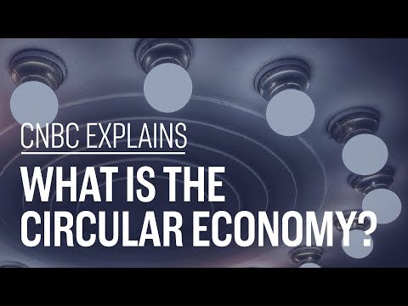
Watch the video and check your answers to the questions.
What do you think the linear economy is?
What do you think the circular economy is?
Notes:
The linear economy is based on a ‘take, make and dispose’ model. A company takes resources, manufactures a product, sells it to the customer, and the customer uses and disposes of the product.
The circular economy is based on a ‘make, use and return’ model. A company recycles and maintains ownership of its product.

Slide 6
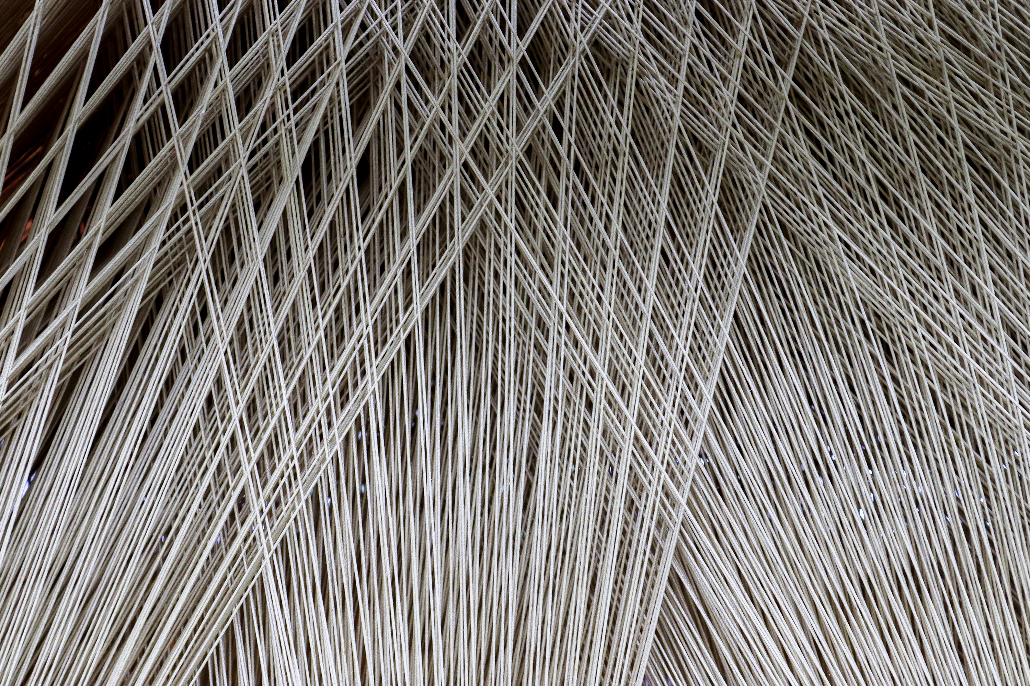
Grammar focus – The passive voice
Formulation of Passive Sentences:
In a passive sentence, the object of the active sentence becomes the subject.
Active: Companies produce goods. (Subject: Companies; Verb: produce; Object: goods)
Passive: Goods are produced by companies. (Subject: Goods; Verb: are produced; Agent: by companies)
6

Slide 7
When to Use Passive Voice:
Emphasis on the Action or Result:
Active: The team conducted the experiment.
Passive: The experiment was conducted by the team.
Use the passive when the emphasis is on the action or result rather than the doer.
Unknown or Unimportant Doer:
Active: Someone stole my bike.
Passive: My bike was stolen.
Use the passive when the doer is unknown or unimportant.
Formality in Writing:
The passive voice is often preferred in formal writing, such as academic papers or presentations, to maintain a sense of objectivity.

Slide 8
Structure:
The structure of a passive sentence is typically: (Subject) + (Auxiliary Verb) + (Past Participle) + (Agent, introduced by "by" or omitted).
Example: The report was written by the team.
Try writing some passive sentences here:

Slide 9


Examples in the Context of Circular and Linear Economies:
Linear Economy:
Active: Companies extract raw materials to produce goods.
Passive: Goods are produced by extracting raw materials.
Circular Economy:
Active: Manufacturers reuse materials to create new products.
Passive: New products are created by reusing materials.

Slide 10
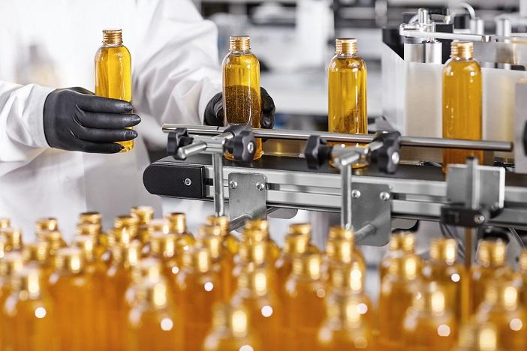

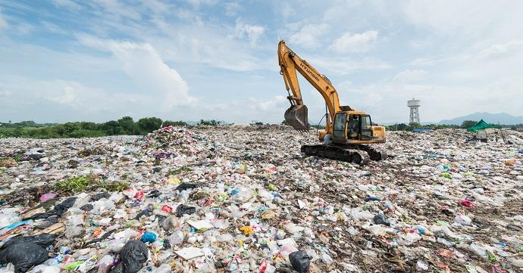



Look at the graphics below and answer the questions.
LINEAR ECONOMY
CIRCULAR ECONOMY
What do you think the linear economy is?
What do you think the circular economy is?

Slide 11

Discuss the questions.
What do you think the advantages and disadvantages of each economy are?
Do you mostly live in a linear or circular economy?

Slide 12
Delayed Feedback

Slide 13

Thanks

