Slide 1

The media and the climate
English C1

Slide 2
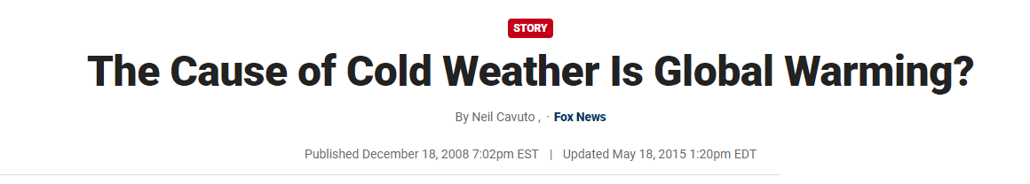
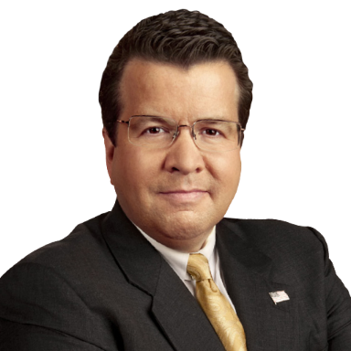
Warm up – Read the article
You probably heard the news that it snowed in Las Vegas.
Yep, Sin City becoming slush city.
Hell truly has frozen over.
Weird thing is, what's happening in Vegas isn't staying in Vegas.
Cold weather and nasty storms already the norm. And it isn't technically even winter yet.
https://www.foxnews.com/story/the-cause-of-cold-weather-is-global-warming

Slide 3

First time southern Nevada's seen anything like this in 30 years.
First time southern California's been looking at 30 degrees this early in 20 years.
So I'm looking at all this wacky weather and asking a buddy of mine who's an environmentalist — you see, I live fair and balanced.
I ask him, "What's going on here? I thought you said I could throw out my parka for a thong?"
The image immediately caused him to recoil.
But he collected himself, then reminded me, "Neil, this is global warming."
"Wait a minute," I said.
"I thought global warming meant, I don't know, warming?"
No, he assured me, this is all part of God's great reaction to man's not-so-great wrecking of his planet.
Neil Cavuto

Slide 4

Now I'm not the sharpest meteorological tool on the map, but even I wondered how my tree-hugging pal could have it both ways.
He assured me last year snow would soon be a memory.
That the oceans would be warming.
More hurricanes would be coming.
And glaciers would be melting.
But more snow than ever this year.
The first snow Vegas has seen in 30 years.
Temperatures below zero in at least 12 states in the Midwest and west, the most so early in any year.
Neil Cavuto

Slide 5

And all coming after a hurricane season that brought largely bupkis this year.
"It's all part of warming," my friend reminded me.
You see, his is not a new forecast, just a revised one.
Where you can kind of have your environmental cake and eat it too.
Where the earth getting warmer is warming, and the earth getting cooler is warming.
So nothing to stop Washington from big environmental spending.
You see, my friend is pushing Congress for more such spending.
I wished him luck as he headed out.
And suggested one other thing: Bring a coat.
Neil Cavuto

Slide 6

Summary
What do you think of Neil’s opinion?
Can you find any flaws in his argument?
What would you say to Neil if you met him?

Slide 7
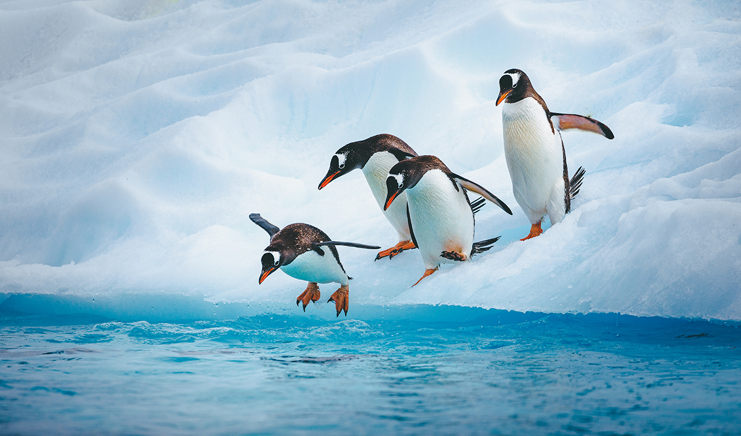
Conversation questions
Do you believe there's a responsibility for media outlets to prioritize accurate reporting on climate change, considering its significant impact on public awareness and policy decisions?
How can individuals distinguish between credible information and false claims when it comes to climate change reporting? What sources or fact-checking methods do you find reliable?
Have you ever encountered misinformation or false claims about climate change? How did you recognize it, and what impact do you think such misinformation can have on public perception?

Slide 8

Framing
In media, framing refers to the way information is presented or "framed" to shape the perception of an issue or event. It involves selecting and highlighting certain aspects of a story while downplaying or omitting others. The framing of news or information can significantly influence how audiences interpret and understand the subject matter.

Slide 9
Key aspects of framing in media include:
Selection of Information
Choosing specific details, facts, or elements to include in a news story.
Emphasis and Prioritization
This can influence the perceived significance of different elements and guide the audience's attention.
Language and Tone
Different linguistic choices can evoke specific emotions and shape the overall tone of the narrative.
Contextualization
Providing context or background information to help the audience make sense of the story.
Visual Elements
The selection and presentation of visual elements can impact the emotional response and understanding of the story.
Cultural and Social Context
Framing is influenced by cultural and social norms, values, and perspectives.
Narrative Structure
The structure of a news story, including the order of information and the use of storytelling techniques, contributes to framing.

Slide 10
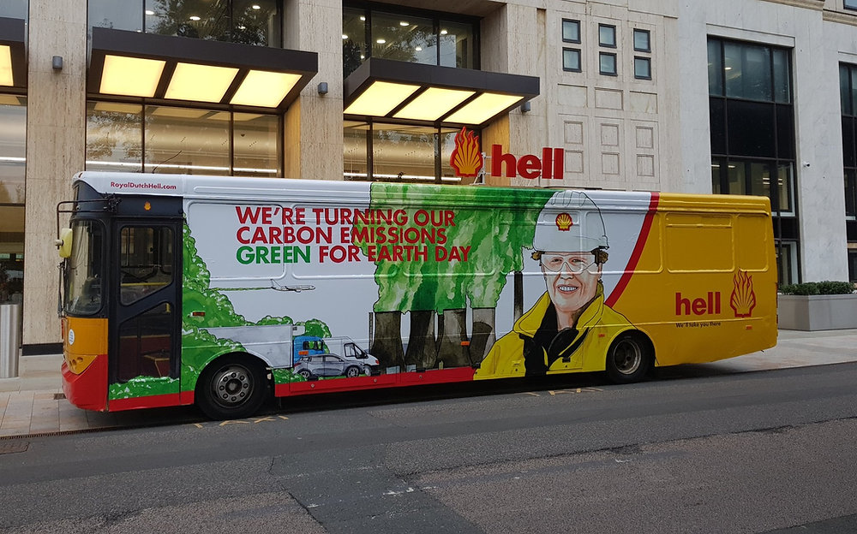
Look at the bus

Slide 11
Can you find anything untrue or misleading?

Slide 12
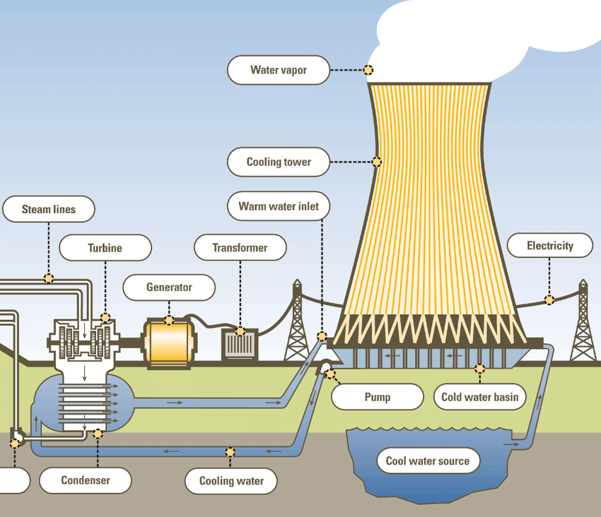
How cooling towers work
This is just water vapour. It’s not green….
So, who should we believe?
Discuss advocacy versus objectivity in climate change reporting, then choose another discussion point from the following pages.
There are 12, but you don’t need to discuss them all.

Slide 13
Discussion points – Choose topics
Advocacy in Climate Reporting:
Discussion: How can advocacy journalism contribute to raising awareness about climate change? What role do journalists play in advocating for specific climate-related issues or policies?
Balancing Scientific Consensus and Scepticism:
Discussion: How should journalists strike a balance between reporting the overwhelming scientific consensus on climate change and presenting diverse perspectives, including scepticism? What challenges might they face in achieving this balance?
Role of Advocacy Organizations:
Discussion: Many environmental advocacy organizations actively engage with the media to promote their causes. What are the ethical considerations when reporting on information provided by advocacy groups? How can journalists ensure accuracy and objectivity?

Slide 14
Discussion points – Choose topics
Transparency in Reporting:
Discussion: Should journalists be transparent about their own views on climate change when reporting on the topic? How does transparency impact the perceived objectivity of climate reporting?
Framing Climate Change Solutions:
Discussion: How do media outlets frame discussions around climate change solutions? Is there a risk of bias in favour of certain approaches or technologies? How can journalists ensure a balanced representation of potential solutions?
Balancing Local and Global Perspectives:
Discussion: Climate change impacts vary across regions. How can journalists strike a balance between global narratives and local perspectives? What are the challenges in accurately portraying the local impacts of climate change?

Slide 15
Discussion points – Choose topics
Consumer Expectations and Media Coverage:
Discussion: How do consumer expectations influence media coverage of climate change? Are there risks of sensationalism or oversimplification to cater to audience preferences? How can media outlets maintain responsible reporting while addressing audience interests?
Avoiding False Balance:
Discussion: How can journalists avoid the trap of false balance in climate reporting, where both sides of an argument are presented equally even when scientific consensus heavily favours one side? What are the consequences of false balance in reporting on climate science?
The Role of Objectivity in Climate Reporting:
Discussion: Is complete objectivity achievable in climate reporting, or should journalists openly acknowledge the severity of climate change given scientific consensus? How can journalists navigate the tension between objectivity and the urgency of the climate crisis?

Slide 16
Discussion points – Choose topics
Impact on Public Opinion:
Discussion: How does the framing of climate change in the media impact public opinion and behaviour? Can advocacy journalism effectively mobilize public support for climate action, or does it risk polarizing views?
Editorial Policies and Guidelines:
Discussion: What role do editorial policies and guidelines play in shaping climate reporting? How can news organizations establish standards that balance advocacy and objectivity?
Inclusion of Diverse Voices:
Discussion: How can climate reporting better incorporate diverse voices, including those from communities most affected by climate change? What challenges exist in amplifying marginalized perspectives while maintaining balance?

Slide 17
Delayed feedback

