Slide 1

Climate and environmental conditions
English C1
Tuspeaking 2024, all rights reserved

Slide 2
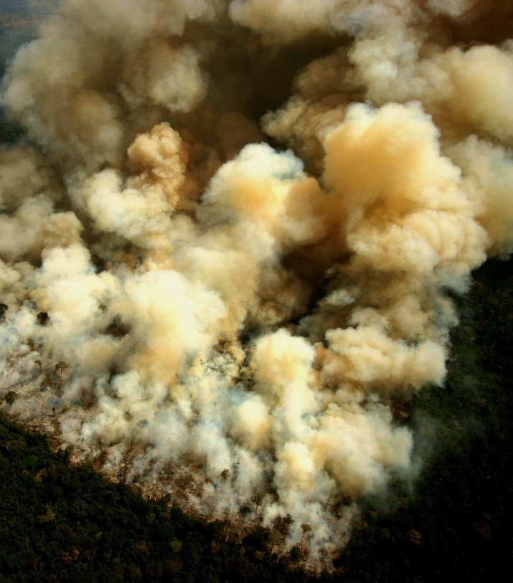
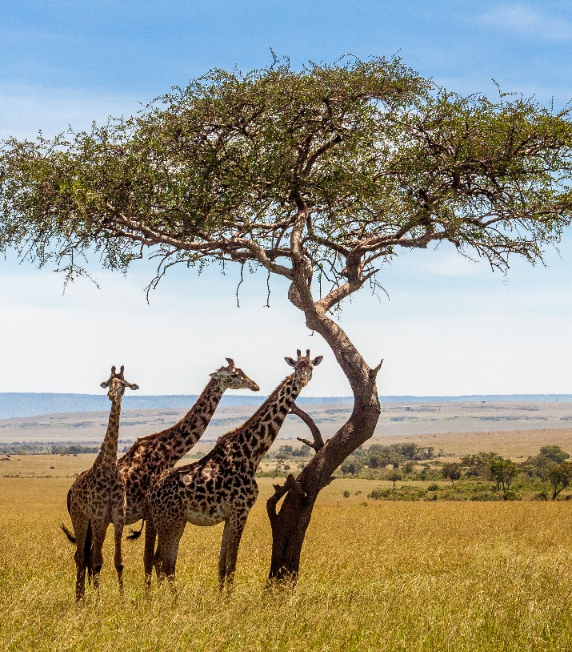
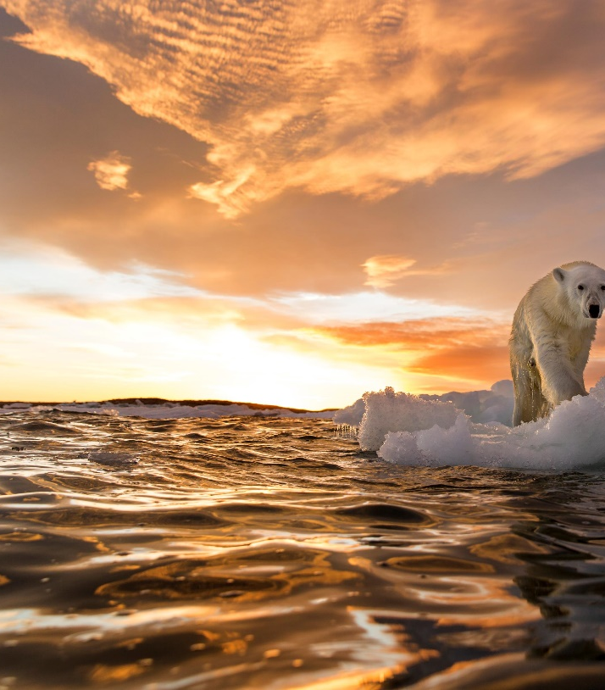
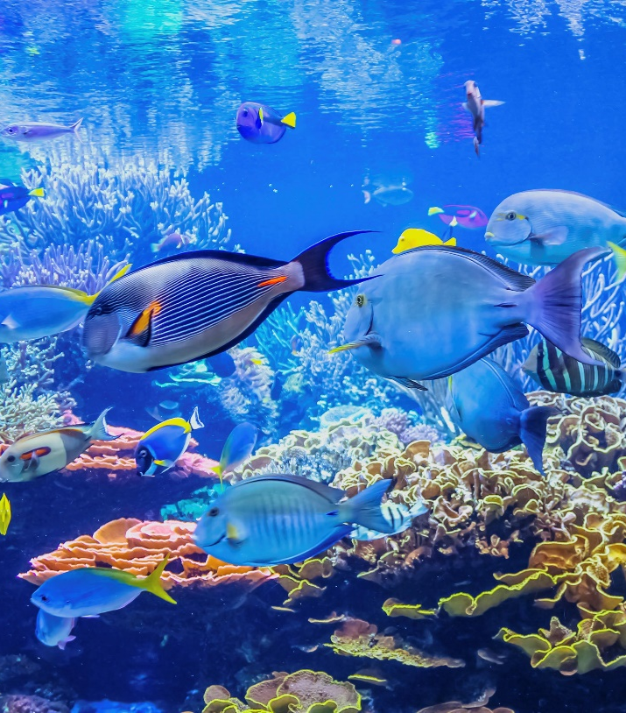
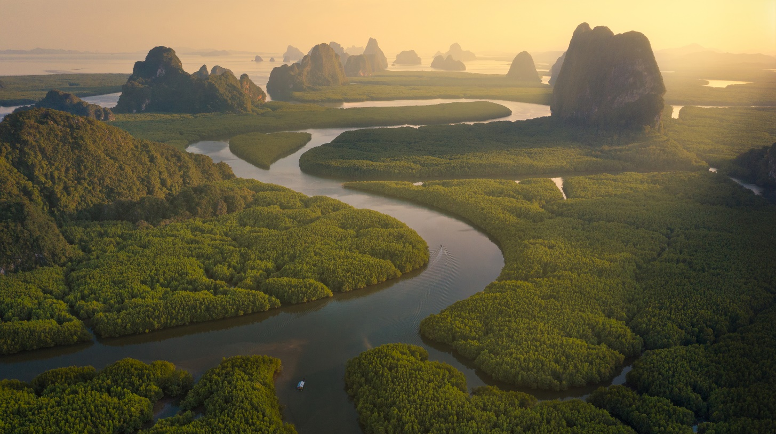
Warm up
How might what is seen in the pictures be affected by climate change?
Can you provide any other examples?

Slide 3
List of Biomes with Vocabulary Definitions:
Tundra:
Definition: A biome characterized by low temperatures, short growing seasons, and permafrost, where vegetation is limited to low-growing plants like mosses and lichens.
Taiga (Boreal Forest):
Definition: A biome dominated by coniferous forests with cold temperatures, long winters, and short summers, supporting trees like spruce, fir, and pine.
Temperate Deciduous Forest:
Definition: A biome with moderate temperatures, distinct seasons, and deciduous trees that shed their leaves in the fall, such as oak, maple, and beech.
Grassland (Prairie/Savanna):
Definition: A biome characterized by grasses as the dominant vegetation, with few trees, moderate temperatures, and distinct wet and dry seasons.
Desert:
Definition: A biome with arid conditions, characterized by low precipitation, high temperatures, and adaptations of plants and animals to conserve water.
Rainforest (Tropical and Temperate):
Definition: A biome with high annual precipitation, dense vegetation, and high biodiversity; tropical rainforests are found near the equator, while temperate rainforests are found in cooler regions.
Temperate Rainforest:
Definition: A biome with high rainfall, mild temperatures, and lush vegetation, dominated by coniferous and broadleaf trees, mosses, and ferns.

Slide 4
List of Biomes with Vocabulary Definitions:
Deciduous Forest:
Definition: A biome characterized by four distinct seasons, including a variety of deciduous trees that shed their leaves in the fall, such as oak, maple, and birch.
Chaparral (Mediterranean Scrubland):
Definition: A biome with hot, dry summers and mild, wet winters, dominated by shrubs, small trees, and adapted plant species.
Freshwater Biome (Lakes, Rivers, Wetlands):
Definition: Aquatic biomes with water containing low salt concentrations, including lakes, rivers, ponds, and wetlands, each supporting specific plant and animal life.
Marine Biome (Oceans):
Definition: The largest biome, covering about 71% of the Earth's surface, characterized by high salt concentrations, diverse marine life, and different zones, such as the intertidal, pelagic, and benthic zones.
Coral Reef:
Definition: A marine biome characterized by warm, shallow waters and the presence of coral colonies, supporting a rich diversity of marine life.
Alpine Biome:
Definition: A biome found in high mountain regions with cold temperatures, rocky landscapes, and unique plant and animal adaptations to survive in extreme conditions.
Chaparral (Mediterranean Scrubland):
Definition: A biome with hot, dry summers and mild, wet winters, dominated by shrubs, small trees, and adapted plant species.
Polar Ice (Polar Desert):
Definition: A biome characterized by extremely cold temperatures, low precipitation, and frozen conditions, found near the Earth's polar regions.

Slide 5
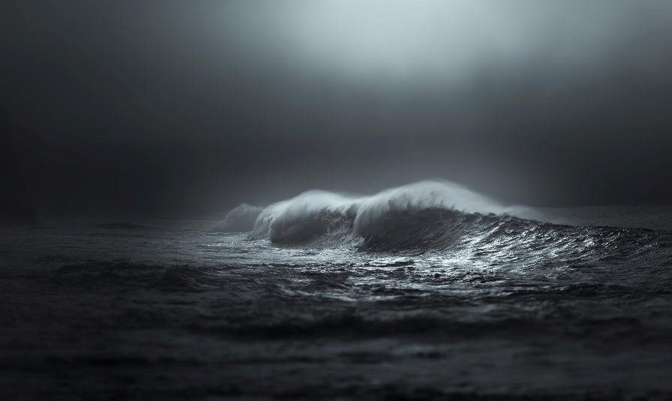
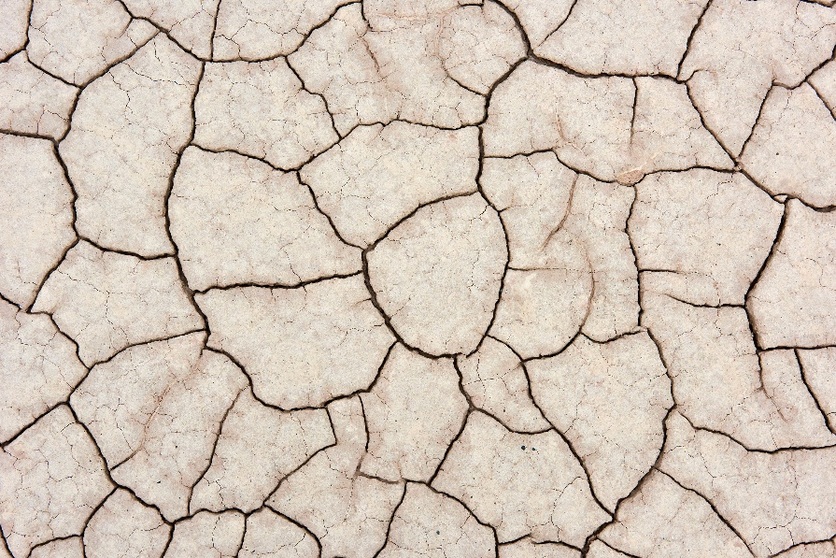
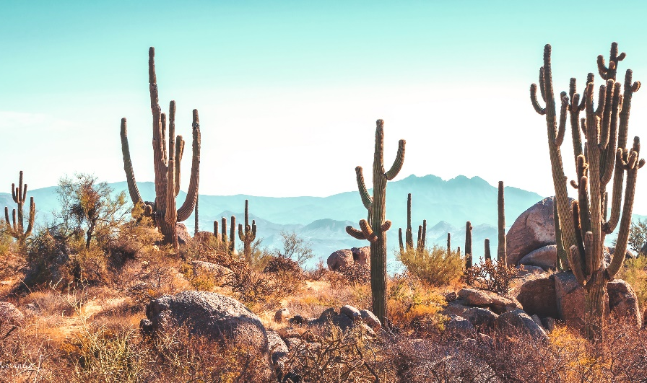
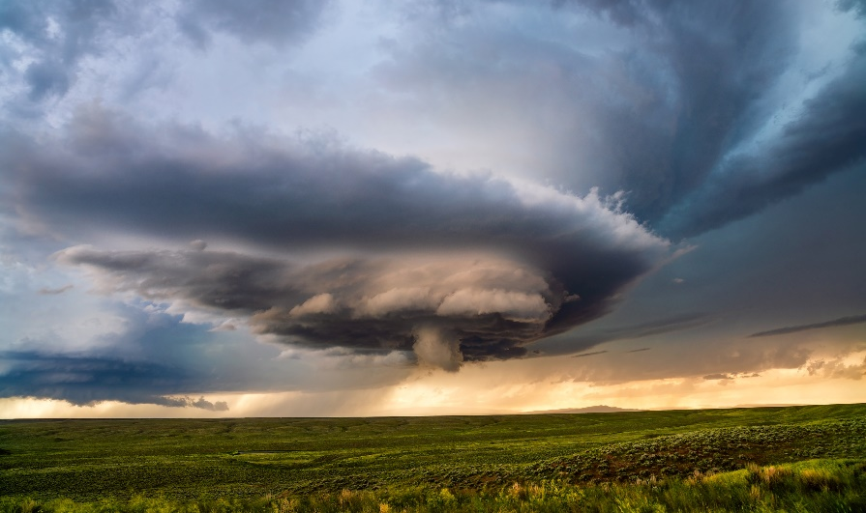
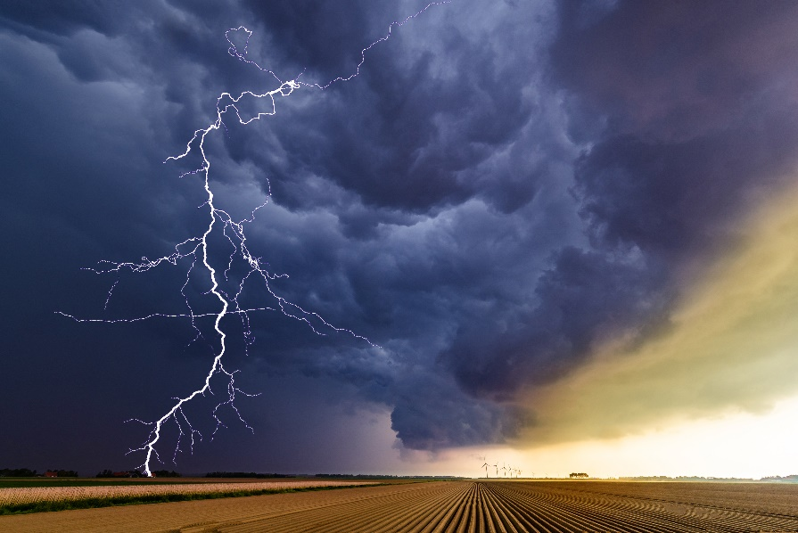
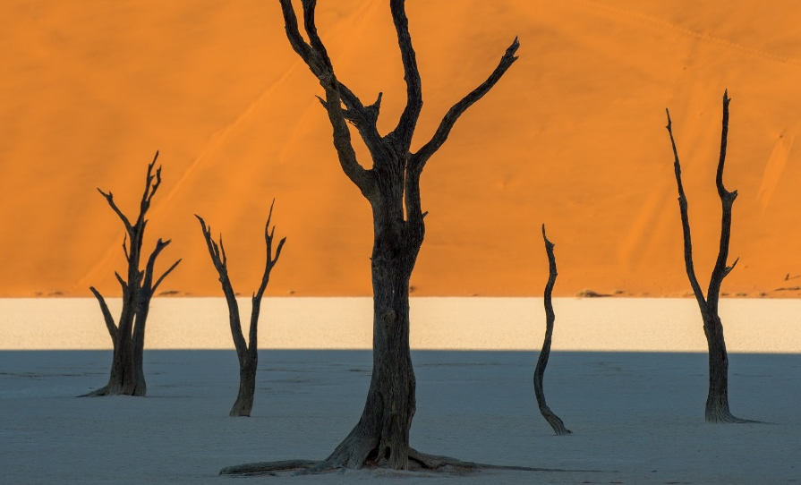
Extreme weather
Brainstorm words related to extreme weather
How many extreme weather phenomenon can you think of?
See if you knew any of the other extreme weather phenomena on the following pages

Slide 6
Extreme Weather Vocabulary List with Definitions:
Heatwave:
Definition: A prolonged period of excessively hot weather, which may be accompanied by high humidity.
Drought:
Definition: A prolonged period of abnormally low precipitation, leading to water shortages and dry conditions.
Hurricane:
Definition: A large, powerful storm with strong winds and heavy rain, typically forming over warm ocean waters.
Tornado:
Definition: A rapidly rotating column of air extending from a thunderstorm to the ground, capable of causing significant damage.
Flood:
Definition: An overflow of water onto normally dry land, often caused by heavy rainfall, storm surges, or the melting of snow.
Blizzard:
Definition: A severe snowstorm with strong winds and reduced visibility, often accompanied by blowing snow.
Cyclone:
Definition: A large-scale atmospheric circulation system characterized by low-pressure centres and circulating winds, known as hurricanes or typhoons in different regions.
Thunderstorm:
Definition: A weather phenomenon characterized by the presence of thunder, lightning, heavy rain, and sometimes hail.
Monsoon:
Definition: A seasonal prevailing wind in a region, especially the Indian subcontinent, bringing heavy rainfall.
Polar Vortex:
Definition: A persistent, large-scale cyclone centred near the Earth's poles, bringing extremely cold temperatures and winter weather.

Slide 7
Extreme Weather Vocabulary List with Definitions:
Sandstorm:
Definition: A strong wind carrying clouds of sand, typically in arid regions, causing reduced visibility and potential damage.
Flash Flood:
Definition: A sudden and rapid flooding of low-lying areas, often occurring within six hours of heavy rainfall or other factors.
Tropical Storm:
Definition: An organized system of clouds and thunderstorms with a defined circulation pattern, less intense than a hurricane.
Ice Storm:
Definition: A weather event in which freezing rain coats surfaces with a layer of ice, causing hazardous conditions.
Hailstorm:
Definition: A storm characterized by the falling of hailstones, which are balls or lumps of ice.
Microburst:
Definition: A localized column of sinking air producing strong, damaging winds at the surface, often associated with thunderstorms.
Heat Index:
Definition: A measure of how hot it feels when relative humidity is factored in with the actual air temperature.
Wind Chill:
Definition: The perceived decrease in air temperature felt by the body due to the combination of actual air temperature and wind speed.
Thundersnow:
Definition: A rare phenomenon in which thunder and lightning occur during a snowstorm.
Tropical Depression:
Definition: A low-pressure system with organized convection (thunderstorm activity) and maximum sustained winds of 38 miles per hour or less, a precursor to a tropical storm.

Slide 8
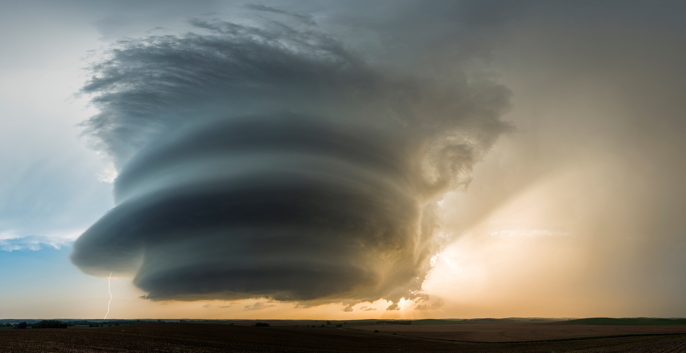
Conversation questions
Have you ever experienced any extreme weather conditions? If so, what were they, and how did you cope with them?
How does extreme weather affect people's daily lives in your region?
What measures do you think governments should take to prepare for and respond to extreme weather events?
Do you think climate change is contributing to the increase in extreme weather events? Why or why not?
How can individuals contribute to mitigating the impact of extreme weather in their communities?
What are some common natural disasters caused by extreme weather, and how do they impact the environment and society?
How has technology helped in predicting and managing extreme weather conditions?
In your opinion, what role do humans play in causing extreme weather events, if any?

Slide 9

Conversation questions
How do extreme weather events affect different industries, such as agriculture, tourism, or transportation?
What steps can individuals take to stay safe during extreme weather conditions?
Share a story or news article about a recent extreme weather event and discuss its impact on the affected community.
How has your perception of extreme weather changed over the years, and why?
What are the potential economic consequences of recurring extreme weather events in a region?
Do you think there is enough awareness about the importance of preparedness for extreme weather conditions in your community?
How can communities work together to build resilience against extreme weather events?

Slide 10
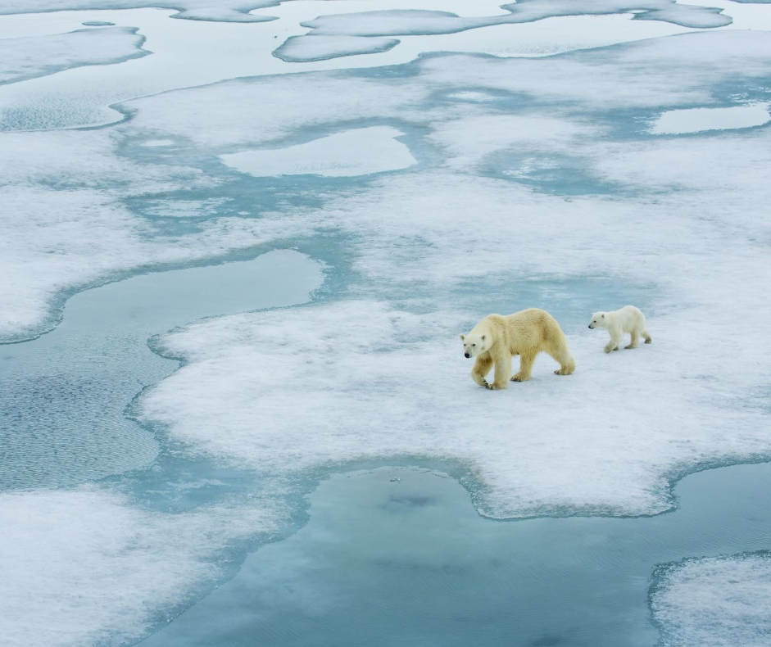
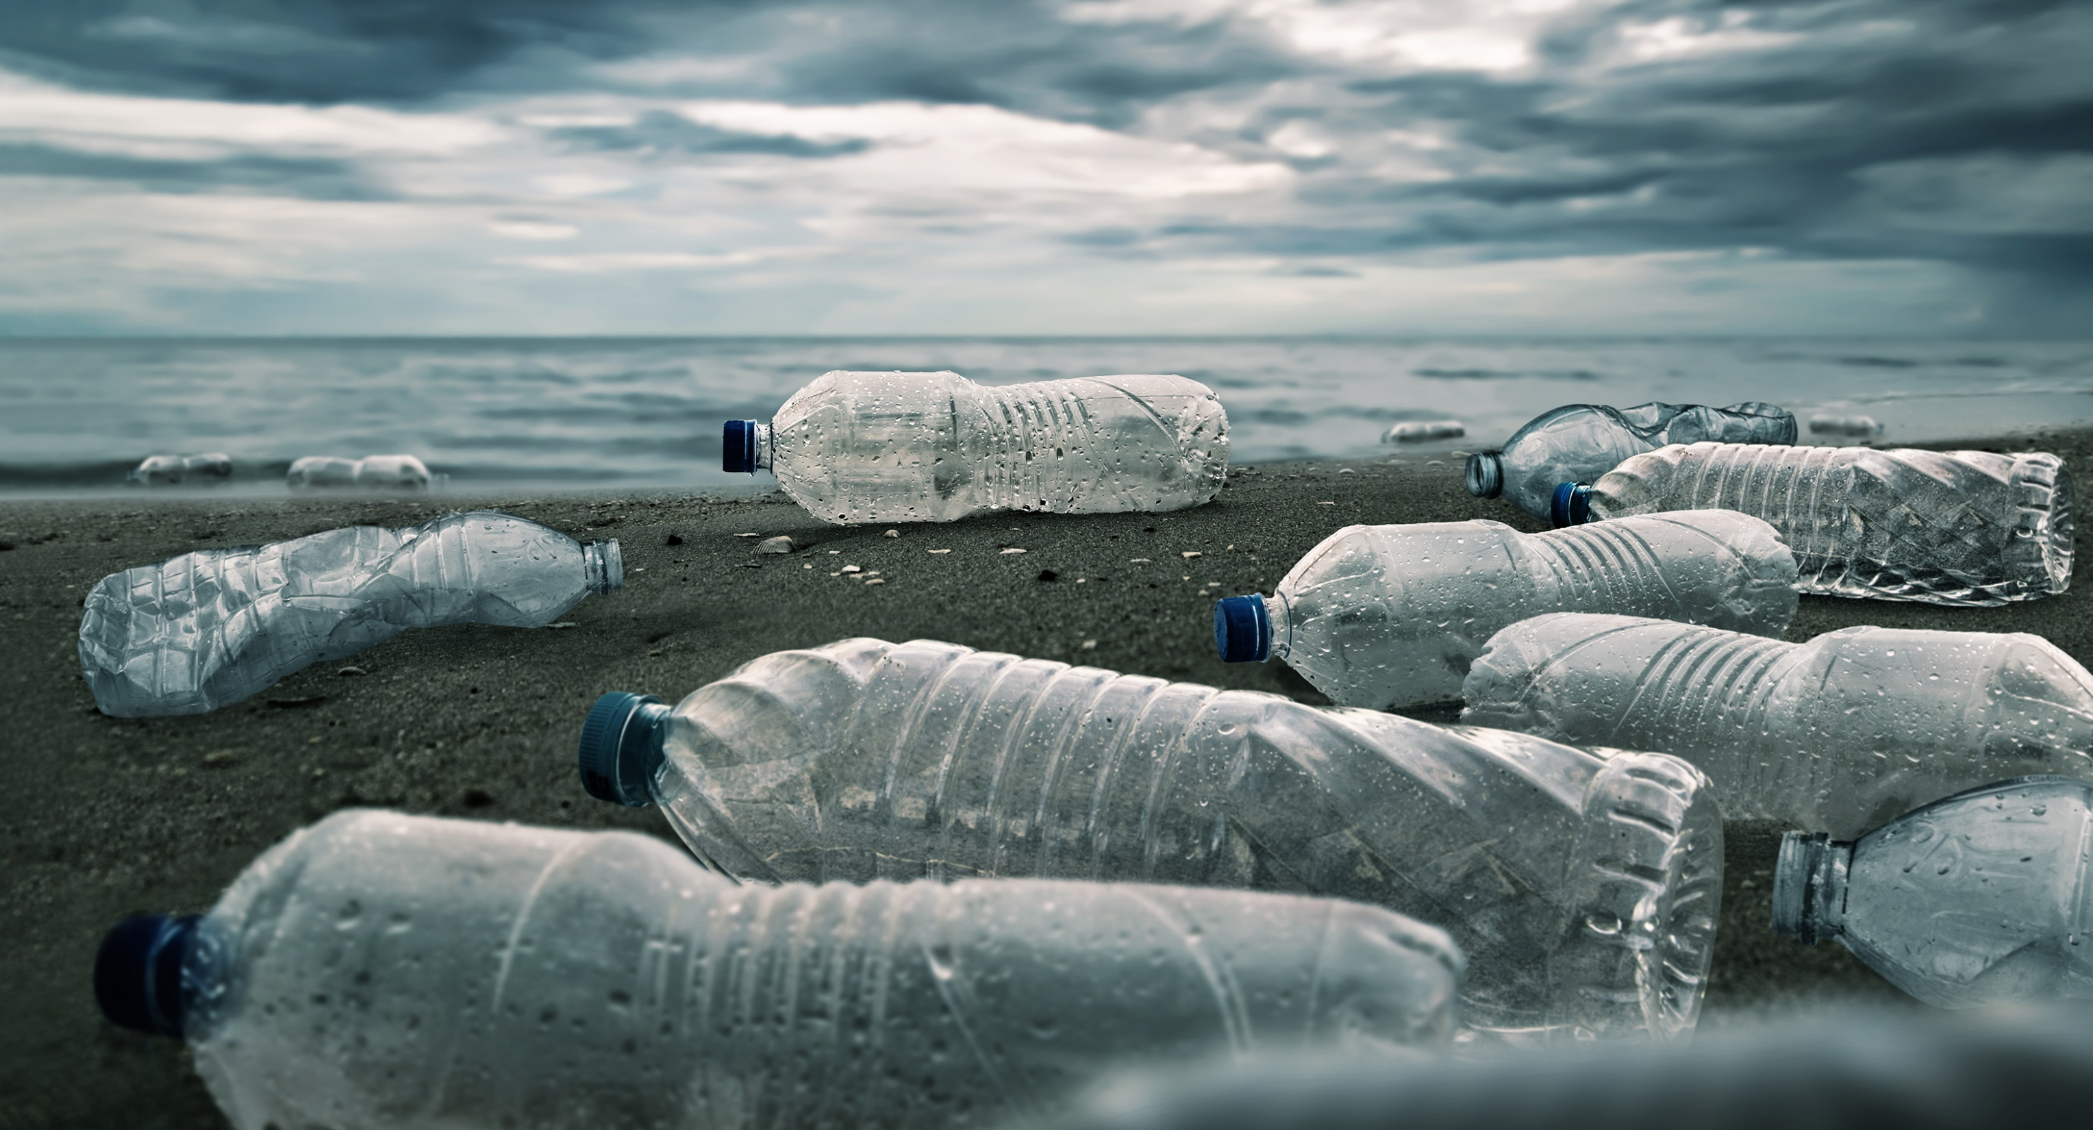
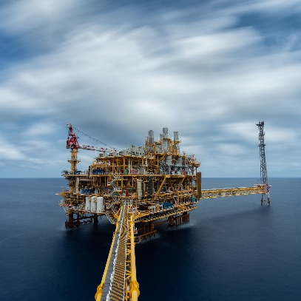
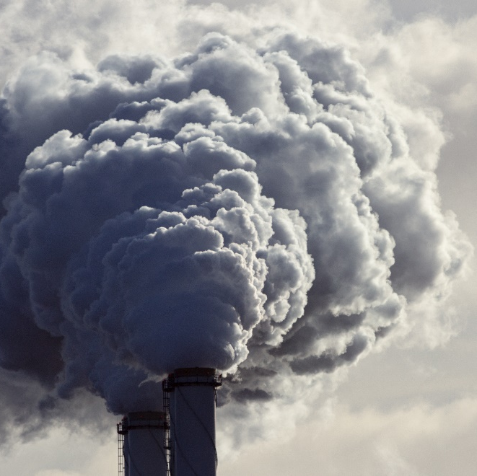

Modals
Using modals, can, could, will, would, might, may, should, must, ought to, etc, talk about how these issues in the photographs can affect the world.

Slide 11

Example sentences
Human activities can significantly contribute to climate change through the emission of greenhouse gases.
Deforestation may lead to disruptions in the climate system by reducing the Earth's capacity to absorb carbon dioxide.
Governments must enforce strict regulations to limit industrial emissions and protect the environment.
The use of renewable energy sources could help reduce our dependence on fossil fuels and curb climate change.
If we continue to ignore environmental concerns, we might face more severe consequences in the form of extreme weather events.
Policymakers should invest in research and development of eco-friendly technologies to address climate-related challenges.
Companies ought to implement sustainable practices in their operations to contribute to a more eco-friendly business environment.
The transition to a circular economy can play a crucial role in reducing waste and minimizing the environmental impact of production processes.

Slide 12
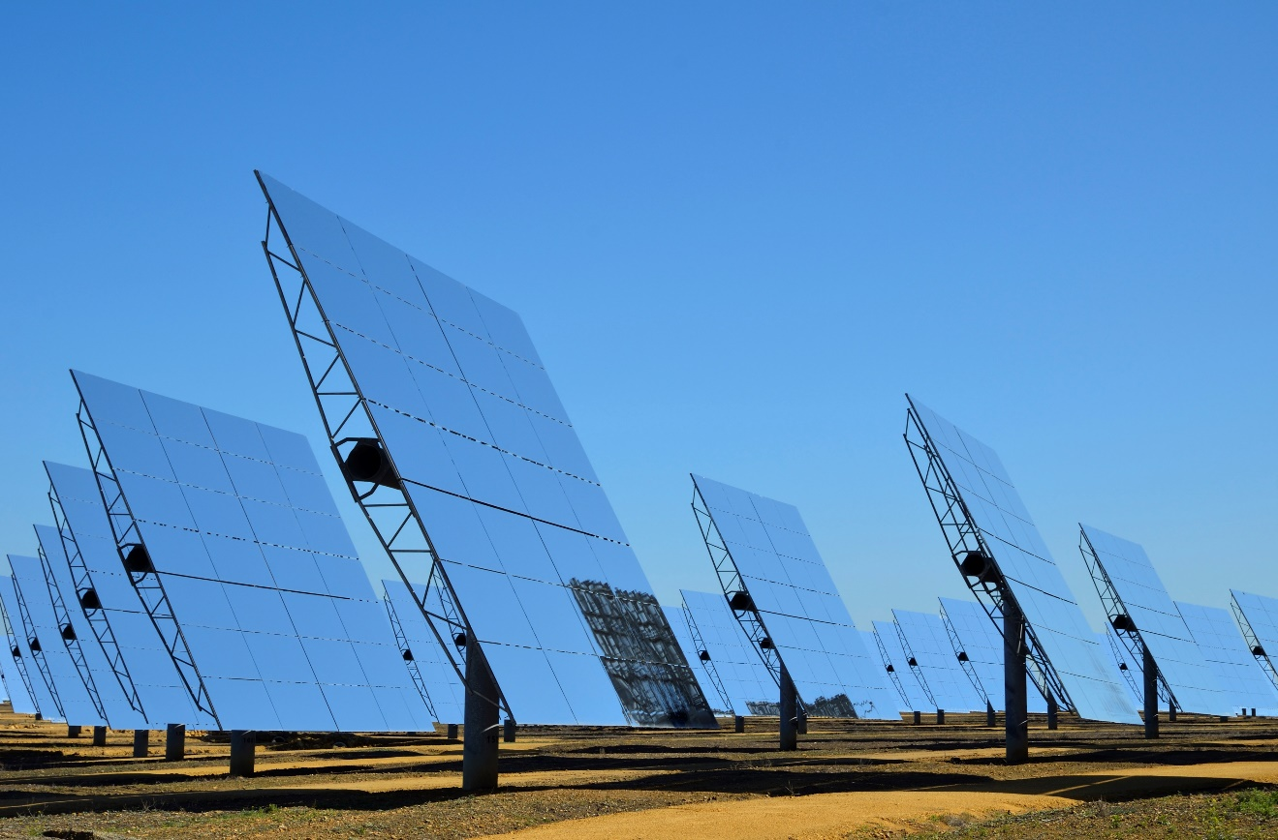
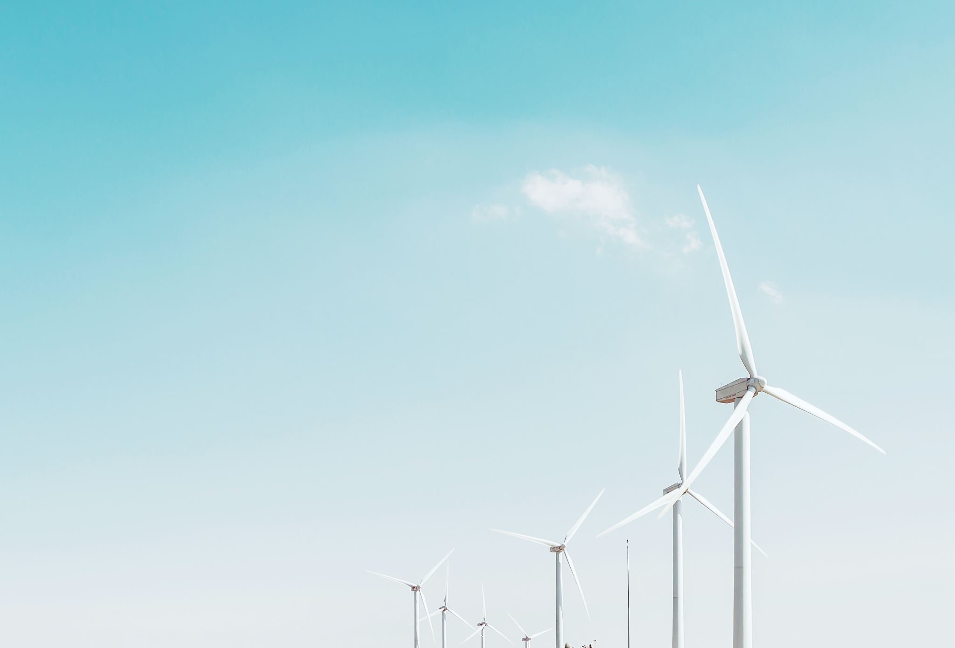
Climate solutions

Slide 13
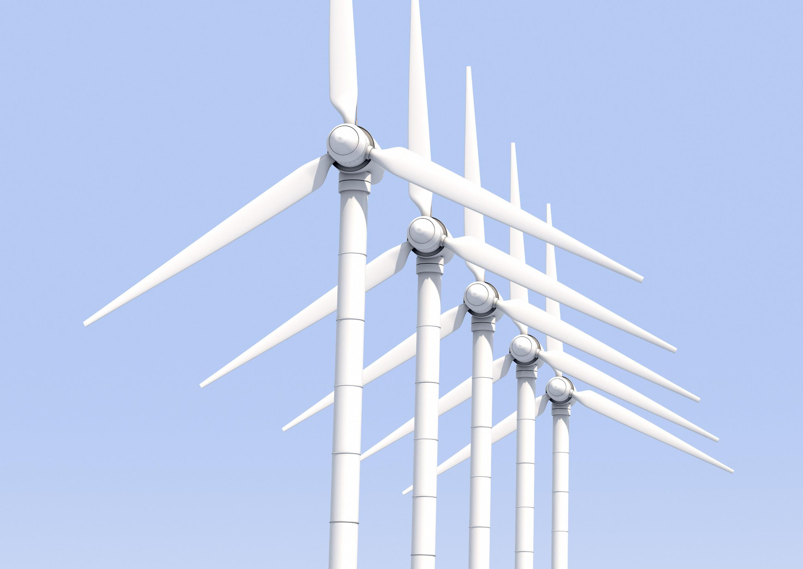
Conversation questions
Climate Change Awareness:
How familiar are you with the concept of climate change?
What do you think are the main contributors to climate change?
Renewable Energy Sources:
Can you name some renewable energy sources?
How important do you think it is for countries to invest in renewable energy?
Zero-Carbon Goals:
What does the term "zero carbon" mean to you?
Do you think it's feasible for a country to achieve zero carbon emissions? Why or why not?
Government Policies:
Should governments play a significant role in promoting and implementing policies for zero-carbon solutions? Why or why not?
What incentives could governments provide to encourage the use of renewable energy?
Individual Actions:
What can individuals do to reduce their carbon footprint in daily life?
How has your awareness of climate change influenced your personal habits or choices?
Technological Advances:
What are some emerging technologies that could help in achieving zero carbon goals?
Do you think technological advancements alone can solve the climate crisis?

Slide 14
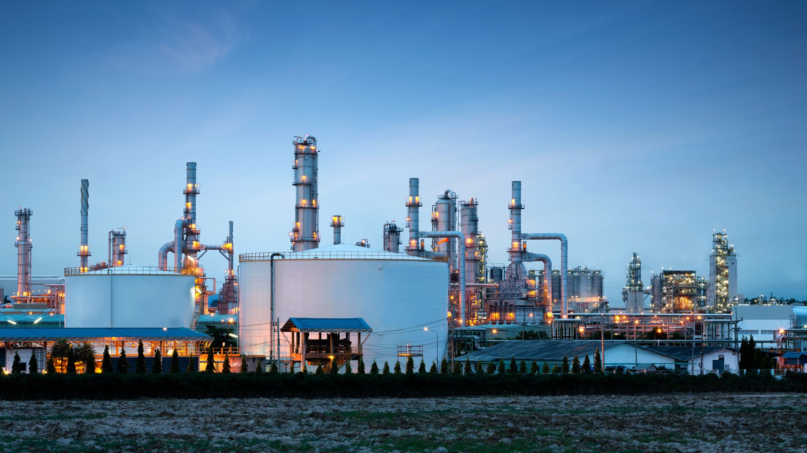
Conversation questions
Challenges and Solutions:
What challenges do you think countries face in transitioning to zero-carbon energy solutions?
How can these challenges be addressed on a global scale?
Global Cooperation:
In your opinion, how important is international cooperation in addressing climate change?
Are there any global initiatives or agreements related to climate change that you are aware of?
Impact on Jobs and Economy:
How do you think the shift to zero-carbon energy solutions might impact employment and the economy?
Are there potential opportunities for new jobs in the renewable energy sector?
Educational Initiatives:
Do you believe that education plays a role in promoting sustainable practices and awareness about climate change?
What changes do you think schools and universities should make to address climate-related issues?
Public Awareness:
How can we increase public awareness about the importance of zero-carbon energy solutions?
What role do media and communication play in shaping public opinions about climate change?
Adaptation and Resilience:
Aside from mitigation efforts, how can communities adapt to the effects of climate change?
What are some examples of communities successfully adapting to climate challenges?

Slide 15
Delayed feedback

