Slide 1

Mass media and communication
English C1

Slide 2

Warm up
Introduction to Media:
What role does media play in your daily life?
How has your consumption of media changed over the years?
Media Preferences:
What types of media do you prefer—TV, radio, print, or online platforms?
Are there specific genres or topics in the media that you find most interesting?

Slide 3

Vocabulary
Media:
Definition: The means of communication, such as newspapers, radio, television, and the internet, that reach or influence people widely.
Mass Media:
Definition: Forms of communication that reach a large audience, typically including television, radio, newspapers, and the internet.
Journalism:
Definition: The profession or practice of reporting and analysing news events through print, broadcast, or online media.
Broadcasting:
Definition: The distribution of audio or video content to a dispersed audience via radio, television, or online platforms.
Print Media:
Definition: Media that is printed on paper, such as newspapers, magazines, and brochures.
New Media:
Definition: Digital forms of communication and media, including online platforms, social media, and digital content.
Editorial:
Definition: Content expressing the opinion or viewpoint of the media outlet, often found in newspapers or online articles.
Press Release:
Definition: A written or recorded communication provided to the media for publication, often announcing news or events.
Infotainment:
Definition: Media content that combines information and entertainment, often in a way that prioritizes entertainment value.
Media Bias:
Definition: The perceived or actual bias in the selection and presentation of news stories, reflecting a particular perspective.

Slide 4
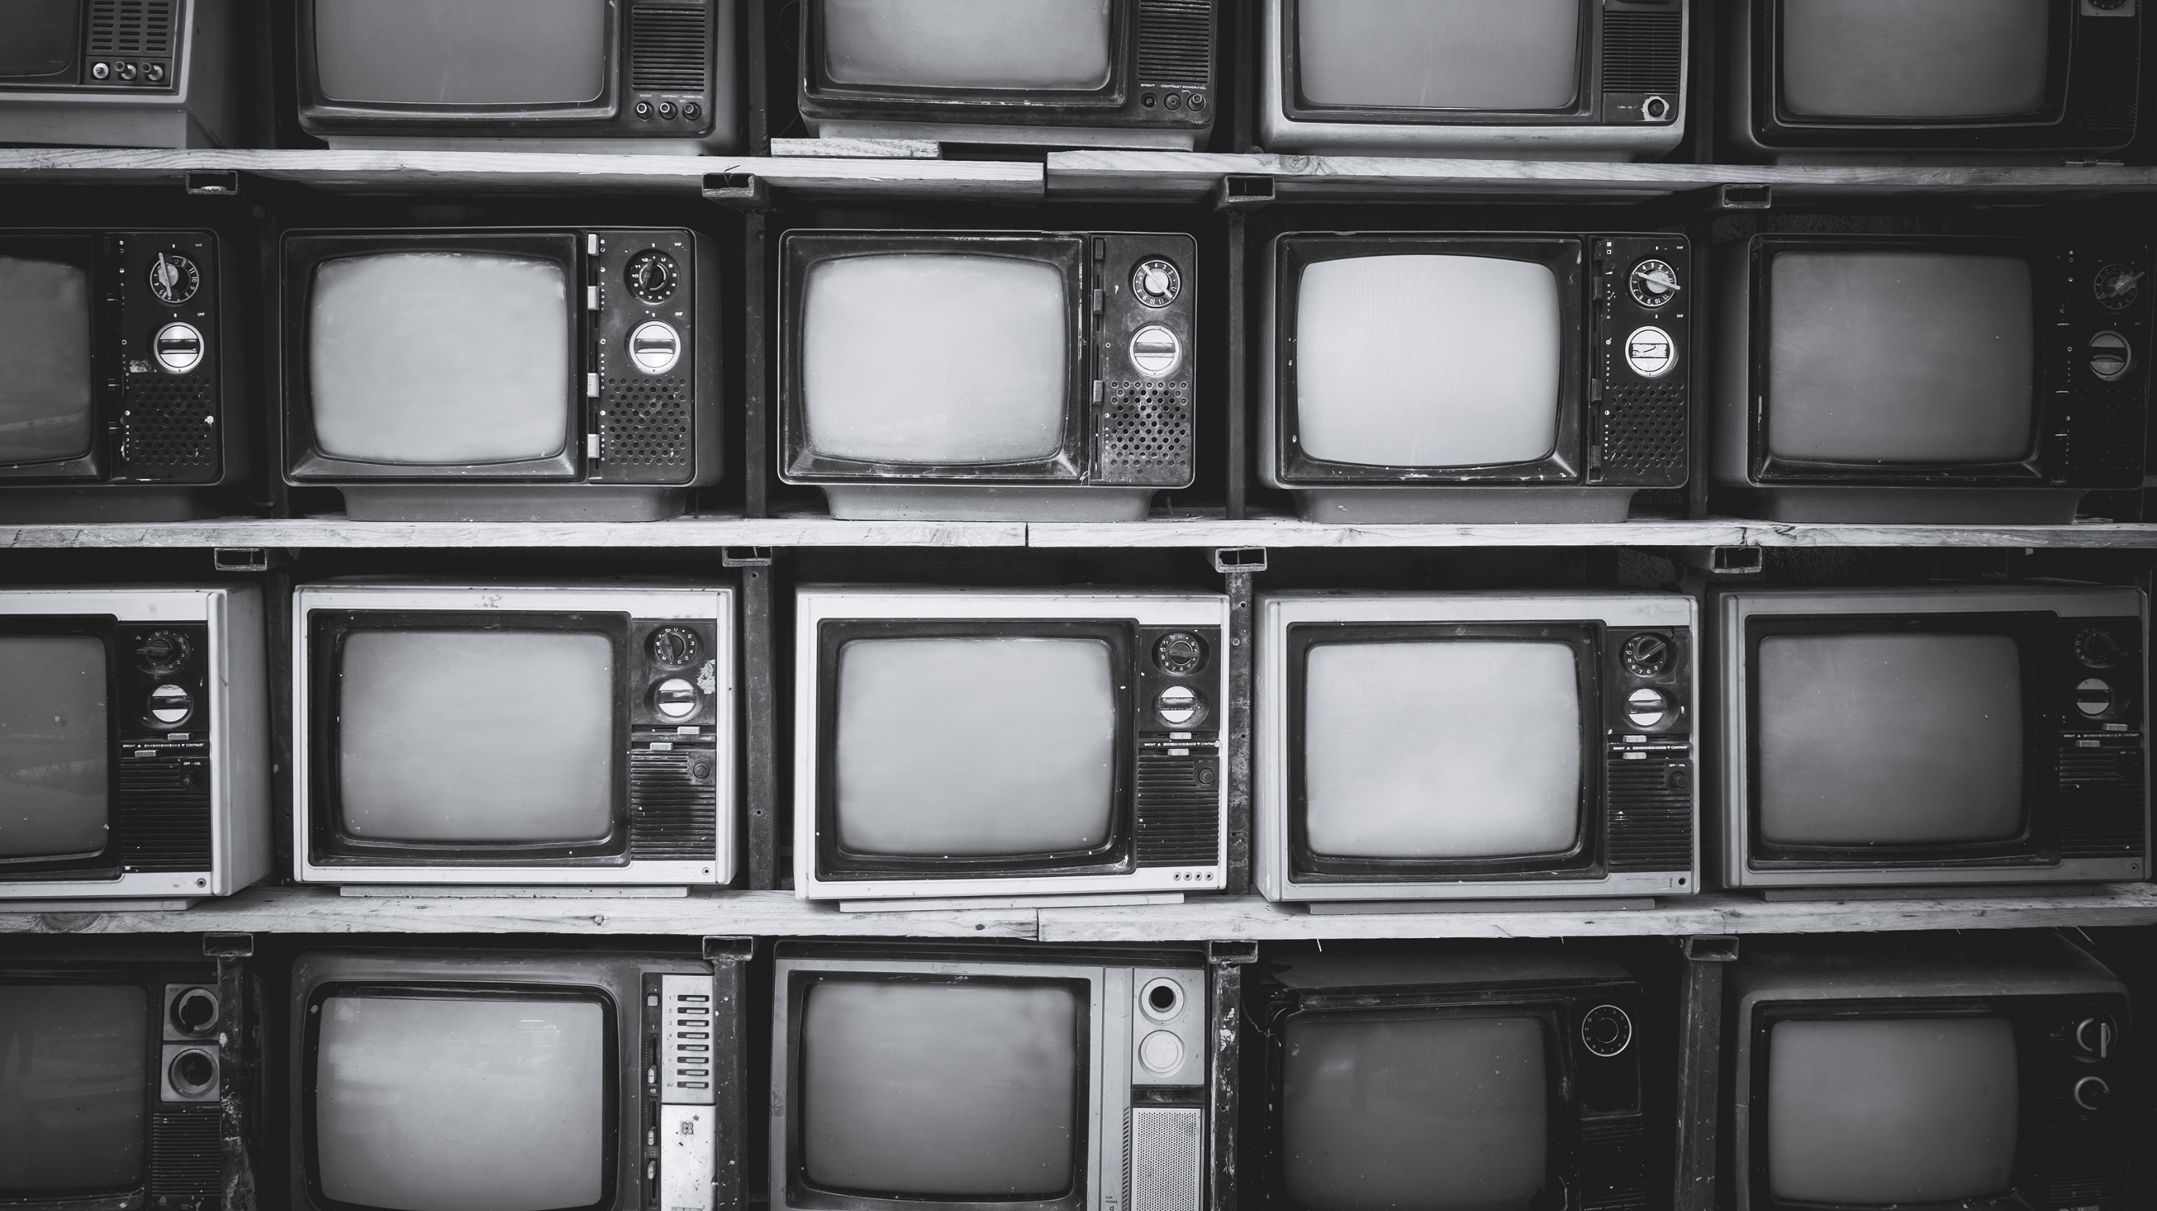
Vocabulary
Censorship:
Definition: The control or suppression of information, ideas, or artistic expression by an authority or government.
Media Literacy:
Definition: The ability to access, analyse, evaluate, and create media in various forms, promoting critical thinking and responsible use.
Clickbait:
Definition: Online content, typically in the form of headlines or thumbnails, designed to attract attention and encourage users to click for more information.
Viral:
Definition: Content, often online, that spreads rapidly and widely among users through sharing and reposting.
Podcast:
Definition: A digital audio or video file available for streaming or download, often part of a series covering various topics.
Aggregator:
Definition: A website or application that collects and displays content from various sources, providing a centralized location for users.
Caption:
Definition: A brief explanation or description accompanying an image, providing context or additional information.
Analytics:
Definition: The collection, measurement, analysis, and reporting of data related to the performance and effectiveness of media content.
SEO (Search Engine Optimization):
Definition: The practice of optimizing online content to improve its visibility and ranking in search engine results.
Meme:
Definition: A humorous image, video, or piece of text that is copied and spread rapidly by internet users.

Slide 5

1. Objective Reporting vs. Advocacy:
Discussion: Explore the balance between objective reporting and advocacy journalism. Should journalists strive to remain impartial, or is it acceptable for them to express personal opinions in their reporting?

Slide 6

2. Sensationalism in Media:
Discussion: Discuss the ethical implications of sensationalism in media. How does sensationalism impact public perception, and what responsibilities do media professionals have in avoiding sensationalistic practices?
Can you think of any other examples closer to home?

Slide 7
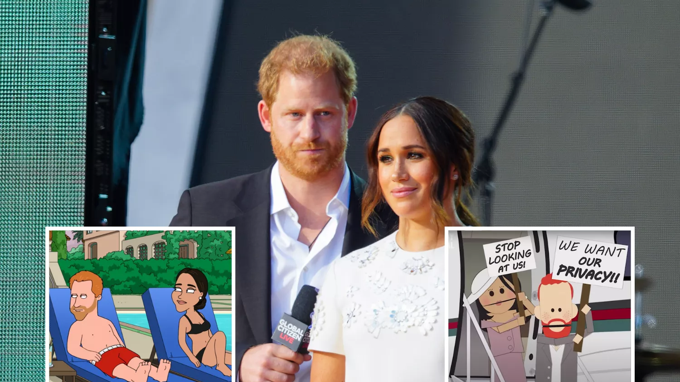
3. Privacy and Intrusion:
Discussion: Examine the ethical considerations surrounding the invasion of privacy by the media. When is it justified to intrude into someone's private life for the sake of a news story?

Slide 8

4. Fake News and Misinformation:
Discussion: Explore the role of media in combating fake news and misinformation. How can media organizations maintain trust, and what responsibility do they have in verifying and correcting information?

Slide 9

Vocabulary 2
Clarity:
Definition: The quality of being clear, easy to understand, and free from ambiguity in media messages.
Conciseness:
Definition: Expressing ideas in a clear and brief manner without unnecessary details or redundancy.
Credibility:
Definition: The trustworthiness and reliability of the source of information, crucial for effective communication.
Engagement:
Definition: The ability of media content to capture and maintain the audience's attention, involvement, and interest.
Feedback:
Definition: Responses, reactions, or opinions provided by the audience to the media content, facilitating a two-way communication process.
Inclusivity:
Definition: Ensuring that media content is designed to be accessible and relatable to a diverse audience, representing various backgrounds and perspectives.
Interactivity:
Definition: The degree to which the audience can actively engage with and participate in media content, often facilitated by digital platforms.
Message Framing:
Definition: The deliberate presentation of information in a particular way to shape the audience's perception or interpretation.
Multimodal Communication:
Definition: Using multiple modes of communication, such as text, images, audio, and video, to convey a message effectively.
Narrative Storytelling:
Definition: Presenting information or messages in the form of a story, making it more engaging and relatable for the audience.

Slide 10

Vocabulary 2
Objectivity:
Definition: Presenting information without personal bias or opinion, maintaining a neutral and impartial stance in media content.
Persuasion:
Definition: The use of techniques to influence or change the attitudes, beliefs, or behaviours of the audience through media messages.
Sensationalism:
Definition: The use of exaggerated or sensationalized content to evoke strong emotions or reactions from the audience.
Transparency:
Definition: Openness and honesty in communication, providing clear information about sources, motives, and intentions.
User Experience (UX):
Definition: The overall experience of a person using media content or platforms, encompassing usability, accessibility, and satisfaction.
Visual Communication:
Definition: Conveying information or messages through visual elements such as images, graphics, and videos.
Digital Literacy:
Definition: The ability to access, analyse, and evaluate information effectively in the digital age, including understanding media sources and content.
Ethical Journalism:
Definition: Adhering to moral principles and standards in journalism, including truthfulness, accuracy, and respect for individuals' rights and privacy.
Media Advocacy:
Definition: Using media channels to promote a cause or social issue, aiming to influence public opinion or policy.
Gatekeeping:
Definition: The process by which media professionals decide which information is selected, presented, and omitted in news coverage.

Slide 11

5. Censorship:
Discussion: Explore the concept of censorship in the media. Under what circumstances, if any, is censorship justifiable?

Slide 12

6. Media Ownership and Independence:
Discussion: Explore the ethical implications of media ownership and its potential impact on editorial independence. How can media organizations maintain integrity in the face of corporate or political influence?

Slide 13

7. Diversity and Inclusivity:
Discussion: How can media organizations promote diversity and inclusivity in their coverage? What are the ethical considerations related to representation in the media?

Slide 14

8. Whistleblowing and Anonymous Sources:
Discussion: Explore the ethical considerations surrounding whistleblowing and the use of anonymous sources in journalism. When is it justifiable for journalists to protect their sources?

Slide 15

9. Social Media and Citizen Journalism:
Discussion: How has the rise of social media impacted traditional journalism ethics? Discuss the role of citizen journalism and the challenges it poses.

Slide 16
Delayed feedback

