Slide 1

Power and People: Exploring the Dynamics of Society, Politics, and Governance
English C1
TuSpeaking 2025, all rights reserved

Slide 2

Objectives of the presentation
To analyze the role of authority and governance in shaping societal structures and political decision-making processes.
To explore the impact of civic duty and democratic participation on government accountability and policy development.
To evaluate the influence of revolution and political opposition in driving social and legislative reforms within different systems of governance.

Slide 3

Warm up
Think-Pair-Share:
What makes a good government?
Discuss examples of leadership or policies that have positively impacted society

Slide 4
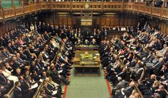
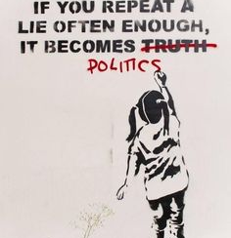


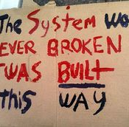
Speaking practice
How can governments ensure fairness and equality in society?

Slide 5
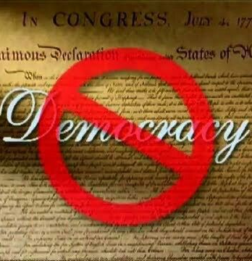
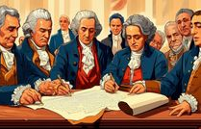
Vocabulary related with the topic
Authority
Democracy
Bureaucracy
Constitution
Sovereignty
Legislation
Opposition
Revolution
Diplomacy
Civic Duty

Slide 6
Let´s practice

Slide 7
Match the words with their terms.
Authority
Democracy
Bureaucracy
Constitution
Sovereignty
Legislation
Opposition
Revolution
Diplomacy
Civic Duty
a) Responsibilities and obligations of a citizen.
b) A governing system characterized by complex rules and hierarchy.
c) The process or body of creating laws.
d) Managing international relations through negotiation.
e) Power to enforce obedience and make decisions.
f) A system of government where citizens vote for leaders.
g) A political group challenging the ruling party.
h) A significant change in political power or social structure.
i) Supreme power of a state to govern itself.
j) The fundamental rules or principles of governance.

Slide 8

Conversation questions
1. What are the most important qualities of a good leader?
2. How can governments ensure fairness and equality?
3. What role do citizens play in shaping government?
4. How do political systems affect law-making?
5. How do political decisions impact daily life?

Slide 9
Grammatical Objective: Passive Voice
Usage: Emphasizes the action or receiver of the action rather than the doer.
Structure: Active: Subject + verb + object
Example: The government passed a new law.
Passive: Object + form of 'to be' + past participle
Example: A new law was passed by the government.

Slide 10

Grammar Exercise
Rewrite the sentences in passive voice:
1. The government enforces strict environmental regulations.
2. People debate political issues on social media platforms.
3. Leaders will implement new educational reforms next year.
4. Activists are organizing a protest against corruption.
5. Voters choose representatives in a democratic election.

Slide 11

Grammar Exercise – Answers
Strict environmental regulations are enforced by the government.
Political issues are debated on social media platforms by people.
New educational reforms will be implemented next year by leaders.
A protest against corruption is being organized by activists.
Representatives are chosen by voters in a democratic election.

Slide 12

Summing Up
Explored concepts of society, politics, and governance
Learned passive voice structure for formal language use
Practiced transforming active into passive sentences

Slide 13
Delayed feedback

