Slide 1

Art and culture
English C1
tuSpeaking 2024, All rights reserved

Slide 2
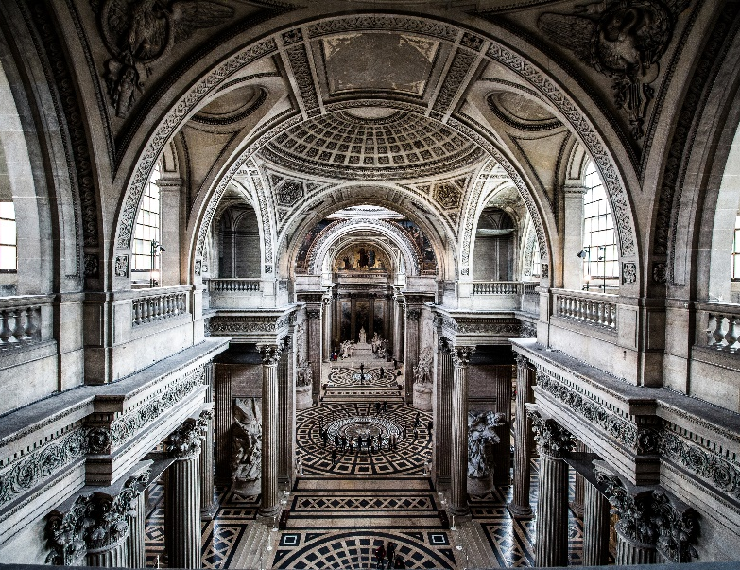
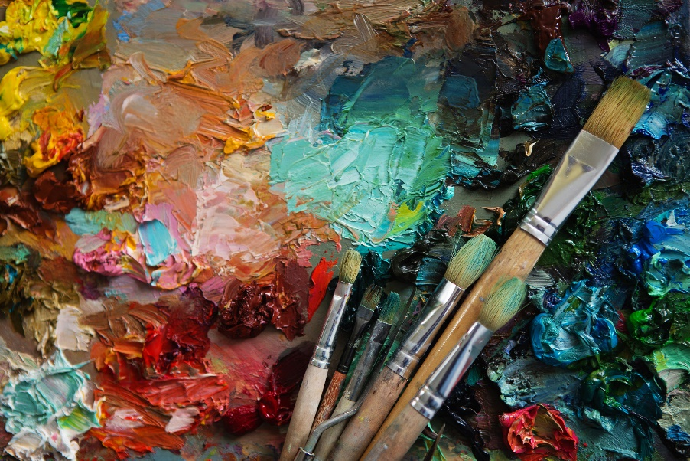

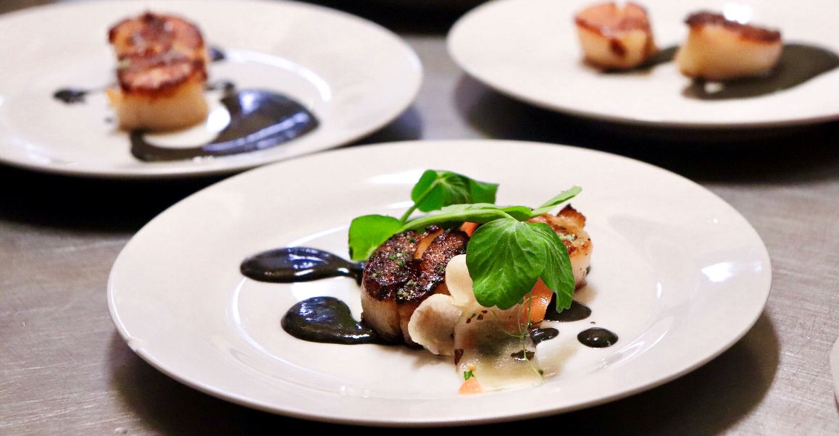
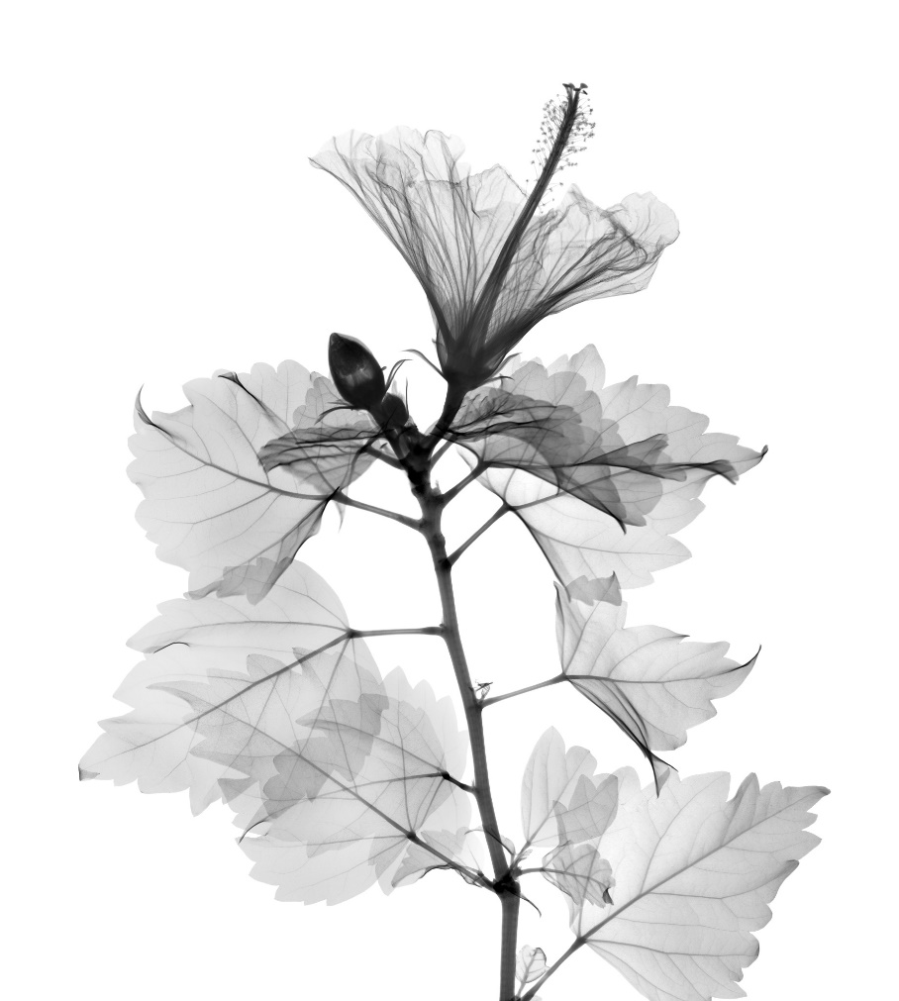
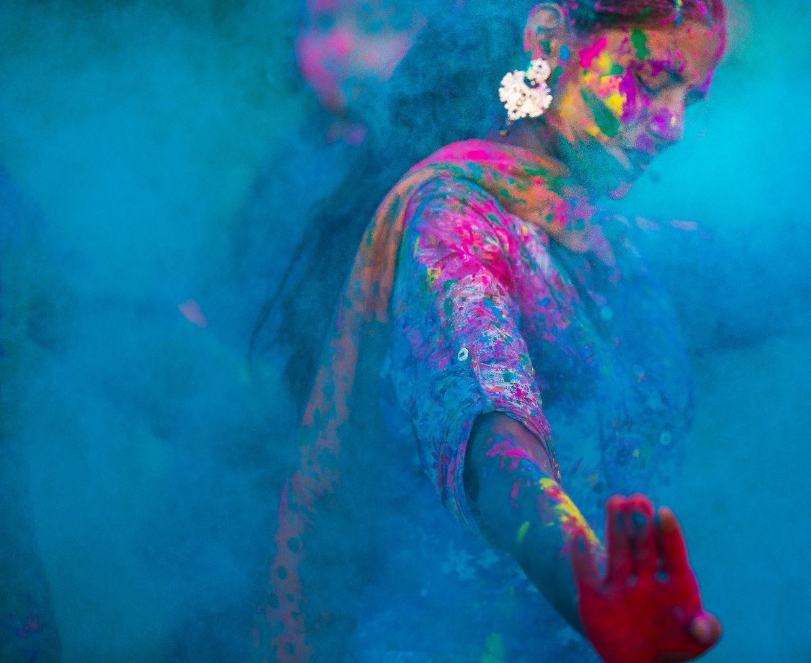
How many forms of art can you think of?

Slide 3
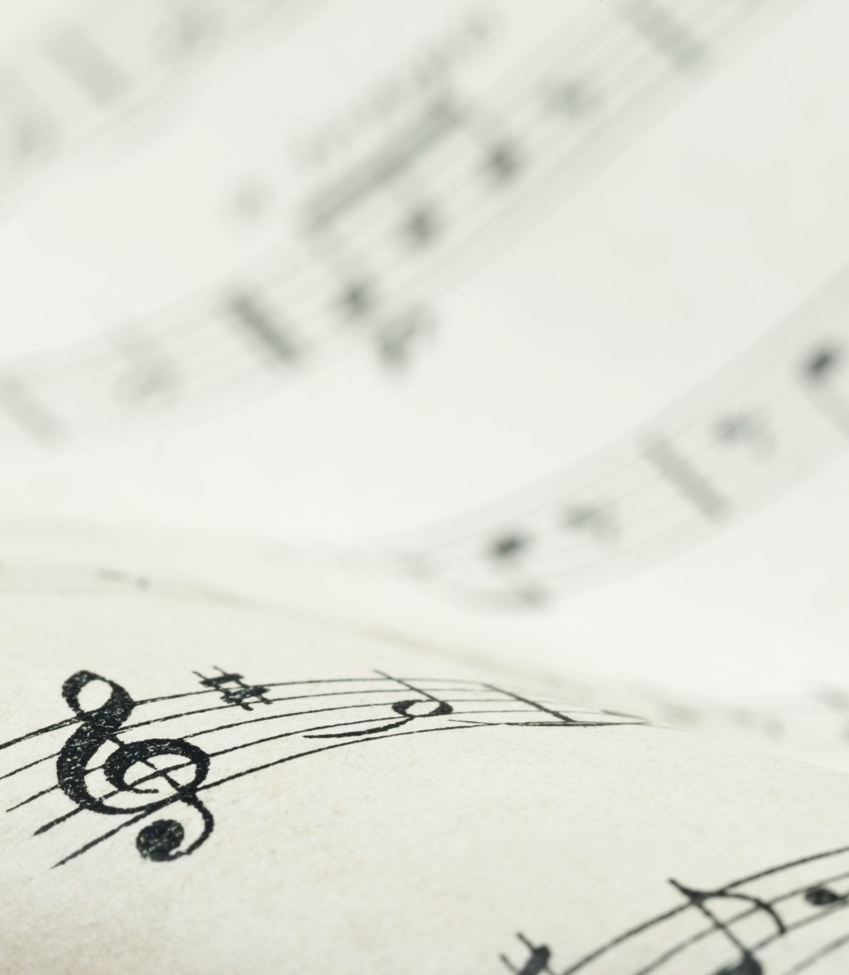
Music
Melody: A sequence of notes that is musically satisfying.
Rhythm: The pattern of sounds and silences in music.
Harmony: The combination of different musical notes played or sung simultaneously.
Genre: A category of music characterized by similarities in form, style, or subject matter (e.g., classical, jazz, pop, rock).

Slide 4
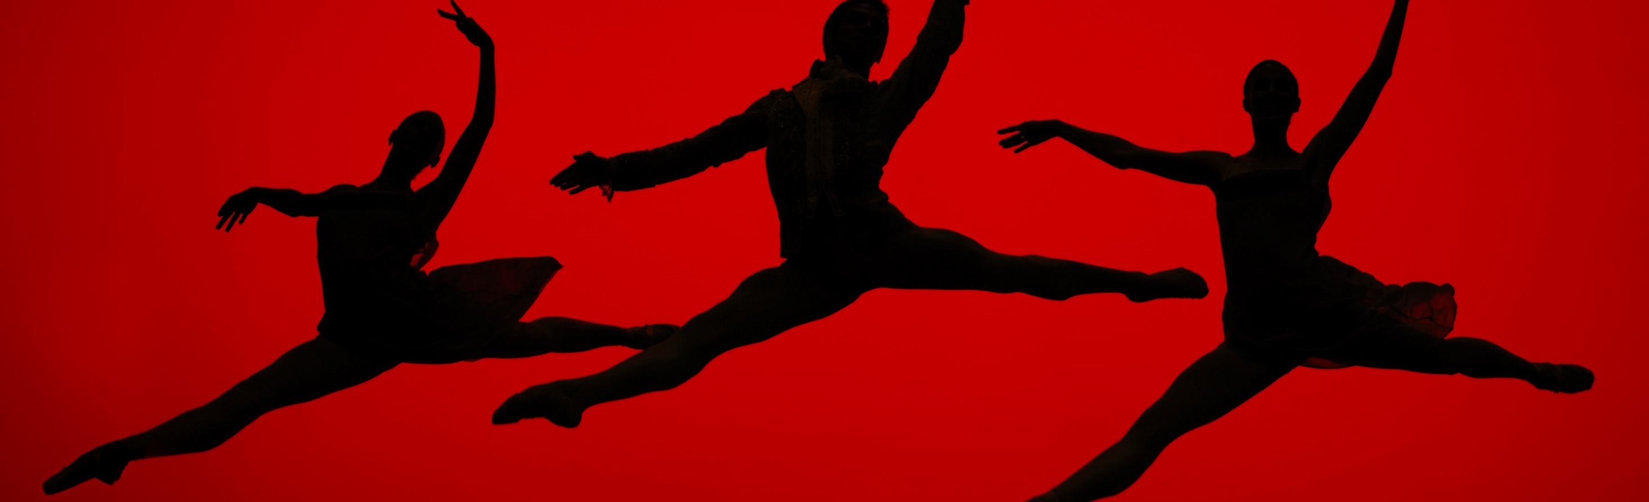
Dancing
Choreography: The art of designing sequences of movements in which motion, form, or both are specified.
Movement: The physical motion performed by dancers.
Style: Distinctive techniques and forms in dance (e.g., ballet, hip-hop, salsa).

Slide 5
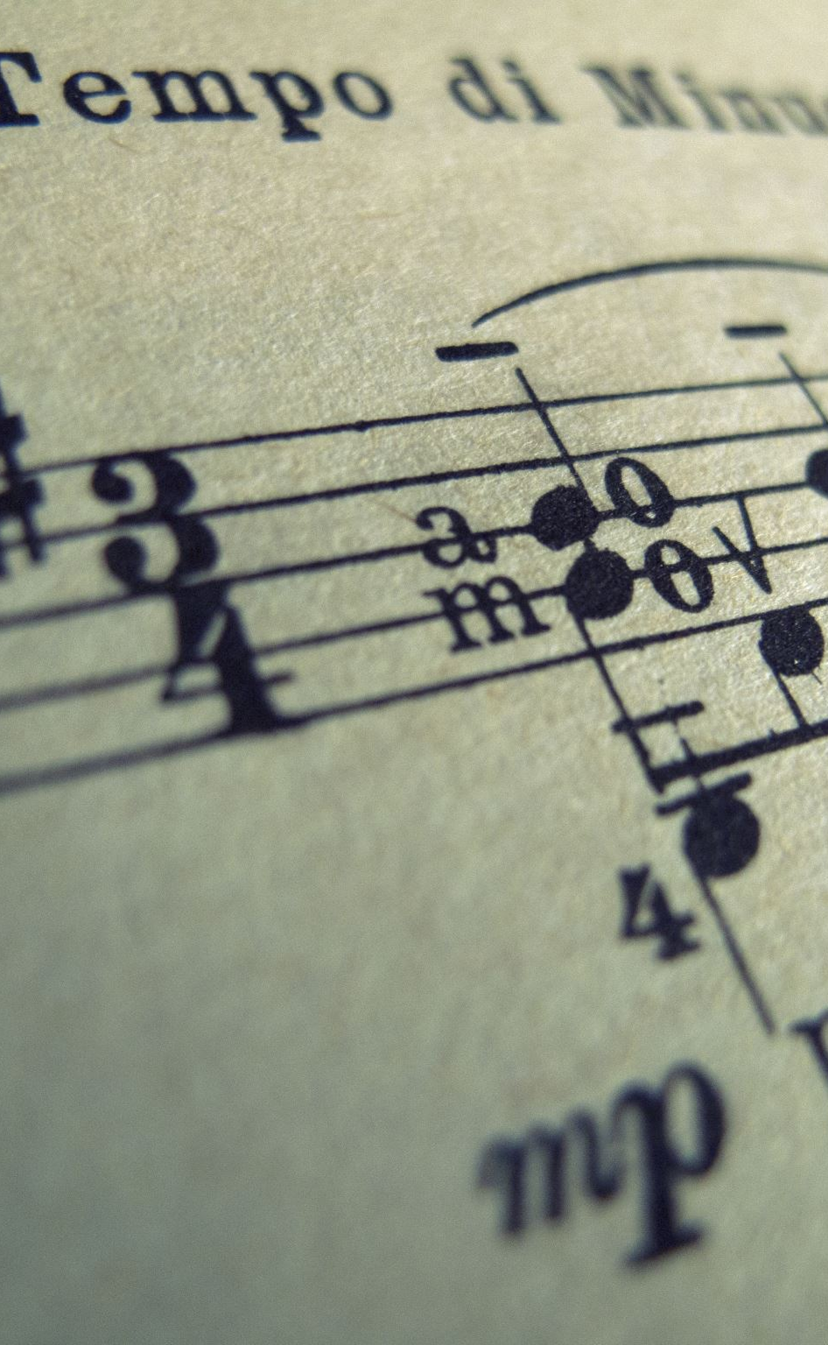
Music Vocabulary
Melody: A sequence of notes that is musically satisfying.
Example: The melody of the song is very catchy and easy to remember.
Rhythm: The pattern of beats or a sequence of sounds and silences in music.
Example: The rhythm of the drum gives the song its lively feel.
Harmony: The combination of different musical notes played or sung simultaneously to produce a pleasing sound.
Example: The harmony between the vocalists created a beautiful sound.
Genre: A category of music characterized by similarities in form, style, or subject matter.
Example: My favorite genre of music is jazz.
Tempo: The speed at which a piece of music is played.
Example: The song has a fast tempo, making it perfect for dancing.
Dynamics: The volume of sound, varying from soft to loud.
Example: The dynamics of the symphony range from very soft to extremely loud.
Pitch: The highness or lowness of a sound.
Example: The singer has an impressive range of pitch.
Beat: The basic unit of time in a piece of music, often what listeners tap their feet to.
Example: The strong beat in the song makes it great for dancing.
Chord: A group of notes played together to form harmony.
Example: The guitarist played a beautiful chord progression.
Lyrics: The words of a song.
Example: The lyrics of the song tell a beautiful story.

Slide 6
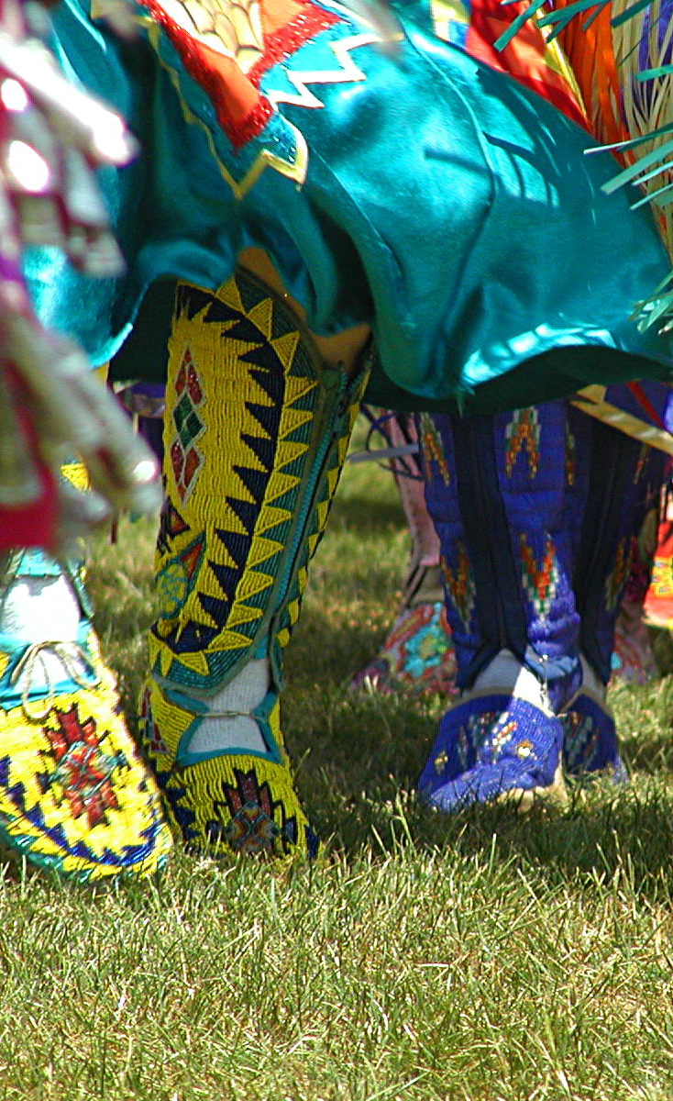
Dance Vocabulary
Choreography: The art of designing sequences of movements in which motion, form, or both are specified.
Example: The choreography for the dance routine was complex and beautiful.
Movement: The physical motion performed by dancers.
Example: Her movements were graceful and fluid.
Style: Distinctive techniques and forms in dance (e.g., ballet, hip-hop, salsa).
Example: He specializes in the hip-hop style of dance.
Routine: A sequence of dance moves performed together.
Example: The dance routine was perfectly synchronized.
Performance: The act of presenting a dance in front of an audience.
Example: The dance performance received a standing ovation.
Technique: The specific methods and skills used in dance.
Example: Good technique is essential for a ballet dancer.
Rhythm: The pattern of beats or a sequence of sounds and silences in music and dance.
Example: The dancers moved in perfect rhythm with the music.
Formation: The arrangement of dancers in a particular pattern.
Example: The dancers changed formation several times during the performance.
Gesture: A movement of part of the body, especially a hand or the head, to express an idea or meaning.
Example: Her gestures added emotional depth to the dance.
Plié: A bending of the knees in ballet.
Example: The dancer performed a perfect plié during the warm-up.

Slide 7
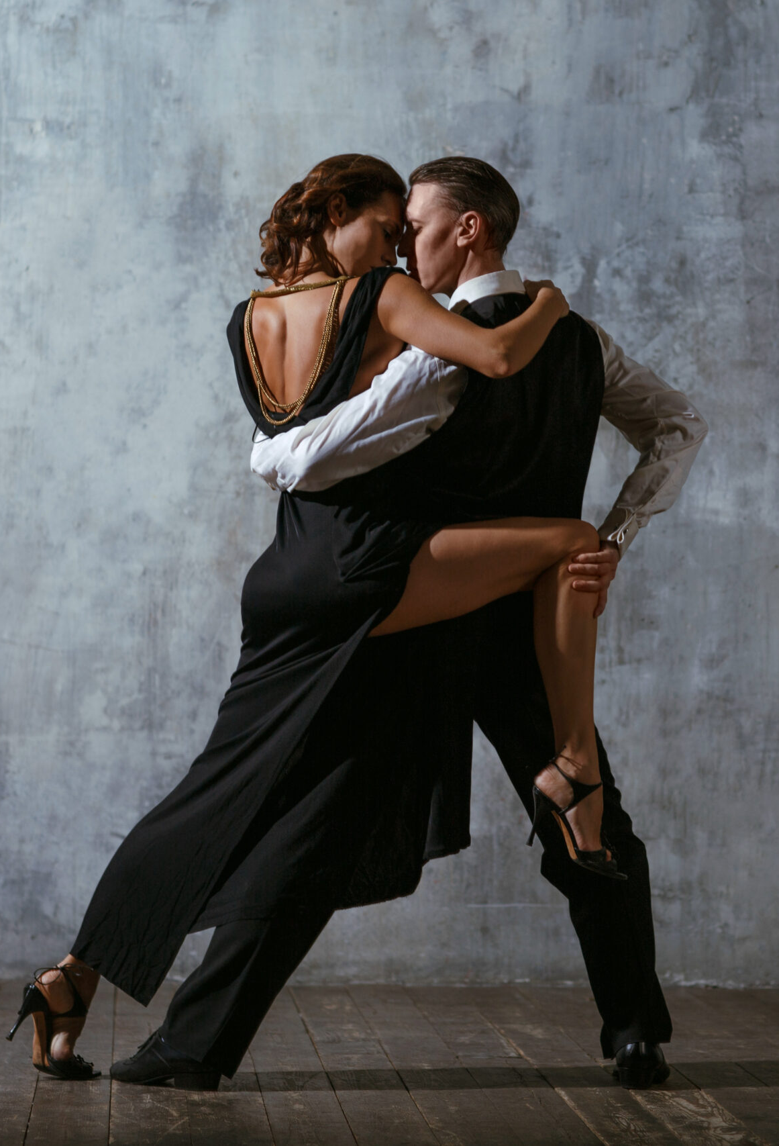
Tango
Tango originated in the late 19th century in Buenos Aires, Argentina. It began as a dance in the lower-class districts and was influenced by European and African cultures. Over time, it became popular worldwide for its dramatic and passionate movements.

Slide 8
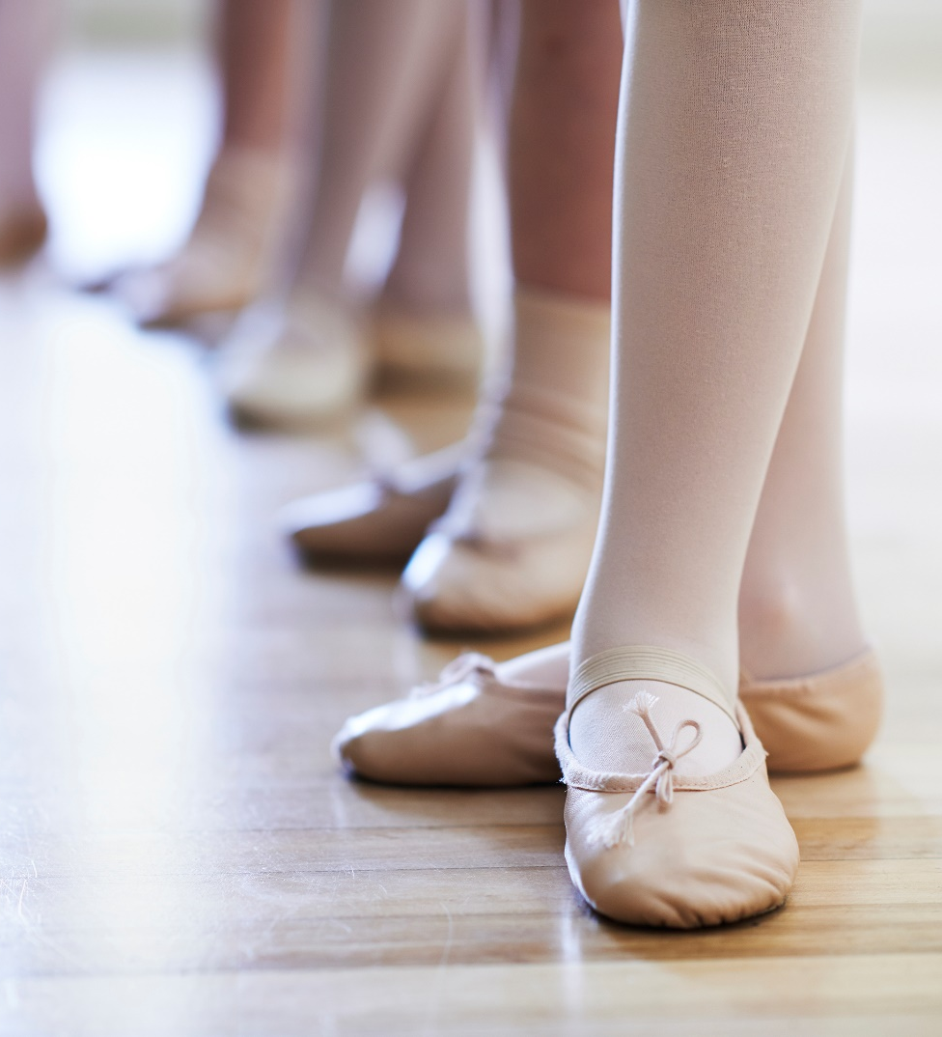
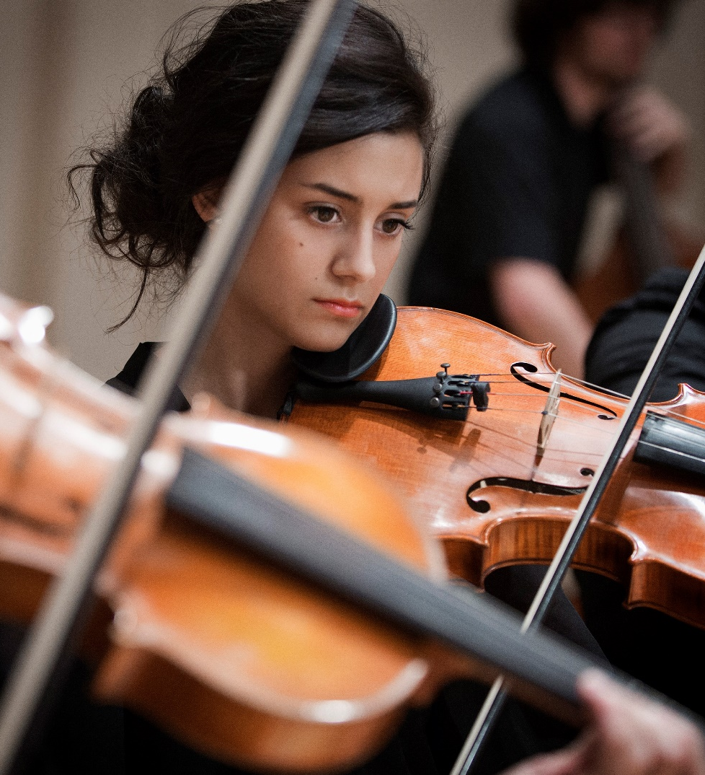


Activity
Take turns to describe a genre of dance or music that you know about.

Slide 9
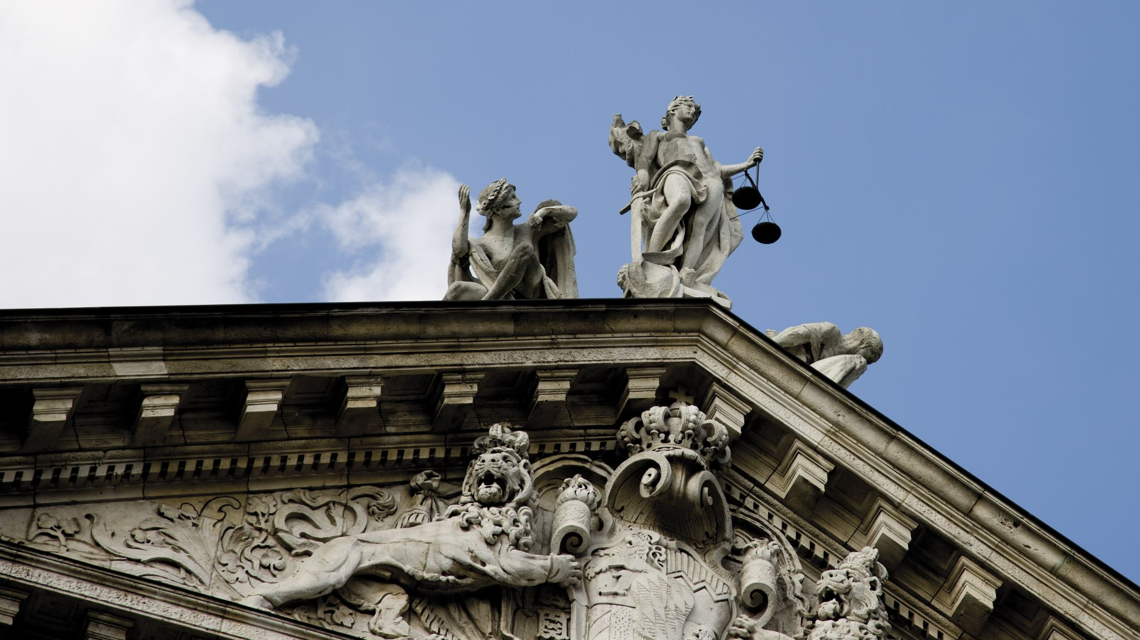
Architecture, Sculpture, and Painting

Slide 10
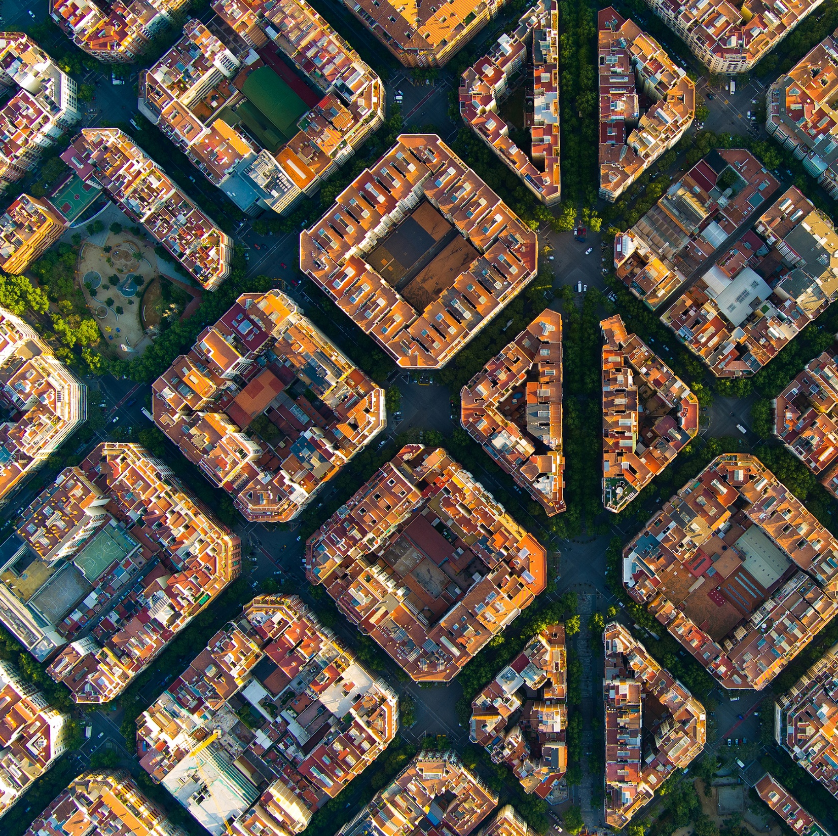
Architecture
Structure: The arrangement and organization of interrelated elements in a building or object.
Design: The creation of a plan or convention for the construction of an object or system.
Function: The specific purpose or activity for which a building or object is used.
Style: The distinctive appearance and construction techniques associated with a particular period, culture, or architect (e.g., Gothic, modern).

Slide 11
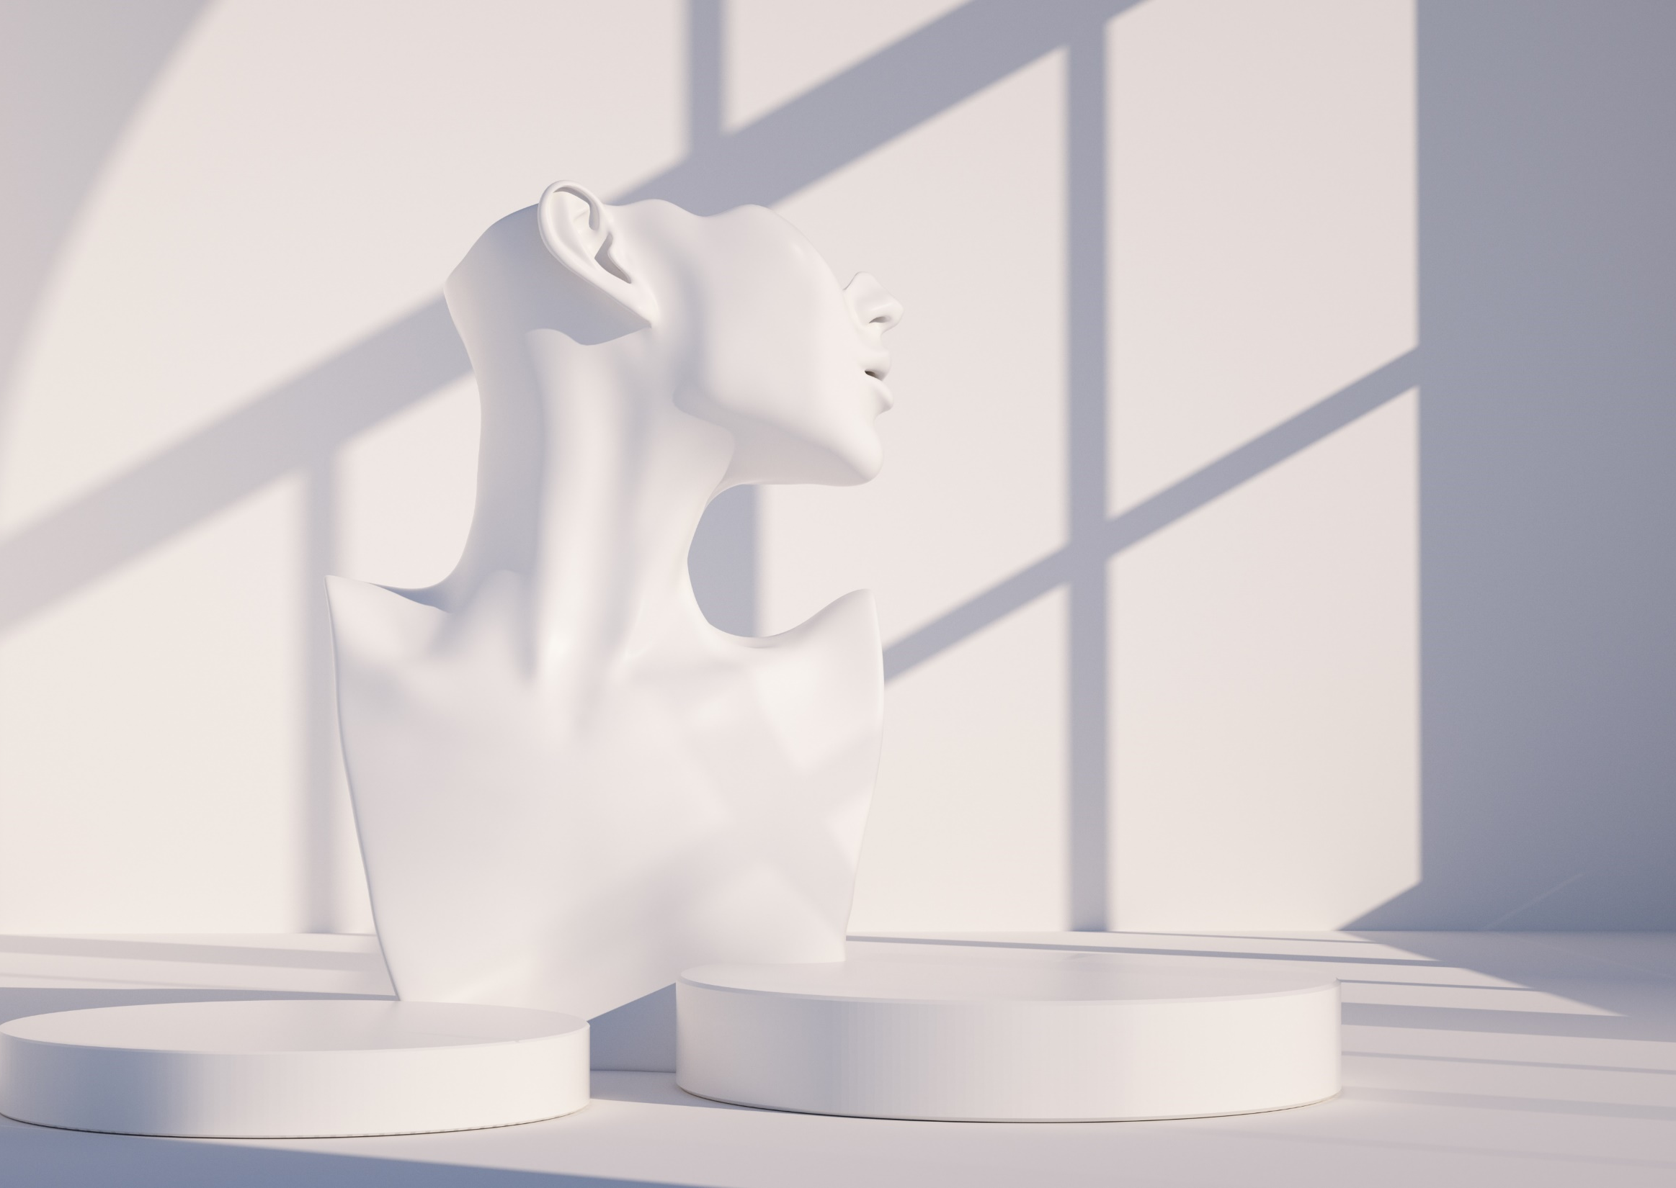
Sculpture
Form: The visible shape or configuration of something.
Medium: The materials used to create a sculpture (e.g., stone, metal, wood).
Technique: The methods used to create a sculpture (e.g., carving, casting, modeling).

Slide 12

Painting
Composition: The placement or arrangement of visual elements in a work of art.
Color: The use of hues in artwork.
Brushwork: The technique and style with which an artist uses a brush.
Genre: A category of painting characterized by similarities in style, form, or content (e.g., portrait, landscape, abstract).

Slide 13
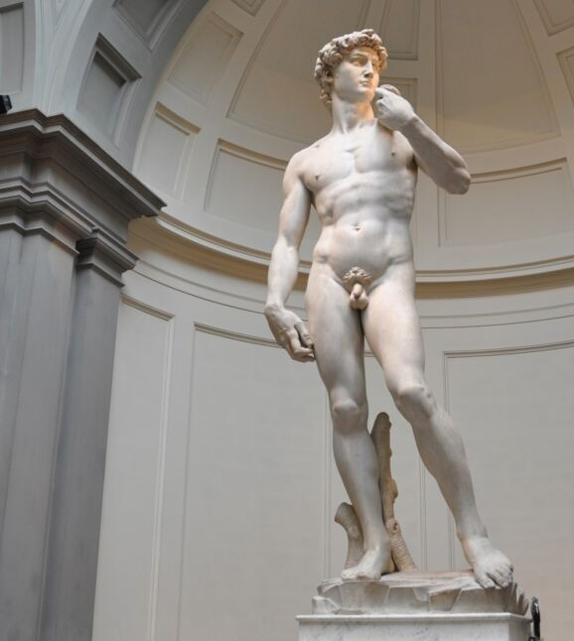
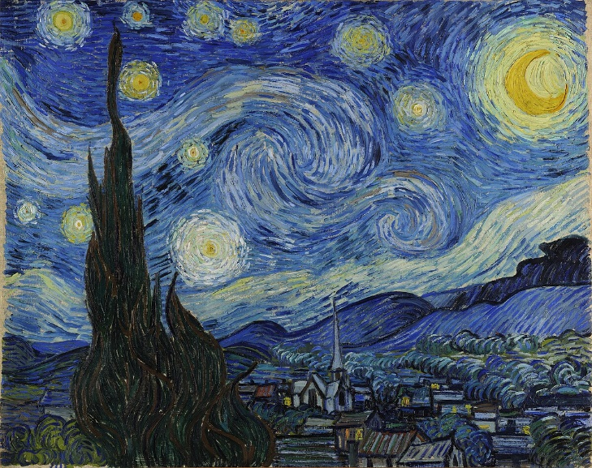
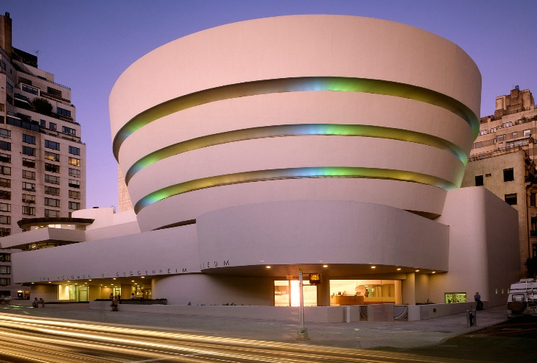
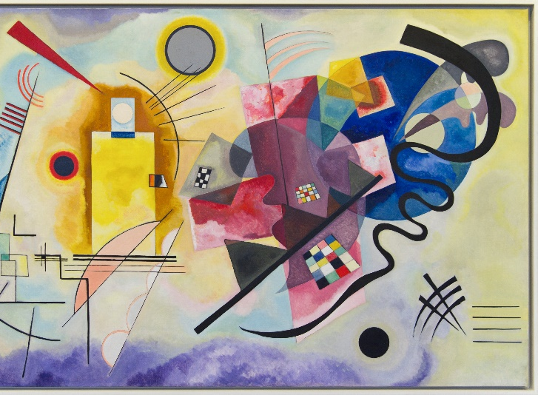
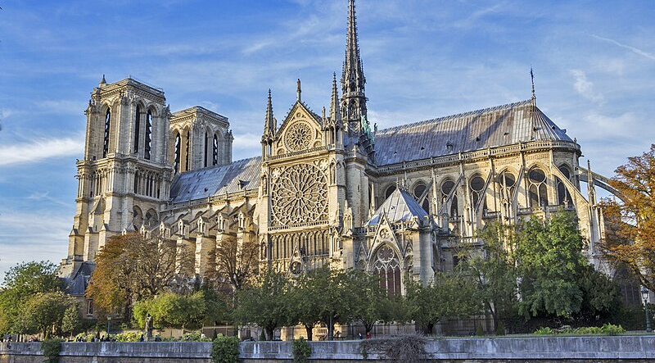
Discussion
What do you think motivated the creation of this work?
What themes can you identify in these works?
Can you identify the artists?

Slide 14
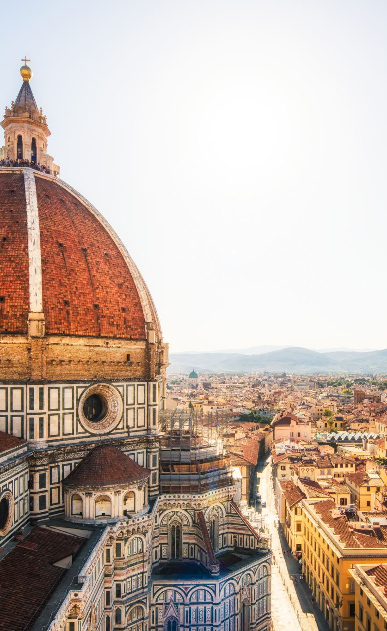
Example answers
Religious Themes in Gothic Cathedrals: "Gothic cathedrals like Notre-Dame were designed to inspire awe and reflect the glory of God. Their tall spires and stained-glass windows create a sense of reaching towards heaven."
The Human Form in Classical Sculptures: "Classical sculptures often focus on the beauty and idealization of the human body, as seen in Michelangelo’s David."
Emotions in Abstract Paintings: "Abstract paintings like those by Kandinsky often aim to evoke emotions through color and form rather than depicting realistic scenes."

Slide 15
Delayed feedback
tuSpeaking 2024, All rights reserved

