Slide 1

Healthcare
English C1
tuSpeaking 2024, All rights reserved

Slide 2
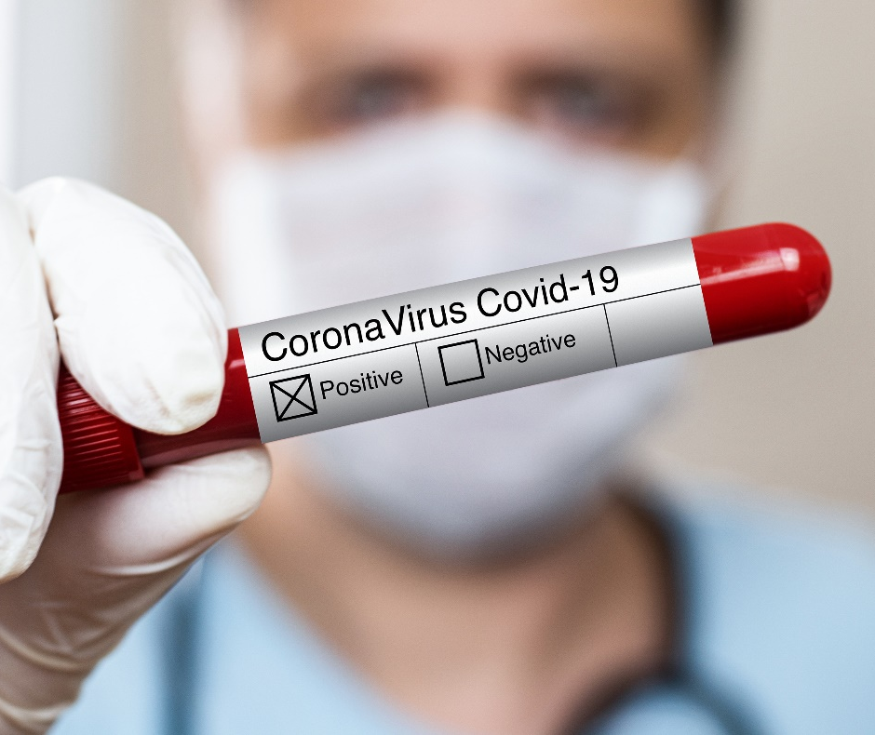



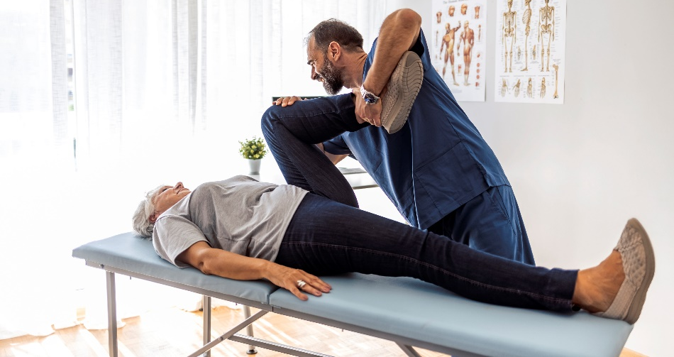
Warm up
What do you do to stay healthy?
Have you ever had a serious injury?
How did you treat it?

Slide 3

Vocabulary - Symptoms
Fever
Cough
Pain
Sore throat
Headache
Nausea
Fatigue
Dizziness
Rash
Swelling

Slide 4

Vocabulary - Health Protection Methods
Vaccination
Hygiene
Handwashing
Quarantine
Balanced diet
Exercise
Sleep
Sanitization
Mask-wearing
Social distancing

Slide 5

Vocabulary - Treatments
Medication
Surgery
Therapy
Rest
Bandage
Antibiotics
Antiseptic
Painkillers
Physical therapy
Inhaler

Slide 6

Vocabulary - Wounds
Cut
Bruise
Burn
Scratch
Abrasion
Puncture
Laceration
Blister
Bite
Sting

Slide 7
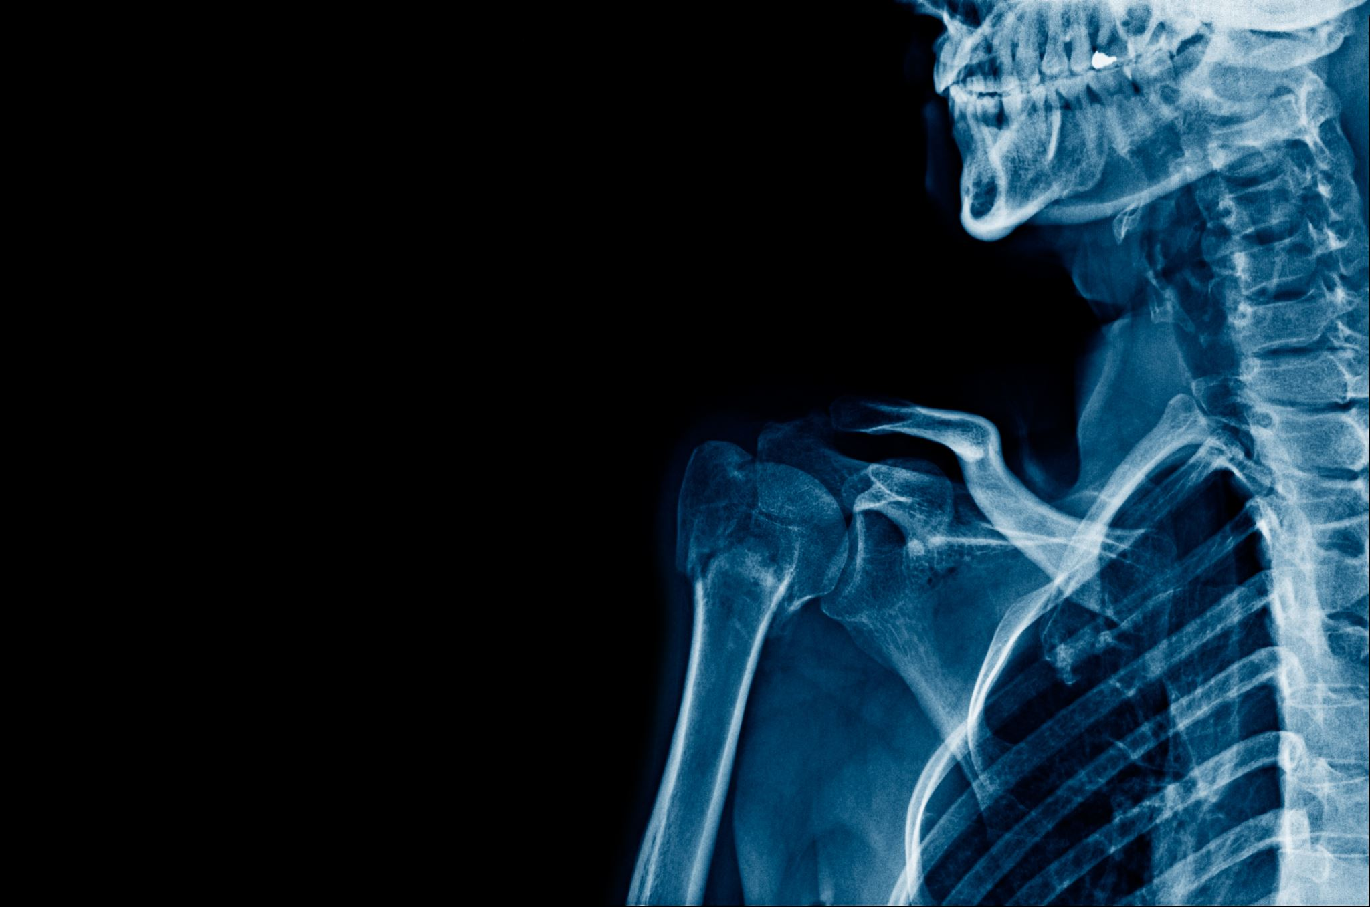
Vocabulary - Traumas
Fracture
Concussion
Sprain
Dislocation
Contusion
Whiplash
Crush injury
Shock
Amputation
Internal bleeding

Slide 8

Example dialogue – Common cold
Patient: Good morning, doctor.
Doctor: Good morning. What brings you in today?
Patient: I’ve been feeling unwell for a few days. I have a sore throat, a runny nose, and a cough.
Doctor: I see. Do you have any other symptoms, like a fever or body aches?
Patient: Yes, I’ve had a mild fever and some body aches, especially in the evenings.
Doctor: It sounds like you might have a common cold. Make sure to drink plenty of fluids, get lots of rest, and you can take over-the-counter medication for your symptoms. If it doesn’t improve in a week, come back to see me.
Patient: Thank you, doctor. I’ll do that.

Slide 9

Role play – Doctors and patients Choose a dialogue and act it out with a partner
Sprained Ankle
Patient: Hello, doctor. I twisted my ankle while playing soccer yesterday, and it’s really swollen.
Food Poisoning
Patient: Hi, doctor. I’ve been having severe stomach cramps and diarrhoea since last night. I think I might have food poisoning.
Seasonal Allergies
Good afternoon, doctor. I’ve been sneezing a lot and my eyes are itchy and watery.
Migraine
Patient: Doctor, I’ve been having severe headaches that last for hours and sometimes make me nauseous.

Slide 10
Now switch roles and try the following
Stomach Ulcer
Patient: Hello, doctor. I’ve been having a burning pain in my stomach for a few weeks now, especially after eating.
Asthma Attack
Patient: Doctor, I’ve been having difficulty breathing and wheezing a lot lately.
High Blood Pressure
Patient: Good morning, doctor. I’ve been feeling dizzy and have headaches frequently.
Anxiety
Patient: Hello, doctor. I’ve been feeling very anxious and it’s affecting my sleep and daily activities.
Back Pain
Patient: Good afternoon, doctor. I’ve been having lower back pain for a few weeks now.

Slide 11
Delayed feedback
tuSpeaking 2024, All rights reserved

