Slide 1

Services
English C1
tuSpeaking 2024, All rights reserved

Slide 2
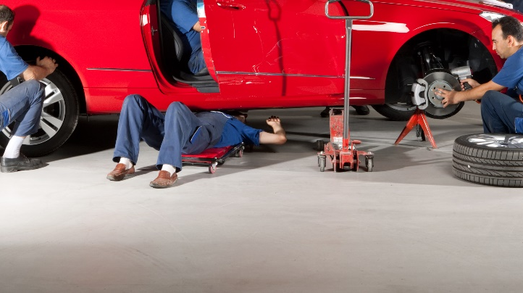
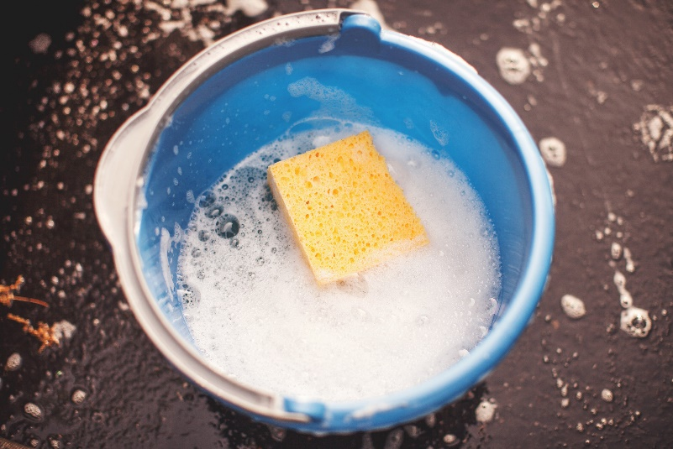
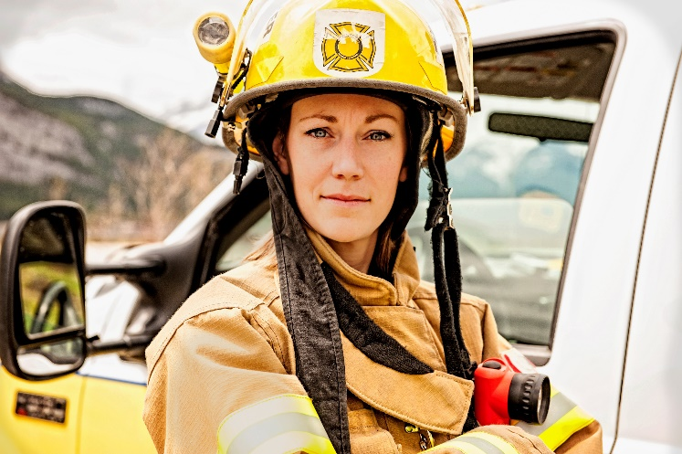
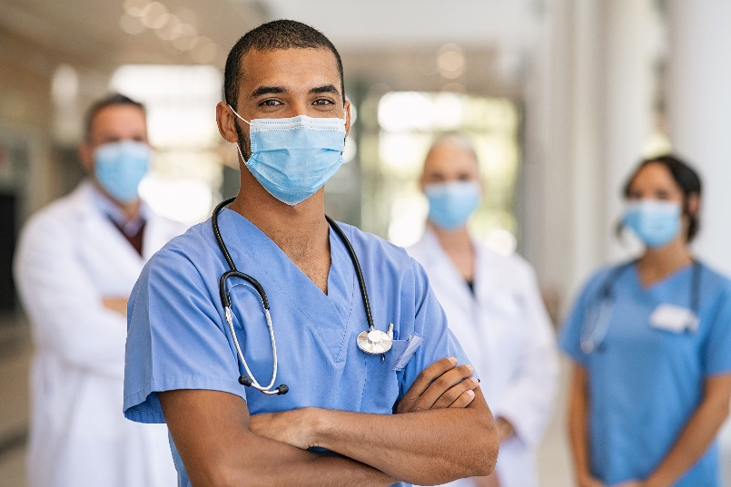
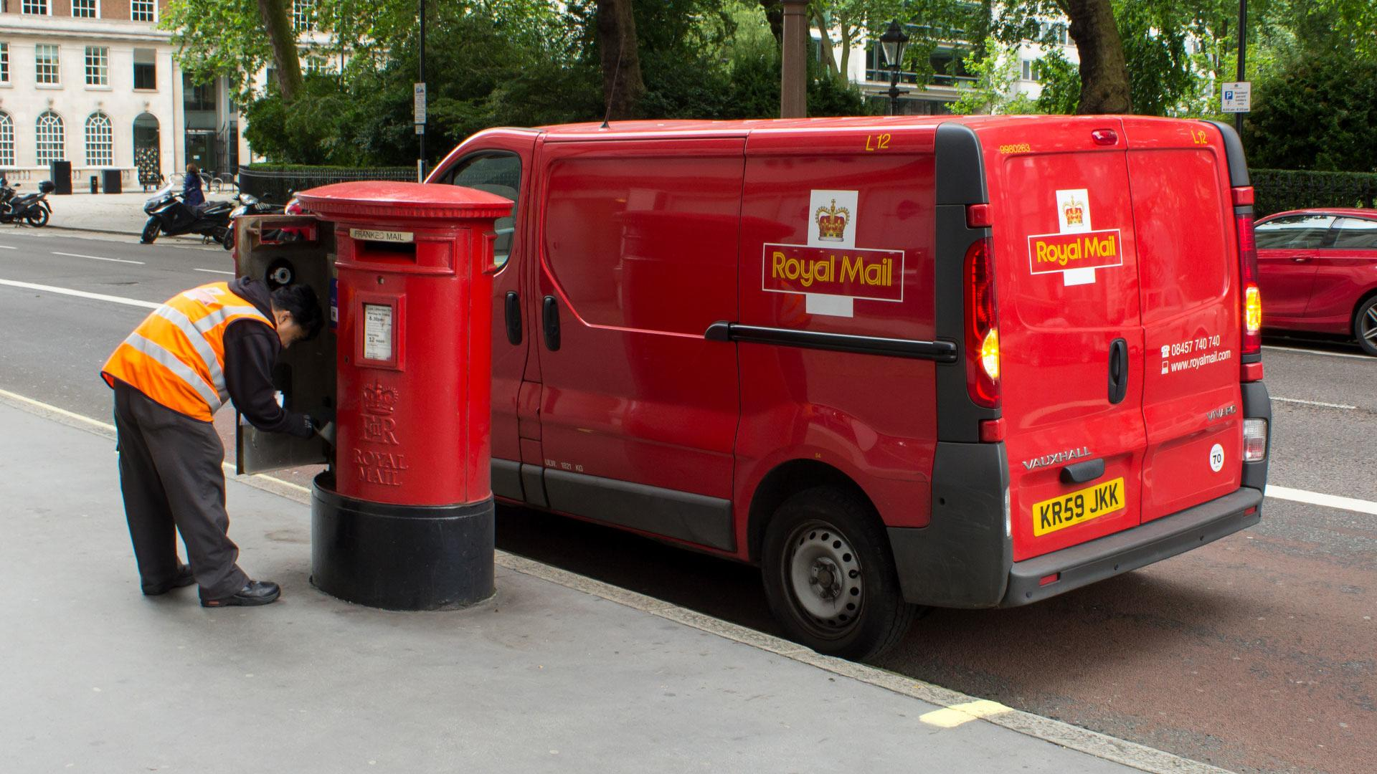
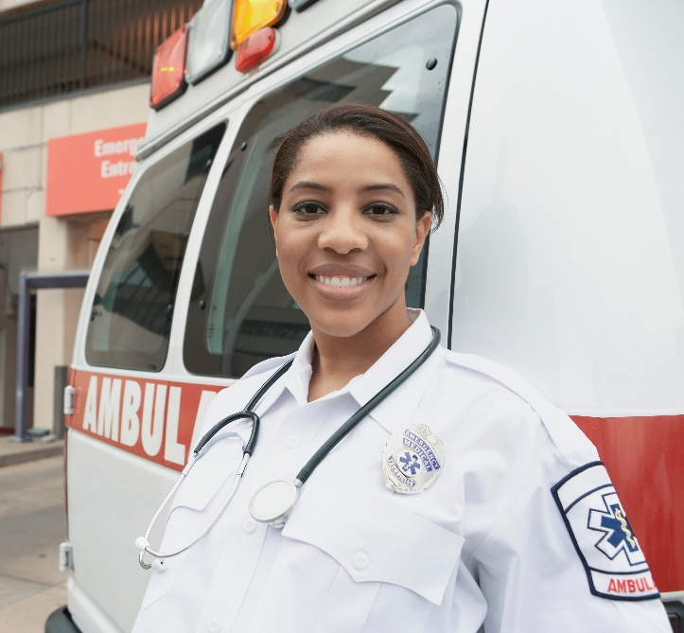
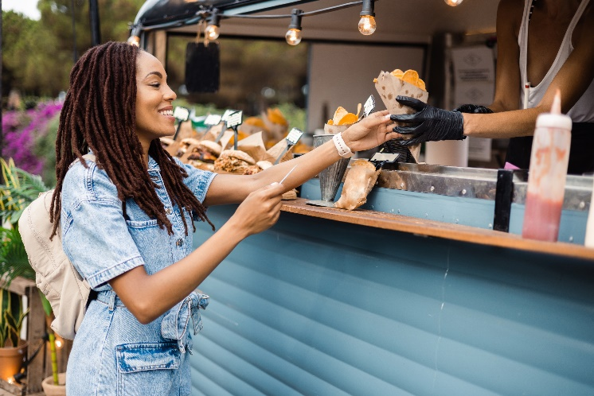
Warm up
How many services have you used today?
This week?
This month?
This year?

Slide 3
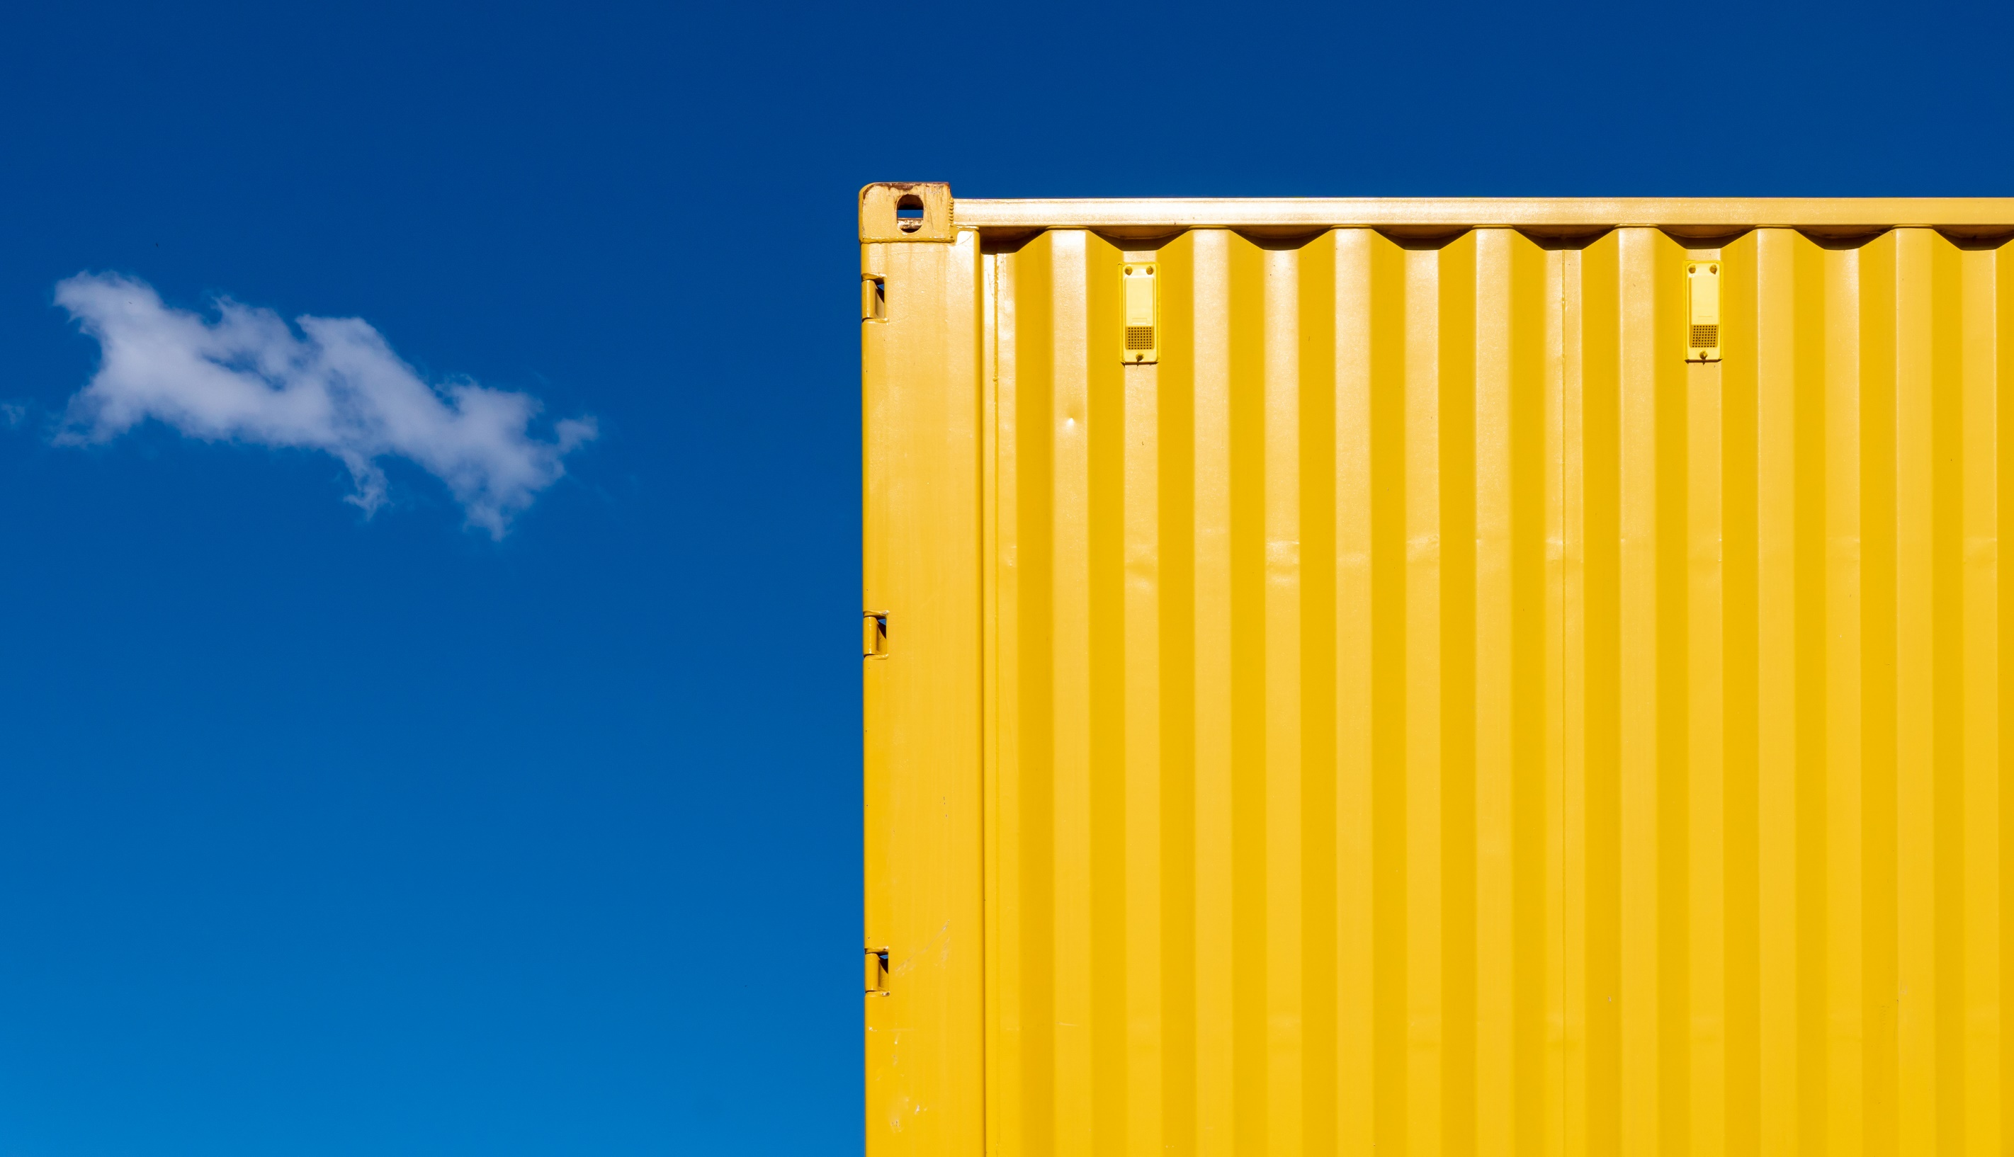
Brainstorm some more examples:
Hotels and Resorts
Restaurants and Cafés
Travel Agencies and Tour Operators
Airlines and Transportation Services
Banks and Financial Institutions
Insurance Services
Hospitals and Clinics
Mental Health and Wellness Services
IT Support and Software Development
Web Design and Cybersecurity
Schools and Universities
Online Learning Platforms
E-commerce and Retail Services
Personal Care and Fitness Services
Real Estate Agencies and Property Management
Legal and Consulting Services
Marketing and Advertising Firms
Entertainment Venues and Amusement Parks
Utilities (Electricity, Gas, Water)
Public Safety and Emergency Services

Slide 4
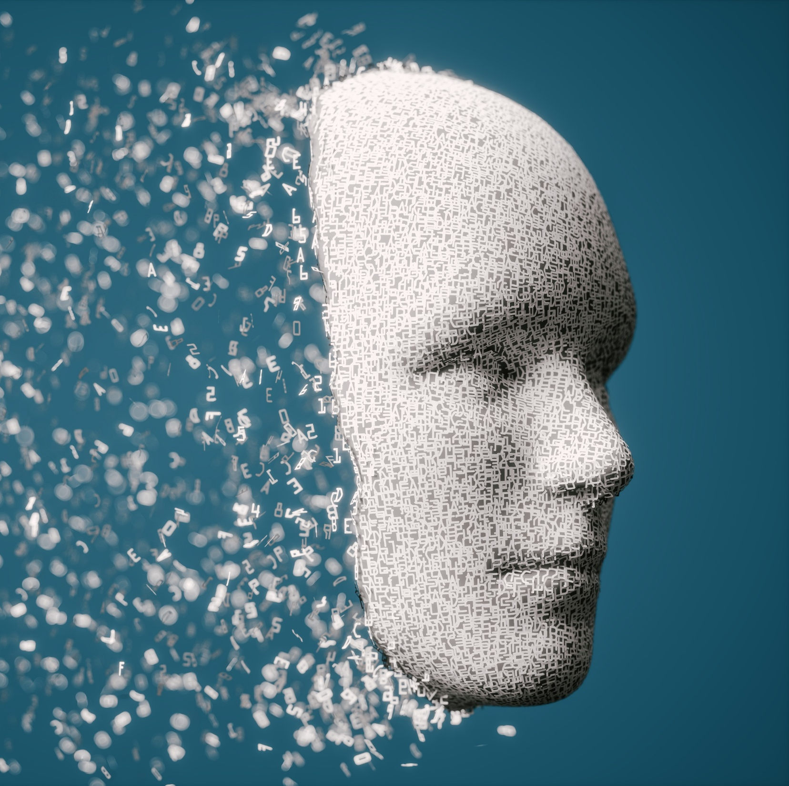
Impersonal Passive Voice
Definition:
The impersonal passive is used to make statements more formal and less direct, often useful in service industry communications.
Structure:
Active: Customers say that the service is excellent.
Passive: It is said that the service is excellent.
Alternative Passive: The service is said to be excellent.

Slide 5
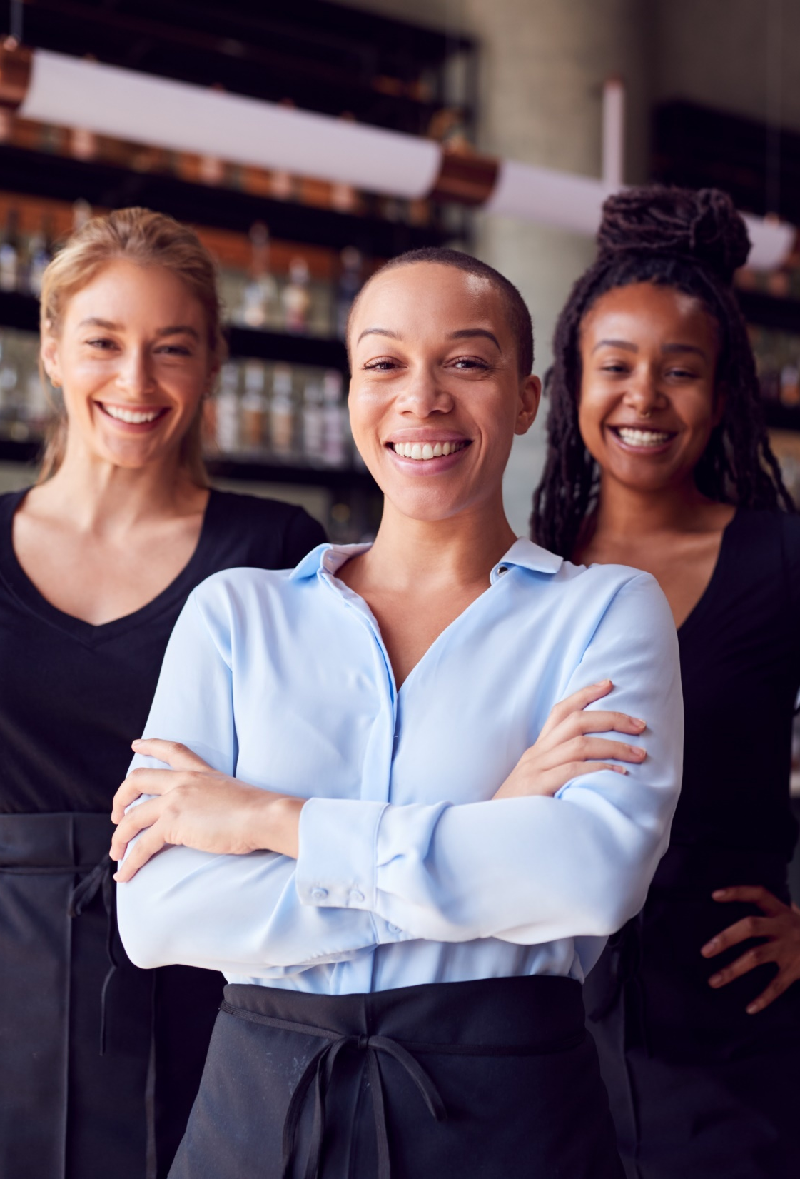
Examples of Impersonal Passive in Services
Example 1:
Active: Customers believe that the hotel is the best in town.
Passive: It is believed that the hotel is the best in town.
Example 2:
Active: Guests report that the restaurant offers great food.
Passive: It is reported that the restaurant offers great food.

Slide 6
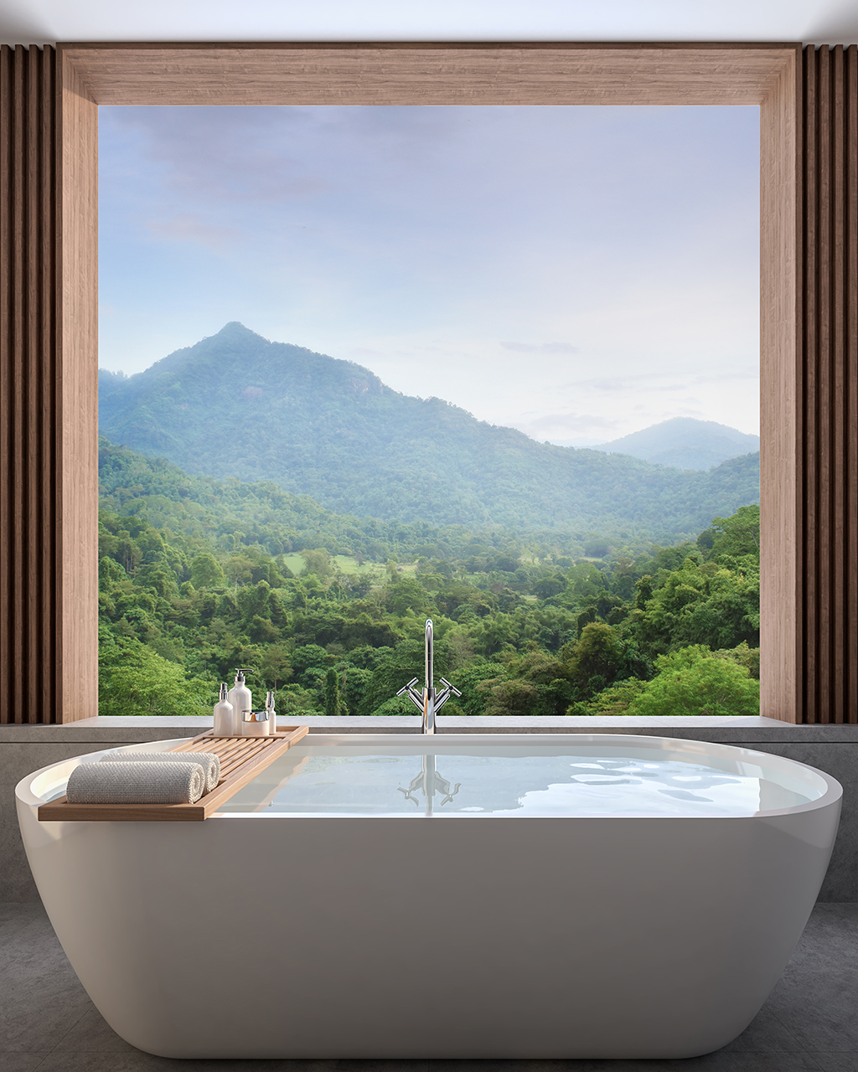
Practice Exercise: Impersonal Passive
Rewrite the sentences using impersonal passive:
Customers think that the new spa is relaxing.
Visitors say that the tour guide is very knowledgeable.
Clients claim that the customer service is exceptional.

Slide 7
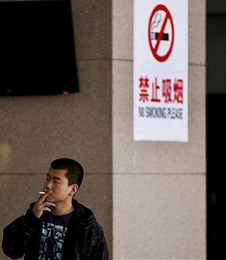
Be Supposed To Be / Not Be Supposed To Be
Definition and Usage:
"Be supposed to be": Indicates an expectation or a general belief, important for setting standards in services.
"Not be supposed to be": Indicates something that is not allowed or not expected, crucial for service policies.
Examples:
Positive: Employees are supposed to be friendly and helpful. (expected behavior)
Negative: Guests are not supposed to smoke in non-smoking areas. (prohibited action)

Slide 8
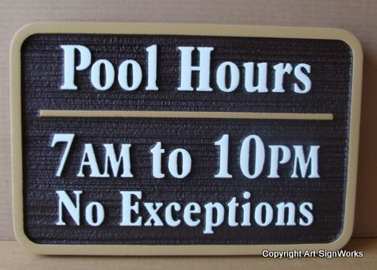
Differentiating Meanings in Service Context
Contextual Examples:
Supposed to (Expectation): The receptionists are supposed to be knowledgeable about local attractions.
Not Supposed to (Prohibition): Hotel staff are not supposed to discuss guest information.
Usage in Sentences:
Positive: The tour is supposed to be very informative.
Negative: Customers are not supposed to use the pool after 10 PM.

Slide 9
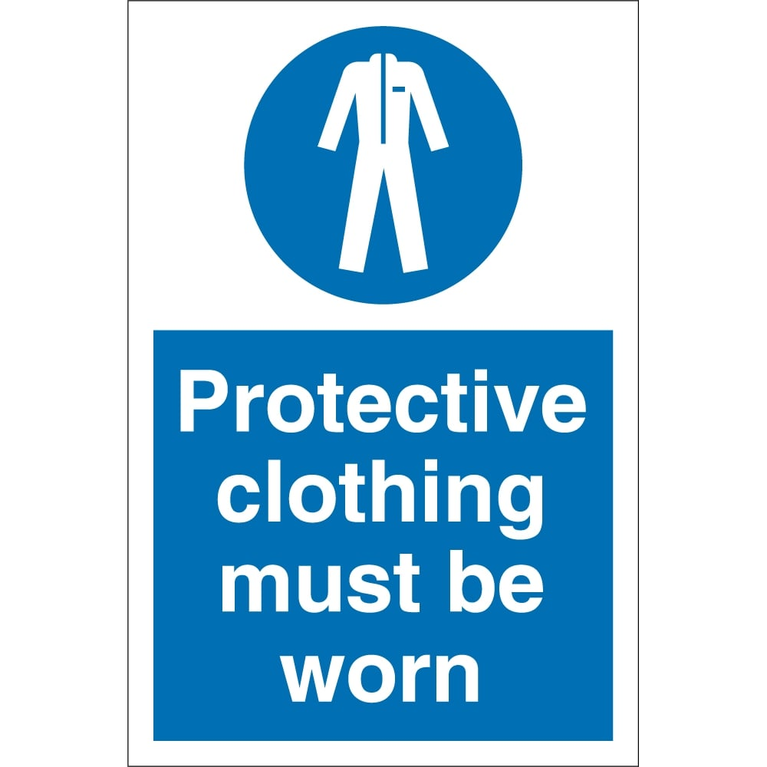
Practice Exercise: Be Supposed To
Complete the sentences with the correct form:
Hotel staff __________ (supposed/not supposed) to be available 24/7 to assist guests.
Tour guides __________ (supposed/not supposed) to provide accurate information about the attractions.
You __________ (supposed/not supposed) to make a reservation in advance for the restaurant.
Customers __________ (supposed/not supposed) to tip the delivery driver for good service.
Employees __________ (supposed/not supposed) to wear uniforms while on duty.
Guests __________ (supposed/not supposed) to smoke in designated areas only.

Slide 10

Suffixes and Modifiers in Describing Services
Common Suffixes to Form Adjectives:
-able: capable of (e.g., reliable service)
-ful: full of (e.g., helpful staff)
-ous: having qualities of (e.g., luxurious experience)
-less: without (e.g., flawless service)
-al: pertaining to (e.g., professional conduct)
-ive: having the nature of (e.g., innovative solutions)

Slide 11

Suffixes and Modifiers in Describing Services
Examples of Suffixes in Services
-able: "The support team is very reliable."
-ful: "She provided helpful information."
-ous: "They offer a luxurious experience."
-less: "The service was flawless."
-al: "The staff demonstrated professional conduct."
-ive: "They are known for their innovative solutions."

Slide 12
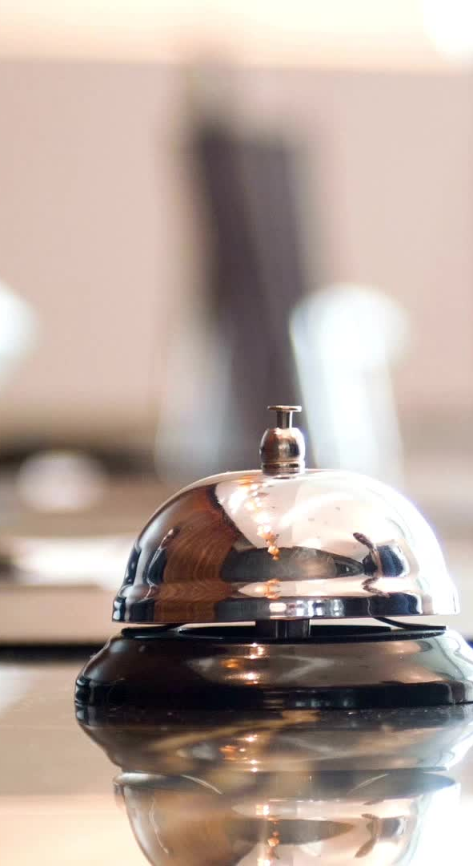
Using Modifiers for Clarity in Services
Examples:
Original: The service was good.
Modified: The concierge service was exceptionally good.
Original: The staff is friendly.
Modified: The hotel staff is extremely friendly and welcoming.

Slide 13
Suffixes and Modifiers
Form adjectives using suffixes:
Comfort -> __________ (able)
Joy -> __________ (ful)
Create -> __________ (ive)
Enhance the sentences with modifiers:
The service was efficient. -> The __________ service was __________ efficient.
The hotel is clean. -> The __________ hotel is __________ clean.

Slide 14
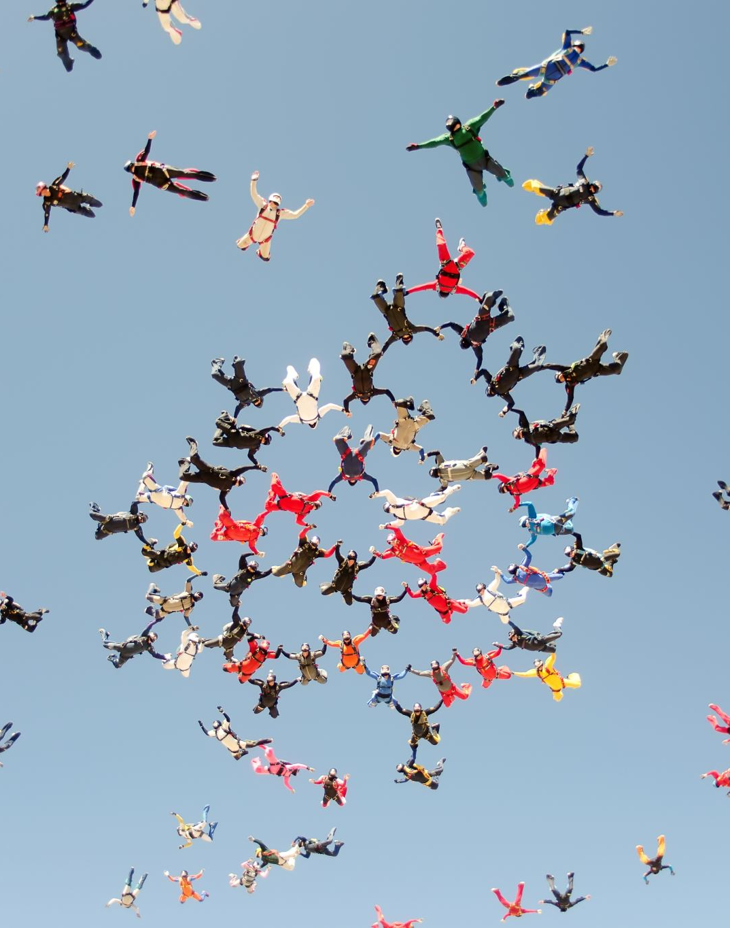
Freer practice
Role play calling customer service for an imaginary service you have received. Use modifiers, adjectives, the impersonal passive and, ‘be supposed to’.
Hint
It might be easier to complain about the services:
Example; It is said that the service at the hotel is unreliable, and the staff are not supposed to be unhelpful or rude, yet we encountered several unprofessional employees who were surprisingly dismissive of our needs.

Slide 15
Delayed feedback
tuSpeaking 2024, All rights reserved

