Slide 1

Education
English C1
tuSpeaking 2024, All rights reserved

Slide 2
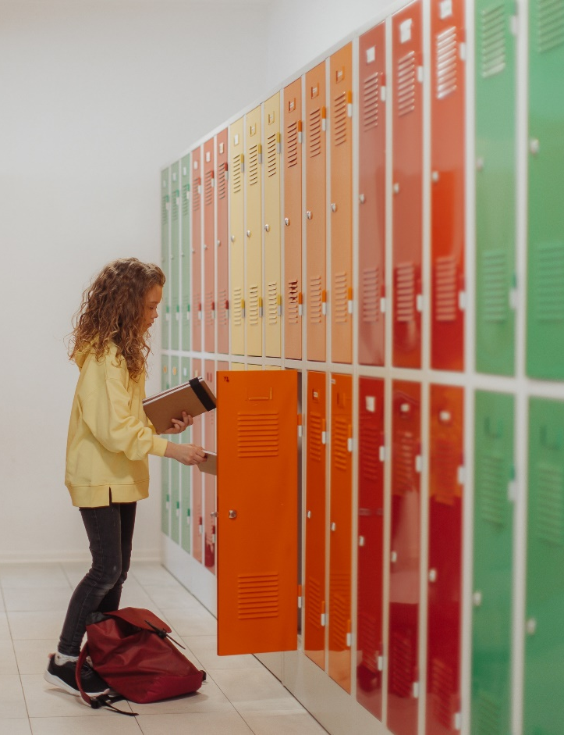
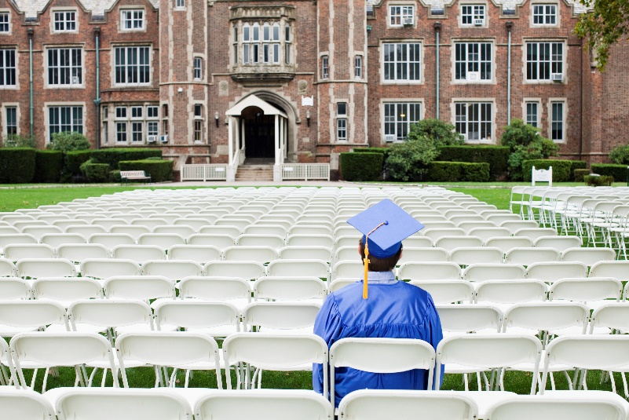
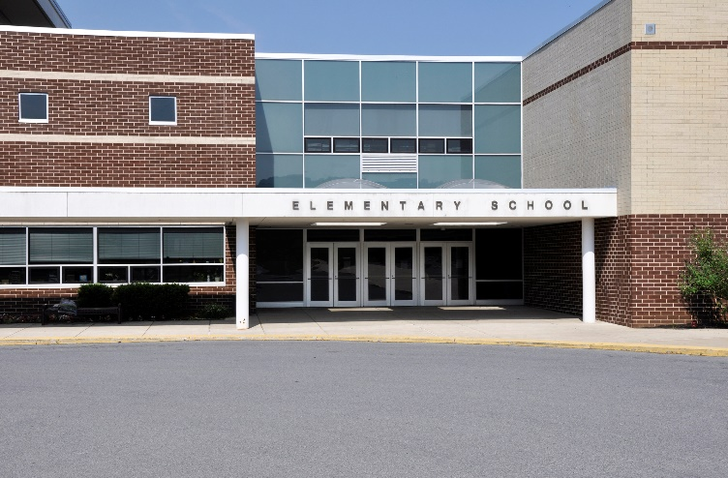
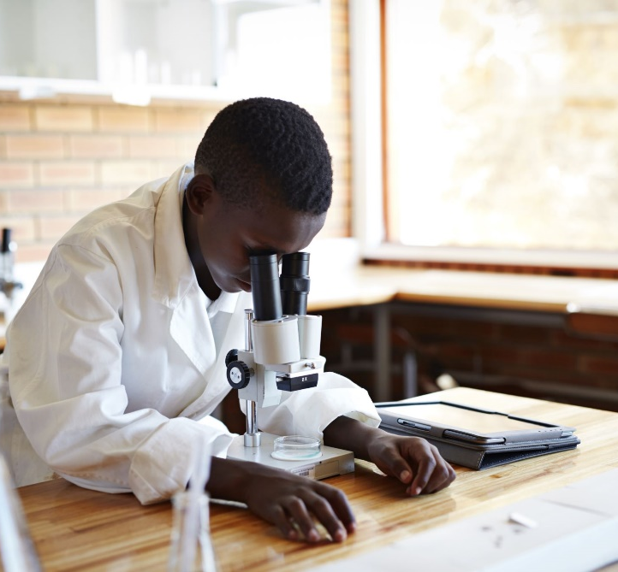

Warm up
Which educational buildings can you see here?
Which did you go to?
Do they all exist in your country or are there different systems too?
Clockwise from top left: Middle school, university, primary school, college, high school.

Slide 3
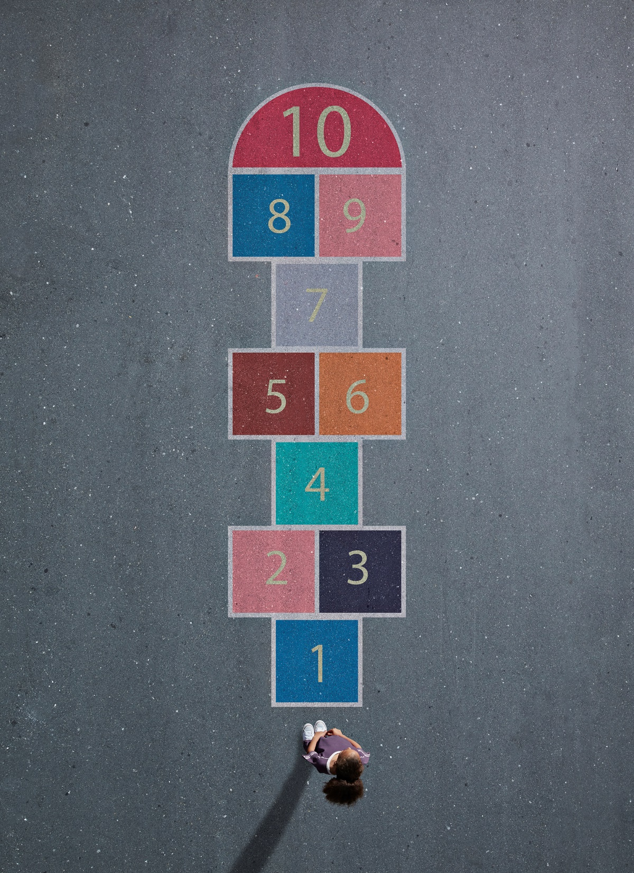
Common Quantitative Expressions
Countable Nouns:
Many: Used with plural countable nouns.
Example: There are many students in the classroom.
A few: Used with plural countable nouns to indicate a small number.
Example: A few teachers attended the meeting.
Several: Used with plural countable nouns to indicate more than two but not many.
Example: Several books were borrowed from the library.

Slide 4

Common Quantitative Expressions
Uncountable Nouns:
Much: Used with uncountable nouns.
Example: She doesn’t have much homework today.
A little: Used with uncountable nouns to indicate a small amount.
Example: There is a little milk in the fridge.

Slide 5

Common Quantitative Expressions
Both Countable and Uncountable Nouns:
A lot of: Used with both countable and uncountable nouns.
Example: There are a lot of students in the hall. / There is a lot of information in the report.
Key Points:
Many and a few are used for things you can count (e.g., books, students).
Much and a little are used for things you cannot count (e.g., milk, homework).
A lot of can be used for both countable and uncountable nouns.

Slide 6

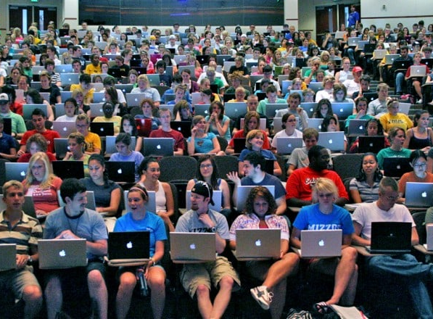
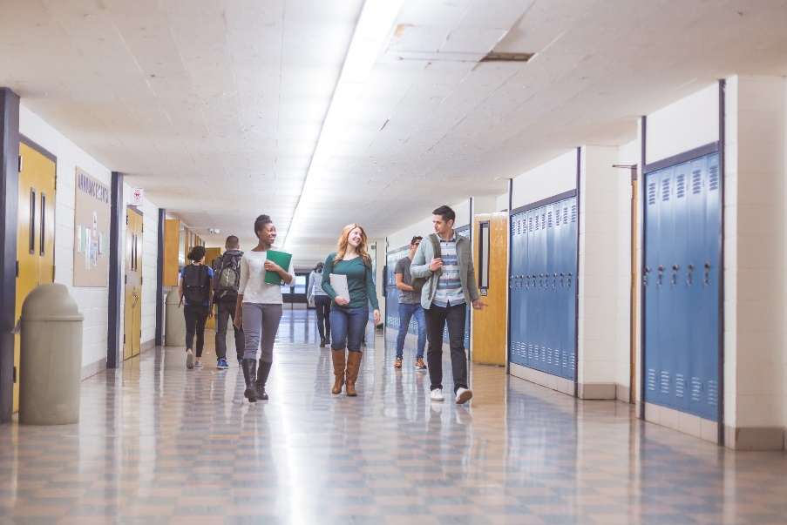
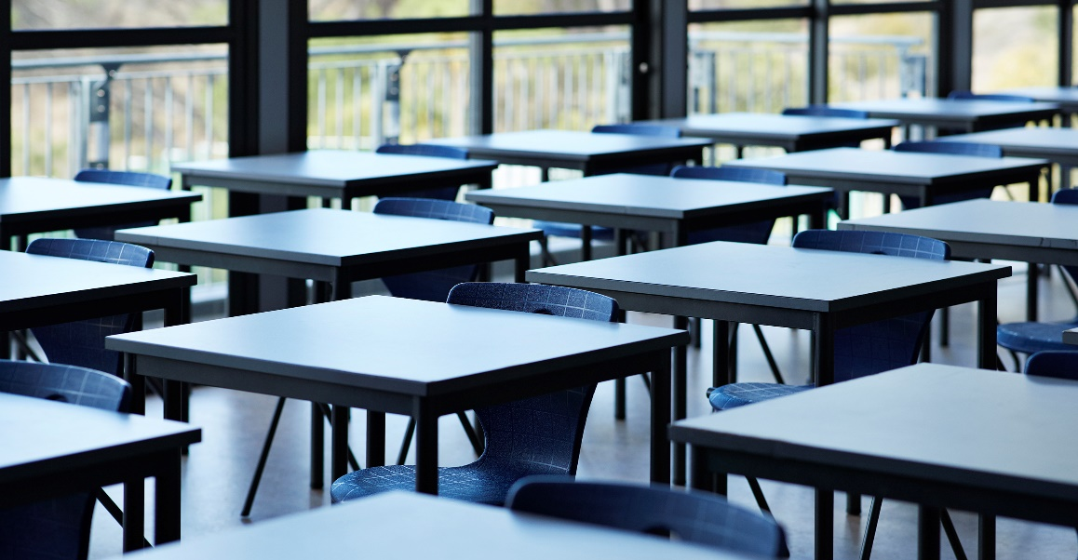



Describe the images using quantitative expressions

Slide 7

Examples in Context:
There are many classrooms in the new school building.
He borrowed a few books from the library.
She doesn't have much time to study today.
We need a little help with the project.
There is a lot of equipment in the science lab.

Slide 8
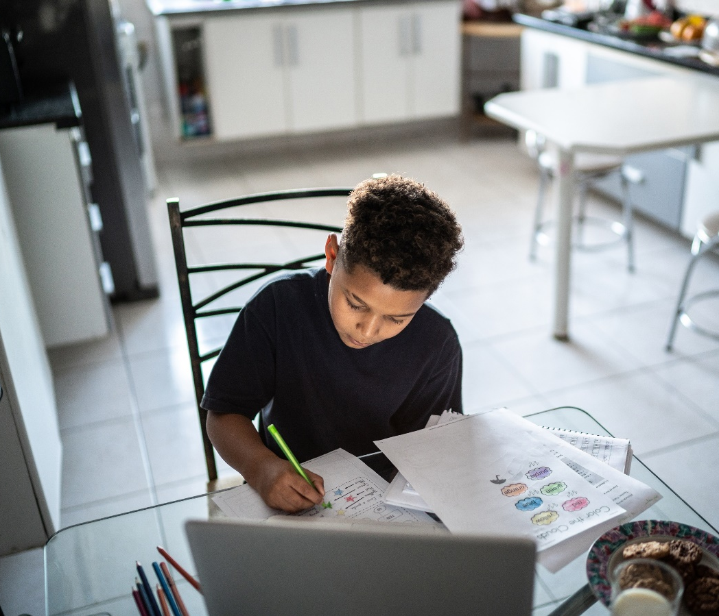
Read each sentence and choose the correct quantitative expression from the options given.
There are _______ chairs in the room.
Options: (a) many (b) much (c) a lot of
He has _______ patience when teaching children.
Options: (a) many (b) a few (c) a lot of
She doesn't have _______ free time during the week.
Options: (a) many (b) much (c) several
We need _______ apples for the recipe.
Options: (a) a little (b) a few (c) much
There is _______ homework for tonight.
Options: (a) many (b) a lot of (c) several

Slide 9
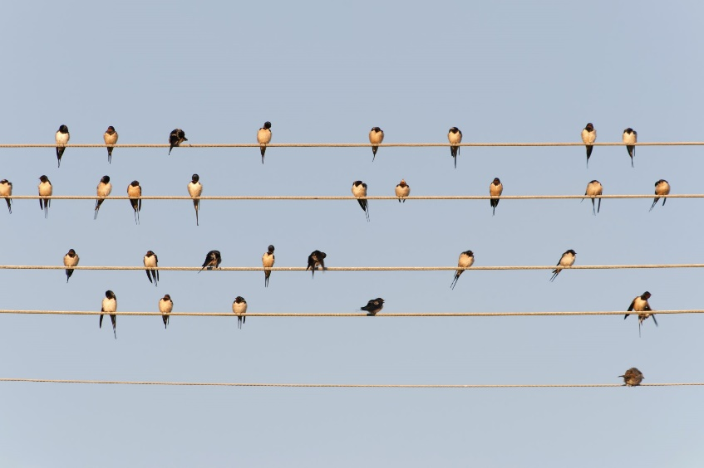
Read each sentence and choose the correct quantitative expression from the options given.
He found _______ books on the topic in the library.
Options: (a) a few (b) much (c) a little
I have _______ questions about the assignment.
Options: (a) much (b) a little (c) several
There isn't _______ milk left in the fridge.
Options: (a) many (b) much (c) several
We saw _______ different birds in the park.
Options: (a) many (b) much (c) a little
The professor gave us _______ advice on our projects.
Options: (a) several (b) a few (c) a lot of

Slide 10

Distinguishing Gendered Nouns in Education
Gendered nouns are specific to male or female individuals, while non-gendered nouns can refer to any gender.
Common Gendered Nouns:
Teacher (neutral)
Headmaster / Headmistress
Actor / Actress
Freshman / Freshwoman
Examples:
The headmaster welcomed the new students.
The actress performed in the school play.

Slide 11

Non gendered nouns
Teacher:
Example: The teacher explained the lesson clearly.
Student:
Example: The student asked a lot of questions.
Principal:
Example: The principal introduced the new policy.
Police Officer:
Example: The police officer visited the school to talk about safety.
Doctor:
Example: The doctor gave a lecture on health.
Use the singular they as a pronoun for non-gendered nouns if you don’t know the person's gender.
The student asked many questions during the lecture. They were very engaged.
The teacher assigned homework to all the students. They made sure everyone understood the instructions.

Slide 12

Articles
Key Points:
Definite Article The: Refers to a specific item known to the speaker and listener.
Indefinite Articles A and An: Refer to any member of a group of similar items.
Zero Article: Used for general statements and with certain proper nouns.

Slide 13

Practice
Sentence: _______ teacher explained the lesson clearly.
Sentence: She needs _______ book for her history class.
Sentence: _______ information is essential for the report.
Sentence: They visited _______ Eiffel Tower.
Sentence: He had _______ idea about the project.
Sentence: She brought _______ apple for lunch.
Sentence: _______ students in the class were very attentive.
Sentence: He was _______ first to submit the assignment.
Sentence: She enjoys studying _______ history.
Sentence: They had _______ meeting about the new curriculum.

Slide 14
Discussion questions
What do you think about the education system in your country?
How does the teacher in your favorite class help you learn better?
What are the most important changes you think the government should make in the education sector?
Can you tell me about a memorable experience you had at school?
Do you have a favorite subject? Why is it your favourite?
Describe an important lesson you learned from a teacher.
What subjects are you most interested in and why?
How do you think technology influences education today?
Do you prefer studying in the morning or at night? Why?
Can you share an interesting project you worked on in the past?
How do students in your country typically prepare for exams?
What is the role of a principal in a school?

Slide 15
Delayed feedback
tuSpeaking 2024, All rights reserved

