Slide 1

Shopping and commercial skills
English C1
tuSpeaking 2024, All rights reserved

Slide 2





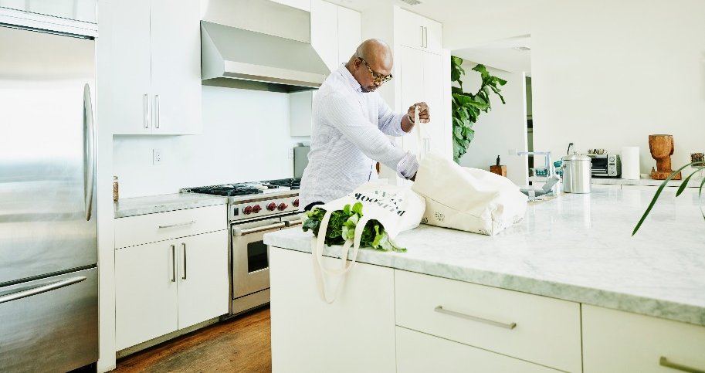
Warm up - Where do you do your shopping?

Slide 3

The passive voice
The passive voice is used when the focus is on the action or the object of the action rather than who or what is performing the action.
The passive voice is formed with the verb to be + past participle (e.g., is made, was bought).
Example: During Covid, a lot of toilet paper was bought.

Slide 4
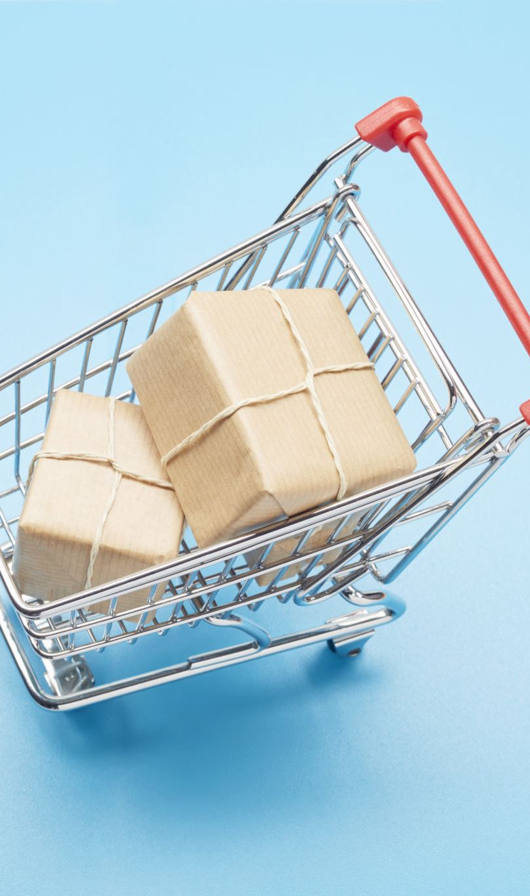
More examples
Present Simple: The store is cleaned every day.
Past Simple: The sale was announced yesterday.
Future Simple: A new branch will be opened next month.
Present Perfect: The product has been delivered.

Slide 5

Why Use Passive Voice?
The passive voice is often used in shopping and commercial contexts to emphasize the product or service rather than the doer.
Example: Complaints are handled by customer service.

Slide 6

Practice
Convert these active sentences to passive:
Active: They opened a new store.
Active: The company offers discounts.
Active: They will deliver the package tomorrow.
Active: The cashier has counted the money.

Slide 7
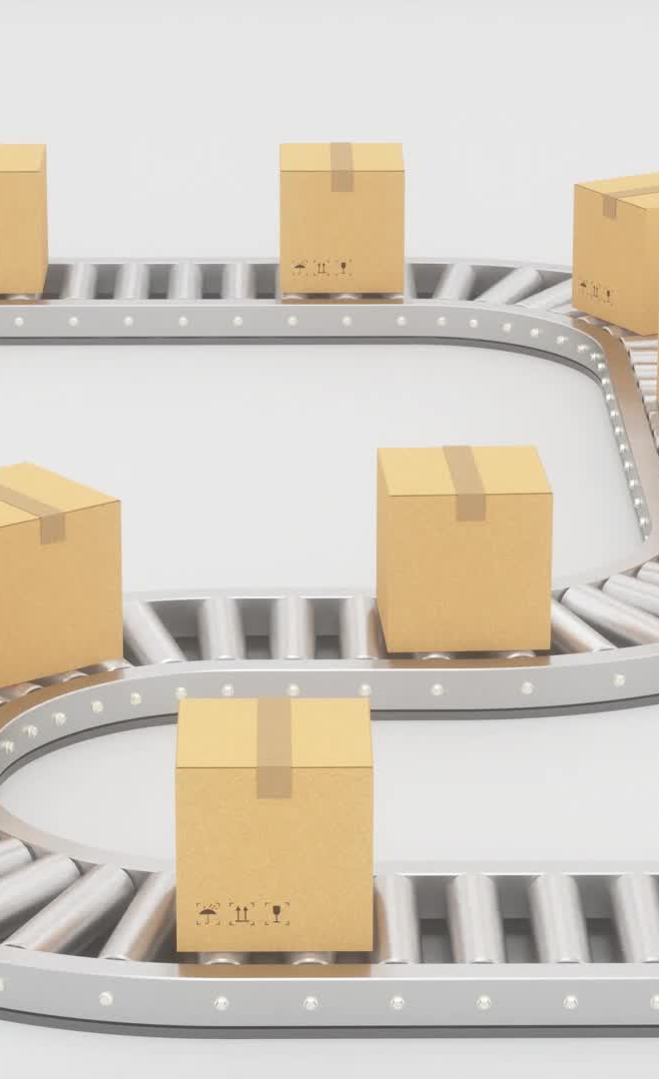
Answers
Active: They opened a new store. → Passive: A new store was opened.
Active: The company offers discounts. → Passive: Discounts are offered.
Active: They will deliver the package tomorrow. → Passive: The package will be delivered tomorrow.
Active: The cashier has counted the money. → Passive: The money has been counted.

Slide 8

Role play – Ask and answer questions, try to respond with the passive
Examples:
Present Simple: How often is the store cleaned?
Example: The store is cleaned daily.
Past Simple: What happened at the grand opening?
Example: The grand opening was attended by many people.
Future Simple: What will happen next month?
Example: A new clothing line will be launched next month.
Present Perfect: What has been done to improve the shopping experience?
Example: New customer service desks have been installed.

Slide 9
Introduction to Be Supposed To:
Be supposed to is used to talk about expectations, obligations, or what is generally believed to be the correct way to do something.
Form: Be supposed to is followed by the base form of the verb (e.g., is supposed to, are supposed to, was supposed to).
Examples Related to Shopping:
Present: Customers are supposed to keep their receipts.
Past: The store was supposed to open at 9 AM.
Future: The sale is supposed to end next week.

Slide 10
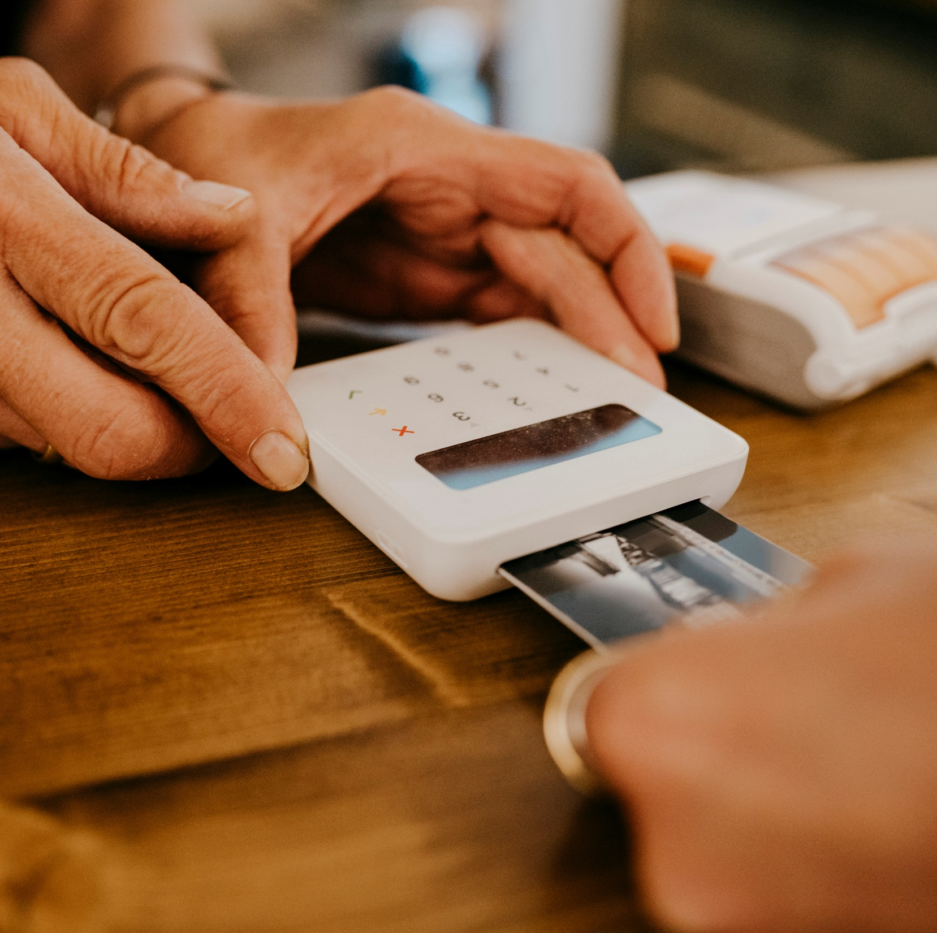
Usage in Different Contexts:
Rules and Regulations: You are supposed to show your ID when using a credit card.
Expectations: Employees are supposed to arrive on time.
General Beliefs: This brand is supposed to be very high-quality.

Slide 11

Exercise: Fill-in-the-Blank Sentences
Examples:
You ________ (be supposed to) compare prices before buying.
The store ________ (be supposed to) close at 8 PM.
We ________ (be supposed to) receive the shipment yesterday.
They ________ (be supposed to) announce the new collection next week.

Slide 12

Answers
You ________ (be supposed to) compare prices before buying.
Answer: You are supposed to compare prices before buying.
The store ________ (be supposed to) close at 8 PM.
Answer: The store is supposed to close at 8 PM.
We ________ (be supposed to) receive the shipment yesterday.
Answer: We were supposed to receive the shipment yesterday.
They ________ (be supposed to) announce the new collection next week.
Answer: They are supposed to announce the new collection next week.

Slide 13
Role-play: Discussing Shopping Scenarios Task: Pairs create and practise their dialogues.
Returning an Item:
Example Dialogue:
A: I'm supposed to bring the receipt when returning an item.
B: Yes, and we are supposed to return it within 30 days of purchase.
Using a Gift Card:
Example Dialogue:
A: Are we supposed to activate the gift card before using it?
B: No, it’s supposed to be ready to use immediately after purchase.
Shopping During a Sale:
Example Dialogue:
A: We are supposed to get an additional discount with this coupon.
B: Yes, but we are also supposed to check the expiration date first.
Customer Service Inquiry:
Example Dialogue:
A: What am I supposed to do if I have a complaint?
B: You are supposed to speak with the customer service representative.

Slide 14
Delayed feedback
tuSpeaking 2024, All rights reserved

