Slide 1

Free time and entertainment
English C1
tuSpeaking 2024. All rights reserved.

Slide 2

Warm-Up Activity Word Association
Take turns to say a word related to one of the words below (groups), or, write as many words as you can related to the words below in 3-5 minutes (one to one).
Music
Travel
Sports
Art
Celebration

Slide 3

Example
Given Word: "Music"
Associations: concert, instruments, dance, rhythm, melody, performance, band, songwriting, lyrics, recording, etc.

Slide 4

Vocabulary Building Introducing word formation: Suffixes
Noun to adjective:
Add "-able" to "comfort" to create "comfortable"
Verb to noun:
Add "-ment" to "develop" to create "development“
Can you think of more word formations?

Slide 5
Suffixes
Base Word | Adjective Form | Verb Form | Adverb Form | Base Word
Comfort | Comfortable | Comfort | Comfortably | Comfort
Develop | Developmental | Develop | Developmentally | Develop
Ambition | Ambitious | Ambition | Ambitiously | Ambition
Create | Creative | Create | Creatively | Create
Perform | Performative | Perform | Performatively | Perform
Nature | Natural | Nature | Naturally | Nature
Limit | Limited | Limit | Limitedly | Limit
Help | Helpful | Help | Helpfully | Help
Nation | National | Nation | Nationally | Nation
Decide | Decisive | Decide | Decisively | Decide

Slide 6

Vocabulary Building Introducing word formation: Prefixes
Noun to adjective:
Add “mis" to “understand" to create “misunderstand”
Verb to noun:
Add “dis" to “respect" to create "disrespect”
Can you think of more word formations?

Slide 7
Prefixes
Base Word | Prefix + Adjective Form | Prefix + Verb Form | Prefix + Noun Form | Prefix + Adverb Form
Understand | Misunderstood | Misunderstand | Misunderstanding | Misunderstandingly
Direct | Indirect | Redirect | Indirection | Indirectly
Respect | Disrespectful | Disrespect | Disrespect | Disrespectfully
Connect | Disconnect | Disconnect | Disconnection | Disconnectedly
Achieve | Overachieving | Overachieve | Overachievement | Overachievably
Lead | Mislead | Mislead | Misleading | Misleadingly
Guide | Unguided | Misguide | Misguidance | Misguidedly
Believe | Disbelieve | Disbelieve | Disbelief | Disbelievingly
Respect | Irresponsible | Disrespect | Irresponsibility | Irresponsibly
Depend | Independent | Depend | Independence | Independently

Slide 8
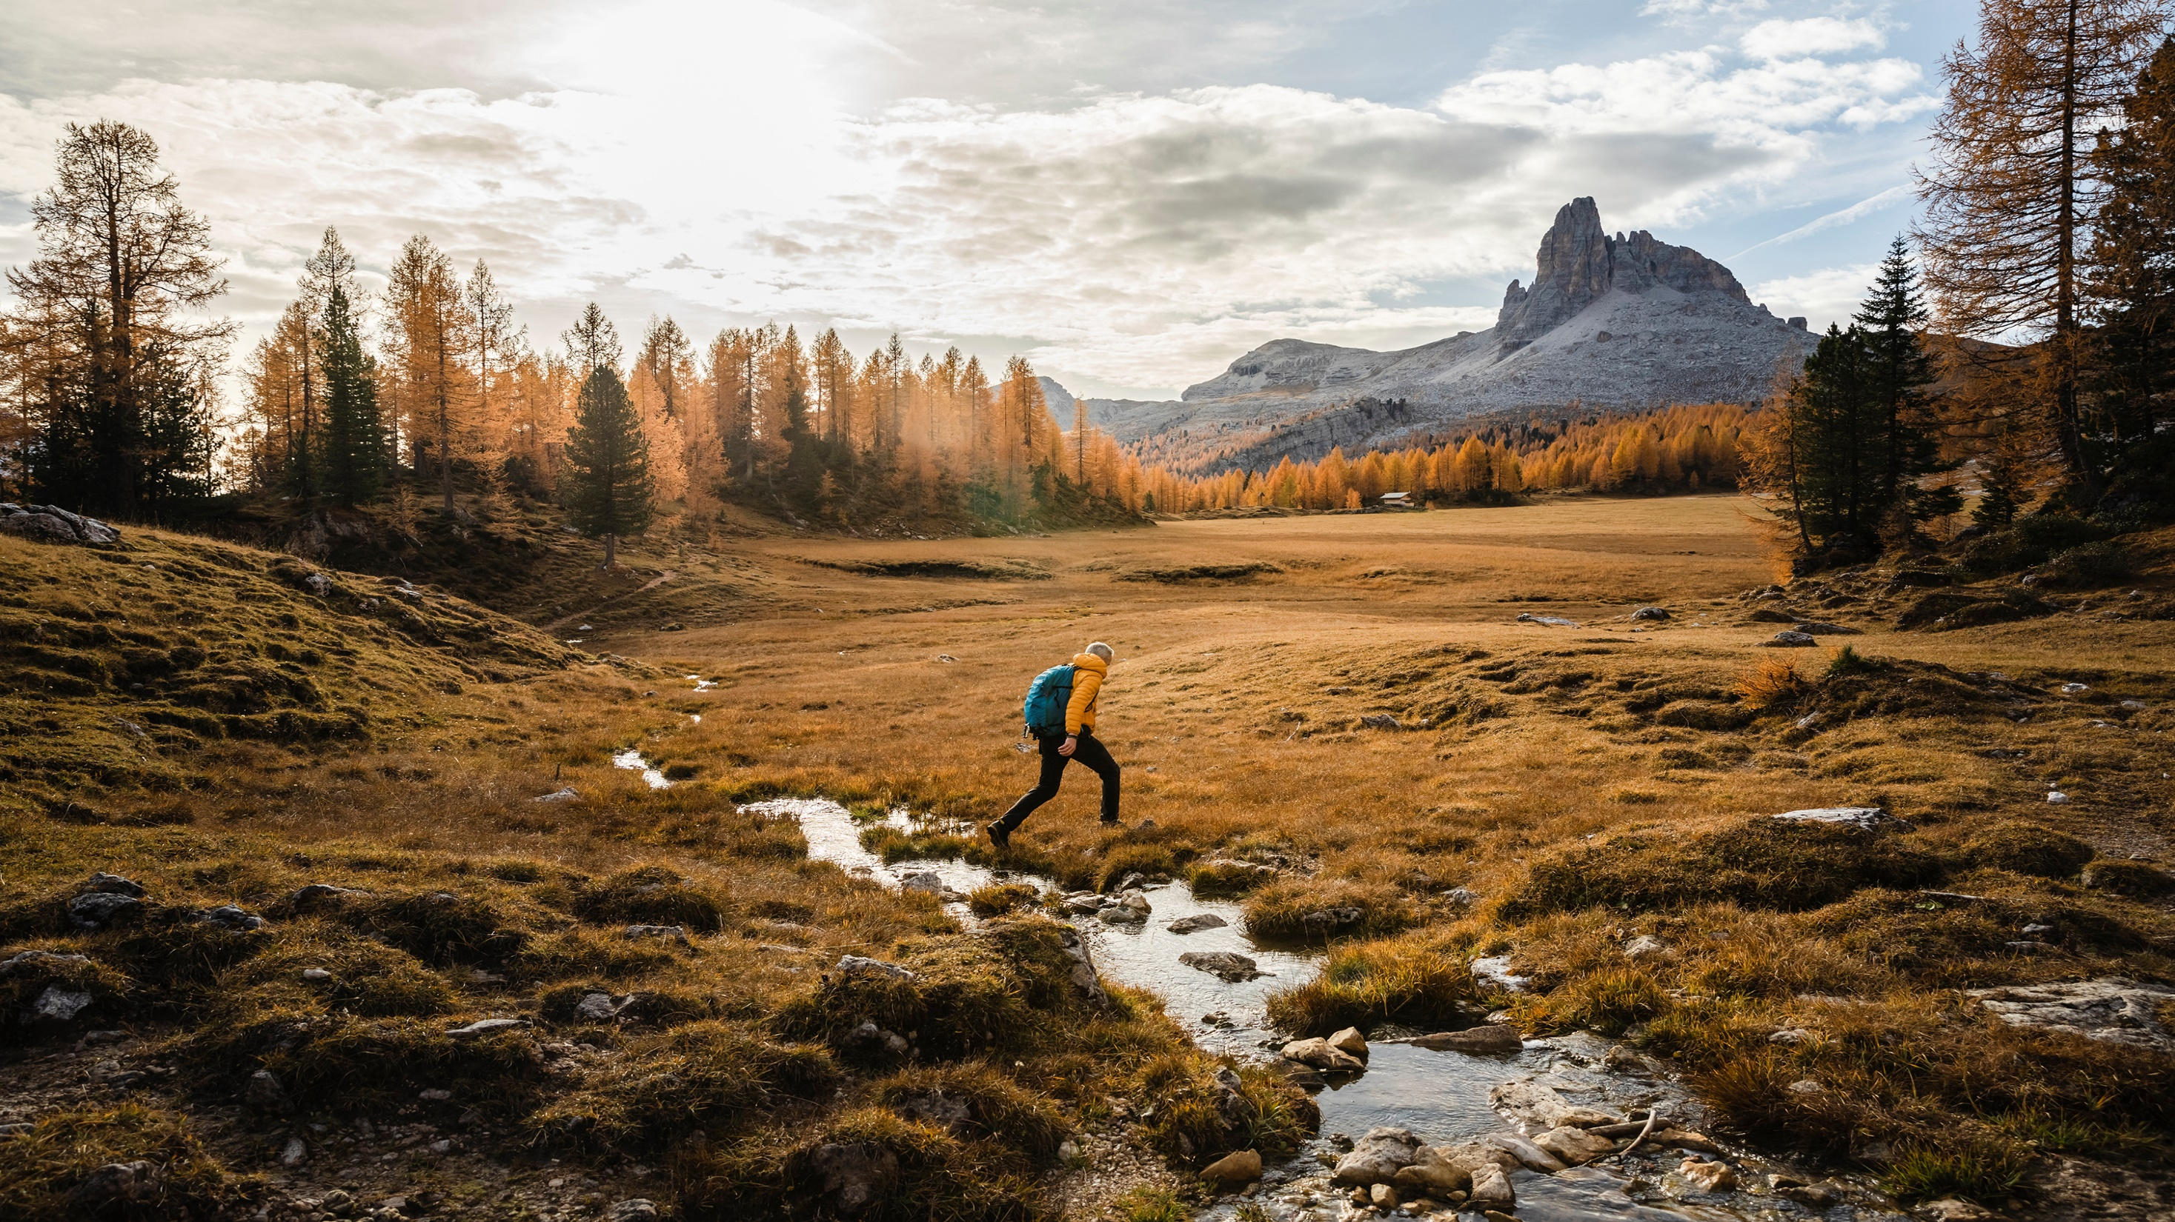
Grammar – Collocations
Collocations are combinations of words that frequently appear together and have become natural pairings in a language.
Go for: This collocation is often used with various leisure activities, indicating participation or engagement. For example:
"Go for a walk"
"Go for a swim"
"Go for a run"
"Go for a hike"
Play: This verb is commonly used with sports, games, and musical instruments. For example:
"Play soccer/football/basketball/tennis"
"Play chess/cards/video games"
"Play the guitar/piano/violin"
Attend: This verb is used with events, classes, or gatherings. For example:
"Attend a concert/festival/party"
"Attend a lecture/seminar/workshop"
"Attend a dance class/yoga session"
Take up: This collocation indicates starting a new activity or hobby. For example:
"Take up painting/drawing/photography"
"Take up knitting/crocheting/sewing"
"Take up gardening/cooking/baking"

Slide 9
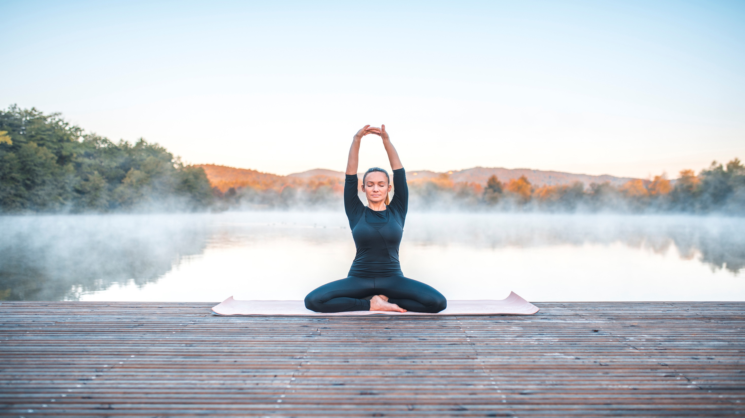
Collocations continued
Enjoy: This verb is used to express pleasure or satisfaction from an activity or hobby. For example:
"Enjoy a good book/movie"
"Enjoy gardening/cooking/baking"
"Enjoy outdoor activities/adventures"
Practice: This verb is used with skills or hobbies that require regular repetition and improvement. For example:
"Practice yoga/meditation/mindfulness"
"Practice playing an instrument/sport"
"Practice drawing/painting/writing"
Explore: This verb is used to describe the process of discovering or experiencing new activities or places. For example:
"Explore nature/parks/trails"
"Explore museums/galleries/exhibitions"
"Explore different cuisines/restaurants/cafes"

Slide 10

Making plans
Let’s….
Example: "Let's go to the movies tonight.”
How about….
Example: “How about going for a picnic this weekend?”
Why don't we….
Example: “Why don't we try that new restaurant downtown?”
We could…..
Example: “We could meet at the park for a game of soccer.”

Slide 11

Making plans
Shall we….
Example: “Shall we go hiking this Saturday?”
What about….
Example: “What about going to the beach tomorrow afternoon?”
Do you fancy…..
Example: “Do you fancy grabbing coffee after class?”
I was thinking we could….
Example: “I was thinking we could visit the art museum this weekend.”

Slide 12
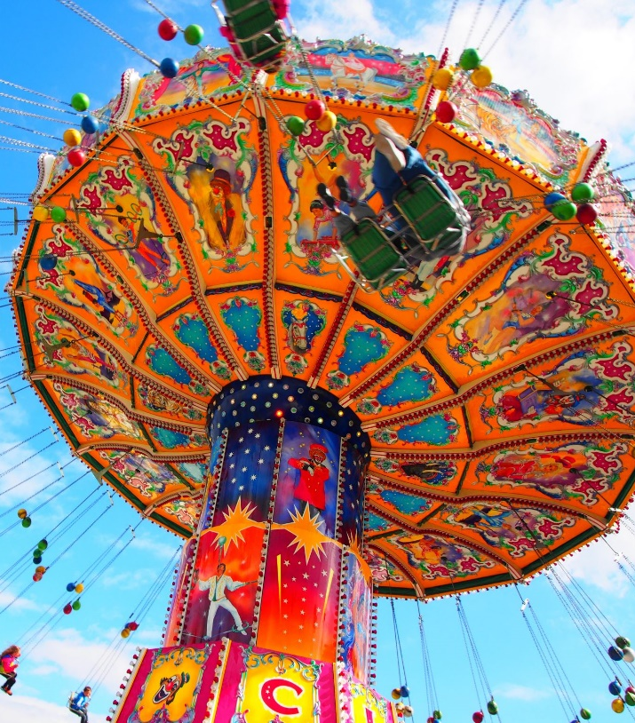
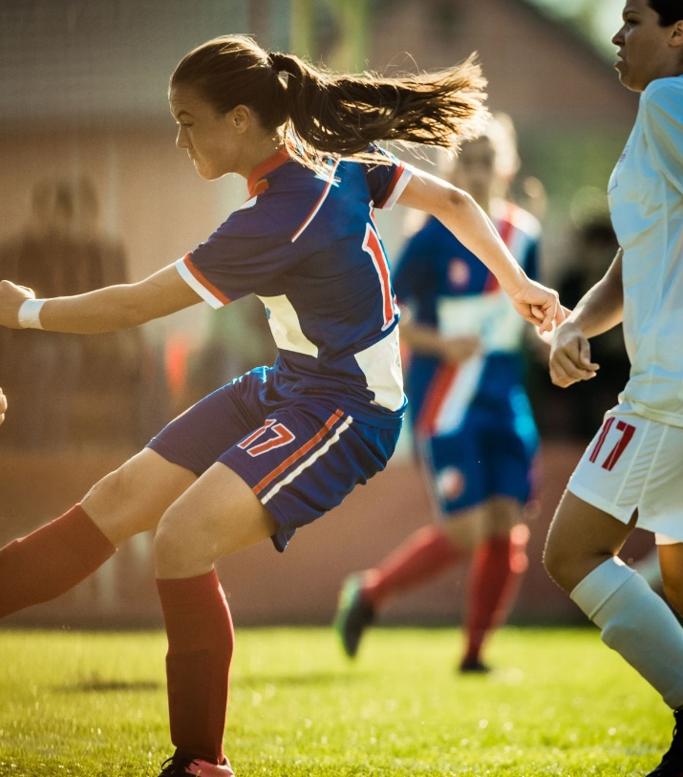
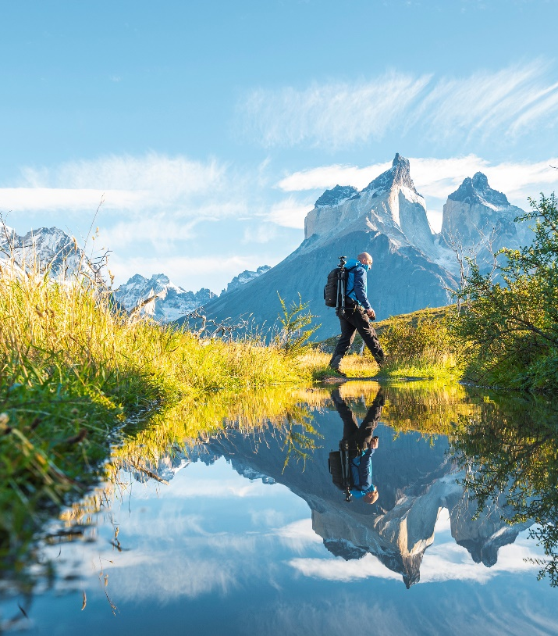
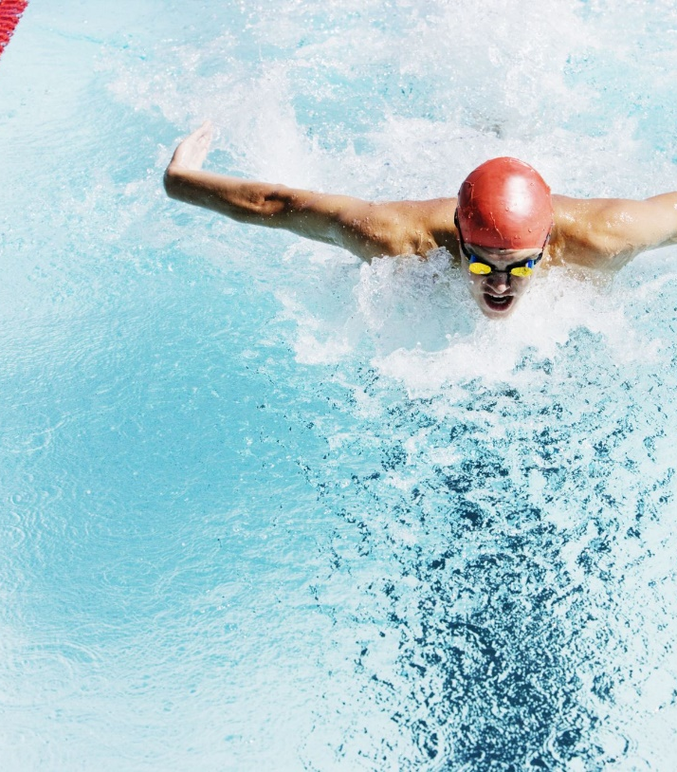
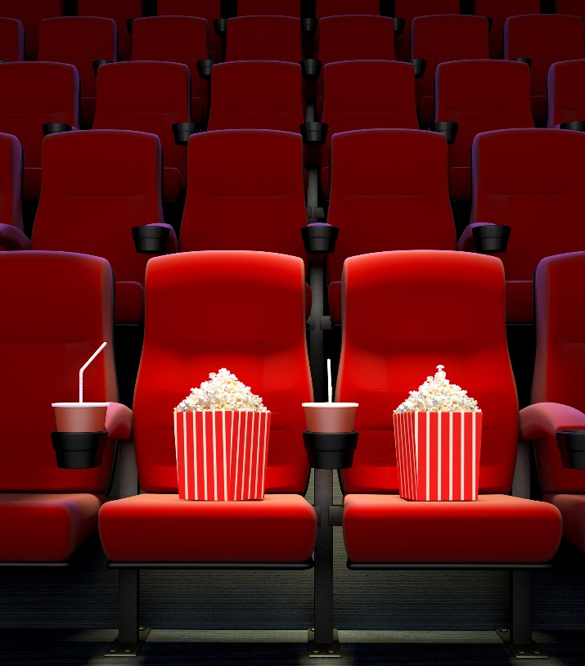

Practice
Make plans to do something soon.
Why don’t we……..?

Slide 13

Delayed feedback

