Slide 1

Food
English C1
TuSpeaking, 2024, all rights reserved

Slide 2
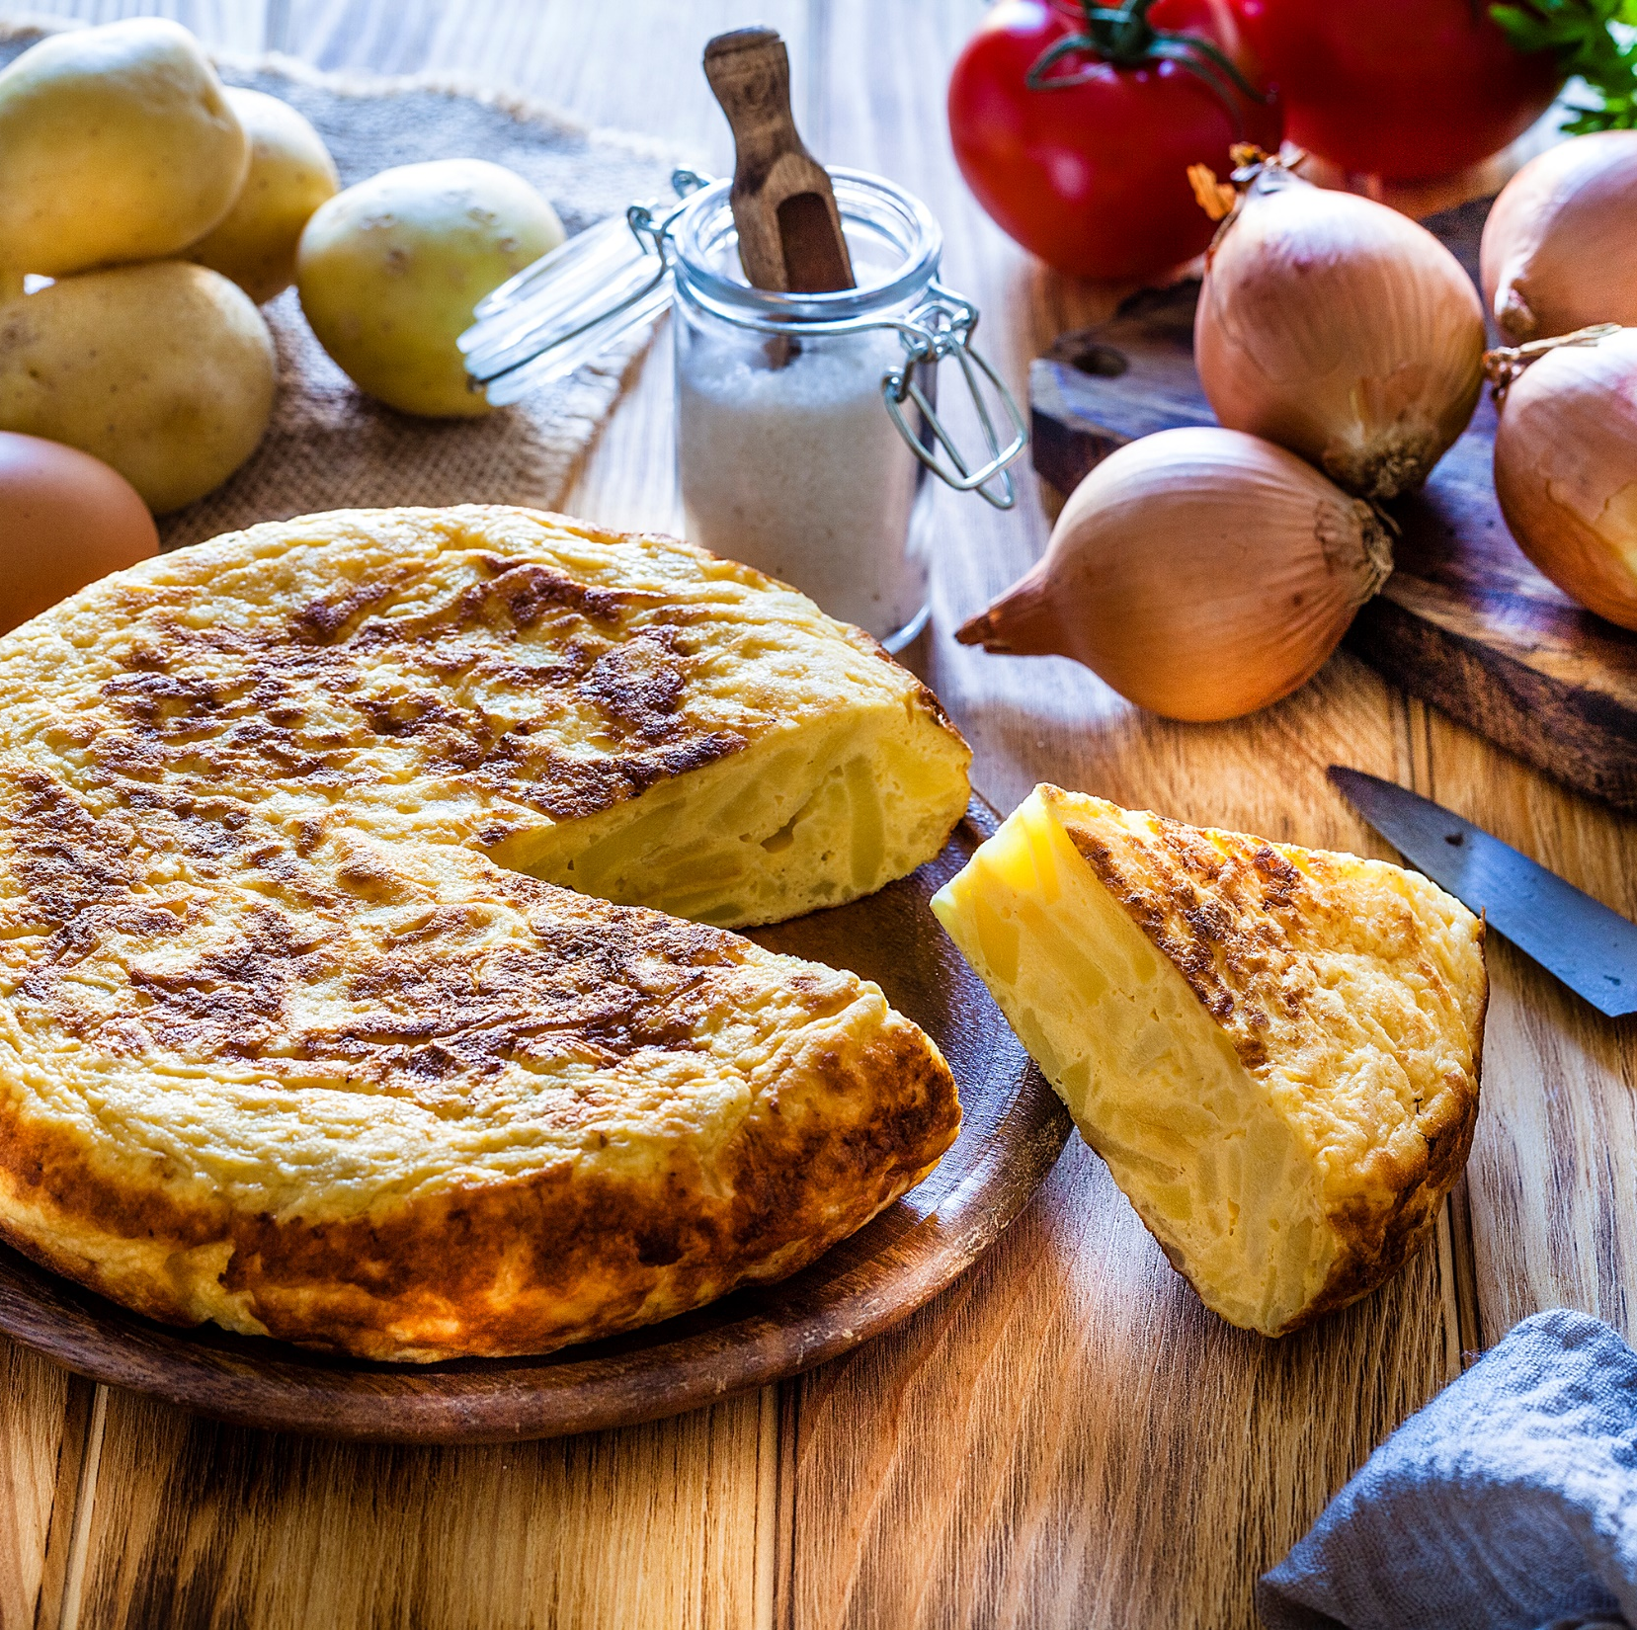
Warm up
How do you make this dish?

Slide 3
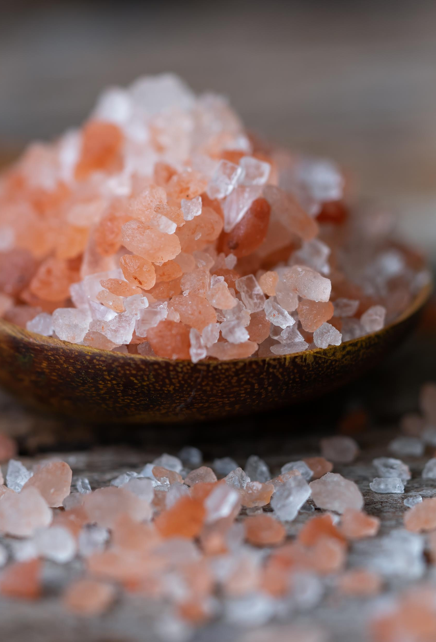
Affirmative Imperatives in Food Contexts
Imperative sentences give commands, instructions, or advice.
Affirmative Imperatives:
Use the base form of the verb.
Examples:
Chop the onions finely.
Add a pinch of salt.

Slide 4
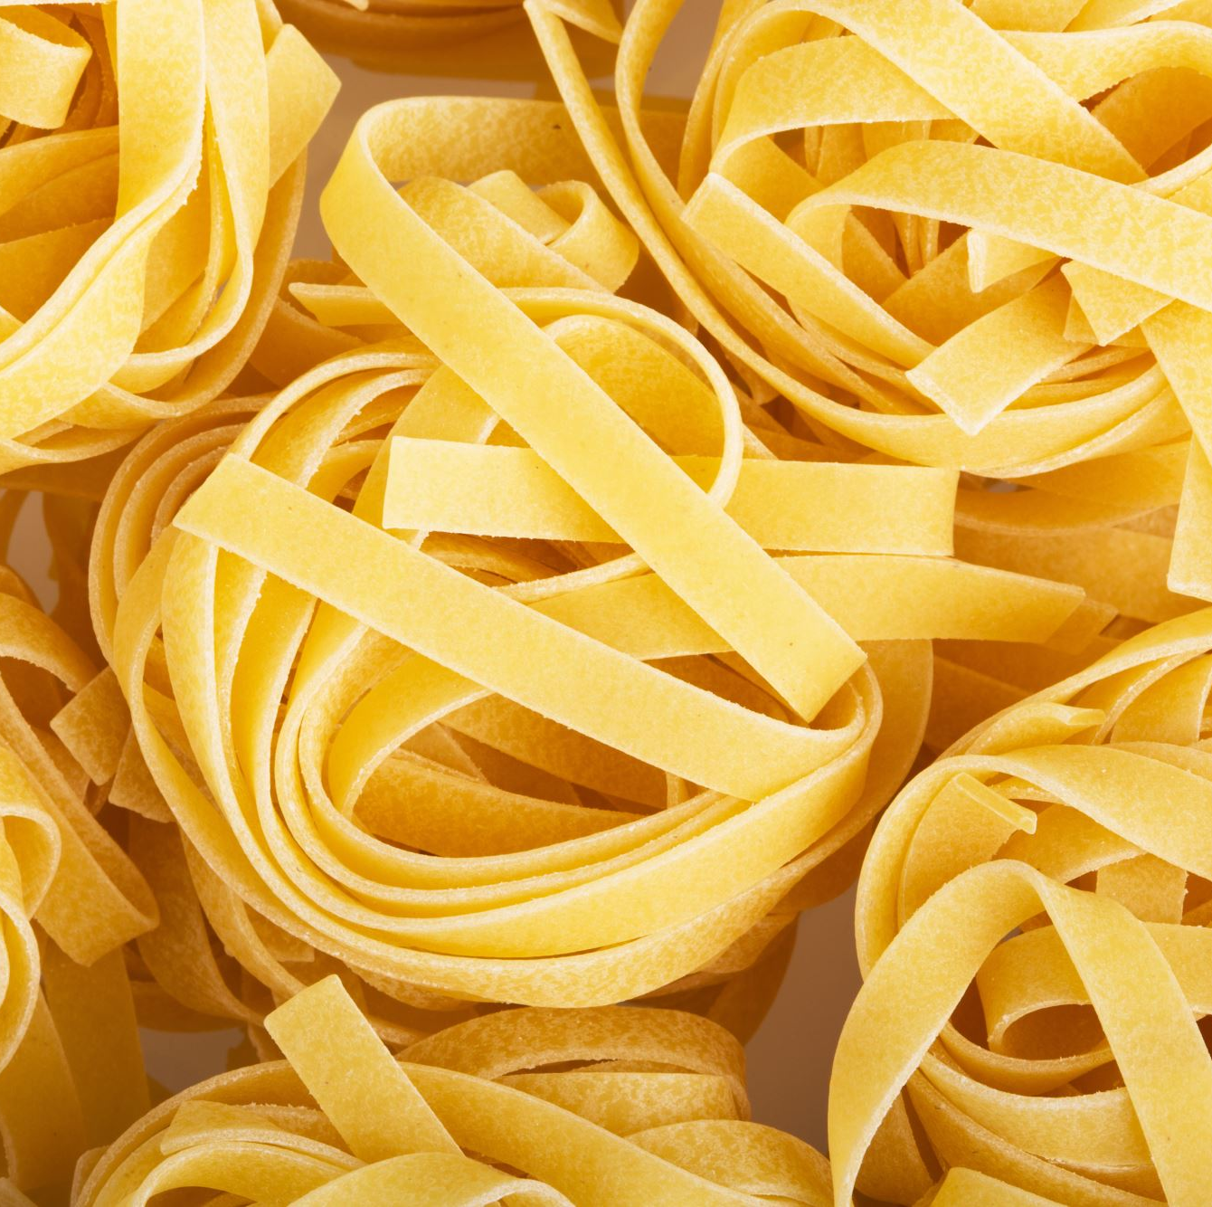
Negative Imperatives in Food Contexts
Negative Imperatives:
Use do not or don't + base form of the verb.
Examples:
Don't overcook the pasta.
Do not leave the stove unattended.

Slide 5
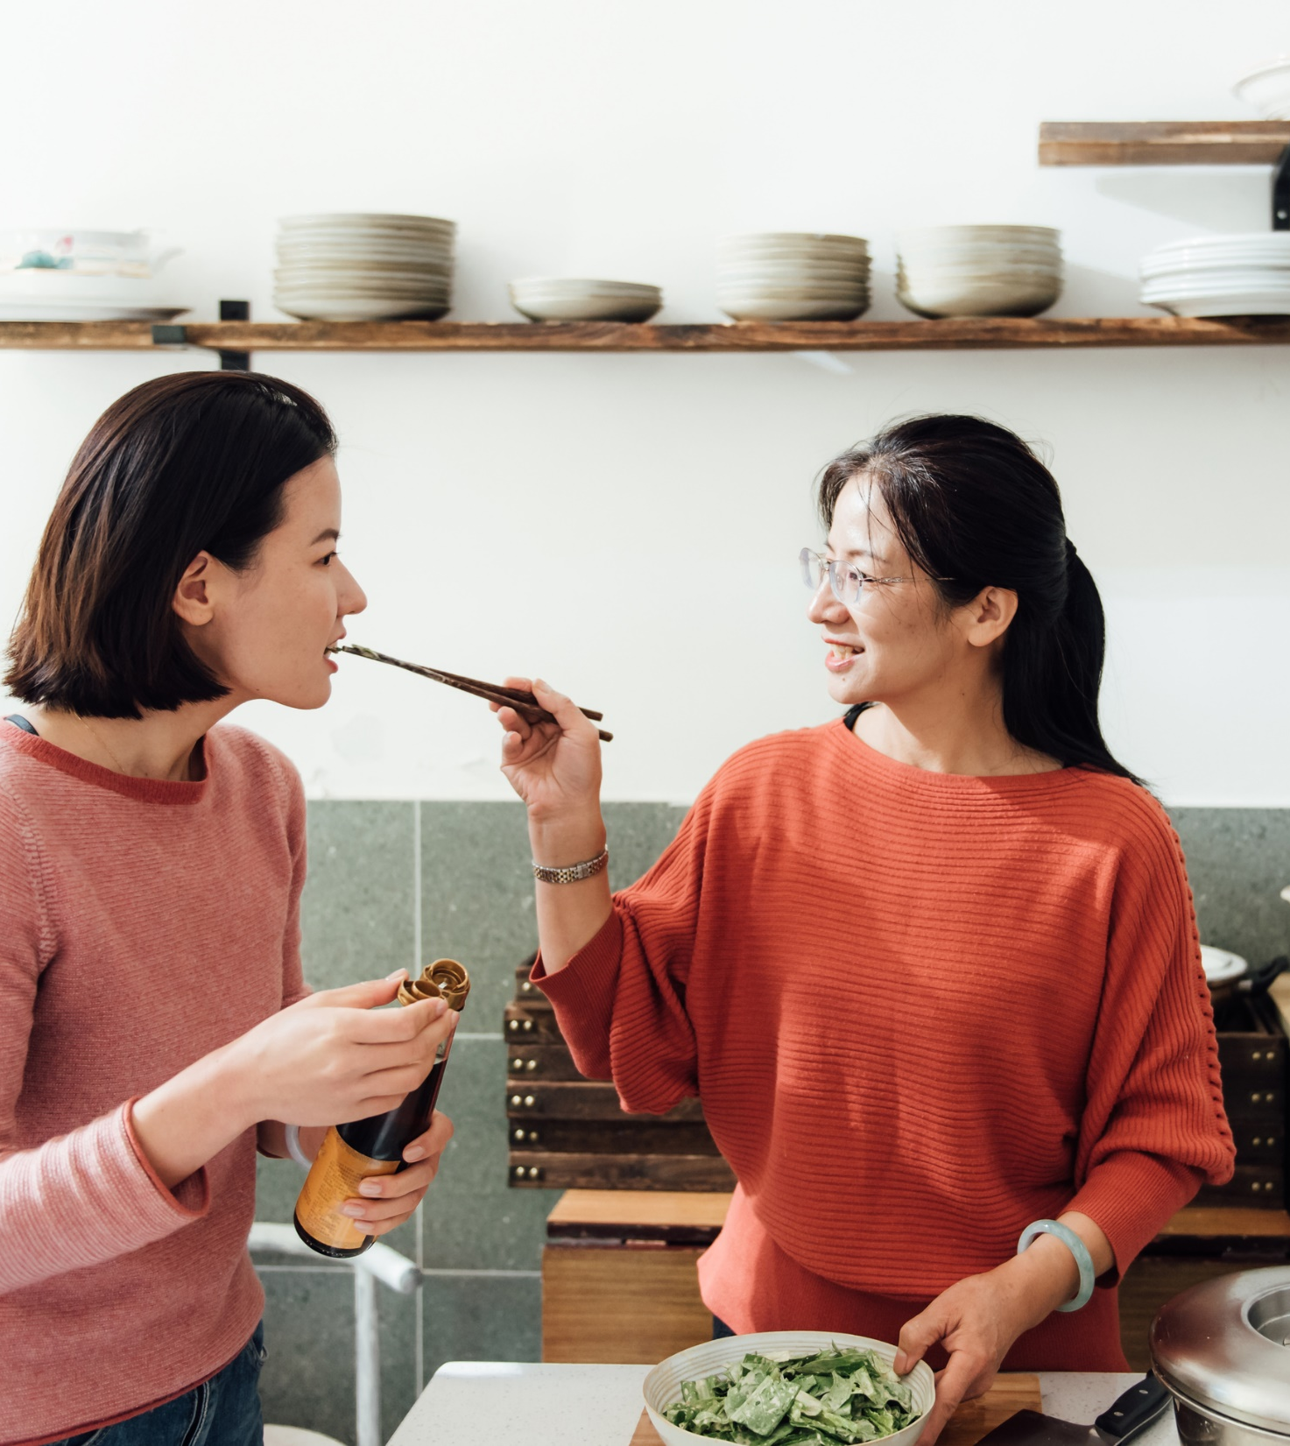
Let in imperatives
Using Let in Imperatives:
To make suggestions or give permissions.
Examples:
Let's start cooking.
Let her try the dish first.
Key Points:
Imperatives usually have no subject; the subject you is implied.
For suggestions, use let's followed by the base form of the verb.

Slide 6
Spanish omelette – find the imperatives
Peel and slice the potatoes thinly, and peel and finely chop the onion. Heat the olive oil in a large frying pan over medium heat. Add the potatoes and onions, cooking gently until they are soft and golden, about 20 minutes. Drain the excess oil and set the potatoes and onions aside.
In a large bowl, beat the eggs and add a pinch of salt. Add the cooked potatoes and onions to the eggs, mixing gently to combine.
Heat a small amount of oil in the frying pan over medium heat. Pour the egg and potato mixture into the pan, spreading it evenly. Cook on one side until the edges are set and the bottom is golden brown, about 5-7 minutes. Carefully flip the omelette using a plate or lid, then cook the other side until golden and fully set, about 5 minutes.
Slide the omelette onto a serving plate. Let it cool slightly before slicing and serving.
Enjoy your delicious Spanish omelette!

Slide 7
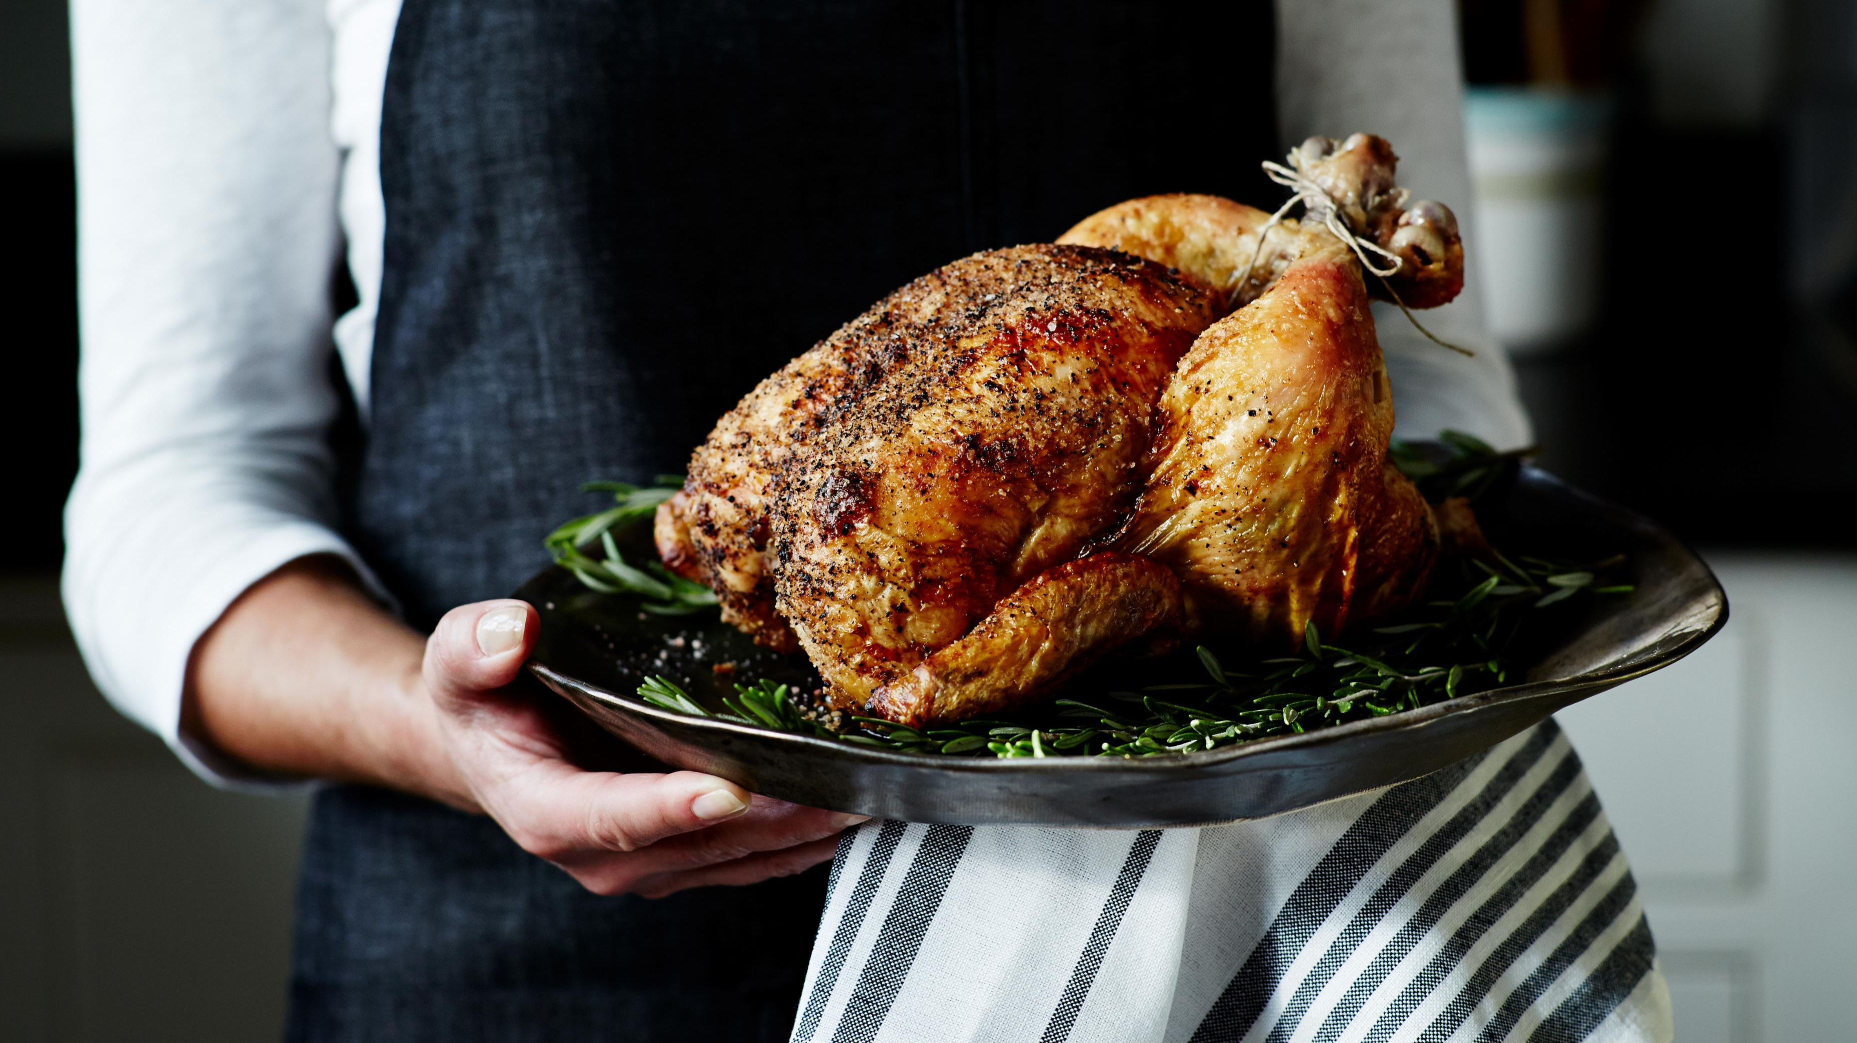
Practice
Take turns to give instructions on how to make a meal that you know.

Slide 8

Comparatives and Superlatives
Explanation: Comparatives compare two items; superlatives compare three or more.
Examples:
Comparative: This dish is spicier than that one.
Superlative: This is the most delicious pie I’ve ever tasted.

Slide 9
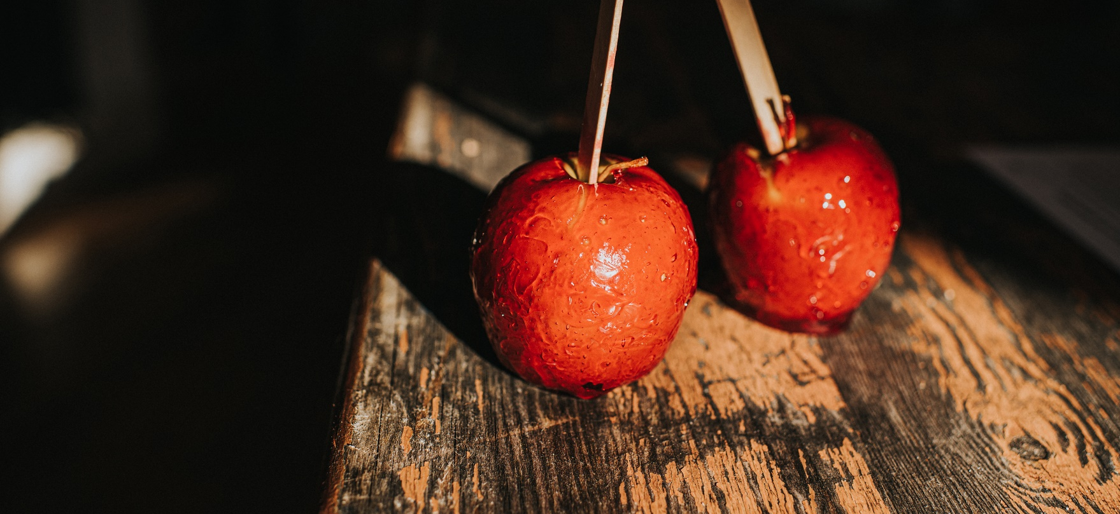
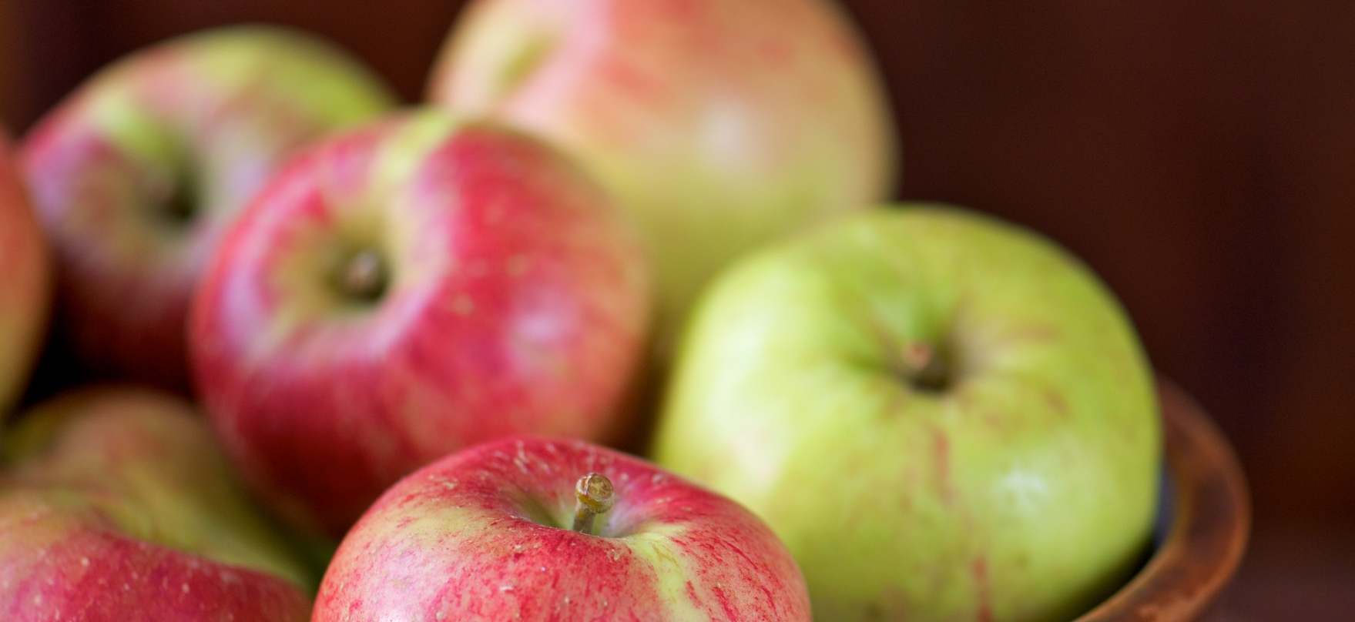
Comparatives
Used to compare two foods or cooking actions.
Formed by adding -er to short adjectives, or using more before long adjectives.
Examples:
Short Adjectives: This apple is sweeter than that one.
Long Adjectives: This dish is more delicious than the other.

Slide 10
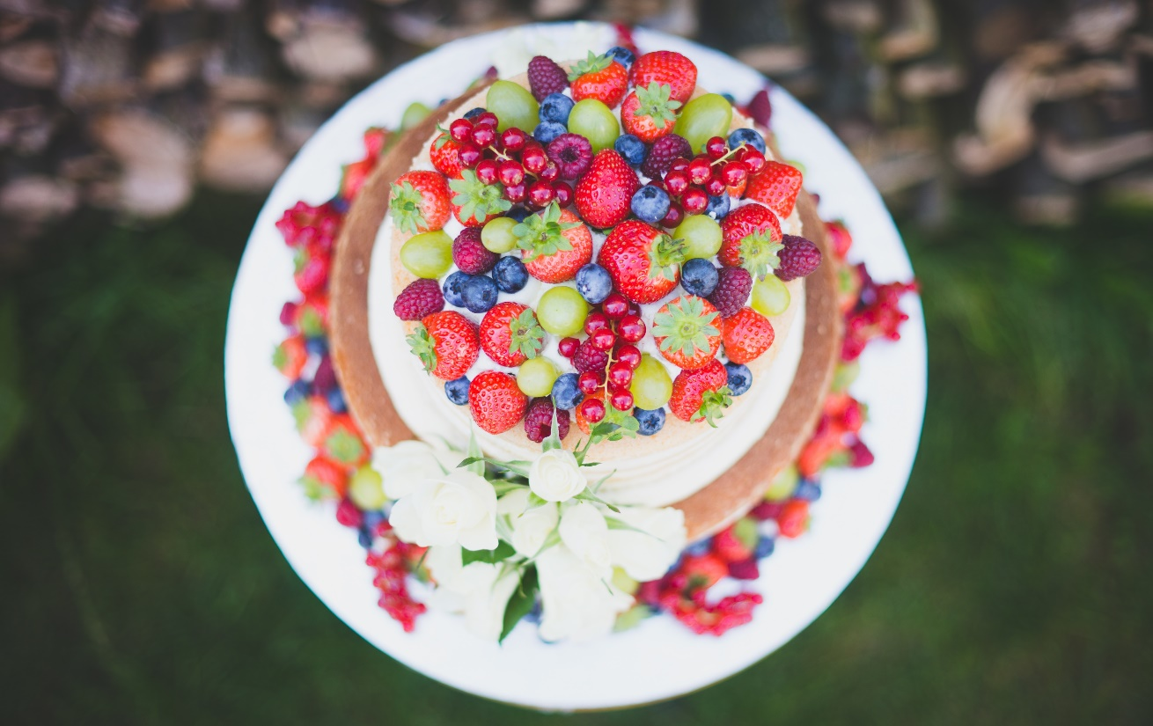
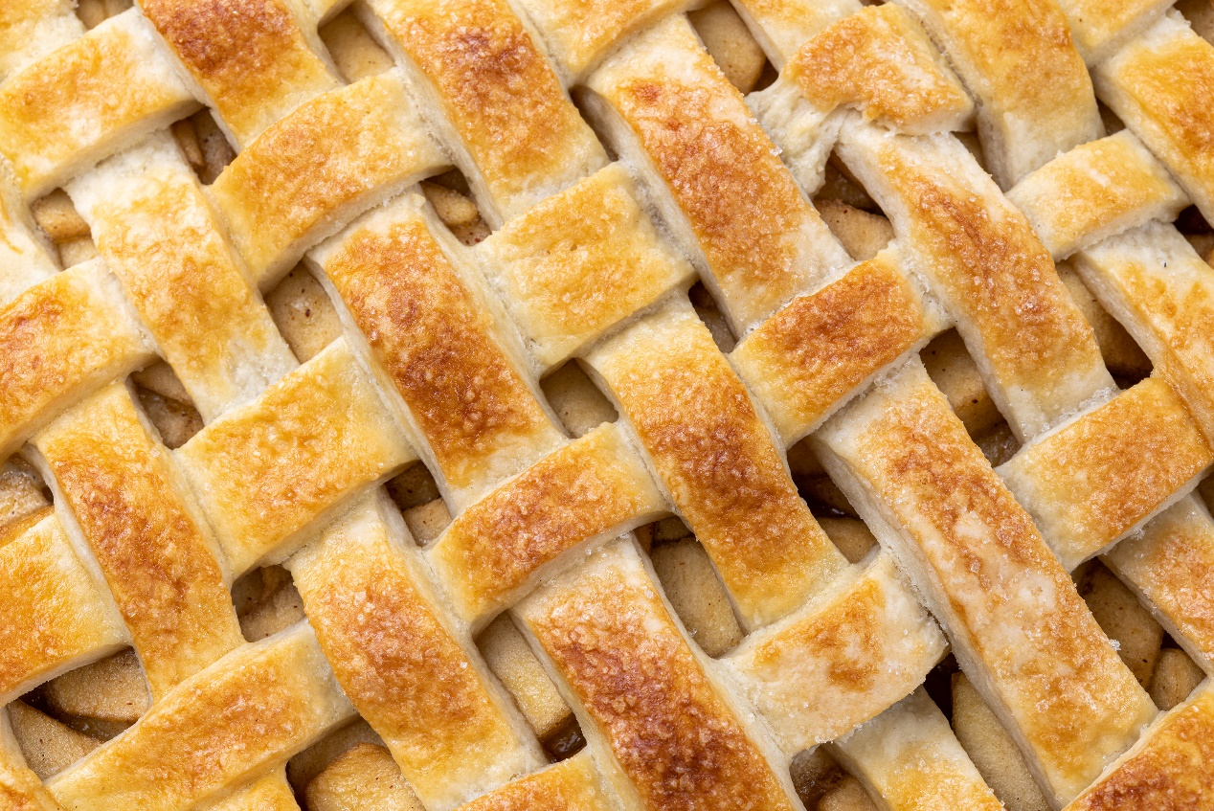
Superlatives
Used to compare three or more foods or cooking actions.
Formed by adding -est to short adjectives, or using most before long adjectives.
Examples:
Short Adjectives: She made the tastiest pie at the contest.
Long Adjectives: This is the most delicious cake I've ever eaten.

Slide 11
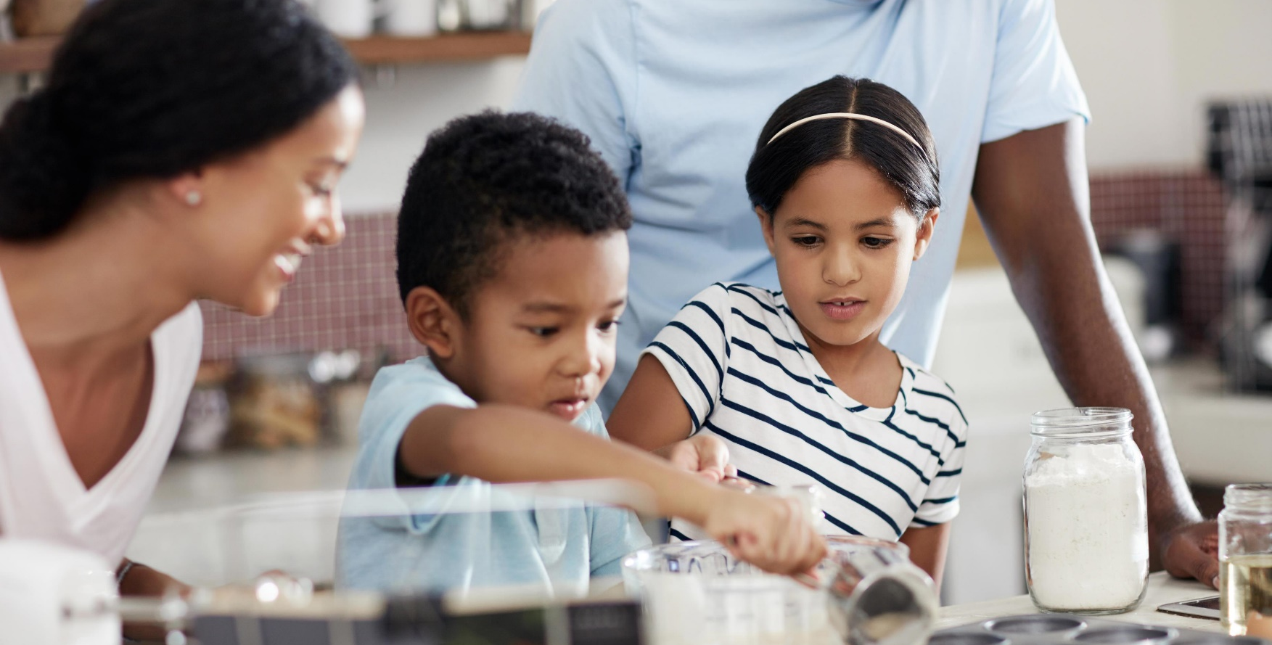
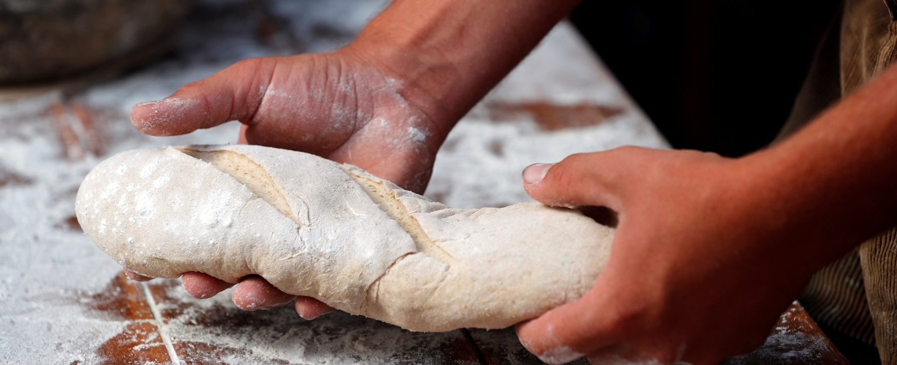
Comparative and Superlative Adverbs
Comparatives describe how two actions differ.
Example: He cooks faster than his sister.
Superlatives describe how one action compares to all others.
Example: She bakes the most skillfully of all the chefs.

Slide 12
Key Points
For one-syllable adjectives, add -er (comparative) or -est (superlative).
Example: This soup is hotter than that one. / This is the hottest chili I've ever tasted.
For adjectives with two or more syllables, use more or most.
Example: This dish is more flavoursome than the last one. / This is the most flavoursome dish on the menu.
Irregular forms must be memorized (e.g., good, better, best).

Slide 13
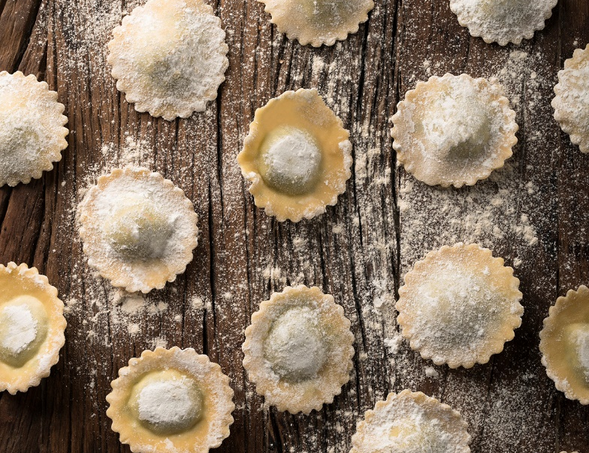
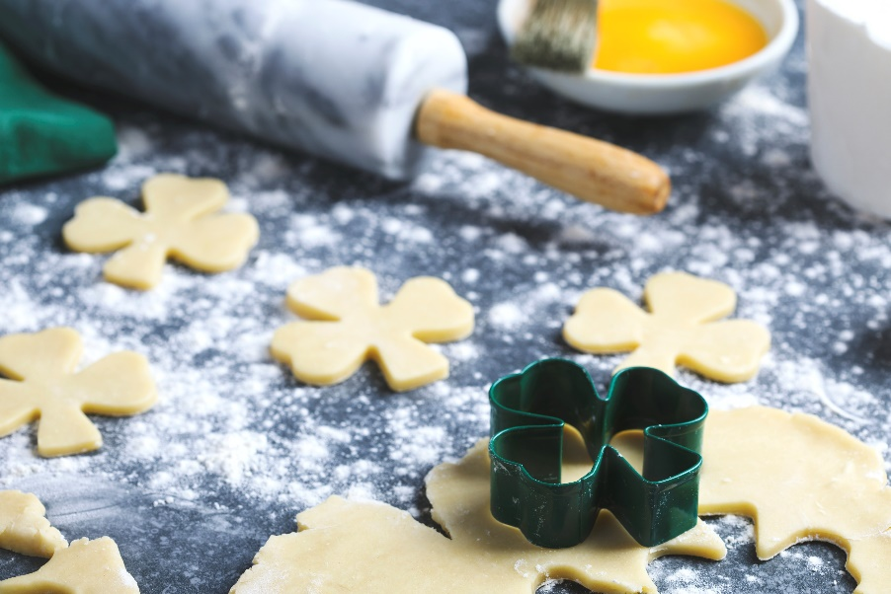
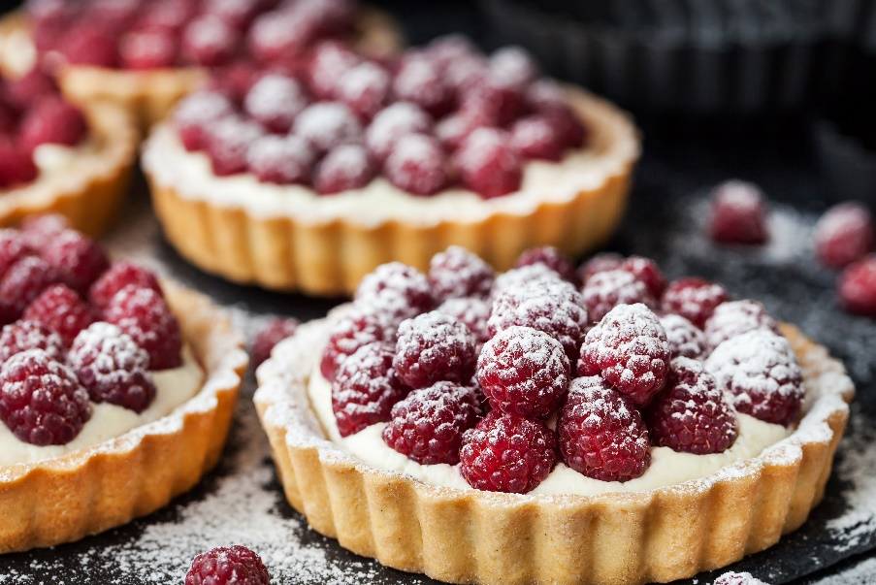
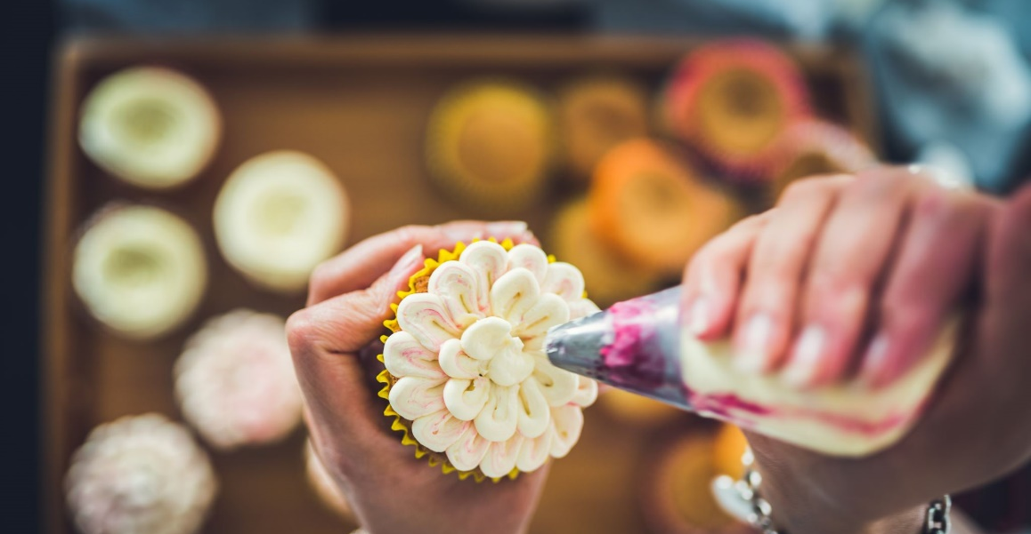
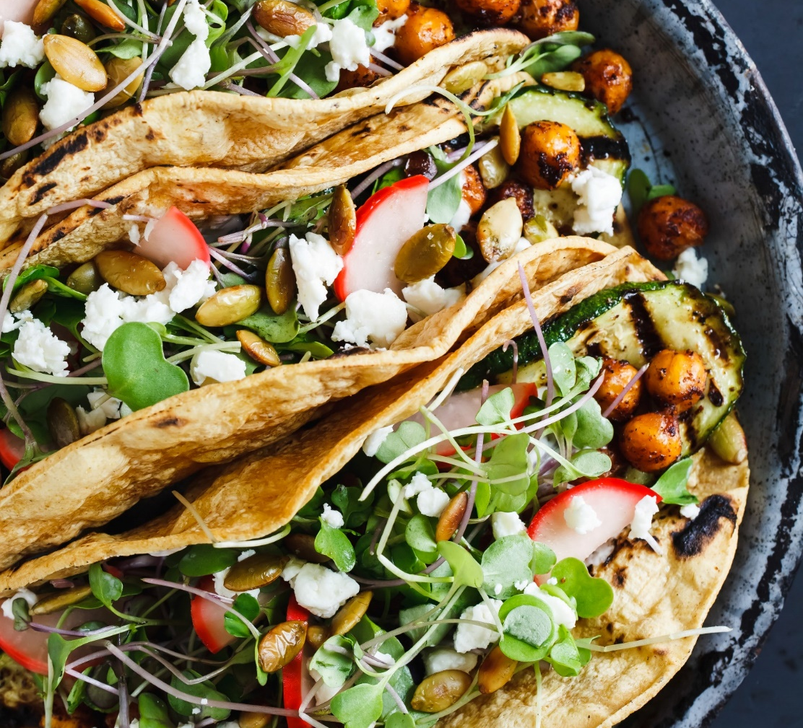
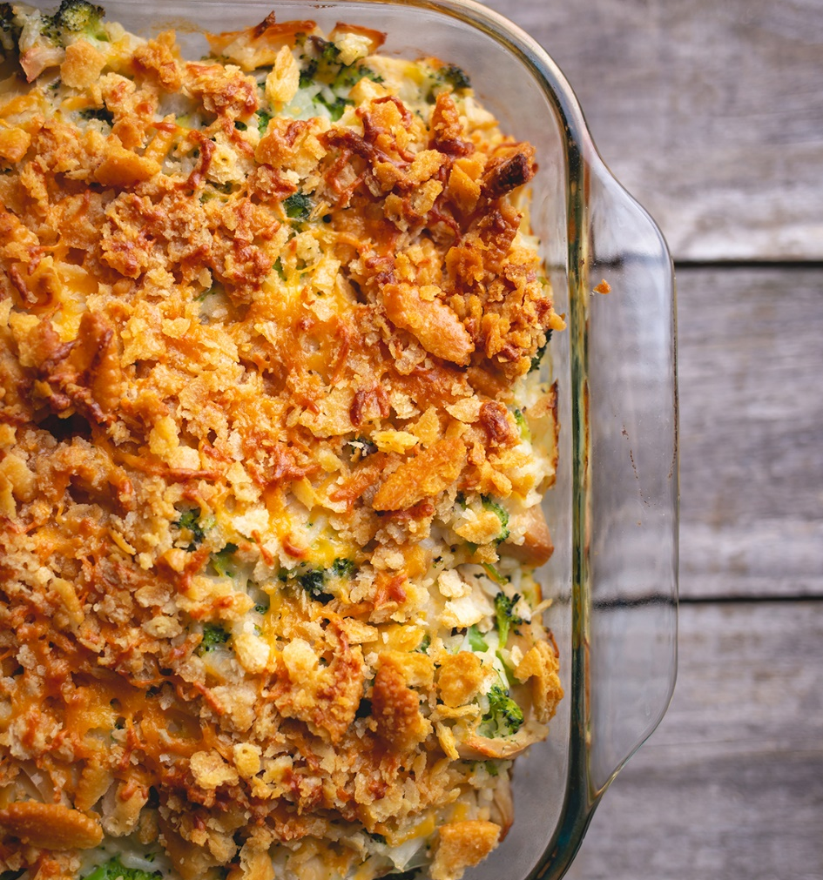
Review and Practice
Create your own recipes using affirmative and negative imperatives, comparatives, superlatives, question tags, and intensifiers.
Share and discuss the recipes with the class.

Slide 14
Delayed Feedback

