Slide 1

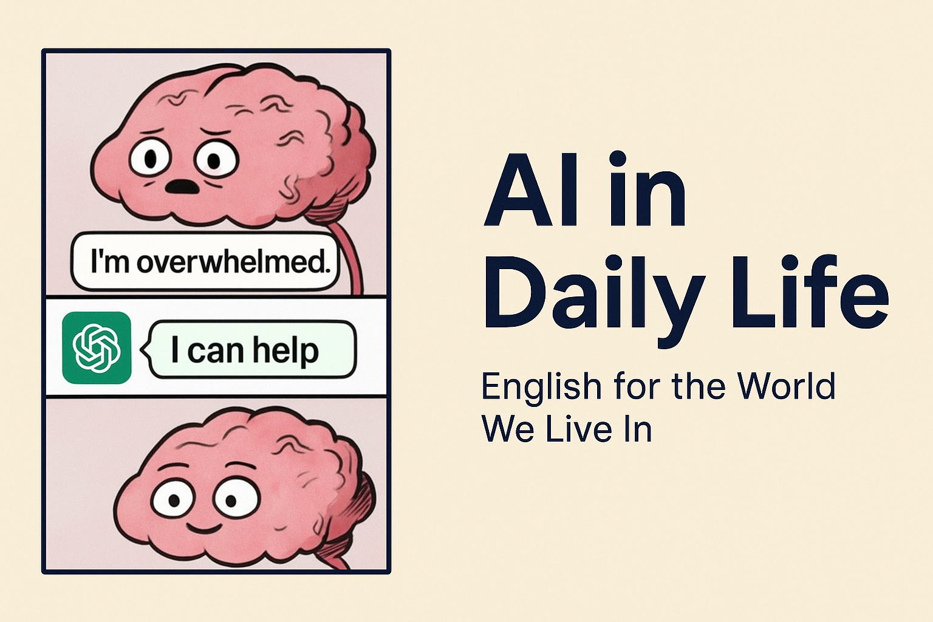
AI in daily life: From Smart Speakers to Self-Driving Dreams
Intermediate Level

Slide 2

✨ OBJECTIVES
By the end of the lesson, students will be able to:
Understand and use vocabulary related to Artificial Intelligence in daily life.
Practice grammar structures to discuss current and future uses of AI.
Express opinions and give examples about the role of AI in society.

Slide 3
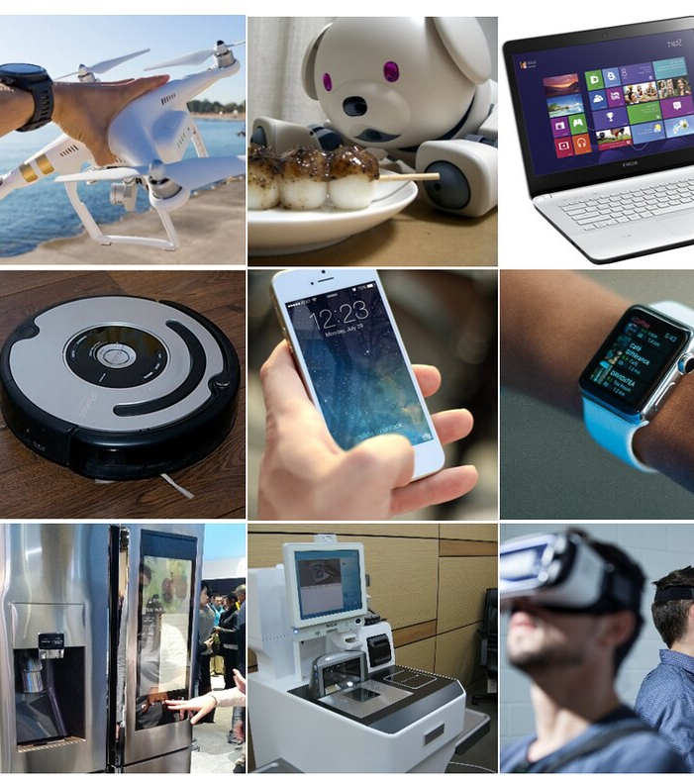
🌈 WARM-UP
Questions to engage students:
Do you use voice assistants like Alexa, Siri, or Google Assistant?
What is the most futuristic AI technology you’ve heard about?
Do you think AI will make our lives easier or more complicated? Why?

Slide 4
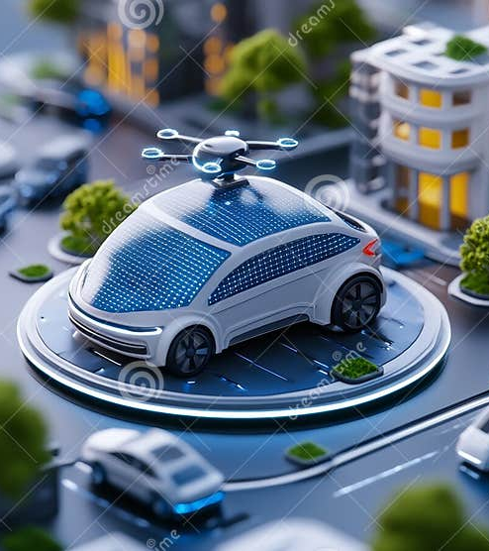
INTRODUCTION
AI is already part of our everyday lives. From smart speakers that play music on command, to recommendation systems that suggest movies, to self-driving cars that promise safer roads, AI is shaping the way we live, work, and communicate.
Today, we’ll explore how AI influences our lives and learn the language to describe it.

Slide 5
📚 VOCABULARY & MEANINGS
Artificial Intelligence (AI): The ability of a machine to think and learn.
Smart speaker: A device with a voice assistant.
Algorithm: A set of rules a computer follows to solve problems.
Self-driving car: A car that drives itself using AI.
Automation: Machines doing tasks without human help.
6. Voice recognition: Technology that understands spoken words.
7. Machine learning: AI systems that improve with experience.
8. Chatbot: A program that talks to people online.
9. Data: Information computers use to learn and make decisions.
10. Innovation: A new idea, method, or technology.

Slide 6
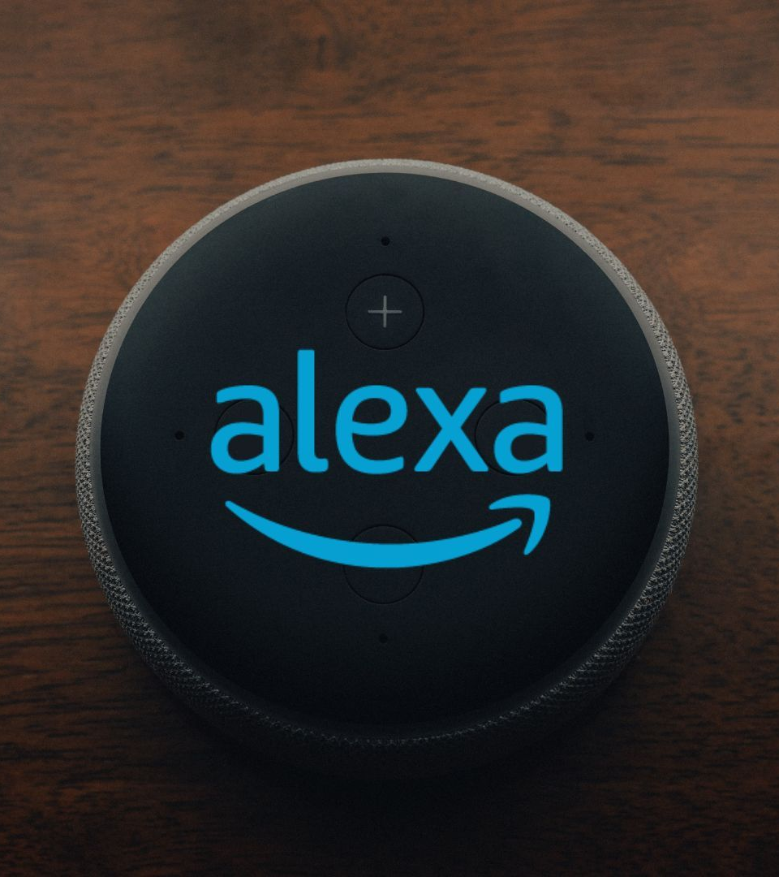
VOCABULARY EXERCISE
Match the word to the definition: Select the words from the given list. (Smart speaker - Artificial Intelligence – Chatbot - Self-driving car - Voice recognition)
__________ A program that talks to people online.
__________ Technology that understands spoken words.
__________ A device with a voice assistant.
__________ A car that drives itself using AI.
__________The ability of a machine to think and learn.

Slide 7
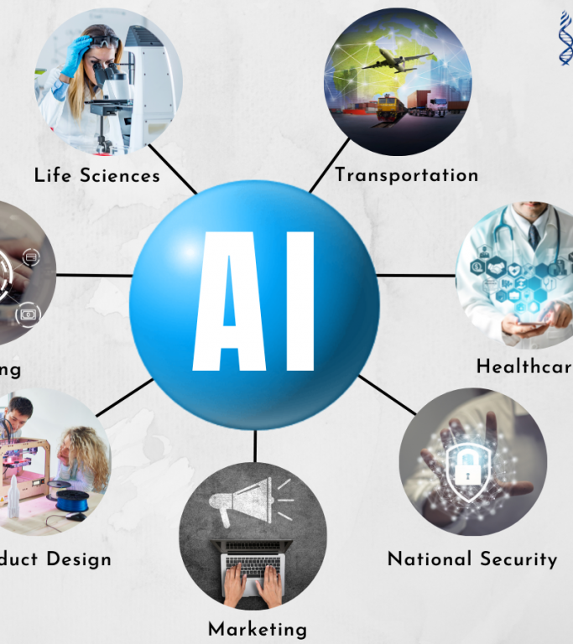
VOCABULARY EXERCISE - ANSWERS
Match the word to the definition: Select the words from the given list. (Smart speaker - Artificial Intelligence – Chatbot - Self-driving car - Voice recognition)
Chatbot → A program that talks to people online.
Voice recognition → Technology that understands spoken words.
Smart speaker → A device with a voice assistant.
Self-driving car → A car that drives itself using AI.
Artificial Intelligence → The ability of a machine to think and learn.

Slide 8
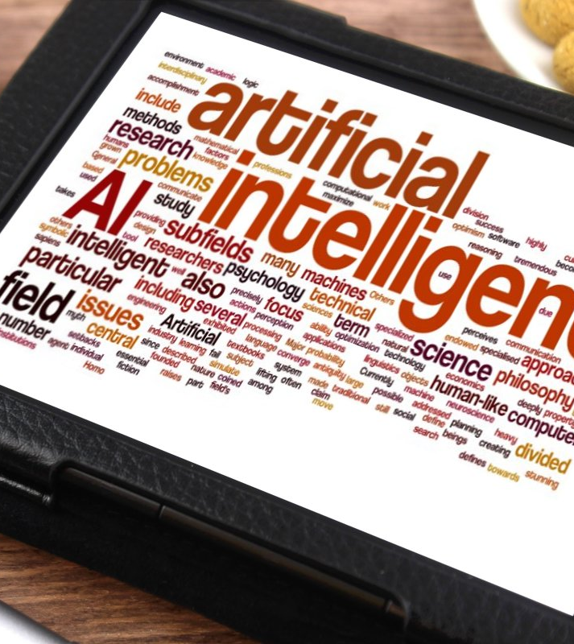
⚖️ GRAMMAR FOCUS
Topic: The Future with “will” and “going to”
Explanation:
We often talk about AI in terms of predictions and plans.
Will is used for predictions or spontaneous decisions.
Going to is used for intentions or plans already decided.

Slide 9

GRAMMAR EXERCISE
Complete with will or going to:
In 20 years, most cars ______ drive themselves.
I ______ try an AI chatbot this week.
People ______ use robots to help with housework.
My school ______ start using AI tools soon.
I think AI ______ replace many jobs.

Slide 10

GRAMMAR EXERCISE - ANSWERS
Complete with will or going to:
In 20 years, most cars will drive themselves.
I am going to try an AI chatbot this week.
People will use robots to help with housework.
My school is going to start using AI tools soon.
I think AI will replace many jobs.

Slide 11

💬 SPEAKING ACTIVITY
Task: In pairs, students answer:
What AI do you use daily?
Do you trust AI recommendations?
Could AI replace some jobs?

Slide 12
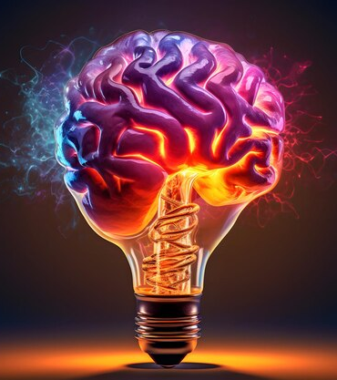
CONCLUSIONS
AI is already here, making daily life easier and more connected.
Vocabulary helps us describe and discuss technology.
Grammar with will and going to allows us to talk about the future of AI.
Students can now predict, plan, and share opinions about AI.

Slide 13
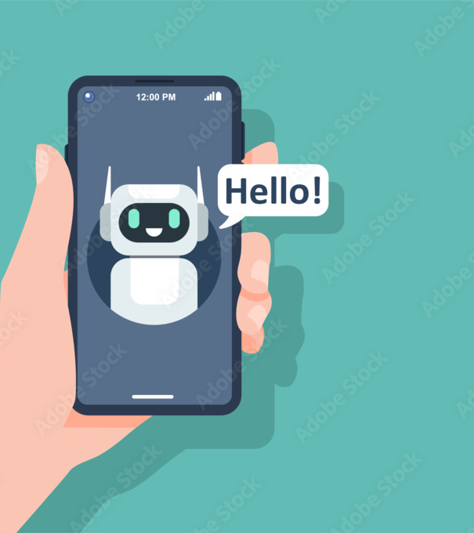
MEMORABLE ENDING
“AI in Your Pocket” Challenge:
Each student writes 1 sentence predicting the role of AI in their future (e.g., “AI will help me learn English faster.”). Share with the class.

Slide 14
